Slide 1
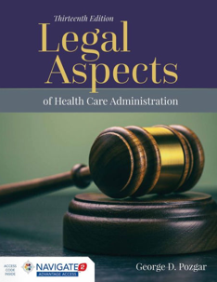
Module 7: Negligence
Notes:
This module pertains to the law of negligence, the most common form of tort law.

Slide 2
Elements
Duty
Breach
Injury
Causation
Notes:
Negligence is the unintentional failure to act under accepted standards of behavior. Four elements are required to establish a claim based on negligence:
Duty,
Breach,
Injury, and
Causation.

Slide 3
Duty
Legal obligation owed
Obligation for person to act the same as reasonably prudent in similar situation
Synonymous with “standard of care”
Notes:
Duty is the legal obligation that is owed by one person to another. In negligence terms, it refers to the obligation that was owed by the defendant to the plaintiff. Generally, it refers to a general obligation for a person to act in the same manner that a reasonably prudent person would act in a similar situation.
You will often hear duty referred to as the “standard of care.” In most negligence cases, the standard of care or duty owed is called the “reasonable man” or “reasonably prudent person standard.” In other words, the duty of care owed is measured by what the average person would consider reasonably prudent. In medical malpractice cases however, this standard is too simplistic. Instead, in medical malpractice cases, the standard of care, or rather the duty owed, is measured against how other professionals would act. For example, if a medical malpractice case is brought against a physician, then the standard of care would be measured against how other physicians would act in a similar situation.
For our purposes, “duty” is synonymous with “standard of care.” It is the duty or standard of care that a physician is held to based on how other physicians would act.

Slide 4
Legal Standard Variation
Who is a reasonable physician?
What neighborhood or location should be considered?
What school of medicine (school rule) do other physicians follow?
Are the profession’s standards adequate?
Expert Witnesses – experts in a particular medical specialty
Notes:
There are jurisdictional differences in how courts measure and apply this standard in medical malpractice cases. Differences that arise are typically in four areas:
Who is a reasonable physician?
What neighborhood or location should be considered?
What school of medicine (school rule) do other physicians follow?
Are the profession’s standards adequate?
Since jurors are not experts in medicine, expert witnesses (people who are experts in a particular medical specialty area) are often used to provide information to the jury to help them understand the standard of care.

Slide 5
The Reasonable Physician
“Reasonable and ordinary”
Standard of other physicians in same line of practice
Notes:
Doctors are only required to provide “reasonable and ordinary” treatment or medical care.
They are only judged by a standard of other physicians in the same line of practice. For example, in a medical malpractice case involving a general practitioner, the standard of care would be a general practitioner, not a specialist.

Slide 6
The Locality Rule
Locality rule has been broadly expanded to a national standard
Expansion based on several factors:
  National accreditation standards for medical education
  National certification for medical board specialties
  Advances in communications technology, including the Internet
Notes:
The location of the physician’s practice, or where the treatment in question happened, also comes into play when considering duty. In the past, the standard for measuring the area of practice was more localized. Usually, the case might be judged by a small town or region where the physician practiced, or a similar location somewhere else in the state or nation.
Today, this traditional locality rule has been more broadly expanded to a national scope. This broader standard refers to “the national medical neighborhood or national medical community, of reasonably competent physicians acting in the same or similar circumstances.” This expansion has been based on several factors:
National accreditation standards for medical education;
National certification for medical board specialties; and,
Advances in communications technology, including the Internet.
In some cases however, a physician may be practicing in conditions or locations that are less than ideal, for example, in a location where proper facilities or equipment are not available. In such a case, a “justifiable circumstances” defense can be made to make the argument that better care would have been provided if the facilities or equipment had been available.

Slide 7
The School Rule
Same general line of practice
Physicians normally considered proficient within their disciplines
Physicians in specialized areas will be held to higher standard of care
Notes:
The school rule is another factor to consider when determining the standard of care. The school rule basically refers to the “same general line of practice.” For example, it would be unfair to hold a chiropractor to the same standard as an MD. Practitioners of alternative remedies, e.g., faith healing, acupuncture, etc., are not held to the same standards of medical practice as long as they are practicing within their area of expertise. The existence of a licensing standard will normally suffice to establish the school rule.
Likewise, physicians and other practitioners will normally be considered proficient within their disciplines. If they stray from that discipline, for example outside into another specialized field for which they have no training, then they may be held liable for injury to a patient. They can be held responsible for failing to refer the patient to a specialist if the medical condition in question is beyond their level of expertise.
Thus, if a general practitioner practices within her area of expertise and doesn’t fail to send a patient to a specialist when required, then she will be held against a standard of other general practitioners. Physicians who practice in more specialized areas however, will be held to a higher standard of care.

Slide 8
Breach
Duty
Duty was breached
Notes:
Once the duty or standard of care has been established, the plaintiff must establish that the duty that was owed was breached.

Slide 9
Expert Witness
Standard of care established with expert witness testimony
Expert witness can express opinion about nature and cause of injury
Notes:
The plaintiff establishes that the duty was breached by presenting evidence pertaining to the facts of the case along with expert testimony about whether the standard of care has been met. Normally, the same expert witnesses used to establish duty will also be called upon to establish the breach of that duty.
Expert witnesses can testify about the facts of the case, but more importantly, they can also express opinions about the nature and cause of the affected patient’s illness or injury and whether the defendant acted appropriately in treating the illness or injury.

Slide 10
Expert Witness Qualifications
Must be familiar with the practice of medicine applicable in the case
Must be knowledgeable of the applicable standards practiced in the locality
Notes:
An expert witness must be qualified to testify in the case in two ways. First, she must be familiar with the practice of medicine that is applicable in the case. The expert witness must be qualified on a professional level. She doesn’t have to practice in the same specialty area, but she must at least be familiar with the type of treatment that was used for the patient’s care.
Second, depending on the locality rule applied, the expert witness must be knowledgeable about the applicable standards practiced in the applicable locality, whether it is local or national in scope. If the national locality rule applies, then any qualified expert in the U.S. will be acceptable to testify.

Slide 11
Medical Publications & Other Sources
Medical treatises
Hospital rules, policies, procedures, etc.
Government agency regulations
Standards of accreditation organizations
Notes:
Sometimes medical treatises are used to prove the standard of care. The problem is that they are technically hearsay. Hearsay is defined as a statement that is made out of court to prove the truth of the matter made in the statement. Medical publications are thus a form of hearsay because they were not written in court. They may still sometimes be used in court though. Some states will limit their use for impeachment purposes where the credibility of an expert witness or the opinion they give is challenged.
Written hospital rules, policies, or procedures may also be used to show the standard of care. This category would also include regulations of government agencies, standards of accreditation organizations, and similar published material.

Slide 12
Negligence per se
Negligence due to the violation of a law meant to protect the public, such as a speed limit or building code. Unlike ordinary negligence, a plaintiff alleging negligence per se need not prove that a reasonable person should have acted differently -- the conduct is automatically considered negligent, and the focus of the suit will be over whether it proximately caused damage to the plaintiff.
Cornell University Law School. Negligence per se. https://www.law.cornell.edu/wex/negligence_per_se. Accessed March 24, 2015.
Notes:
Statutes may also be used to prove the standard of care. In fact, when an action is a violation of a statute or regulation, it may also constitute negligence per se. This is certainly advantageous to the plaintiff’s case. According to Cornell University Law School:
Negligence due to the violation of a law meant to protect the public, such as a speed limit or building code. Unlike ordinary negligence, a plaintiff alleging negligence per se need not prove that a reasonable person should have acted differently -- the conduct is automatically considered negligent, and the focus of the suit will be over whether it proximately caused damage to the plaintiff.
Cornell University Law School. Negligence per se. https://www.law.cornell.edu/wex/negligence_per_se. Accessed March 24, 2015.

Slide 13
Negligence per se
The plaintiff has to show that a violation of the statute occurred and that an injury resulted,
The injured person was one that the statute was meant to protect, and
The harm was the type that the statute was enacted to prevent.
Notes:
To use this legal doctrine, three specific elements must be shown:
The plaintiff has to show that a violation of the statute occurred and that an injury resulted,
The injured person was one that the statute was meant to protect, and
The harm was the type that the statute was enacted to prevent.

Slide 14
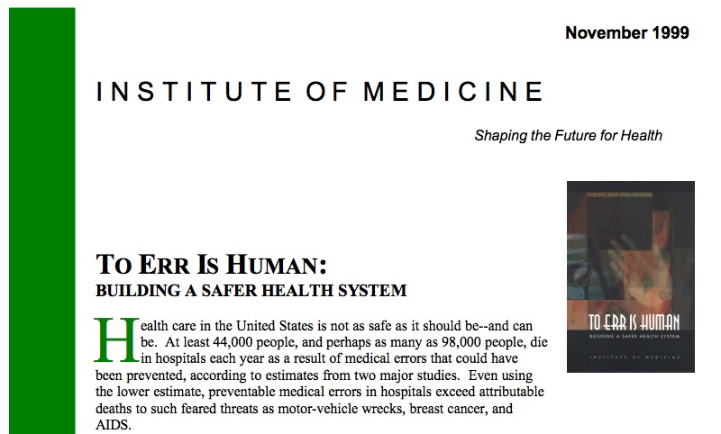
Adverse/Never Events
Institute of Medicine. To Err Is Human: Building a Safer Health System. https://www.iom.edu/~/media/Files/Report%20Files/1999/To-Err-is-Human/To%20Err%20is%20Human%201999%20%20report%20brief.pdf. Accessed March 25, 2015.
Notes:
Quite frequently, medical errors occur during the provision of medical care, causing injury or death. In many of these cases, when the outcome is so egregious that it is indefensible, expert witness testimony is not required to establish negligence.
The landmark report issued by the Institute of Medicine (IOM) in 1999 called To Err Is Human exposed the vast numbers of errors occurring in our healthcare system. Although the numbers have been criticized as being underestimated, the report estimated that approximately 98,000 people die in U.S. hospitals every year from medical errors. Recognizing that the numbers were probably low, the report stated that “preventable medical errors in hospitals exceed attributable deaths to such feared threats as motor-vehicle wrecks, breast cancer, and AIDS.”
Institute of Medicine. To Err Is Human: Building a Safer Health System. https://www.iom.edu/~/media/Files/Report%20Files/1999/To-Err-is-Human/To%20Err%20is%20Human%201999%20%20report%20brief.pdf. Accessed March 25, 2015.

Slide 15
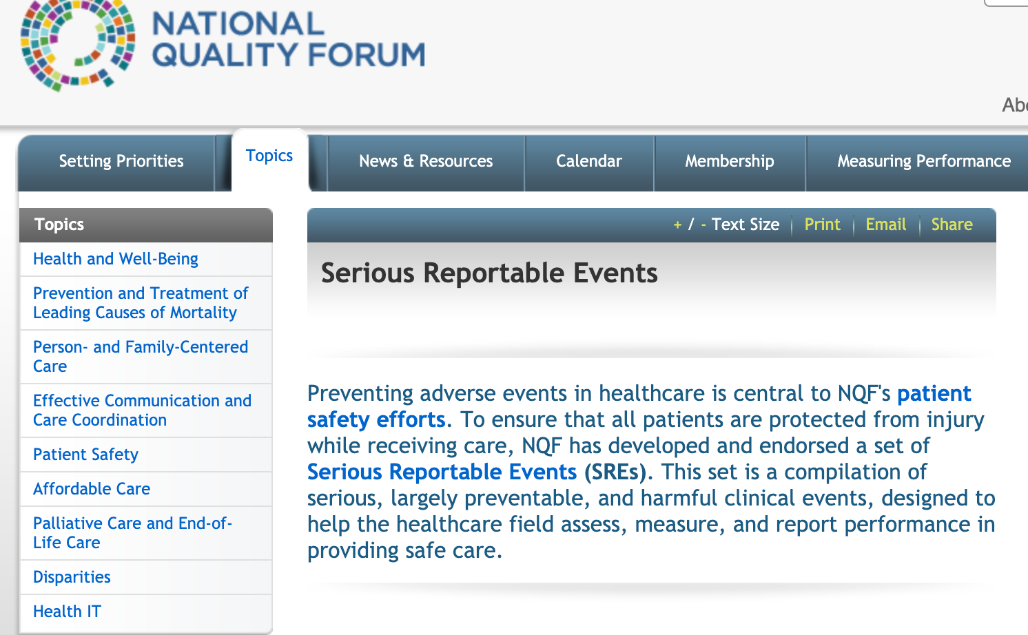
National Quality Forum. Serious Reportable Events. http://www.qualityforum.org/topics/sres/serious_reportable_events.aspx. Accessed September 23, 2019.
Notes:
Many serious events, called adverse events or never events, often result from the failure to adhere to standard medical practices and policies. The term “never events” pertains to a specific list of serious events that the National Quality Forum has designated as those that should never occur in a healthcare setting. An example is operating on the wrong patient, or amputating the wrong leg. In 2010, the year after the IOM report, the U.S. Department of Health and Human Services issued a report called “Adverse Events in Hospitals: National Incidence Among Medicare Beneficiaries.” This report estimated the national incidence of adverse events for hospitalized Medicare beneficiaries, assessed how these events could be prevented, and estimated the associated costs to Medicare.
For our purposes in this module, the significance of this list of serious reportable events is the fact that many of these incidents are considered negligence per se and don’t require expert testimony to establish the standard of care. For example, if the injury to the plaintiff was that the surgeon performed surgery on the wrong body part, it would not be necessary to have an expert witness testify that it was below the standard of care to operate on the wrong body part. It would be considered negligence per se.

Slide 16
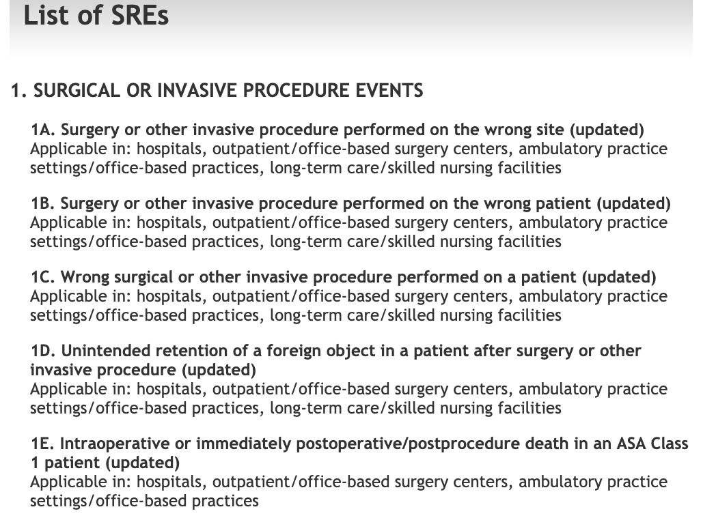
National Quality Forum. List of SREs. http://www.qualityforum.org/Topics/SREs/List_of_SREs.aspx. Accessed September 23, 2019.
Notes:
Many serious events, called adverse events or never events, often result from the failure to adhere to standard medical practices and policies. The term “never events” pertains to a specific list of serious events that the National Quality Forum has designated as those that should never occur in a healthcare setting. An example is operating on the wrong patient, or amputating the wrong leg. In 2010, the year after the IOM report, the U.S. Department of Health and Human Services issued a report called “Adverse Events in Hospitals: National Incidence Among Medicare Beneficiaries.” This report estimated the national incidence of adverse events for hospitalized Medicare beneficiaries, assessed how these events could be prevented, and estimated the associated costs to Medicare.
For our purposes in this module, the significance of this list of serious reportable events is the fact that many of these incidents are considered negligence per se and don’t require expert testimony to establish the standard of care. For example, if the injury to the plaintiff was that the surgeon performed surgery on the wrong body part, it would not be necessary to have an expert witness testify that it was below the standard of care to operate on the wrong body part. It would be considered negligence per se.

Slide 17
Res Ipsa Loquitur
The accident or injury is of a type that normally does not occur without someone else’s negligence
The defendant had sole control of the apparent cause of the accident or injury
The plaintiff could not have contributed to the accident or injury
Notes:
Res ipsa loquitur is another legal doctrine that is applicable to expert testimony. Res ipsa loquitur (frequently stated as simply “res ipsa”) is a Latin phrase meaning “the thing speaks for itself.” It is defined as follows:
In tort law, a principle that allows plaintiffs to meet their burden of proof with what is, in effect, circumstantial evidence. The plaintiff can create a rebuttable presumption of negligence by the defendant by proving that the harm would not ordinarily have occurred without negligence, that the object that caused the harm was under the defendant’s control, and that there are no other plausible explanations.
In laymen’s terms, this is a doctrine in tort law that infers negligence from the nature of the injury or accident. You don’t have to present direct evidence to show what happened. It refers to an injury that normally does not occur without some form of negligence on the defendant’s part.
The application of res ipsa requires three things:
First, the accident or injury is of a type that normally does not occur without someone else’s negligence. The general test to show this is whether by using common knowledge and applying ordinary experiences, someone could infer that the defendant was negligent. It can’t simply be based on a bad treatment outcome. It has to be something that clearly indicates negligence on the part of the defendant, for example, leaving a sponge or other foreign object in a patient’s surgical site.
Second, it must be shown that the defendant had sole control of the apparent cause of the accident or injury. This can be problematic to prove since in many surgical cases there will be many people in the room. Some cases have applied the doctrine to multiple defendants however.
Third, the plaintiff must show that he or she could not have contributed to the accident or injury, for example, if the injury happened during surgery and the patient was under anesthesia. If the injury could possibly be attributed to the plaintiff’s actions, then res ipsa won’t apply.
Cornell University Law School. Res Ipsa Loquitur. https://www.law.cornell.edu/wex/res_ipsa_loquitur. Accessed March 24, 2015.

Slide 18
Strict Liability
Unusual in medical malpractice cases
Imposes liability without the need to prove negligence
Applicable in product liability law
Applies to products, not services
Notes:
As I mentioned in a previous module, strict liability is unusual in medical malpractice cases. Your textbook mentions it in relation to res ipsa loquitur and the standard of reasonable prudence. In that sense, in some very unusual cases, the doctrine of strict liability will impose liability without the need of showing negligence. The doctrine is applicable in product liability law for suits brought against manufacturers and vendors of dangerous products. It imposes liability for defective goods that present an unreasonable risk of injury and do actually cause an injury.
Strict liability does not apply to services, only to products.

Slide 19
Elements
Duty
Breach
Injury
Causation
Notes:
Now let’s turn to the 3rd and 4th elements of negligence -- injury and causation. For a plaintiff to win a negligence lawsuit against a defendant, it’s not enough to show that the defendant physician had a duty and failed to meet the standard of care (breach) and that the plaintiff was injured (injury). The plaintiff must also show causation -- that the injury was the proximate cause of the negligence.

Slide 20
Proximate Cause
The injury would not have occurred “but for” the defendant’s act, or
The injury was a foreseeable result of the negligent act
Measured by “preponderance of the evidence”
Notes:
Under traditional rules of negligence, a plaintiff has to prove that the defendant’s actions actually caused the plaintiff’s injuries. “But for” the defendant’s actions, the injury would not have happened. Proximate cause pertains to the scope of a defendant’s responsibility. A defendant won’t be held responsible unless she could have foreseen the possibility of the harm.
Under negligence law, an injury is the proximate cause of a negligence act if:
The injury would not have occurred “but for” the defendant’s act; or,
The injury was a foreseeable result of the negligent act.
All that is required is for the plaintiff to show that there was a strong likelihood that negligence caused the result. It is measured by a preponderance of the evidence standard (a standard lower than that required in criminal trials). The negligence doesn’t have to be the sole cause of the injury, but it does need to be a significant factor.

Slide 21
Damages
Actual (Compensatory) – monetary amount to replace what the plaintiff lost
Punitive – punish the defendant for injurious action
Notes:
As well as proving that the resulting injury was caused by the defendant’s negligence, a plaintiff must also prove damages -- a legally recognized harm. In other words, she must prove what the injury is worth in actual damages.
Actual or compensatory damages are the most common form of damages. They compensate for the monetary amount necessary to replace what the plaintiff lost, and nothing more. Examples are the cost of medical and rehabilitation treatments and lost employment earnings. The amount of damages has to be objectively determined by the judge or jury of the case.
Punitive damages are more serious. They punish the defendant for his conduct. They also act to deter the future commission of injurious acts. Punitive damages are awarded in addition to compensatory damages, but only in certain circumstances. They can be awarded when a defendant’s behavior is found to be especially egregious. They are usually not awarded in breach of contract claims.

Slide 22
Vicarious Liability
Respondeat Superior – Let the superior respond
Employer can be held responsible for the negligent actions of employees or other people under his control
Notes:
Under the legal doctrine of vicarious liability, a healthcare provider (such as a hospital, healthcare facility, or physician) can be held liable for the actions of others. It is based on the principle of respondeat superior, which in Latin means “let the superior respond.” What this means is that an employer -- a hospital, physician, or other providers -- can be held responsible for the negligent actions of their employees or other people under their control.

