Slide 1
High Risk Antepartum Care Part 1
Kimberly Rosenbaum, MSN, RNC-OB, IBCLC
Fall 2021
Assistant Clinical Professor, Texas State University

Slide 2
Objectives
Differentiate the types of diabetes mellitus and their respective risk factors in pregnancy.
Identify maternal and fetal risks or complications associated with diabetes in pregnancy.
Discuss implications of trauma in regard to mother and fetus.
Discuss the use of tocolytics and antenatal glucocorticoids in preterm labor.
Evaluate the effects of prescribed bed rest on pregnant women and their families.
Describe the care of a woman with post-term pregnancy.
Explain the effects of hyperemesis gravidarum on maternal and fetal well-being.

Slide 3
Endocrine Changes In Pregnancy
Alterations in maternal glucose metabolism, insulin production, and metabolic homeostasis
2nd and 3rd trimesters: “diabetogenic” effect on the maternal metabolic status:
decreased tolerance to glucose
increased insulin resistance
decreased hepatic glycogen stores
increased hepatic production of glucose
Delivery: drop in levels of circulating placental hormones; Maternal tissues quickly regain their prepregnancy sensitivity to insulin

Slide 4
Diabetes Mellitus
Incidence worldwide growing at rapid rate
Pathogenesis
Defects in insulin secretion, insulin action, or both
Convert glucose into energy by burning muscle and fats
Type 1 diabetes: 5-10% of all DM cases
Type 2 diabetes: 90-95% of all DM cases
Gestational diabetes mellitus (GDM)
GDM A1 – Diet
GDM A2-Medication
Notes:
Photo by Sriram Bala, creative common license, no changes made, https://www.flickr.com/photos/sriram/1571464801

Slide 5
Pregestational Diabetes Mellitus
Pregestational diabetes mellitus
Preconception Counseling
Maternal Risks and Complications
Macrosomia, with increased risks of birth complications
Hydramnios (polyhydramnios)
Infections
Ketoacidosis; Diabetic Ketoacidosis (DKA)
Hypoglycemia/hyperglycemia
Fetal and Neonatal Risks and Complications
Increased perinatal mortality
IUFD (stillbirth)
Congenital malformations
Hypoglycemia at birth

Slide 6
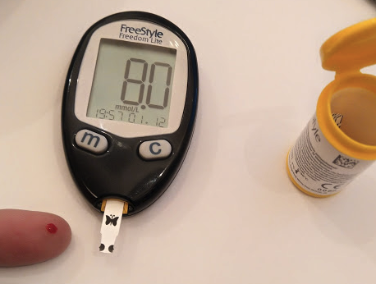
Pregestational Diabetes Mellitus
Assessment, exam, and labs
Antepartum Care
More frequent monitoring in pregnancy
Primary goal: Achieving and maintaining constant euglycemia
Diet
Exercise
Insulin therapy
Self-Monitoring of blood glucose (SMBG)
Fetal surveillance
Delivery
Notes:
Photo from Omstaal, creative common license, no changes made, can be found at https://commons.wikimedia.org/wiki/File:Self_Monitoring_of_Blood_Glucose.png

Slide 7
Pregestational Diabetes Mellitus Care
Intrapartum
Monitoring for dehydration, hypoglycemia, and hyperglycemia
Blood glucose levels carefully monitored
Continuous EFM
Intravenous infusion
Possible cesarean birth for macrosomia
Postpartum
First 24 hours, insulin requirements drop substantially
Risk of hemorrhage due to uterine distention
Breastfeeding
Contraceptive methods education

Slide 8
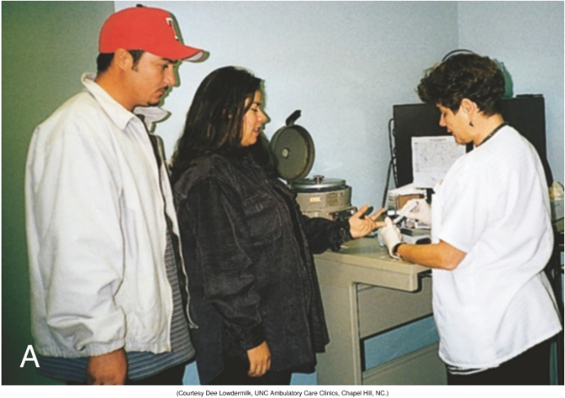
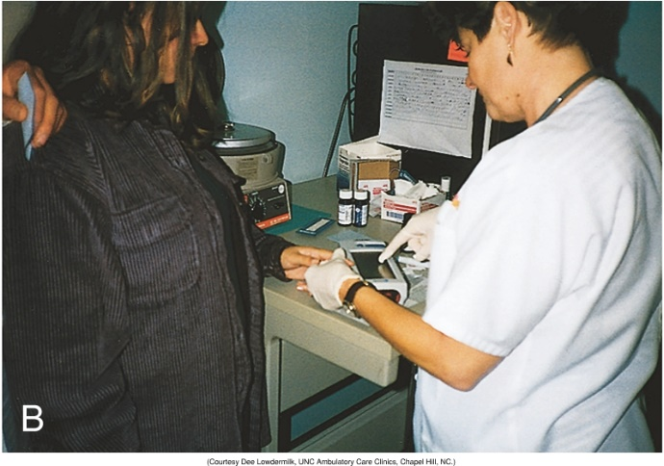
Gestational Diabetes Mellitus (GDM)
Complicates about 9% of all pregnancies in US
Risk Factors for GDM:
Family history of diabetes
Previous pregnancy that resulted in an unexplained stillbirth or the birth of a malformed or macrosomic fetus
Obesity, hypertension, glycosuria, and maternal age older than 25 years
Notes:
Shown is Figure 29-2 from the textbook: Clinic nurse collects blood to determine glucose level. B, Nurse interprets glucose value displayed by monitor. (Courtesy Dee Lowdermilk, UNC Ambulatory Care Clinics, Chapel Hill, NC.)
https://www.picmonic.com/learn/pregnant-diabetic-patient-interventions_10852

Slide 9
GDM Screening
Early Pregnancy Screening
High risk
Screening at 24 to 28 Weeks of Gestation
Two-step Screening Method: recommended by ACOG
1-hour, 50-g oral glucose: glucose value of 130 to 140 mg/dl, or higher, is considered a positive screen
3-hour, 100-g oral glucose (OGTT): diagnosed with GDM if two or more values are met or exceeded

Slide 10
Gestational Diabetes Mellitus (GDM)
Maternal Risks
Preeclampsia
Cesarean delivery
Development of Type 2 diabetes later in life
Fetal Risks
Macrosomia and associated risks for birth trauma
Neonatal hypoglycemia and hyperinsulinemia
Notes:
Shown is Figure 29-5 from the textbook: Two-step method for diagnosing gestational diabetes mellitus (GDM), recommended by the American College of Obstetricians and Gynecologists (ACOG). Data from American College of Obstetricians and Gynecologists. (2018). Gestational diabetes mellitus. Practice bulletin no. 190. Obstetrics & Gynecology, 131(2), e49-e64.

Slide 11
GDM Antepartum Care
Goal is strict blood glucose control
Dietary modification
Exercise
Self-monitoring of blood glucose
Pharmacologic therapy
Fetal surveillance
NSTs beginning at 32 weeks of gestation
Notes:
Shown is Figure 29-4 from the textbook: Insulin pump shows basal rate for pregnant women with diabetes. (Courtesy MiniMed, Inc., Sylmar, CA.)

Slide 12
GDM Care
Intrapartum Care
Blood glucose levels monitored hourly in labor
maintain levels at 80 to 110 mg/dl
Infusion of insulin, if needed
Postpartum Care
Will return to normal glucose levels after birth
High risk for recurrent GDM in future pregnancies
Glucose tolerance test at 6-12 weeks
Repeat screening every 3 years

Slide 13
Hyperemesis Gravidarum
Hyperemesis gravidarum (occurs in 0.3-3% of all pregnancies) is excessive, prolonged vomiting accompanied by the following:
Weight loss
Electrolyte imbalance
Nutritional deficiencies
Ketonuria
Notes:
Https://www.flickr.com/photos/evilerin/3158385504, author is Evil Erin, creative common license
No changes were made to photo

Slide 14
Hyperemesis Gravidarum
Usually begins in 1st trimester; 10% throughout
Risk Factors:
Younger maternal age, nulliparity, a body mass index (BMI) less than 18.5 or greater than 25, and low socioeconomic status
Clinical manifestations
significant weight loss and dehydration
dry mucous membranes
decreased BP
increased pulse rate
poor skin turgor

Slide 15
Hyperemesis Gravidarum (3 of 3)
Interprofessional Care Management
Assessment
Severity, frequency, duration of episodes
Determination of ketonuria
Psychosocial assessment: role of anxiety
Interventions
Intravenous (IV) therapy for correction of fluid and electrolyte imbalances
Medications
Enteral or parenteral nutrition as a last resort
Follow-up care

Slide 16
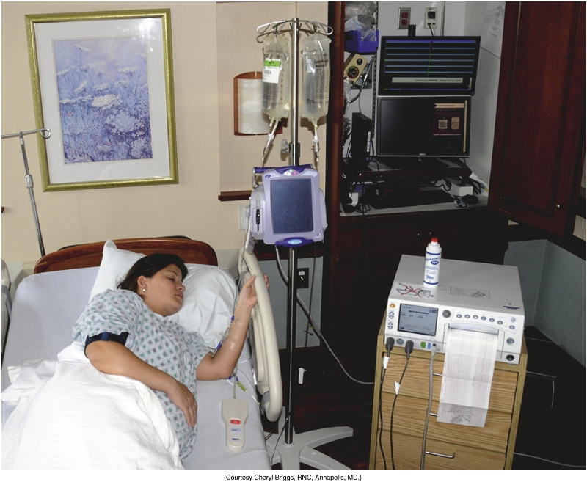
Other Medical Disorders in Pregnancy
Cardiac Disorders
Pulmonary Disorders
Gastrointestinal disorders
Urinary tract infections
Asymptomatic Bacteriuria
Cystitis
Pyelonephritis
Client Education
Notes:
Show is Figure 32-7 from the textbook: Woman in side-lying position receiving oxytocin. (Courtesy Cheryl Briggs, RNC, Annapolis, MD.)

Slide 17
Other Medical Disorders in Pregnancy
Surgery During Pregnancy
Approximately 1 in 500 women require nonobstetric surgery during pregnancy
Two common nonobstetric abdominal conditions requiring surgery during pregnancy:
Appendicitis
Occurs in about 1 in 1000 pregnancies
Symptomatic Cholelithiasis
Interprofessional Care Management
Assessment
Hospital Care

Slide 18
Trauma During Pregnancy
Significance
Most cases of trauma are reported in the third trimester
Most are a result of motor vehicle injuries (MVAs)
Maternal Physiologic Characteristics
Fetal Physiologic Characteristics
Mechanisms of trauma
Blunt abdominal trauma
Penetrating abdominal trauma
Thoracic trauma
Notes:
Photo from https://pixabay.com/photos/violence-against-women-domestic-4209778/
Creative common license, no changes made

Slide 19
Trauma During Pregnancy
Physiological changes of pregnancy may affect , risks, S/S, and outcomes
Blood volume
Location of Organs
Fetal Monitoring – frequency, duration
Interprofessional Care Management
Immediate stabilization
Perimortem cesarean birth
It has been suggested that “perimortem cesarean birth” be replaced by the term “resuscitative hysterectomy”

Slide 20
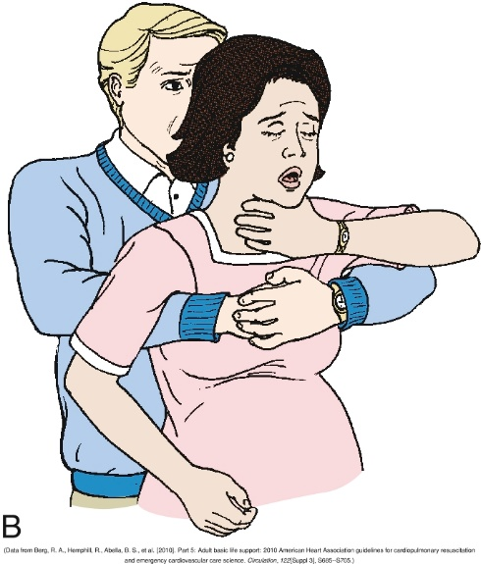
Choking in a Pregnant Woman
Notes:
Shown is Figure 30-2 from the textbook: Clearing airway obstruction in woman in late stage of pregnancy. A, Standing behind victim, place your arms under woman’s armpits and across chest. Place thumb side of your clenched fist against middle of sternum, and place other hand over fist. B, Perform backward chest thrusts until foreign body is expelled or woman becomes unconscious (see Emergency box: Relief of Foreign Body Airway Obstruction in the textbook). (Data from Berg, R.A., Hemphill, R., Abella, B.S., et al. (2010). Part 5: Adult basic life support: 2010 American Heart Association guidelines for cardiopulmonary resuscitation and emergency cardiovascular care science. Circulation, 122(Suppl 3), S685-S705.)

Slide 21
Cardiopulmonary Resuscitation in Pregnancy
Specific modifications
Uterine displacement in second half of pregnancy
Defibrillation paddles must be placed one rib space higher
If CPR is not effective within 4 minutes & pregnancy is at or beyond fetal viability (23 to 24 weeks of gestation), consider perimortem cesarean birth

Slide 22
Ch 32
• Ch 32 Labor and Birth complications
o Preterm birth vs low birth weight
o Preterm labor, post term pregnancy, PPROM

Slide 23
Preterm Labor and Birth
Preterm labor and birth
Preterm labor (PTL): regular contractions along with a change in cervical effacement or dilation or both or presentation with regular uterine contractions and cervical dilation of at least 2 cm
Preterm birth: any birth that occurs between 20 0/7 and 36 6/7 weeks of gestation
Decreasing rates of preterm birth in the last decade, due to:
(1) improved fertility practices that reduce the risk for higher-order multiple gestations;
(2) quality improvement programs that limit scheduled late preterm and near-term births to only those with valid indications; and
(3) increased use of strategies to prevent recurrent preterm birth
Notes:
Image from CFCF at https://commons.wikimedia.org/wiki/File:Cervix_birth.png
No changes made, creative common license

Slide 24
Preterm Labor and Birth
Sub-Categories:
very preterm (<32 weeks of gestation)
moderately preterm (32 to 34 weeks of gestation)
late preterm (34 0/7 to 36 6/7 weeks of gestation)
Preterm Birth Versus Low Birth Weight
Preterm birth or prematurity: length of gestation regardless of birth weight
Low birth weight: ≤ 2500 grams at birth

Slide 25
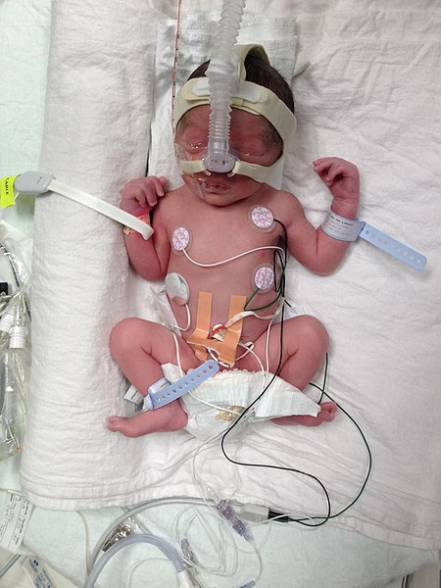
Preterm Labor and Birth
Spontaneous Versus Indicated Preterm Birth
Spontaneous: 75% of preterm births
Indicated: 25% of preterm births
Causes of Spontaneous Preterm Labor and Birth
Multifactorial; multiple pathologic processes
Infection is the only definitive factor
Medically indicated
HTN
Pre-eclampsia
Medical Disorders
Fetal Disorders
Notes:
Photo by Lazarus000, titled “Preterm birth”
Creative common license, no changes made, found at https://commons.wikimedia.org/wiki/File:Premature_birth_Alberta,_Canada.jpg

Slide 26
Predicting Spontaneous Preterm Labor and Birth
Risk factors
Cervical length
But cervical length >30 mm in the 2nd and 3rd trimester unlikely to give birth prematurely
Fetal Fibronectin (fFN)Test
Test is used to predict who will not go into preterm labor
Women with a negative test have less than a 1% chance of giving birth within two weeks

Slide 27
PTL Management
Interventions
Prevention
Early recognition and diagnosis
Lifestyle modifications
Activity restriction
NO evidence to support bedrest; should not be routinely recommended
Restriction of sexual activity
Notes:
Shown is Figure 32-2 from the textbook: Woman at home on restricted activity for preterm labor prevention. Note how she has arranged her daytime resting area so that needed items are close at hand. Courtesy Amy Turner, Cary, NC.)

Slide 28
Prelabor Rupture of Membranes (PROM)
PROM: Spontaneous rupture of amniotic sac and leakage of fluid prior to the onset of labor at any gestational age
PPROM: membranes rupture before 37-0/7 weeks of gestation

Slide 29
Interprofessional Care Management: PROM and PPROM
Determined individually for each woman
Dependent on gestational age
Vigilance for signs of infections
Fetal assessment
Prolonging Pregnancy
Antibiotics
Magnesium sulfate
PPROM at less than 32 weeks is managed expectantly and conservatively

Slide 30
Chorioamnionitis
Bacterial infection of the amniotic cavity
Major cause of complications for mothers and newborns at any gestational age
Occurs in approximately 1% to 5% of term births but in as many as 25% of preterm births
Diagnosed by the clinical findings of maternal fever, maternal and fetal tachycardia, uterine tenderness, and foul odor of amniotic fluid
Neonatal risks
Treatment

Slide 31
Postterm Pregnancy
Postterm pregnancy (postdates) 42+ weeks of gestation
Maternal and Fetal risks
Increased Maternal morbidity
Dysfunctional labor and birth canal trauma
Labor and birth interventions more likely
Abnormal fetal growth (macrosomia)
Prolonged labor
Shoulder dystocia or operative birth risks increase
Postmaturity syndrome

Slide 32
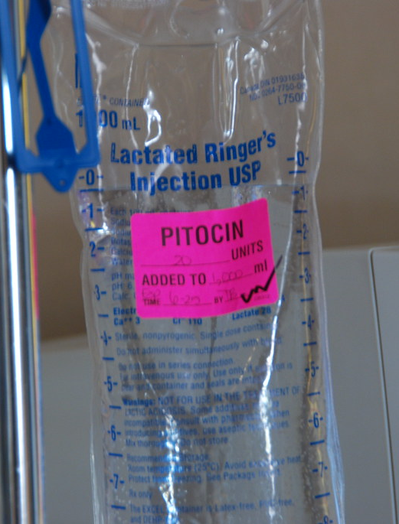
Postterm Pregnancy, Labor, and Birth (2 of 2)
Interprofessional Care management
Controversial
Perinatal morbidity and mortality increase greatly beginning at 41 0/7 weeks of gestation
More frequent fetal assessment, testing
Notes:
Photo from Drew Allen at https://www.flickr.com/photos/drewesque/2608674753
Image cropped, creative common license

Slide 33
Case Study (1 of 3)
Your client is a G2 P1001 at 42 weeks gestation. Her biophysical profile (BPP) exam was 4/10.
What does this mean about the health of her fetus?
Given her gestational age, what are some of the potential causes of this condition?
Notes:
To review the BPP, see textbook Chapter 26:
BPP scoring and management are detailed in Tables 26-2 and 26-3 in the textbook.
The BPP is used frequently in the late second and the third trimester for antepartum fetal testing because it is a reliable predictor of fetal well-being. A BPP of 8 or 10 with a normal AFV is considered normal. Advantages of the test include excellent sensitivity and a low false-negative rate (Miller et al., 2013). One limitation of the test is that, if the fetus is in a quiet sleep state, the BPP can require a long period of observation. Also, unless the ultrasound examination is videotaped, it cannot be reviewed (Greenberg et al., 2012).
Categories of risk include biophysical, psychosocial, sociodemographic, and environmental (see Box 26-1 in the textbook). Risk factors are interrelated and cumulative in their effects.
Biophysical risks include factors that originate within the mother or fetus and affect the development or functioning of either one or both. Examples include genetic disorders, nutritional and general health status, and medical or obstetric-related illnesses. Box 26-2 in the textbook lists common risk factors for several pregnancy-related problems.
See textbook chapter Chapter 32, Postterm Pregnancy, Labor and Birth; Maternal and Fetal Risks; Care Management:
Maternal risks are often related to dysfunctional labor, such as increased risk for perineal injury related to fetal macrosomia. Risk for hemorrhage and infection is higher. Interventions such as induction of labor with prostaglandins or oxytocin, forceps- or vacuum-assisted birth, and cesarean birth are more likely to be necessary. Each of these interventions, of course, carries its own set of risks. The woman also may experience fatigue, physical discomfort, and psychologic reactions such as depression, frustration, and feelings of inadequacy as she passes her estimated date of birth. Relationships with close friends and family members may become strained and the woman’s negative feelings about herself may be projected as feelings of resentment toward the fetus (Gilbert, 2011; Rampersad & Macones, 2012).
Another complication associated with postterm pregnancy is abnormal fetal growth. Although the risk of having a small for gestational age infant is increased, only 10% to 20% of postterm fetuses are undernourished. Macrosomia (birth weight more than 4000 g) occurs far more often. Macrosomia occurs when the placenta continues to provide adequate nutrients to support fetal growth after 40 weeks of gestation. Macrosomic infants have an increased risk for operative delivery and shoulder dystocia leading to fetal injury (Rampersad & Macones, 2012).
Other fetal risks associated with postterm gestation are related to the intrauterine environment. After 43 to 44 weeks of gestation, the placenta begins to age. Enlarging areas of infarction and increased deposition of calcium and fibrin in its tissue decrease the placenta’s reserve and may affect its ability to oxygenate the fetus. Decreased amniotic fluid (less than 400 mL), oligohydramnios, is the complication most frequently associated with postterm pregnancy. Because of the decreased amount of amniotic fluid, there is a potential for cord compression and resulting hypoxemia (Gilbert, 2011). Other potential complications include meconium-stained amniotic fluid and increased chance of meconium aspiration (Rampersad & Macones, 2012).
Postmaturity syndrome occurs in 10% to 20% of neonates born following postterm pregnancies. Postmaturity syndrome is characterized by dry, cracked, peeling skin; long nails; meconium staining of skin, nails, and umbilical cord; and perhaps loss of subcutaneous fat and muscle mass (Gilbert, 2011; Rampersad & Macones, 2012).

Slide 34
Case Study (2 of 3)
Her cervical exam reveals cervix is closed/ long/ -3/ firm/ posterior
What is her Bishop’s score?
Given this score, what type of induction orders might the nurse anticipate?
Notes:
See Table 32-3 in the textbook: Her Bishop’s score is 0. All five assessment categories receive a zero.
The nurse would anticipate cervical ripening orders (Prostaglandin gel, Cervidil, cervical dilators, etc.)
See Chapter 32: Induction of Labor; Cervical Ripening Methods; Augmentation of Labor, in the textbook.

Slide 35
Case Study (3 of 3)
What potential newborn complications might the nurse expect at birth?
Describe some typical features of the postdates newborn.
Notes:
Show is Figure 32-7 from the textbook: Woman in side-lying position receiving oxytocin. (Courtesy Cheryl Briggs, RNC, Annapolis, MD.)
From textbook Chapter 32:
During labor, the fetus of a woman with a postterm pregnancy should be continuously monitored electronically for a more accurate assessment of the FHR and pattern. Inadequate fluid volume can lead to compression of the umbilical cord, which results in fetal hypoxia that is reflected in variable or prolonged deceleration patterns. If oligohydramnios is present, an amnioinfusion may be performed to restore amniotic fluid volume to maintain a cushioning of the cord. See Chapter 18 for additional information on amnioinfusion.
From textbook Chapter 34: Features of Postmature Infants:
A pregnancy that is prolonged beyond 42 weeks is a postterm pregnancy, and the infant who is born is called postterm or postmature. Postmaturity can be associated with placental
insufficiency, resulting in a fetus that has a wasted appearance (dysmaturity) at birth because of loss of subcutaneous fat and muscle mass. However, not all postmature infants show signs of dysmaturity; some will continue to grow in utero and will be large at birth. Most postmature infants are oversized but otherwise normal, with advanced development and bone age. A postmature infant will have some, but not necessarily all, of the following physical characteristics (McGrath & Hardy, 2011):
Generally a normal skull, but the reduced dimensions of the rest of the body in the presence of dysmaturity make the skull look inordinately large
Dry, cracked (desquamating), parchment-like skin at birth
Firm nails extending beyond the fingertips
Profuse scalp hair
Depleted subcutaneous fat layers, leaving the skin loose and giving the infant an “old person” appearance
Long and thin body
Absent vernix
Can have meconium staining (golden yellow to green) of skin, nails, and cord, indicative of a hypoxic episode in utero or a perinatal infection such as listeriosis
Can have an alert, wide-eyed appearance symptomatic of chronic intrauterine hypoxia
The perinatal mortality rate is significantly higher in the postmature fetus and neonate. One reason for this is that during labor and birth the increased oxygen demands of the postmature fetus are not fully met. Insufficient gas exchange in the postmature placenta also increases the likelihood of intrauterine hypoxia, which can result in the passage of meconium in utero, thereby increasing the risk for meconium aspiration syndrome (MAS).
Parents may be concerned about the appearance of the postmature infant. Nurses can help them understand reasons for the dry, peeling, skin and other characteristics of postmaturity. Initial bathing should be done with a mild soap. It can be helpful to moisturize the skin with a petrolatum-based ointment. Nurses need to be alert to common problems associated with postmaturity such as meconium aspiration, fetal distress, macrosomia, and birth injury (De los Santos-Garate et al., 2011).

