Slide 1
Prenatal Screening and Diagnostic Testing
Beth Biggan, MSN, RN
St. David’s School of Nursing
Texas State University

Slide 2
What is it?
The use of our technology to perform procedures that help us:
Detect *congenital disorders (aka birth defects)
and
Assess fetal well-being in utero
*Congenital disorders affect an estimated
1 in 33 infants worldwide (WHO)

Slide 3
Why do we do it?
1-) If we can detect congenital disorders, we can prepare families for their child’s special needs, allow families to make choices about pregnancy termination, and potentially begin treating the disorder in utero
2-) If we can assess fetal well-being, we can make decisions about the optimal time for delivery

Slide 4
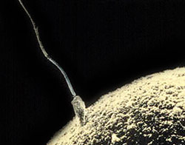
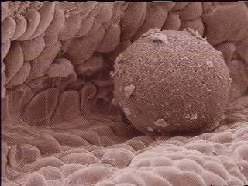
Who is at increased risk of having a child with a congenital disorder ?
Maternal age >35, paternal age >40
Previous offspring or family member with a genetic condition, birth defect, or mental retardation
Hx. of multiple miscarriages (3 or more) or stillbirth
Exposure to teratogenic agent
Maternal Diabetes
Maternal Obesity
Sperm joining egg
Human egg
A human female is born with about 1 million eggs

Slide 5
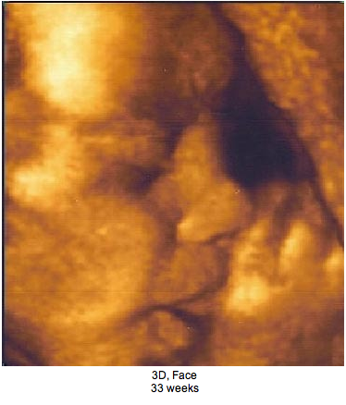
Let’s look at the prenatal screening and diagnostic testing available each trimester, but 1st…
3D Ultrasound

Slide 6
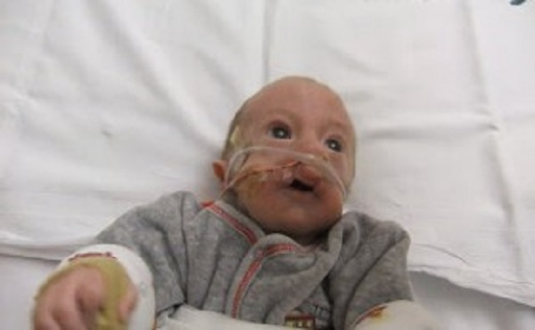
Review new vocabulary
Screening test- an examination that calculates a likelihood or probability that a disorder is present (less invasive)
Diagnosis test- an examination that verifies with certainty that a disorder is present (more invasive)
Trimesters of pregnancy- 1^{st:} 1-12 weeks; 2^{nd:} 13-27 weeks; 3rd: 28-40 weeks
Alpha Fetoprotein (AFP)- serum protein produced by the fetal liver; AFP crosses the placenta; found in both maternal serum and amniotic fluid
Trisomy- genetic abnormality in which a fetus has an extra chromosome
Trisomy 18

Slide 7
First Trimester

Slide 8
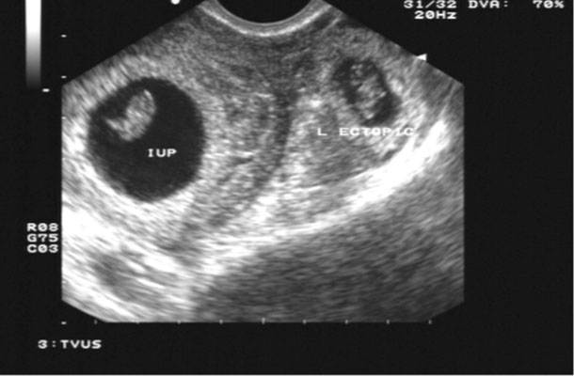
Level 1 Ultrasound See Table 26-1 (p. 638)
Uses intermittent high-frequency sound waves to create an image of the fetus and other structures
Transvaginal
Identify gestational sac and fetal heartbeat=confirms fetal viability
Determines location of pregnancy
Detect fetal number
Assessment of gestational age: 1st trimester
is the MOST ACCURATE TIME using CRL
Ectopic pregnancy

Slide 9
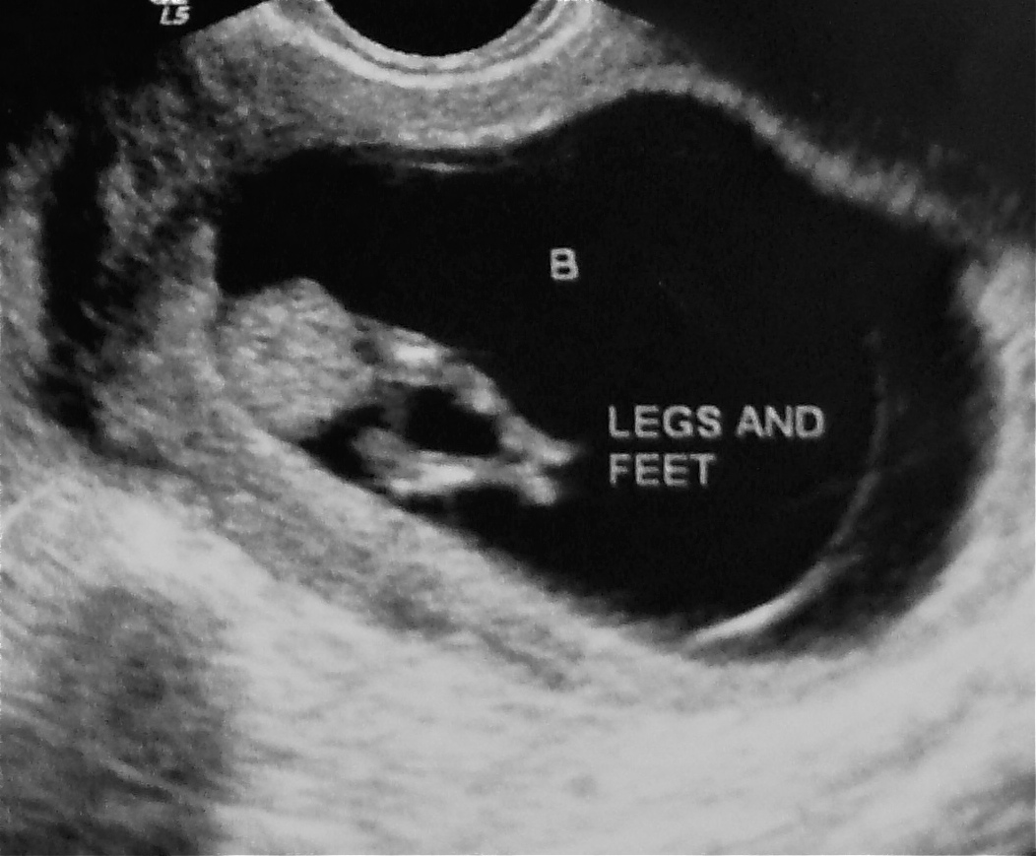

Slide 10
Screening available in the first trimester
“1st Trimester Prenatal Screening”
Optimal time to perform is 11 weeks
Screens for Down Syndrome (Trisomy 21), Trisomy 18, and Trisomy 13
Maternal blood sample analyzed for 2 proteins:
Free Beta-hCG
PAPP-A (pregnancy associated plasma protein-A)
US measurement of nuchal translucency
Notes:
Free Beta-hCG: Human Chorionic Gonadotropin (hCG) is a glycoprotein hormone normally produced by placenta during
pregnancy. The hormone is present in blood and urine around seven to thirteen days following implantation
of the fertilized ovum. Levels higher than normal are associated with a fetus that has a chromosomal abnormality.
Pregnancy-associated plasma protein A: Abbreviated as PAPPA or PAPP-A. Women with low blood levels of PAPPA have an increased risk of a fetus with a chromosomal abnormality.
Nuchal translucency test: A measurement of the size of the translucent space behind the neck of the fetus using ultrasound at between reflecting the amount of fluid that has accumulated under the skin of the fetus. Nuchal translucency tends to be increased in chromosome disorders such as Down Syndrome. This is strictly a screening test. It gives no concrete answers, only statistics.

Slide 12
Pros and Cons of 1st Trimester Prenatal Screening
Cons
Pros
In regards to pregnancy termination, the earlier you know about a potential problem the better
Non-invasive=low risk
Families appreciate having time to prepare for an infant with special needs
Too early to measure MSAFP
1/3 of women do not seek prenatal care until they are in their second trimester
It’s just a screening test:
Diagnostic testing (chorionic villus sampling) is invasive and includes risks
1st trimester amniocentesis carries significant risk of club foot, amniotic fluid leakage and fetal loss

Slide 13
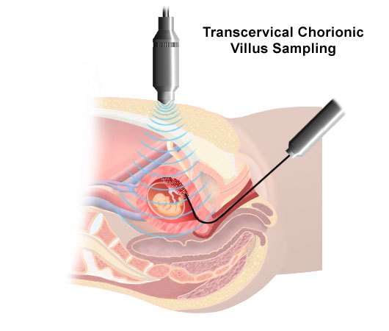
Chorionic Villus Sampling (CVS)
Done between 10-13 weeks
Using needle or catheter, villi from the fetal portion of the placenta are removed under US guidance
Cells are grown and can be tested for chromosome abnormalities
No Amniotic fluid is obtained so it does not measure AFP. MSAFP should be done at 15-20 weeks
Miscarriage rate is 2.5%
Risk of infection/limb malformation

Slide 14
After CVS
Visualize fetal cardiac movement
Monitor maternal vital signs
Instruct pt to report heavy bleeding and/or leaking of amniotic fluid
Rh negative mothers need Rhogam
Bed rest for several hours after procedure

Slide 15
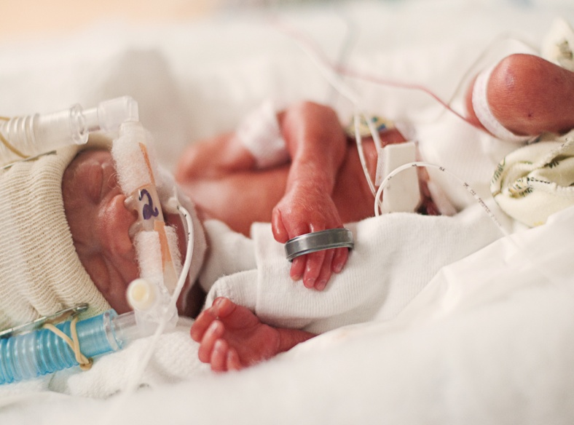
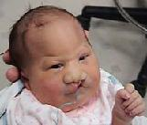
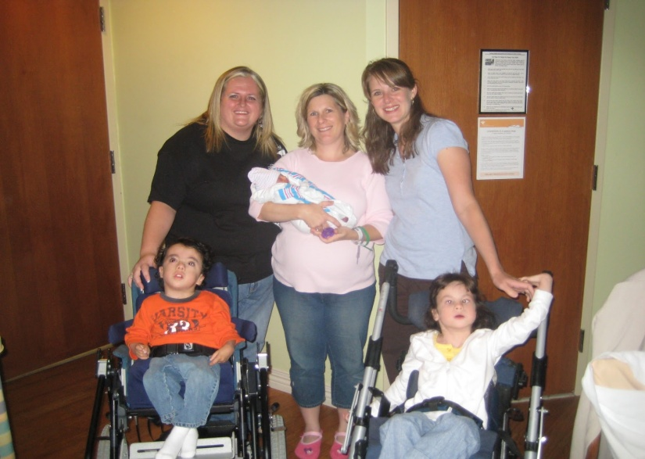
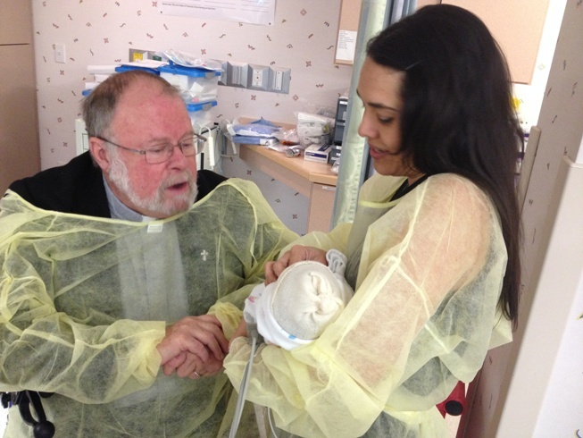
Support patients with information, not advice…

Slide 16
Second Trimester

Slide 17
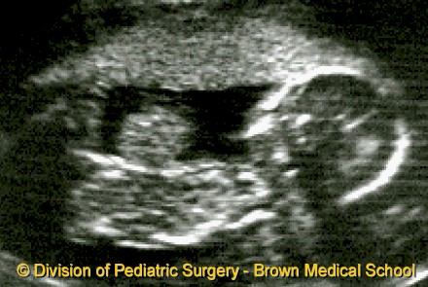
Level I Ultrasound in the 2nd trimester
Transabdominal (a full bladder helps!)
Assess fetal number
Assessment of gestational age (not as accurate as before 22 weeks)
Assess fetal anatomy & growth
Assess placental location and maturity
Assess amniotic fluid volume (AFI)
Guide diagnostic procedures like amniocentesis
If obvious anatomical malformations are noted,
patient will be referred for Level II Ultrasound
What have we found here?

Slide 19
Gastroschisis
What lab value would you expect to see elevated for this pregnancy?

Slide 20
Screening available in the second trimester
“Multiple Marker Screening” (MMS) also called a “triple screen”, “quad screen”, or AFP usually combined with Level 1 ultrasound
MMS screens for these congenital disorders:
Neural tube defects (NTD) and ventral wall defects
Trisomy 21 (Down syndrome)-Quad screen detects 80%, misses 20%
Trisomy 18-Quad screen detects 60-70%, misses 30-40%
May also detect other abnormalities
The Maternal serum is tested for 3 or 4 biomarkers
1. hCG (human chorionic gonadotropin)
2. uE3 (uncongugated estriol)
3. AFP (alpha-fetoprotein)
4. inhibin-A
Notes:
uE3: A part of biochemical second trimester or cross-trimester screening for Down syndrome and trisomy 18 syndrome. A marker of fetal demise. An element in the prenatal diagnosis of disorders of fetal steroid metabolism, including Smith-Lemli-Opitz syndrome, X-linked ichthyosis and contiguous gene syndrome (placental sulfatase deficiency disorders), aromatase deficiency, primary or secondary fetal adrenal insufficiency, and various forms of congenital adrenal hyperplasia.
AFP (alpha-fetoprotein): AFP is a plasma protein that is normally produced by the fetus. It serves as the basis for some valuable tests. AFP is manufactured principally in the fetus's liver and, also, in the fetal gastrointestinal (GI) tract and the yolk sac, a structure temporarily present during embryonic development. The level of AFP is typically high in the fetus's blood. It goes down in the baby's blood after birth. And by a year of age, it is virtually undetectable.
During pregnancy, AFP crosses the placenta from the fetal circulation and appears in the mother's blood after the 1st trimester. The level of AFP in the mother's blood (the maternal serum AFP) provides a screening test for a number of disorders including:
Open neural tube defects (anencephaly and spina bifida); and
Down syndrome (and other chromosome abnormalities).
The maternal serum AFP (MSAFP) tends to be:
High with open neural tube defects such as anencephaly and spina bifida (meningomyelocele); and
Low with Down syndrome
inhibin A: An elevated inhibin A (along with an increased beta-hCG, decreased AFP, and a decreased estriol) is suggestive of the presence of a fetus with Down syndrome. As a screening test, abnormal quad screen test results need to be followed up with diagnostic tests.

Slide 21
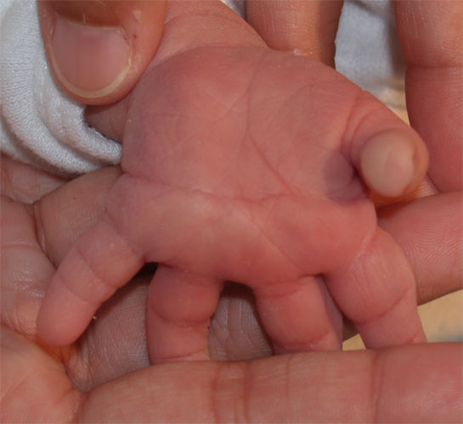
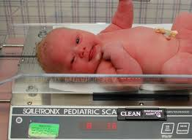
Low MSAFP= Possible Down Syndrome or other Trisomy
Confirmed with amniocentesis

Slide 22
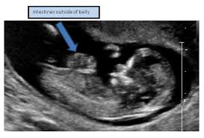
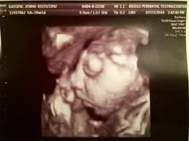
High MSAFP= Possible Neural Tube Defect (NTD) or Abdominal Wall Defect
Includes spina bifida, anencephaly, and encephalocele, gastroschisis
Confirmed with diagnostic US or amniocentesis
Notes:
There are two types of NTDs: open, which are more common, and closed. Open NTDs occur when the brain and/or spinal cord are exposed at birth through a defect in the skull or vertebrae (back bones). Examples of open NTDs are anencephaly, encephalocele, and spina bifida. Rarer types of NTDs are called closed NTDs. Closed NTDs occur when the spinal defect is covered by skin
Spina bifida: A part of a group of birth defects called neural tube defects. The neural tube is the embryonic structure that eventually develops into the baby's brain and spinal cord and the tissues that enclose them.
Normally, the neural tube forms early in the pregnancy and closes by the 28th day after conception. In babies with spina bifida, a portion of the neural tube fails to develop or close properly, causing defects in the spinal cord and in the bones of the backbone.
Spina bifida occurs in various forms of severity. When treatment for spina bifida is necessary, it's done through surgery, although such treatment doesn't always completely resolve the problem.
Anencephaly: A NTD that occurs when the cephalic (head) end of the neural tube fails to close, usually between the 23rd and 26th days of pregnancy, resulting in the absence of a major portion of the brain, skull, and scalp. Infants with this disorder are born without a forebrain, the largest part of the brain consisting mainly of the cerebrum, which is responsible for thinking and coordination. The remaining brain tissue is often exposed; it is not covered by bone or skin.
Approximately 1,000 to 2,000 babies are born with anencephaly each year in the U.S. The disorder affects females more often than males.
Encephaloceles: A congenital gap in the skull that usually results in a protrusion of brain material.
A meningocele is an encephalocele that contains only the meninges and cerebral spinal fluid. These type of defects have a much better prognosis than those where brain tissue also protrudes into the sac.

Slide 23
Anencephaly
http://www.redbookmag.com/life/news/a44510/jaxon-strong-foundation/

Slide 24
Encephaloceles
Notes:
Ectopic neural tissue within (closed) and pertruding (open) outside of the scalp

Slide 25
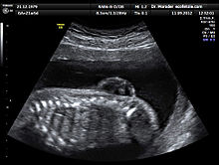
Spina Bifida

Slide 26
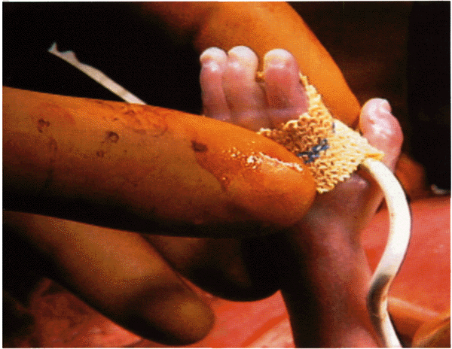
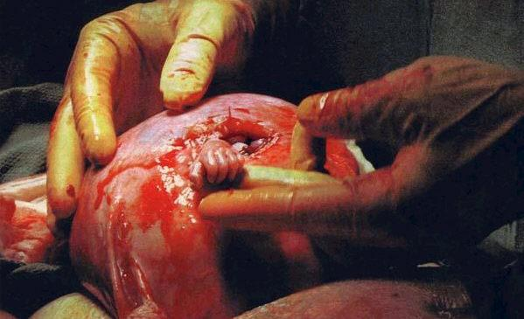
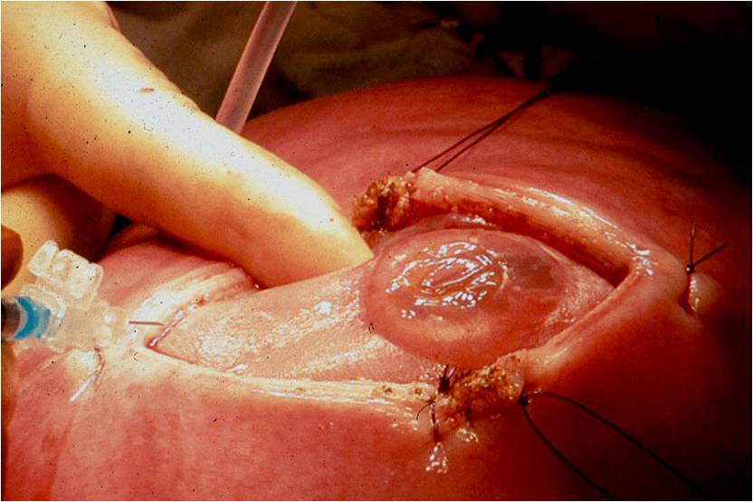
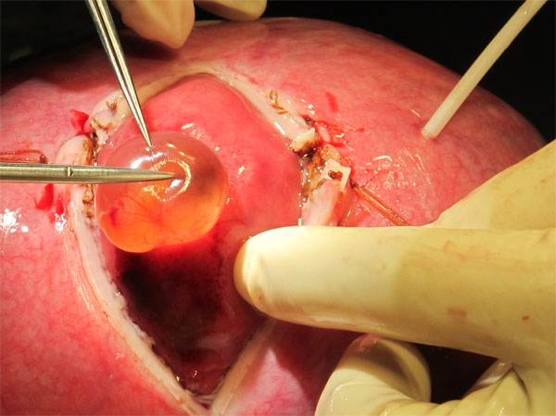
Cutting-Edge Technology: Fetal Surgery

Slide 27
http://www.cardinalglennon.com/fetalcareinstitute/Pages/Lily%27sStory.aspx

Slide 28
Your patient has a positive multiple marker screen— so now what?

Slide 29
Could it be a false positive?
Conditions Associated with False Positive MMS:
Incorrect gestational age
Multiple fetuses
Impending miscarriage
Fetal demise-missed abortion
Maternal obesity
Incorrect race used in calculation of lab value

Slide 30
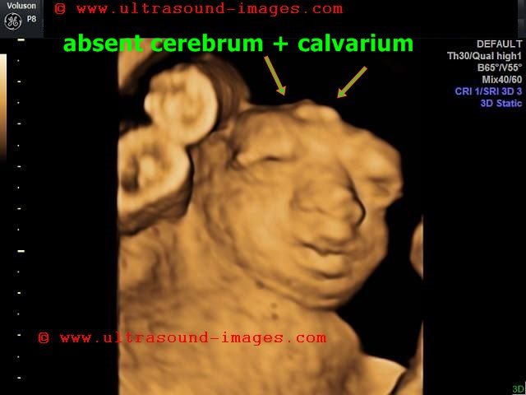
Level II Diagnostic Ultrasound
Looks for suspected anomalies of the:
head and face
spine
chest and heart
abdomen and kidneys
skeleton

Slide 31
Genetic Amniocentesis
Done at 15-20 weeks
With US guidance 20-30cc of amniotic fluid is removed from amniotic sac
Fetal cells can be tested (karyotyped) for chromosomal abnormalities
AFP in amniotic fluid can be measured to detect NTDs
Miscarriage rate is 0.5%
Complications:
Infection
Injury to fetal limb
Miscarriage
https://www.youtube.com/watch?v=XXIW8GHwJ_M

Slide 32
After amniocentesis
Monitor FHR for 1 hour
Administer Rhogam if mom Rh negative
Mom should avoid strenuous activity for 24 hours
Instruct mom to report contractions/cramping, vaginal bleeding, leakage of fluid, fever

Slide 33
Emerging Technology
Notes:
Emerging technologies and promising applications of screening and “next generation” advances for aneuplody screening
Current methods of fetal genetic testing typically involve obtaining samples of amniotic fluid, placenta, fetal blood, or rarely, other fetal tissues or fluids. The invasive techniques required for obtaining fetal samples (eg, amniocentesis, chorionic villus biopsy, etc.) place the fetus at risk of injury or death. Therefore, development of an accurate, safe, rapid, noninvasive test for prenatal diagnosis is an area of active investigation.
Fetal genetic material can be found in the maternal circulation, raising the possibility of using maternal blood to diagnose fetal disease. Intact fetal cells can be identified in maternal blood, but are not a reliable source of fetal genetic material because these cells are extremely rare and may persist for years after prior pregnancies. By comparison, fetal "cell-free" nucleic acids (DNA and RNA) are more plentiful in the maternal circulation and unique to the current pregnancy. Thus, they have great potential for use in prenatal diagnosis.

Slide 34
Third
Trimester

Slide 35
Nonstress Test
Noninvasive
Measures FHR reaction to movement
Client is attached to monitor
Client pushes the monitor button when experiences fetal movement
Note: high rate of false positive results due to sleepy baby, maternal medications, fetal immaturity.

Slide 36
Biophysical Profile
Combines FHR monitoring (like a nonstress test) and ultrasound to visualize the movement and responses
Measures:
FHR max. 2 pts
Fetal breathing movements max 2 pts
Gross body movements max 2 pts
Fetal tone max 2 pts
Qualitative amniotic fluid volume max 2 pts

Slide 37
Biophysical Profile (Con’t)
Score of 8-10 normal, low risk of fetal asphyxsia
Score of 4-8 abnormal, suspect chronic fetal asphyxsia
Score of abnormal,

Slide 38
Pre-delivery screenings
Group B Strep
Collected after 35 weeks gestation
Vaginal and rectal culture
If + (positive) treat with antibiotics while in labor
Failure to treat can cause fetal complications or death
Note: this is natural vaginal flora in some women

Slide 39
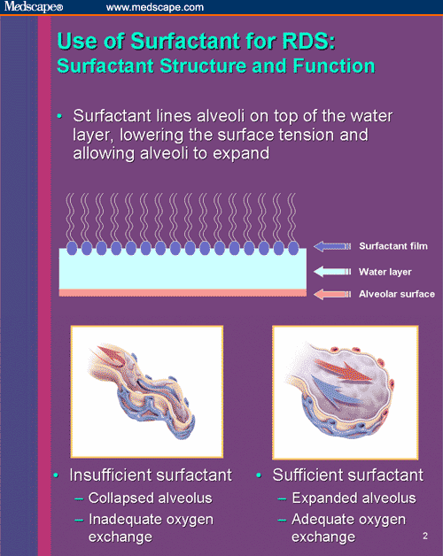
Amniocentesis for fetal lung maturity:
To assess for the presence of surfactant

Slide 40
The role of surfactant:
Substance synthesized and secreted by Type II alveolar cells in the lungs
Surfactant enables low surface tension within alveoli
Decreases the amount of force needed to inflate the lungs
Prevents alveolar collapse upon expiration
Lecithin/sphygnomyelin (L/S) ratio should be 2:1. This indicates a high probability of fetal lung maturity and adequete level of surfactant.
Notes:
We need to talk about surfactant briefly, because this is a vital substance. Surfactant is secreted by Type II alveolar cells in the lungs. Small amounts of surfactant begin being secreted at about 20 weeks EGA.
The purpose of surfactant is to keep the walls of the alveoli from collapsing, it keeps the walls of the alveoli from essentially sticking together, during expiration
One of the reasons for the respiratory distress we seen in preterm infants is a lack of surfactant
There is, however, a lab test we can do to assess the maturity of the fetal lungs by looking for components of surfactant in the amniotic fluid called lecithin and sphyngomyelin
Now, remember surfactant is secreted in the fetal lungs and the fetal breathing movements we discussed cause amniotic fluid to move in and out of the fetal lungs, so we can find traces of surfactant in the amniotic fluid.
Surfactant is made primarily of several different types of phospholipids. Two of the phospholipids are lecithin and sphyngomyelin.
We know there is a greater amount of sphyngomyelin in the amniotic fluid than there is lecithin until about 32 weeks gestation.
However, at 32 weeks gestation the amount of lecithin begins to increase greatly until about 35 weeks gestation
Then at 35 weeks gestation we find 2 times as much lecithin in the amniotic fluid than there is sphyngomyelin, hence the L/S ratio of 2:1. Research has shown that this L/S ratio of 2:1 predicts fetal lung maturity and adequate levels of surfactant.
This is very convenient, because there are times when we want to know if an infant’s lungs are mature, say in the case of a high-risk pregnancy where the doctor feels labor needs to be induced or a c-section performed, we may not have good dating criteria for one reason or another we may not have a good idea of whether or not the infant’s lungs are mature and we can feel safe in going ahead with the delivery

Slide 41
Psychosocial aspects of screening and diagnostic testing
May give parents false reassurance
Limited options for correcting anomalies
Grief over the loss of their “normal” baby
The burden of choosing to terminate a wanted pregnancy can feel overwhelming
We support patients with information, and we offer them our compassion

Slide 42
To screen or not to screen?

