Slide 1
Pain relief during labor Fall 2021

Slide 2
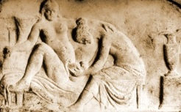
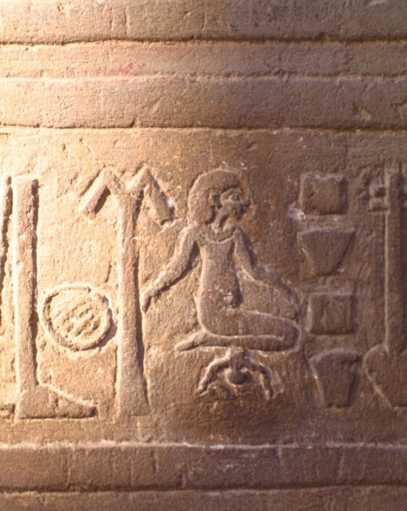
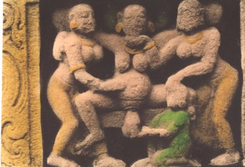
First let’s review the historical context of pain relief during childbirth...
Before the 1900’s, birth took place in the home

Slide 3
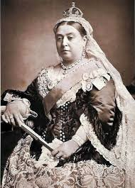
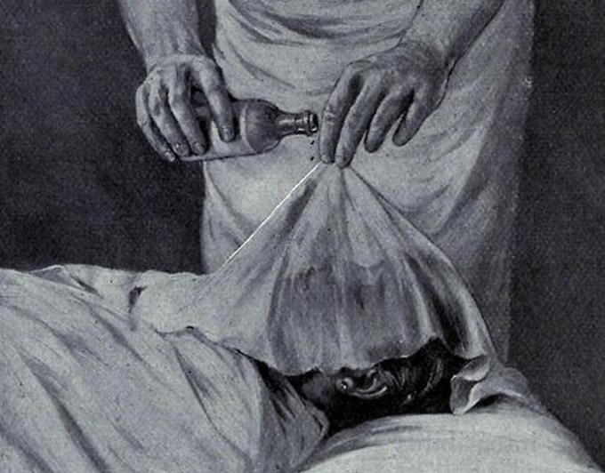
Development of modern anesthesia brought birth into the hospital setting
Physicians felt obligated to use this new development to help alleviate suffering: opium, chloroform, morphine and scopolamine combination; bloodletting was also used
Queen Victoria
Chloroform

Slide 4
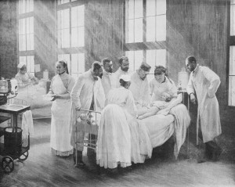
Maternity wards began as one big room with 20-30 beds, no visitors were allowed.

Slide 5
Now, 98% of all births take place in the hospital.
Present day labor and delivery suite in the USA
Labor and delivery room 1980’s

Slide 6
What are we missing in the Hospital setting?

Slide 7
Present day Labor & Delivery Suite in Germany

Slide 8
Unique Nature of Pain During Birth
Childbirth pain is unique because:
It is normal and self-limiting
It can be prepared for
It ends with the baby’s birth
Pain is a complex physiologic and psychological experience.
Subjective and personal

Slide 9
Adverse Effects of Excessive Pain
Physiologic effects
Increase in metabolic rate and oxygen demand
Increase in production of catecholamines, cortisol, glucagon
Less oxygen/waste exchange for fetus
Psychological effects
No interaction with infant
Unpleasant memories

Slide 10
Pain in Labor
Pharmacological options
Non-Pharmacological options
IV medication
Epidural anesthesia
Nitrous Oxide
Hydrotherapy
Ambulation
Hypnotherapy
Prayer
http://www.austinabc.com/~austinab/locations/south-austin/
Vanderbilt hydrotherapy tubs for L&D

Slide 11
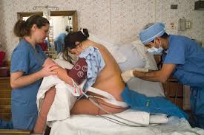
Epidurals for Pain Relief
Benefits:
Decreased anxiety
Increased relaxation
Possible improvement in labor progress

Slide 12
Epidurals for pain relief

Slide 13
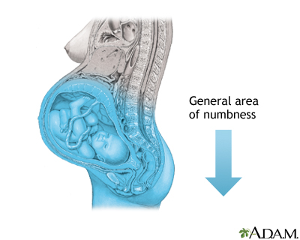
Epidural for pain management
Patients may still feel pressure with an epidural!

Slide 14
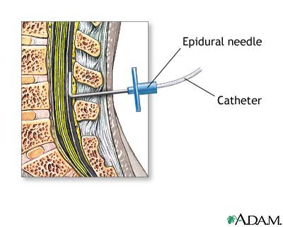
Epidurals for Pain Relief
Potential Adverse Effects:
Maternal hypotension
Fetal decompensation
Maternal fever
Fetal decompensation
Newborn sepsis work-up and treatment
Dural puncture = spinal headache
Migration of epidural catheter
Pruritis
Prolonged second stage
Operative delivery
Episiotomy
Perineal lacerations
Bladder distention

Slide 15
Question
The most important nursing intervention after the injection of epidural anesthesia is monitoring:
a. urinary output.
b. contractions.
c. maternal blood pressure.
d. intravenous infusion rate.
Notes:
ANS: C
Epidural anesthesia may produce maternal hypotension due to vasodilation. Maternal hypotension may cause extreme fetal distress. The mother is prone to bladder distention and this needs to be monitored. However, this does not become a problem until 1 to 3 hours later. Continuing monitoring of the contractions is important because they may be altered by the epidural. However, this is not the most important nursing intervention after the epidural is administered. The intravenous infusion needs to be maintained before, during, and after the epidural. However, it is not the most important nursing intervention at this point.
DIF: Cognitive Level: Comprehension
OBJ: Nursing Process Step: Implementation
MSC: Client Needs: Physiologic Integrity

Slide 16
Emergency Box in text p. 348-
Maternal hypotension with decreased placental perfusion:
Turn patient to left lateral position
Maintain or increase IV fluid infusion rate
Administer O2 by nonrebreather face mask at 10-12 L/min
Elevate patient’s legs
Notify HCP
What medication will the CRNA often administer?
Notes:
A vasopressor like ephedrine to increase blood pressure

Slide 17
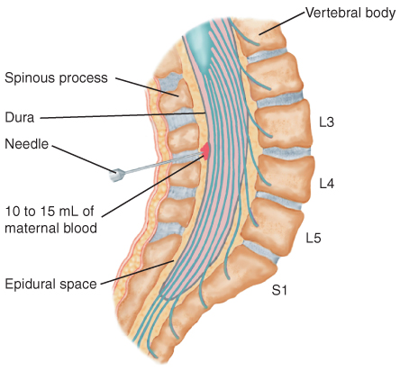
Blood Patch for Relief of Spinal Headache

Slide 18
Contraindications to epidurals
Hypotension
Coagulopathy
Infection at injection site
Allergy to anesthetic drug
Maternal refusal or inability to cooperate
Maternal cardiac conditions

Slide 19
IV Meds for pain relief
Systemic opioids like Demerol and Stadol commonly used; sedatives like Reglan
Given IV push
Risk: Systemic effects on both mother and baby
Biggest concern is for newborn respiratory depression
***Naloxone (Narcan)*** should be available in every delivery room

Slide 20
A nurse just administered IV pain medication to her laboring patient. Which medication does she need to have available at the bedside when the patient delivers? Why?
Notes:
Answer: Narcan

Slide 21
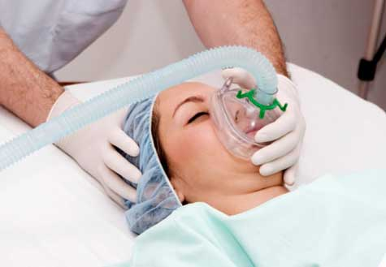
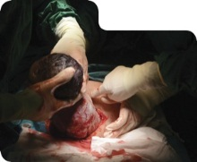
General Anesthesia
Used rarely for vaginal births
Infrequently for elective cesarean section
May be necessary if indications necessitate a rapid birth
Place wedge under left hip
Risks:
Difficulty with intubation
Aspiration of gastric contents-
NPO or clear liquid status may be indicated
Oral antacid is given as a pre-medication to neutralize acidic stomach contents

Slide 22
Cricoid Pressure
Technique of applying pressure on the cricoid cartilage to occlude the esophagus and prevent aspiration of gastric contents during induction of general anesthesia

Slide 23
Sometimes laboring patients Panic
Use a firm voice
Use a focal point
Place a hand on her chest firmly
Breathe with her
Face a Face
DON’T LEAVE HER

Slide 24
Violent Behavior
Walk away…protect yourself first
Document everything thoroughly and objectively
Notify supervisor/incident report
Contact security

Slide 25
THE END
Notes:
Can you tell this baby was in a frank breech position?

