Slide 1
Perinatal Loss
Kimberly Rosenbaum MSN, RNC-OB, IBCLC
Assistant Clinical Professor
Texas State University

Slide 2
Objectives
Describe the various types of perinatal loss and the various family responses to perinatal loss
Differentiate between helpful and hurtful responses in caring for women, their partners and families who experience a perinatal loss
Identify individualized nursing interventions to meet the special needs of bereaved women, their partners and families with a perinatal loss and the ensuing grief.
Lowdermilk: Chapter 37

Slide 3
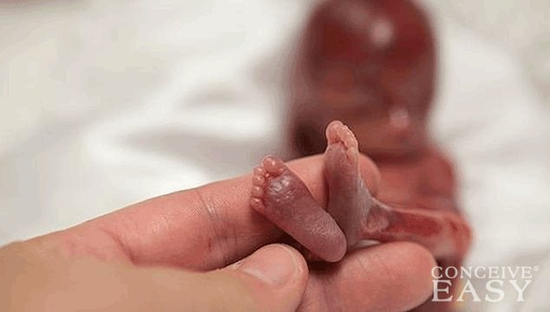
Definitions
Miscarriage
In utero death prior to 20 weeks of gestation
Fetal death/demise
Any death prior to birth after 20 weeks of gestation
Also called IUFD (intrauterine fetal demise)
Stillbirth
A fetal death occurring at 20 weeks or later
Neonatal death
Death of live-born infant at less than 28 days old
Infant death:
Death within the first year
Pregnancy termination
TOPFA: termination of pregnancy for fetal anomalies (medical interruption of pregnancy)
Multifetal Pregnancy Reduction (MFPR)

Slide 4
Grief
Grief as a Process:
It is dynamic and involves complex emotions, thoughts, and behaviors that shift and change;
It is a process that is enduring and has no time limit;
It is highly individualized and manifests differently from person to person;
It is pervasive involving psychological, social, physical, cognitive, behavioral, and affective responses and can affect every aspect of a person’s life

Slide 5
Grief Theories
Kübler-Ross’ Five Stages of Grief:
Denial
Anger
Bargaining
Depression
Acceptance
Continuing Bonds Theory
Dual Process Model
Caregiving Theory

Slide 6
Family Aspects of Grief
Grandparents
Complicated by emotional pain witnessing and feeling immense grief of their child
Siblings
Young children respond more to the reactions of parents
School-aged kids
Teenagers

Slide 7
Communication
What NOT to Say
Better Options
“I’m sad for you.”
“How are you doing with all of this?”
“This must be hard for you.”
“What can I do for you?”
“I’m sorry.”
“I’m here, and I want to listen.”
Remember the power of silence and just “being with” the family.
God had a purpose for her.”
“Be thankful you have another child.”
“The living must go on.”
“I know how you feel.”
“It’s God’s will.”
“You have to keep on going for her sake.”
“You’re young; you can have others.”
“We’ll see you back here next year, and you’ll be happier.”
“Now you have an angel in heaven.”
“This happened for the best.”
“Better for this to happen now, before you knew the baby.”
“There was something wrong with the baby anyway.”
Notes:
Box 37.1 from Lowdermilk, also from Gunderson Lutheran Affiliate

Slide 8
Communication
Helping The Bereaved Parents Acknowledge And Express Their Feelings
Validate the experience and feelings of the parents
Encourage them to tell their stories
Listen with care
Offer helpful versus unhelpful responses
Allow enough time to engage with them without being rushed
Simple, unambiguous, and consistent language is crucial
Notes:
Shown is Figure 37-2 from the textbook: Laura’s family members say a special goodbye. (Courtesy Amy and Ken Turner, Cary, NC.)

Slide 9
Perinatal Loss Management
Give the family options
Holding Their Fetus Or Infant
Research evidence supports the importance of parents’ seeing or holding their fetus or infant, but they should never be made to feel they “should” see or hold their baby
Parents appreciate explanations about what to expect
When bringing the baby’s body to the parents, it is important to treat the baby as one would a live baby

Slide 10
Decisions & Ethics
Respectful Disposition of the body
After 20 weeks
Prior to 20 weeks
Autopsy
Personal, cultural, and religious views
Organ donation
Spiritual rituals
Memorial or funeral service
Do not rush the family into making decisions

Slide 11
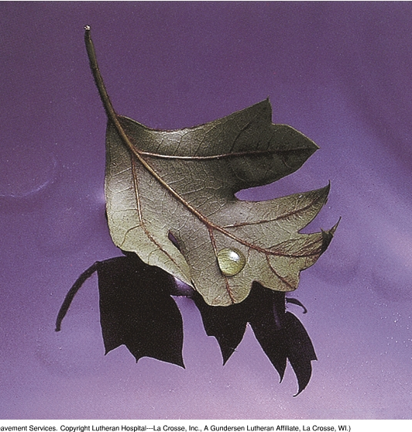
Postpartum Care
Hospital Unit
Location on Unit
BUBBLE-LE

Slide 12
Baby care
Do your length, weight, head circumference, crib card, footprints & handprints, clay molds
Hold them like a baby, cradle them
Refer to them by name, he/she, not it
Swaddle in a baby blanket, put on a hat
Special clothes available, often donated, some very small, some from wedding dresses, decorative cloth diapers – this is all more memorabilia
Give them things that touched baby or had a connection to baby – crib card, tape measure, lotion bottle comb, clothing, hats, blankets
Ask about pictures and a lock of hair

Slide 13
Protecting
Physical and emotional pain
Hunger
Cold
Thirst
Dignity
Hope
Soothing

Slide 14
Nurturing
Breast milk
Doing for the baby
Holding
Parenting
Bathing
Regulating temperature
(Warland & Davis, 2011)

Slide 15
Socializing
Helping the child be in relationship with others
Helping the child be known as a “real person”
(Côté-Arsenault & Denney-Koelsch, 2011)

Slide 16
Special Situations
Infertility or Assisted reproduction
Death from multiple birth
Adolescent Grief
Medical Interruption of Pregnancy
Miscarriage or ectopic pregnancy
Neonatal or Infant Death

Slide 17
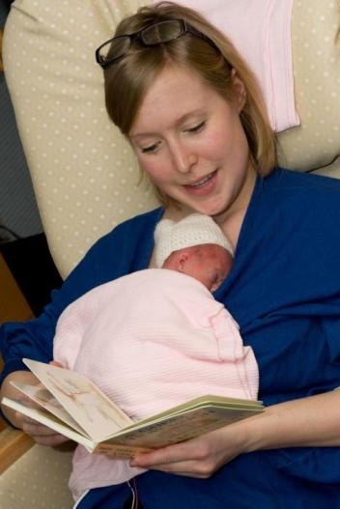
Memory Making
Keepsakes Time
Photography
Ritual

Slide 19
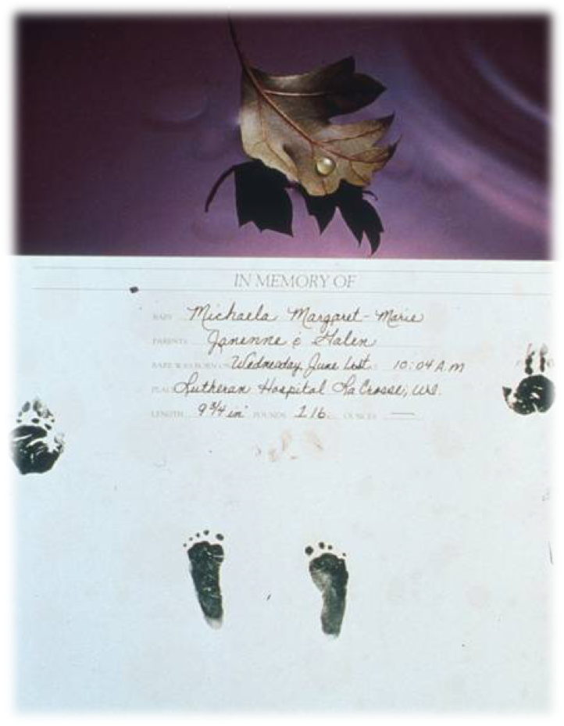
.

Slide 20
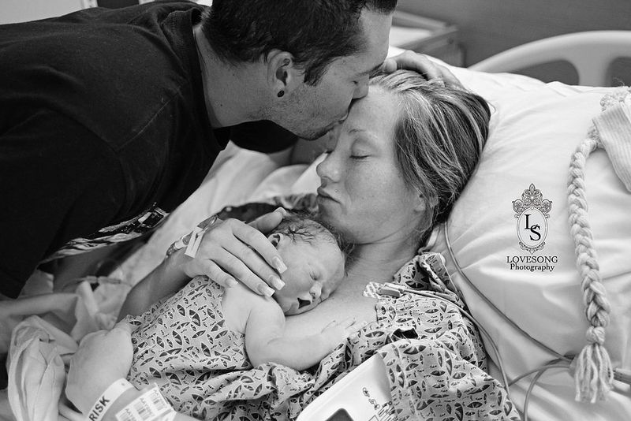
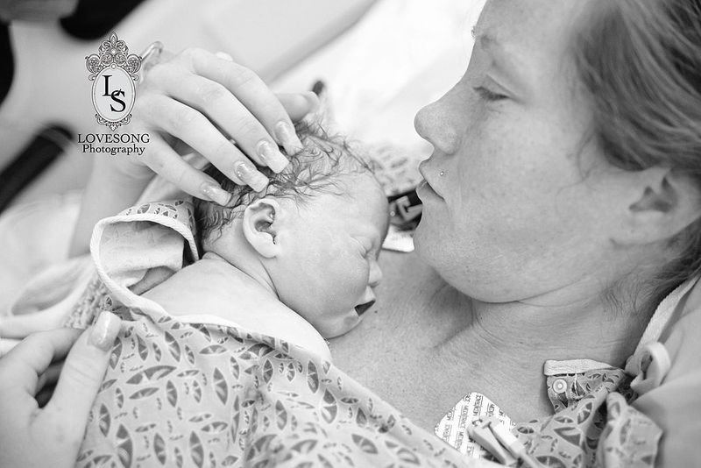
Journalistic photography

Slide 21
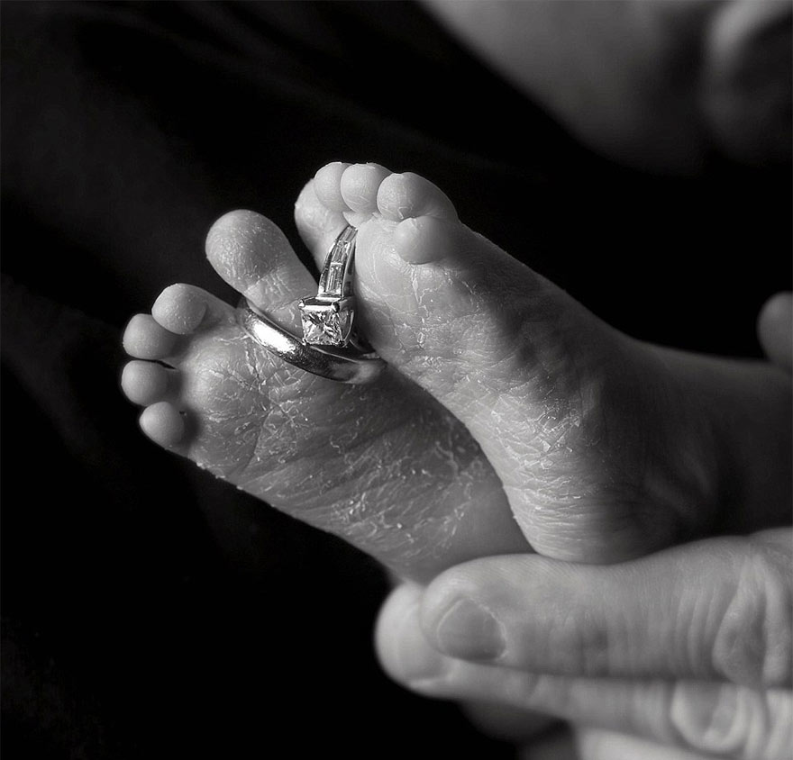
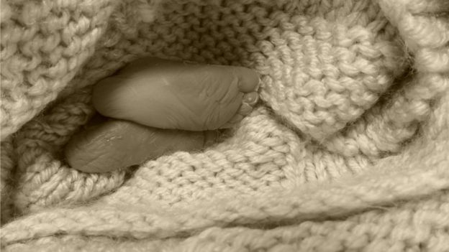
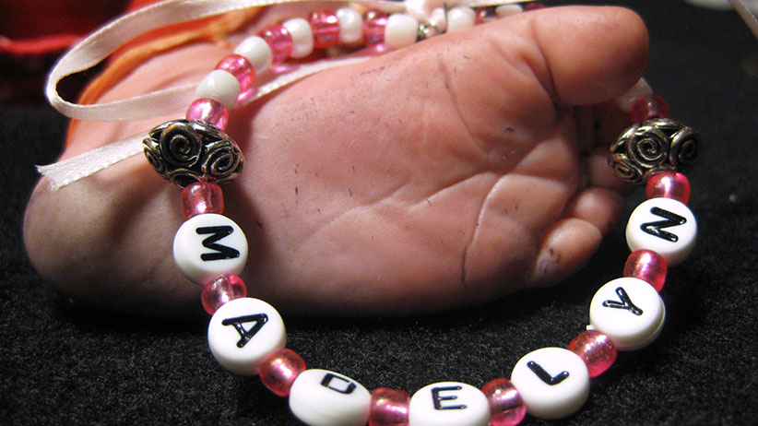

Slide 22
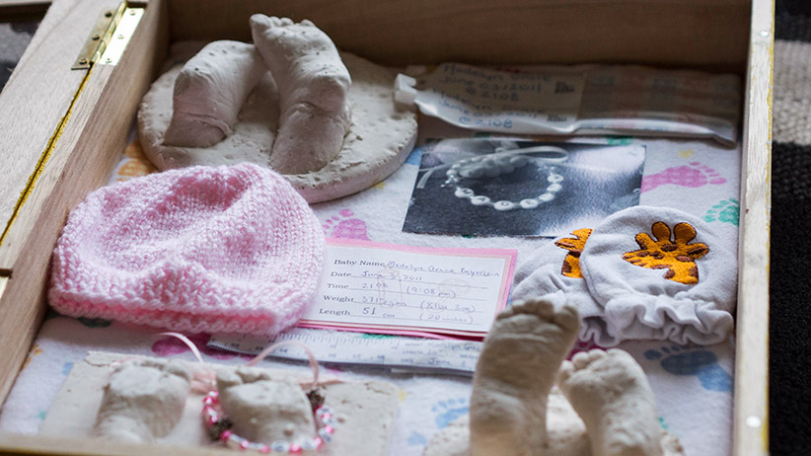
Mementoes

Slide 23
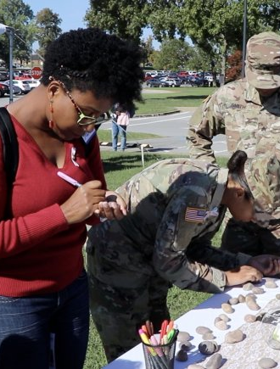
Follow up
Written and verbalized discharge information
Follow up Phone calls & cards
Grief conference
F/u appointment
Perinatal support group

Slide 24
Objectives
Describe
Describe the various types of perinatal loss and the various family responses to perinatal loss
Differentiate
Differentiate between helpful and hurtful responses in caring for women, their partners and families who experience a perinatal loss
Identify
Identify individualized nursing interventions to meet the special needs of bereaved women, their partners and families with a perinatal loss and the ensuing grief.

Slide 25
Questions?

