Slide 1
RDG 1300 LAST CLASS!!!!
Agenda
What’s left?
Final Exam overview
Exam Strategies

Slide 2
What’s Left – Missing Assignments
If you have missing assignments, they are now entered in as zeroes.
If you want your assignments to be graded by me, you need to turn them in before your final exam is due (December 7).
I will be available for one-on-one conferences both this week and next week. Please email me to set up a time if you need to talk about catching up.

Slide 3
Prepping for the final – Class notes
On Canvas, return to the link under the module from our last class, titled “My Mustache, Notes for the Final”
New Groups! Each group will be assigned one slide to work on
Add to your slide by using textboxes. Click the icon shown below to add a text box
Update your slides with your group – once you’re finished, read your classmate’s slides and make an attempt at creating a summary

Slide 4
Final Exam Structure
1 Vocab-in-context question
3 Short answer questions (paragraph-length responses)
1 Essay Question
1 hour, 30 minute time limit
Open book, open notes, open everything

Slide 5
Vocabulary in-context (1 questions)
Example from the Nah, We Straight
"Supporting linguistic segregation is fundamentally at odds with the social justice work the Rickfords and Smitherman seek to accomplish and even contradicts their very own writing. So why would such erudite intellectuals back code switching?" (Young 59).
What does the word "erudite" mean in the context of this sentence? (short answer, 1 pt)
Explain how you can use context clues from the text to understand the meaning of this word. Be specific in explaining and provide an example to support your answer (short answer, 4 pts)

Slide 6
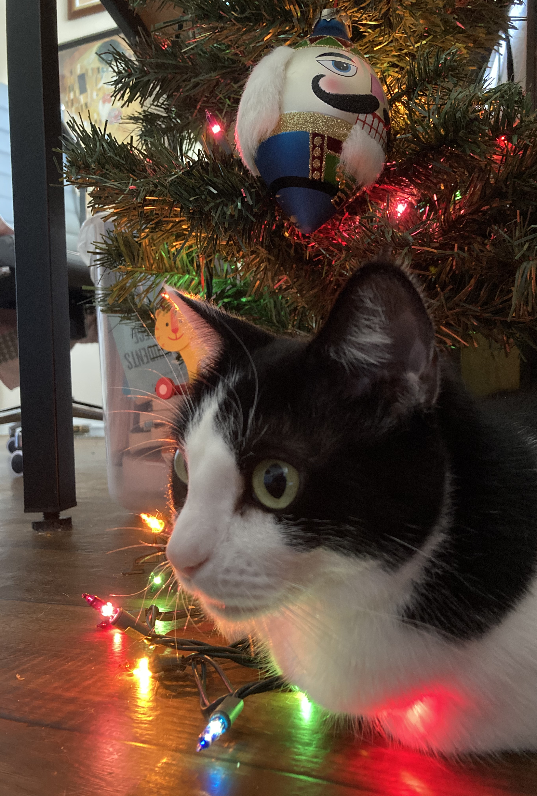
Okay, how do you approach this question?

Slide 7
Strategies for approaching this
Providing a dictionary definition is NOT the way to go here (but it may not hurt to look it up)
Start with finding the specific page or section where this quote comes from in the text.
Then, determine what the sentence or paragraph that the word appears in means to you. THIS will help you define the word.
REMEMBER – math rules apply here. The explanation of how you determined what the word means is worth more than actually defining the word. This means, you can totally miss the definition but still get 4 points (!!!)

Slide 8
What I’m looking for…
A great response will…
Provide a definition for the word that makes sense in context
Give an honest explanation of how you determined the meaning (1-2 sentences)
Pull in reading strategies that we talked about in class
A less-great response will…
Just provide a dictionary definition
Give a canned explanation of how you determined the meaning
Don’t just say “I used a context clue”

Slide 9
Short answer (1 question, 10 pts)
Example from the midterm
In addition to quotes from athletes and I.A.A.F. officials, Ruth Padawar, the author of "Too Fast to be Female," provides several narratives of individual athletes’ experiences of being tested, humiliated, and disqualified from competition. What is the author’s purpose for providing these narratives? How do the narratives help the author achieve that purpose? Provide at least one specific example from the article to support your claim. (5pts)

Slide 10
Okay, how would you approach this question?

Slide 11
Strategies for answering this
Remember – all instructors (including me) typically have to grade many of these. They’ll usually refer to a rubric in order to make things easier to grade.
The question from the midterm actually had three mini questions
What’s her purpose? 1pt
How does the author achieve this purpose? 1pt
Explain your response using a specific example 3pts
So, any rubric that I (hypothetically) made in order grade this essay more efficiently would address how you covered each question in your response

Slide 12
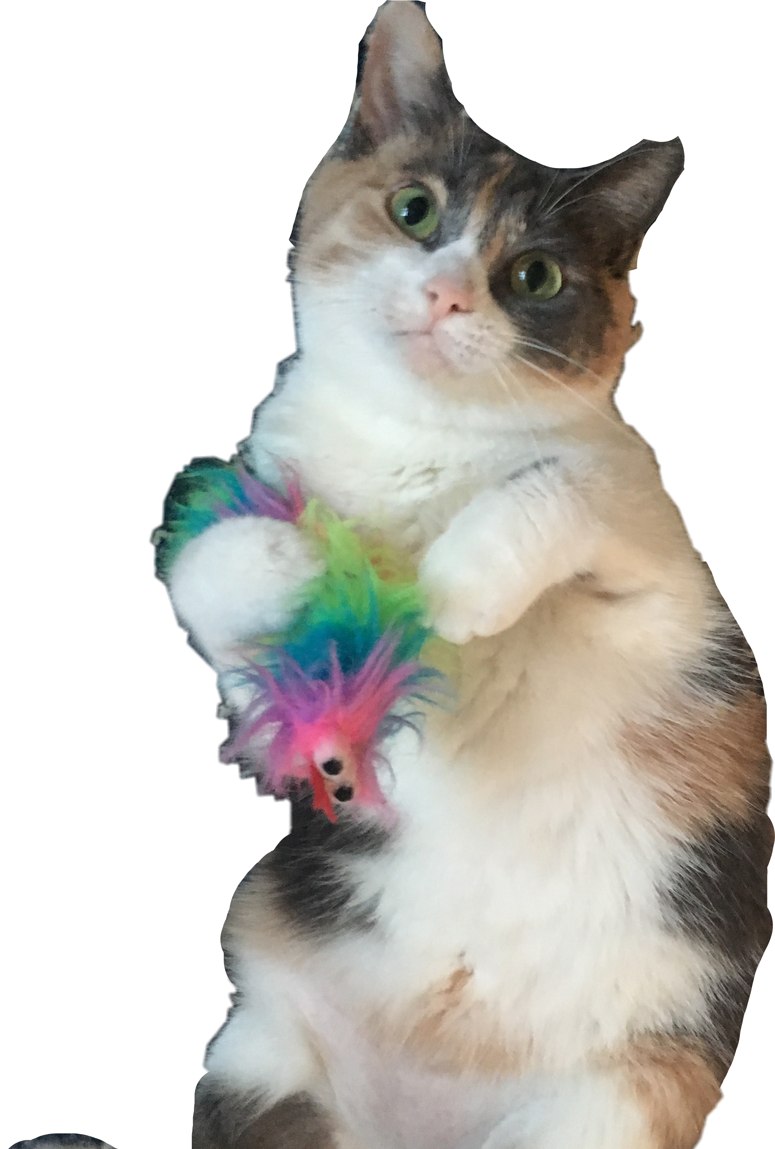
Strategies for answering this…
Short answer questions are typically a mix of recall (repeating information from the text) and critical response (responding with your own ideas).

Slide 13
What I’m looking for…
A good response will…
Carefully read the short answer question and determine how many mini-questions or mini-responses I’m actually looking for.
Cover each mini question with at least a sentence, maybe more (remember though, it is SHORT answer)
A less-good response will…
Fail to cover the question in its entirety
Respond with incomplete sentences/ideas (a one word response is typically not appropriate for this sort of thing.

Slide 14
Essay Response (30 points)
Example from the midterm
In her article, Ruth Padawar writes:
“Just what role testosterone plays in improving athletic performance is still being debated. At the hearing, both sides agreed that synthetic testosterone—doping with anabolic steroids—does ramp up performance, helping male and female athletes jump higher and run faster. But they disagreed vehemently about whether the body’s own testosterone has the same effect.”
Consider the stories of intersex athletes that Padawar includes in her article and refer back to Kimberlé Crenshaw's concept of intersectionality. How do the intersecting identities of Dutee Chand affect her ability to compete as an Olympic athlete? How do you think the I.O.C. and the I.A.A.F should address this situation to ensure fairness and inclusion?
Your response should include a thesis statement to introduce your argument and two well-organized body paragraphs that provide evidence to support your argument. Explain your evidence carefully, making explicit connections between the readings. Save time to read over your answer and make any necessary edits before you submit! (20pts)

Slide 15
How would you approach this question?

Slide 16
Strategies for answering this…
Essay questions will usually have one main question that you’re expected to respond to, but may have additional questions/directions that may refer to how you’re supposed to respond.
Remember, instructors usually use some kind of rubric or checklist to grade these in order to be more efficient
You are likely NOT going to be graded on style points here. Boring is better (usually).
Break the question into parts and use some time to plan what you’re going to write.

Slide 17
Strategies for answering this…
Intro/thesis (1-2 sentences)
Reintroducing the question in my own words
“The intersecting identities of Duttee Chand affect her ability to compete because… In order to address this, the IOC and I.A.A.F should…
Body paragraph(s)
“One way these intersecting identities affects Chand’s ability to compete is… ”
“A strategy that the I.O.C. and the I.A.A.F could use to address this might be…”
Conclusion Paragraph
Come back to your thesis/introduction. How do your responses in the body of the essay support your overall claim?

Slide 18
What I’m looking for…
A good response will…
Have an identifiable paragraph structure (indenting is your friend!)
Carefully address each of the questions posed
Show evidence of planning
A less good response will…
Be one big blob of text (srsly, indenting is your friend).
Appear to be rushed or not planned
Neglect to have an identifiable claim or thesis

Slide 19
Overall notes
Remember, this exam is open book, open notes, open everything. Make use of all the resources that are available to you!
Also remember – this exam was developed to mirror the diagnostic exam.
It might be a good idea to go back and check this out (!!!)

Slide 20
Course Evaluation
Have you all received an email about this?

Slide 21
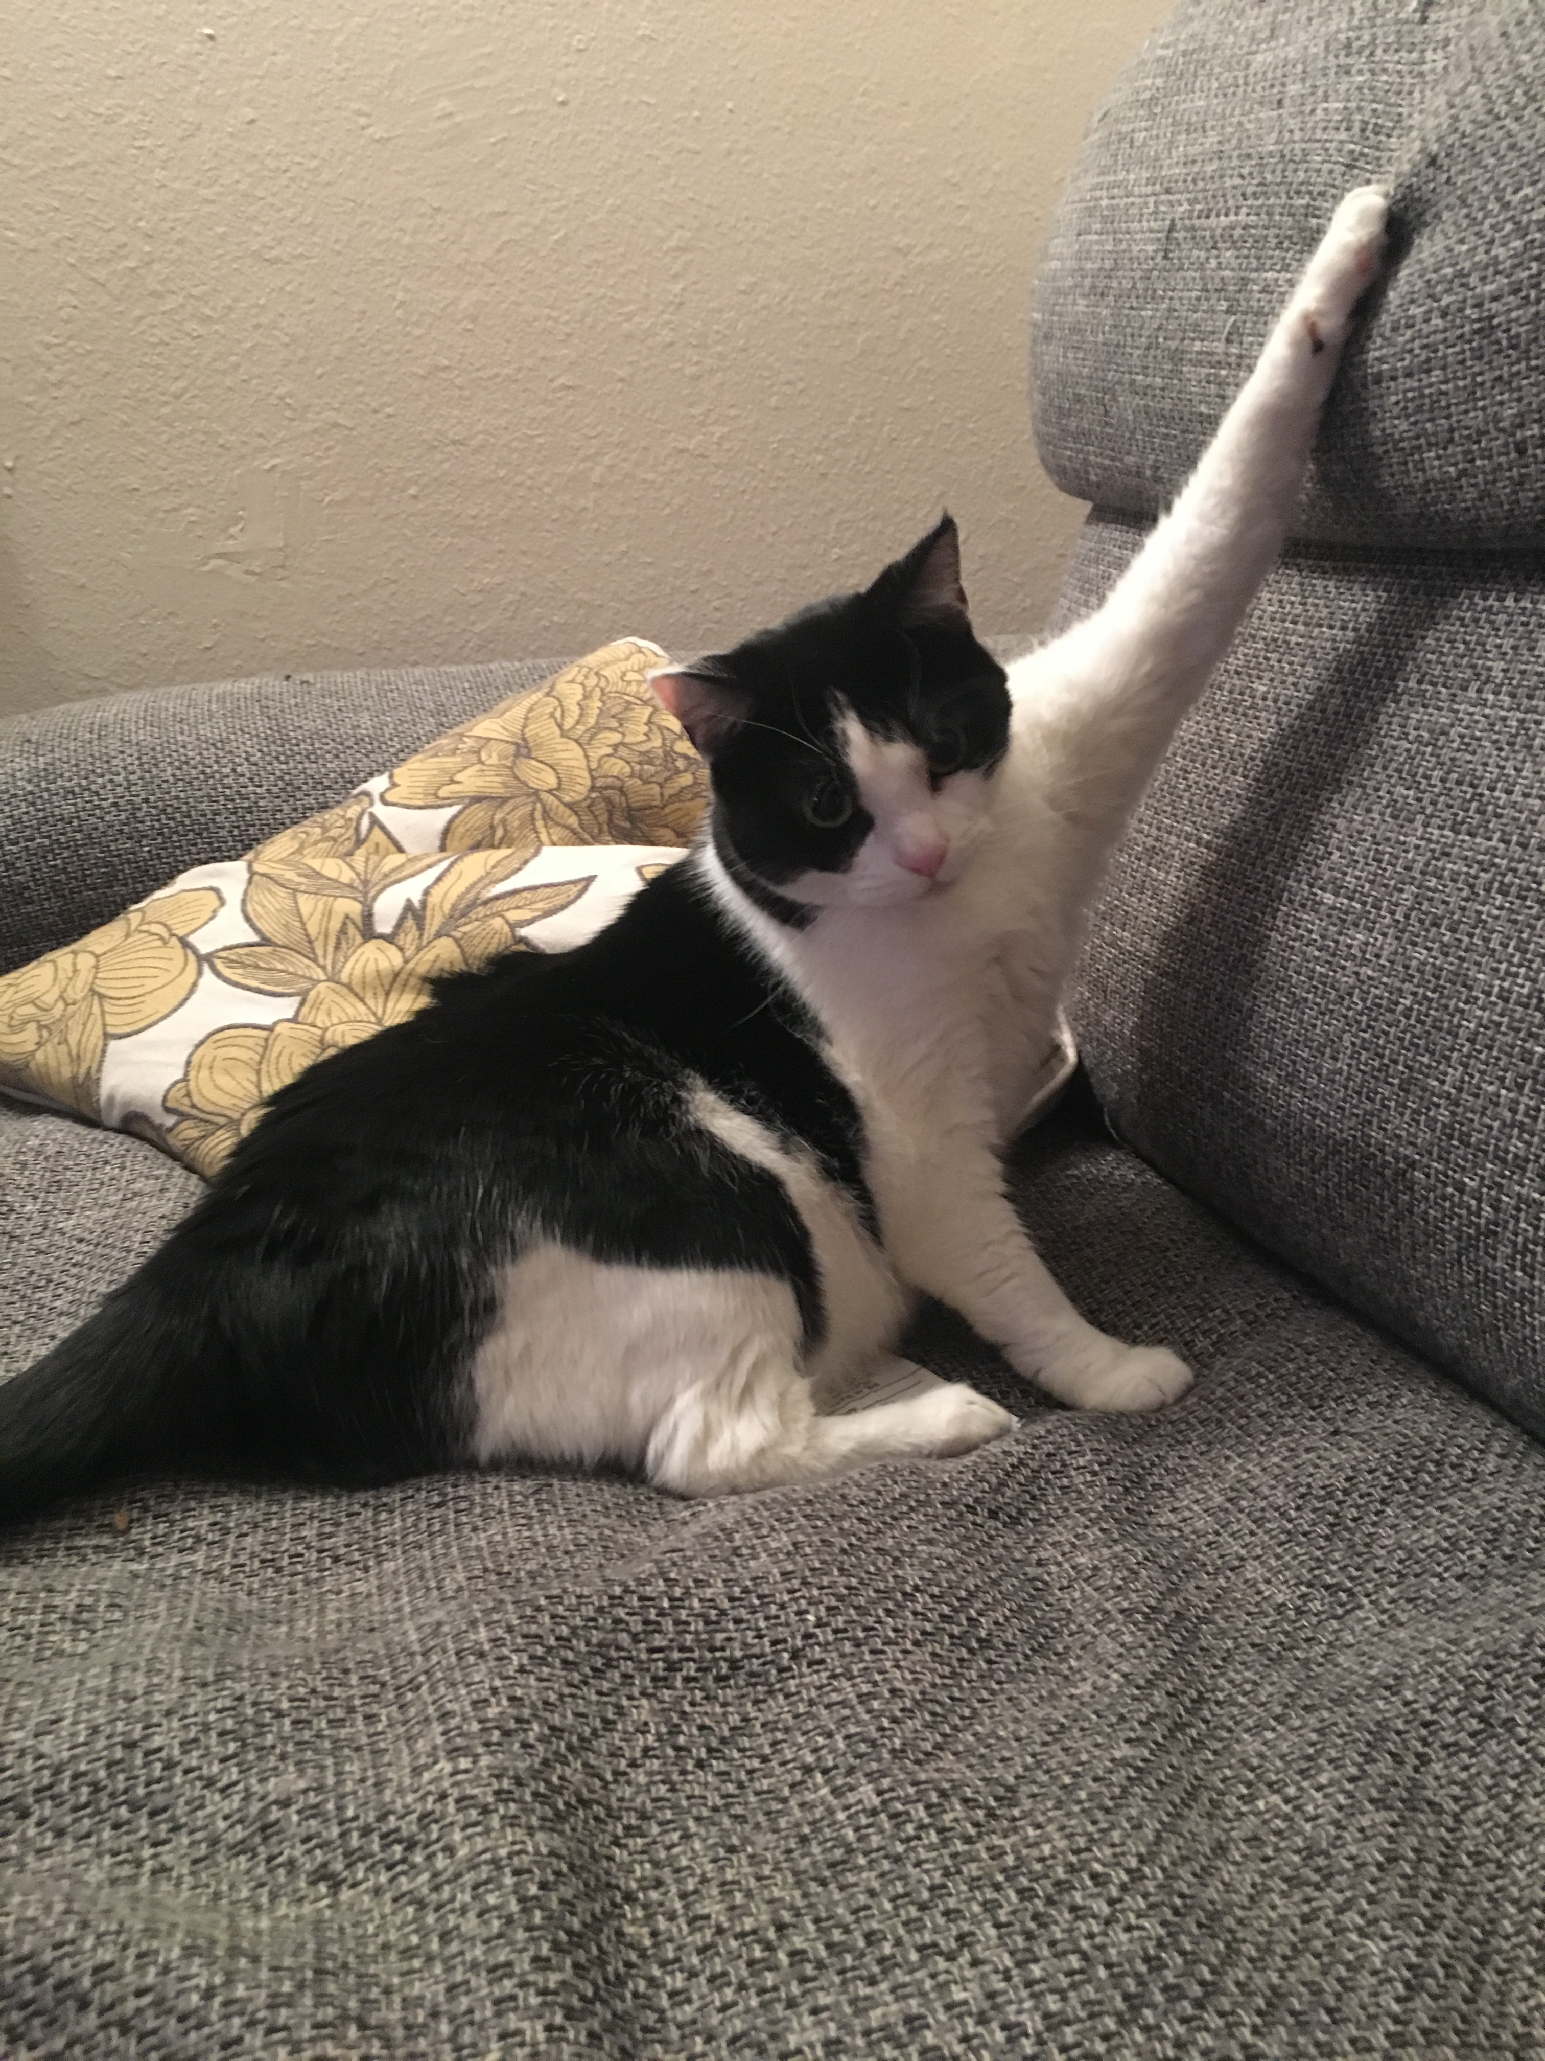
For next time…
I will open the final at 2pm today. You may take it at any time before December 7 at midnight.
If you want to have access to me for any questions during the exam, I will open a zoom link so that you can take it during our scheduled final exam time (December 7 from 11-1:30)
Finals tip from Casey “Hang in there!”
I’ll miss you all ☹

