Slide 1
RDG 1300 P07
To start class:
Cameras on!
Have access to your reading for today…
Tuesday, Nov. 30

Slide 2
Agenda
Metacognitive Reading Reflection Paper (Part 2) CHECK IN
Final Portfolio + Worktime
Getting ready for the final
My Mustache Notes

Slide 3
How was your weekend – Fall Break Check-in

Slide 4
What’s coming up
Metacognitive Reading Reflection (Part 2) due TODAY
Portfolio Project (we’ll work on this in-class) due Thursday, December 2nd
Final Exam – Wednesday, Dec. 7: 11-1:30
You may take it whenever you want, but that’s the time that I’ll be available for questions

Slide 5
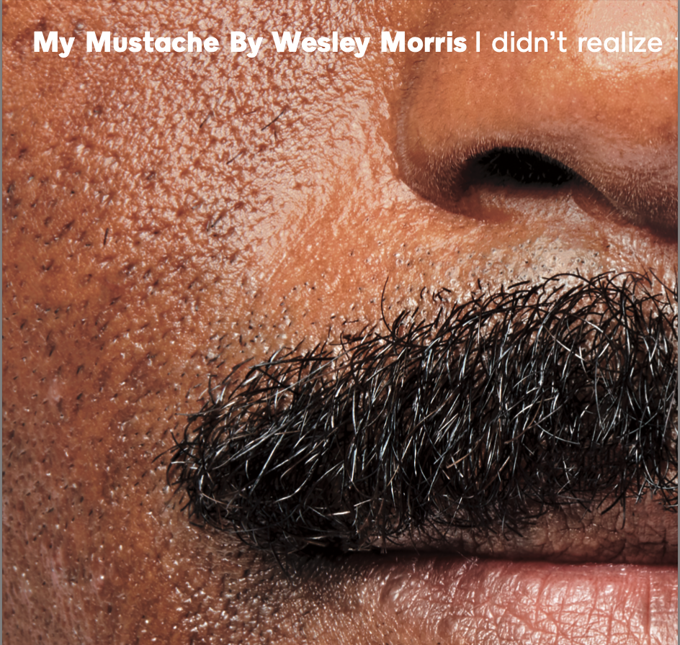
I promise, I planned on assigning this before I had a mustache

Slide 6
Prepping for the final – Class notes
On Canvas, find the link under today’s module, titled “My Mustache, Notes for the Final”
Each group will be assigned one slide to work on
Add to your slide by using textboxes. Click the icon shown below to add a text box
Update your slides with your group – once you’re finished, read your classmate’s slides and make an attempt at creating a summary

Slide 7
Strategy Use Portfolio Project
Purpose
The purpose of this assignment is to collect examples of work that you've done this semester that exemplifies your mastery of certain reading strategies or skills and demonstrates your achievement of the course's learning outcomes.

Slide 8
Strategy Use Portfolio Project
Brief Summary
Part 1 – Introductory paragraph.
Part 2 – Inclusion of at least 6 assignments that you’ve completed for this class.
Part 3 – A brief reflection on each assignment that you include
(i.e. – why is this assignment a good example of your work?
Extra – images of annotations, notes, cats, etc.

Slide 9
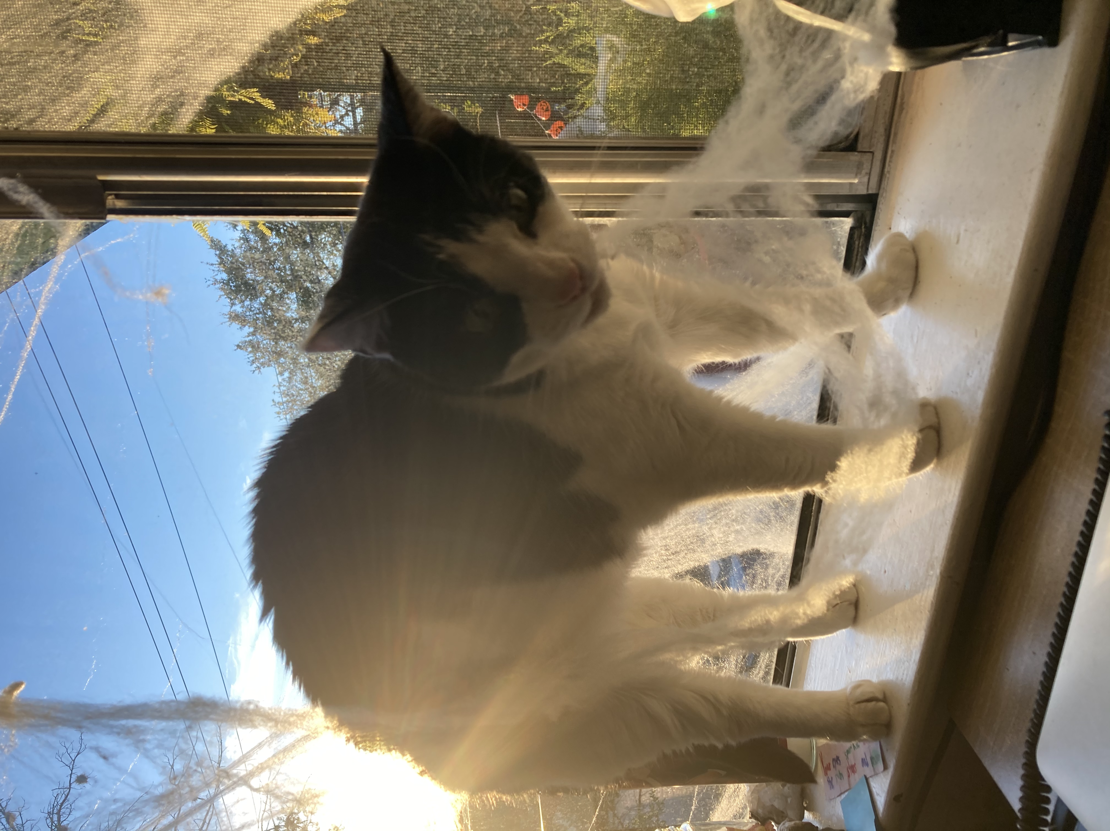
Strategy Use Portfolio Part 1
Introduce your portfolio through a short introductory paragraph.
Provide a thesis statement that guides your reader’s viewing of the portfolio.
What do you want them to take away from learning about your learning this semester? How will developing these skills help you achieve your college or career goals? How have you used these skills outside of RDG1300 or ENG1310/20?

Slide 10
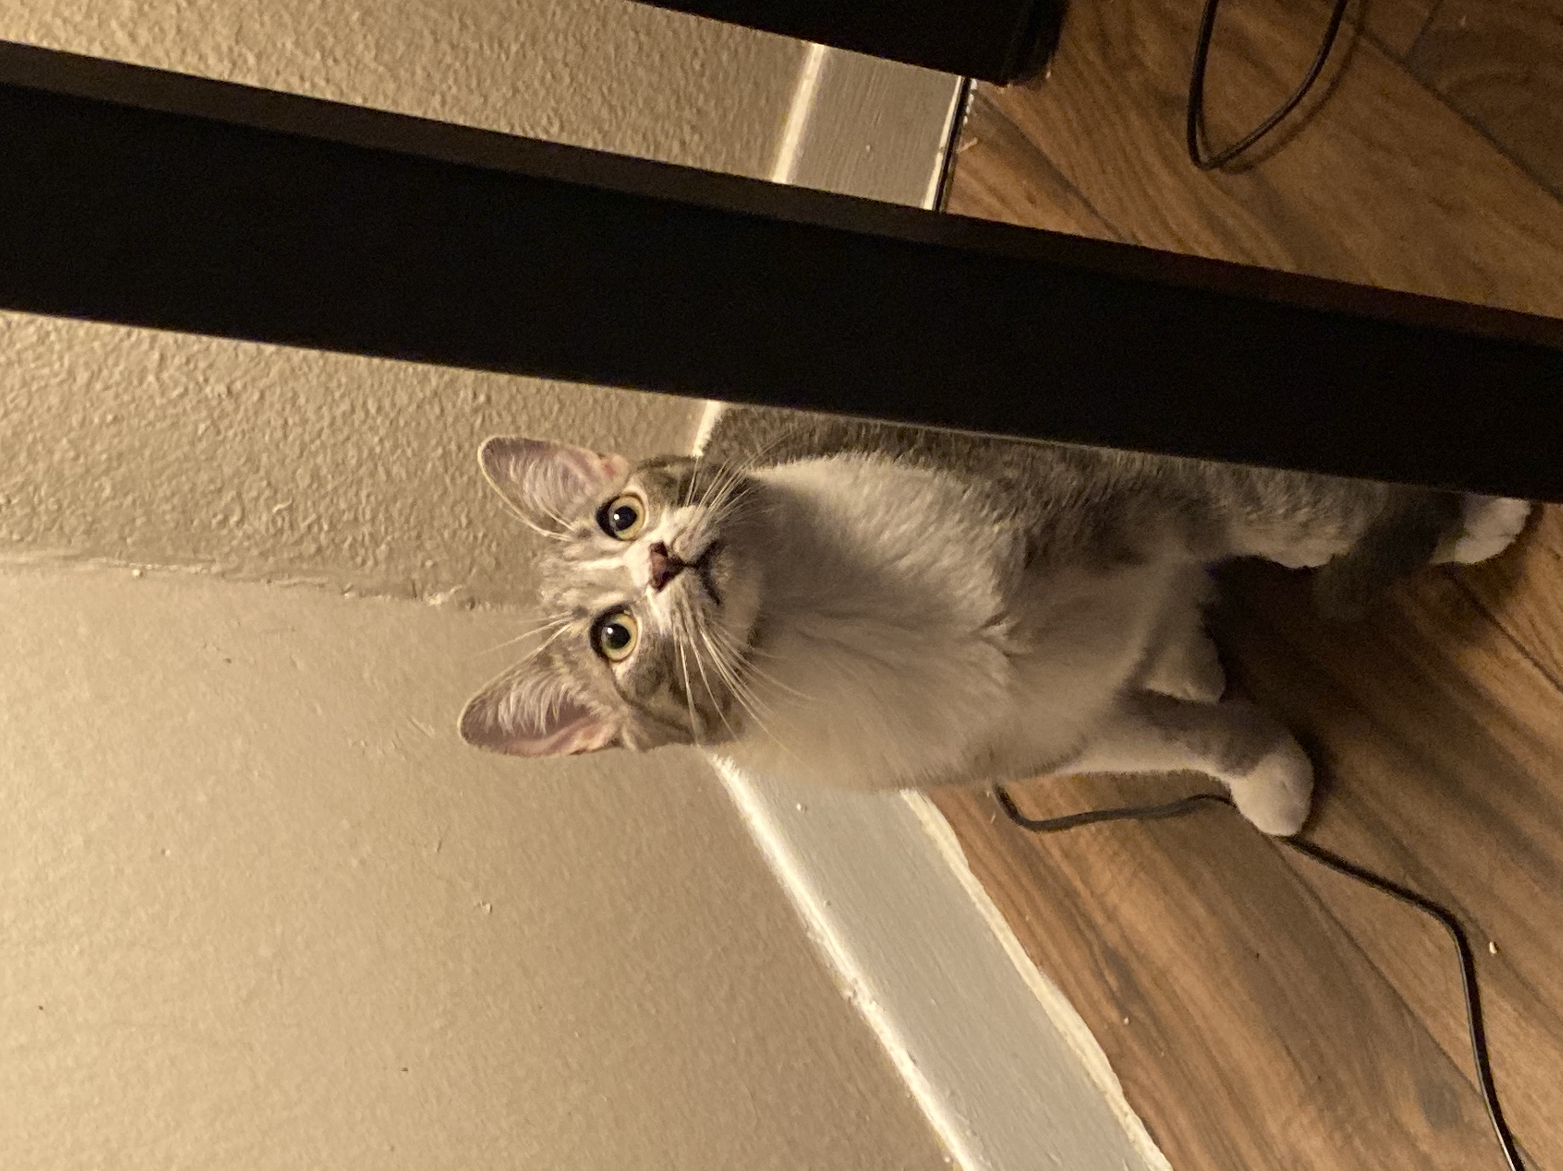
Strategy Use Portfolio Part 2
Provide evidence of your skill development by including 6 assignments that you've completed for me this semester.
You should choose assignments that you feel particularly proud of, or assignments that helped you better achieve one of our course outcomes

Slide 11
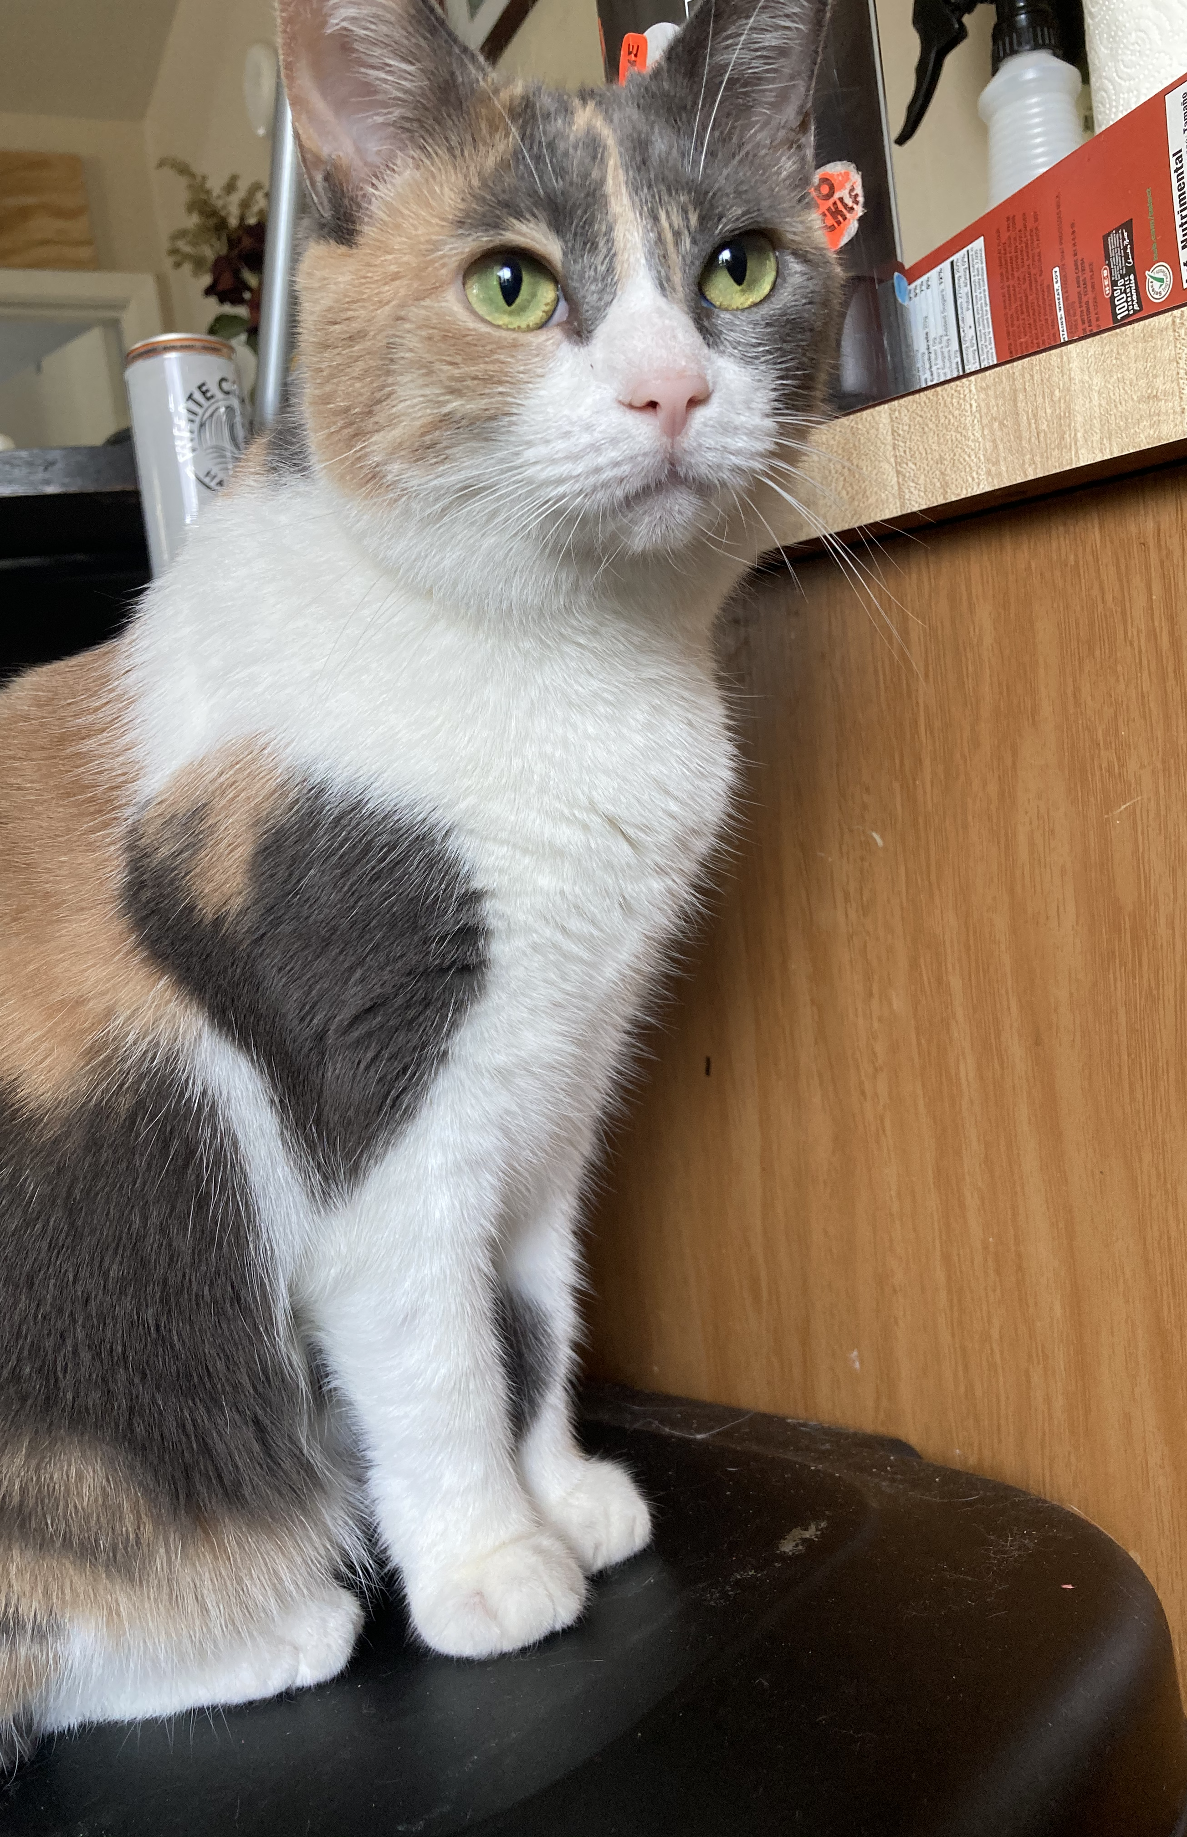
For each assignment that you include…
For each assignment that you include, you should write 2-3 sentences about why you included it.
For this portion, you could also include images. For example, I might decide to include an image of my annotations to help me describe how I found the author’s purpose from when I read my Peer Paper in order to demonstrate my ability to identify purpose and intended audience.
Using images as well as words will help you understand what the skill is that you've mastered and frame your reflection of the importance of that skill.

Slide 12
Assignments that you may include
Diagnostic/midterm Exam Responses
Any reading log (may use multiple reading logs)
In-class activities or discussions
Metacognitive reading reflection paper
Text Review
Peer Response Paper
Critical Reaction Paper
Any individual annotations or notes from your readings
If you want to include something that isn’t on this list, let me know! I’ll probably say yes!

Slide 13
Our course learning outcomes
Apply active reading strategies | This refers to all of the reading strategies that we discussed this semester (i.e. annotating, summarizing, finding main arguments) Assignments Metacognitive Reading Reflection (part 1 and 2), Text Review, Midterm/diagnostic exam, MARSI/T-SEF scales, reading logs
Identify purpose, audience; apply knowledge of purpose, audience and message across a variety of texts as a text producer | This refers to your ability to respond to readings by understanding what an author is trying to say (their main argument/purpose for writing). Assignments Critical Reaction paper, reading logs
Recognize hierarchical and relational rhetorical structures/organizational patterns | This refers to your ability to notice different text features (like margin info, graphs, pictures, etc.) and use these features to assist your reading. Assignments Text Review, reading logs
Demonstrate appropriate vocabulary usage across multimodal, multidisciplinary texts | This refers to your ability to notice/recognize difficult terms and/or concepts that were present in readings and to use strategies to assist your understanding of them. Assignments Metacognitive Reading Reflection Paper, Reading Logs, Text Review
Make inferences and evaluate texts for author assumptions and the validity of claims within and across texts | This refers to your ability to notice/recognize things like logical fallacies or bias in academic texts Assignments Critical reaction, peer response, reading logs

Slide 14
Our Course Learning Outcomes (continued)
Identify and evaluate the relevance and quality of ideas in multiple modalities; develop rhetorically sound arguments by applying multiple supports for a claim and selecting appropriate language | This refers to your ability to notice claims/arguments that authors are making and your ability to respond to those claims/arguments with your own ideas. Assignments Reading Logs, Critical Reaction, Peer Response
Develop and use effective drafting and revision strategies to strengthen college-level writing in multiple modalities | This refers to your ability to revise/draft your essays and collaborate with your peers to improve the quality of your work Assignments Critical Reaction, Peer Response
Recognize and apply conventions of academic English in reading and writing, including appropriately incorporate the ideas and words of others | This refers your ability to be able to use/recognize the type of writing style(s) that college instructors expect from you. BTW, super uncomfortable with this whole learning outcome, but there you are. Assignments All assignments
Demonstrate growth in metacognitive and self-regulatory processes | Metacognition means “thinking about thinking.” Pretty much everything we did in this class was mean to help you become more aware of how you learn in an academic context. I especially wanted these assignments to help you realize that we all have things to learn about how we learn (harr harr). Assignments Reading Logs, Metacognitive Reading Reflection Paper (part 1 and 2), Strategy-use portfolio

Slide 15
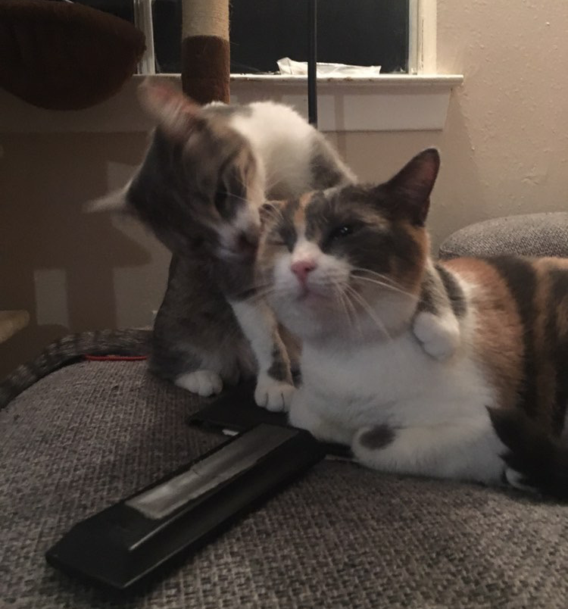
In-Class Worktime
Please spend the rest of the class period either
Putting together your final portfolio
Reading/annotating “My Mustache” for the final exam
Writing a poem about your favorite photo of James’ cats

Slide 16
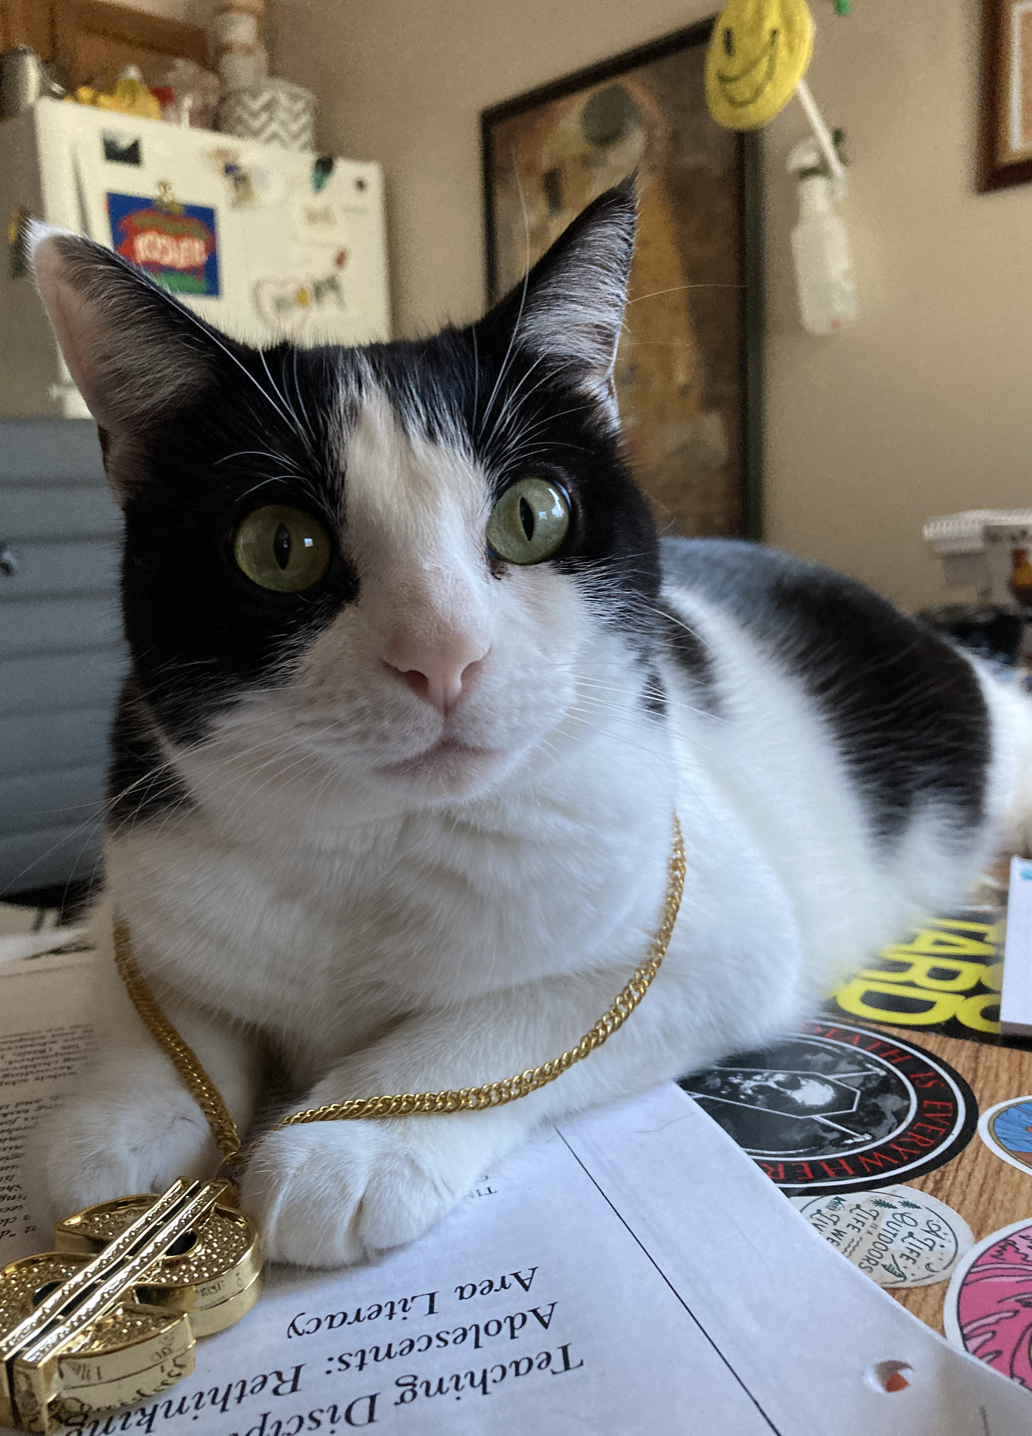
Course Evaluation
Have you all received an email about this?

Slide 17
For next time…
Finish Portfolio
Finish annotations for “My Mustache”
Get caught up on any missing assignments!

