Slide 1
RDG 1300 P07
To start class:
Cameras on!
Monday, Nov. 22

Slide 2
Agenda
MARSI (round 2)
Metacognitive Reading Reflection Paper #2
Getting ready for the final

Slide 3
How was last class?

Slide 4
What I skipped class to go do…
Presentation 1 – Classroom rosters
Presentation 2 – Textbook reading strategies

Slide 5
Class Rosters as an “Unexpected” Site of Contention
Notes:
Exp as an instructor
My usual approach to rosters was – students inform me of preferred names, nicknames, pronouns, during their introductions
Didn’t realize the ways in which institutional gender ideologies force students to be their own advocates in places where they don’t possess a lot of symbolic power
Students during SG meeting asking student leadership to advocate for easier institutional pathways to change their names
In my class, I was a proponent of this ideology through my approach to my class roster
”unexpected” for me as an instructor

Slide 6
Discussion
When you are enrolled in classes, how do you change your personal information on the class roster?
What power do you, as students, have over this information?
Notes:
For me, I have access to things like:
Legal first/last name
“preferred” name
Email/student ID number
Major
Pronouns, though very few students actually chose to enter in something here

Slide 7
Class Rosters as an “expected” source of anxiety
The dread surrounding daily roll call may include
Risk of being “outed”
Being made to feel like a nuisance
Outright hostility/disrespect
Sharing a gender identity may put students in a position of extreme vulnerability(Seelman, 2019)

Slide 8
Actually Using Textbook Reading Strategies: A T-SEF Scale Instructor Guide
Dyer, J., Lollar, J., Taylor, M. Z., & Regalado, Y. M.
This Photo by Unknown author is licensed under CC BY.
Notes:
James

Slide 9
T-SEF Scale Components
Textbook Reading Skills
A list of textbook reading skills that are applicable to college reading contexts
Self-efficacy
A way to measure students’ confidence in their ability to use a particular textbook reading skill
Frequency
How often students use the particular skill listed

Slide 10
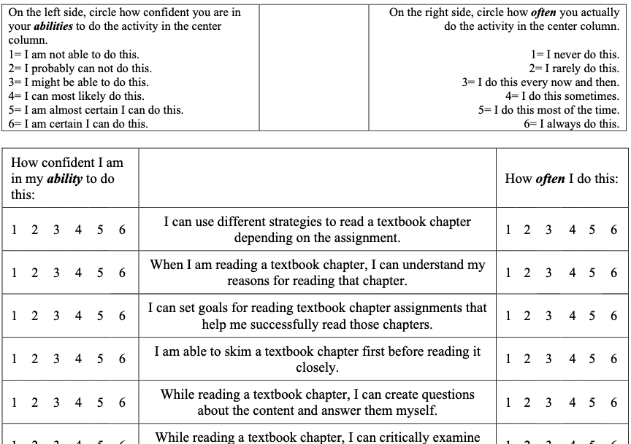
The Scale
Recognizing that students may be confident in using a skill could mean little if they do not actually use the skill.

Slide 11
What’s coming up
Metacognitive Reading Reflection (Part 2) due Tuesday, November 30
Portfolio Project (we’ll work on this in-class) due Thursday, December 2nd
Final Exam – Tuesday, Dec. 7: 11-1:30

Slide 12
Expansion #4 (It’s the last one, I promise)

Slide 13
Metacognitive Reading Reflection Paper (Part 2)
Purpose:
To reflect on how your reading approach has (or hasn’t) changed throughout the semester.

Slide 14
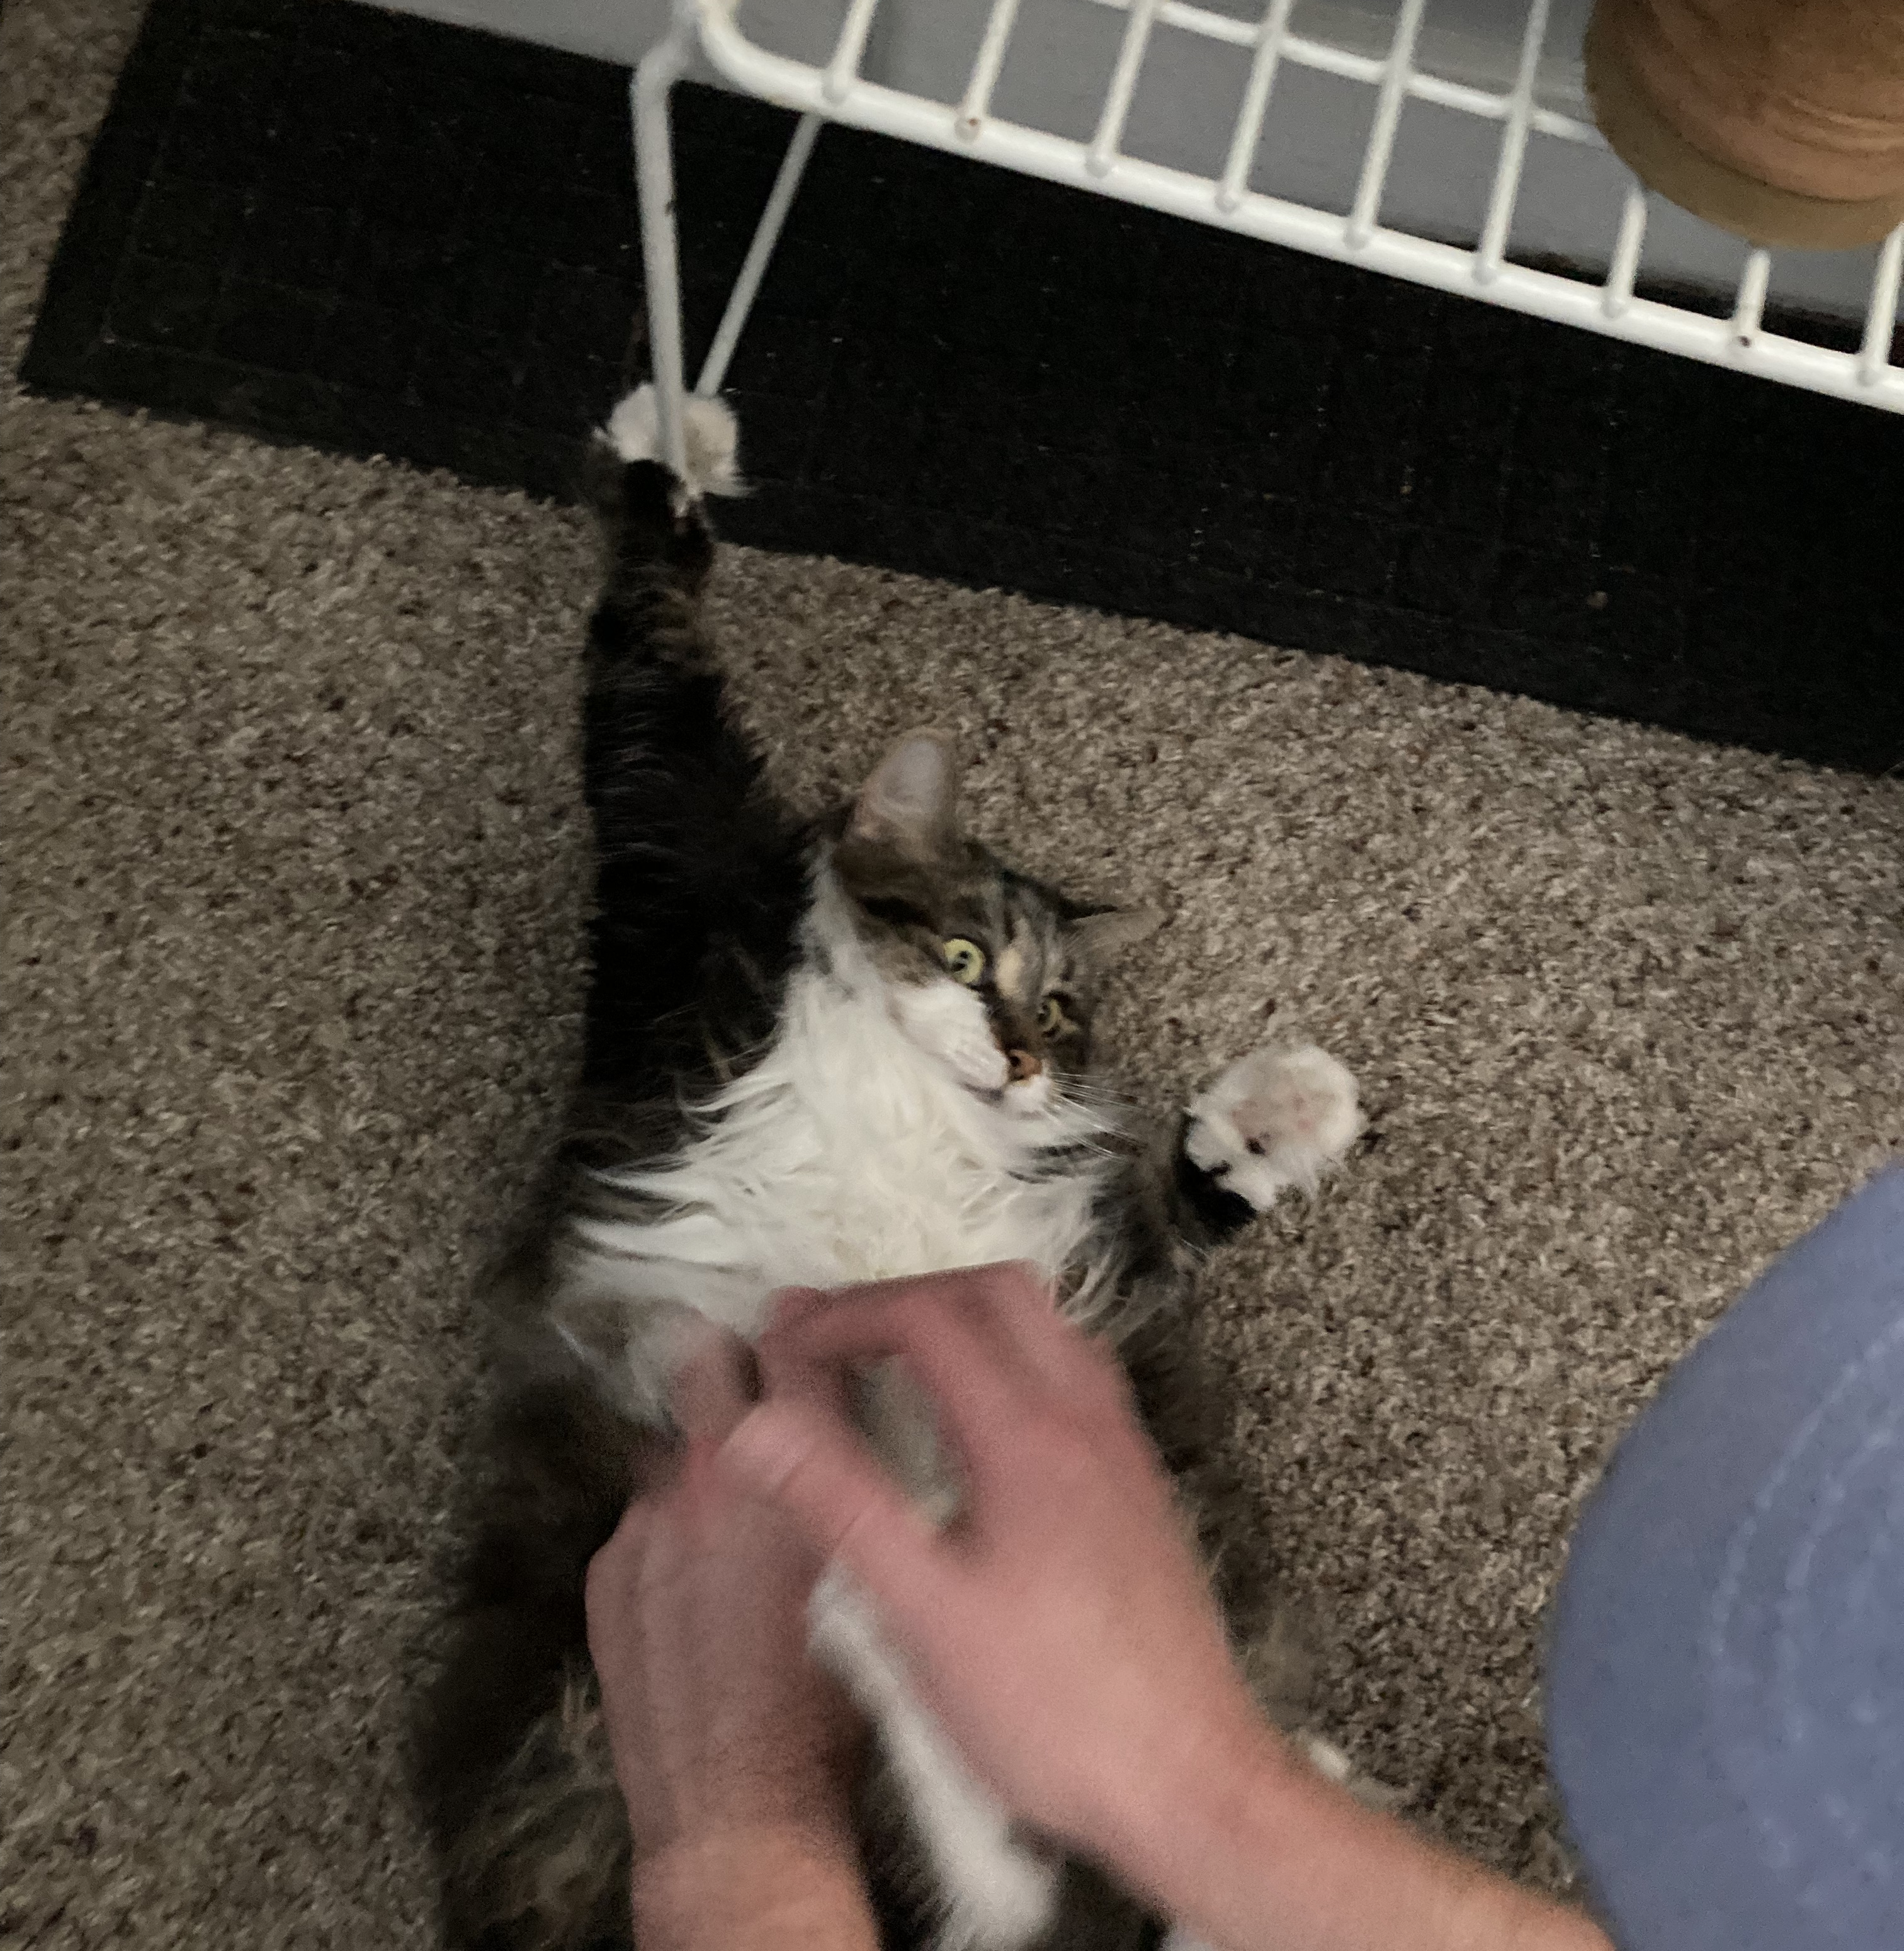
How I interpret my MARSI
High Score?
I use a lot of support strategies, like taking a ton of notes, circling content, annotating, and usually I write up a summary at the end of a reading
I need to work on global reading strategies. Often I don’t really prepare myself for a reading by previewing or skimming the text to find out what’s coming.
I also need to work on problem solving strategies, though perhaps not as much.
Honest Score

Slide 15
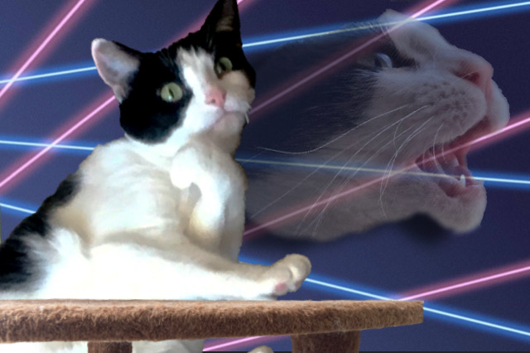
How I reflected on my own MARSI scores
Throughout my semesters as a doctoral student I’ve focused a lot on my purpose for reading things (GLOB – Question 1), particularly whether or not a research article actually reflects my purpose for reading that article (GLOB – Question 7
I’ve become much more focused on reading efficiently by paying close attention to sections of a text that are difficult (PROB – Question 16) and holding myself accountable for rereading sections that I don’t get (PROB – Question 27)
Honest Score

Slide 16
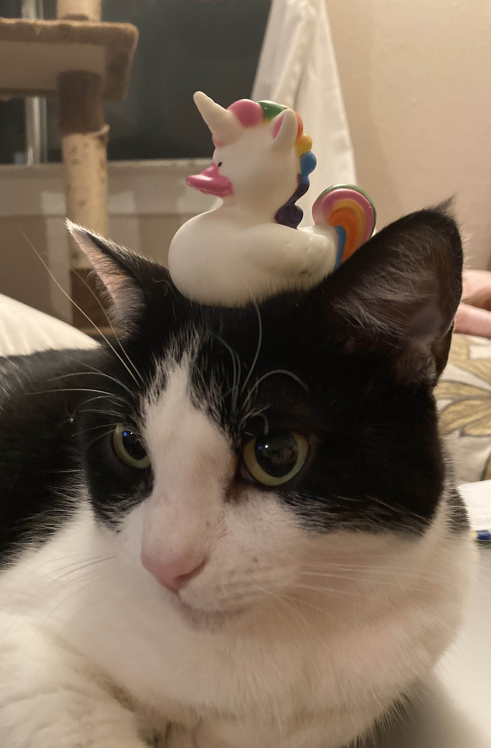
Partner Discussion
Review your submission for the Metacognitive Reading Reflection paper
Link to the assignment is in today’s module
Once you’ve done this, talk about your paper with your partner.
What is your overall reading approach?
Where were your strengths?
Where were your “growth edges”?

Slide 17
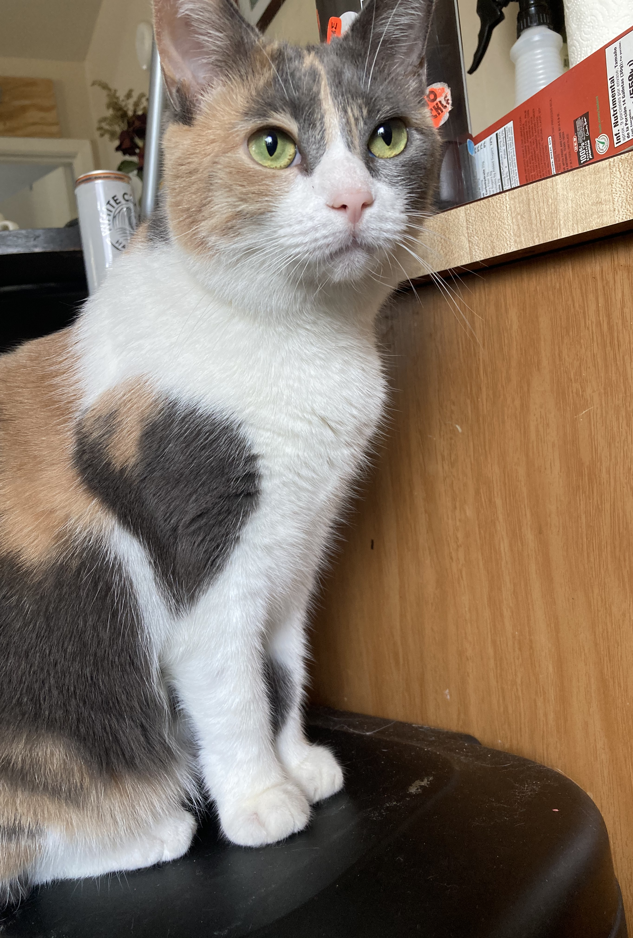
Metacognitive Reading Reflection (Part 2)
Step 1 - Complete the MARSI one more time…
Download the Microsoft word document from Canvas
Step 2 – Reread your first Metacognitive Reading Reflection Paper
I’ve posted a link under today’s module where you can review your previous submission
Step 3 – Download the Metacognitive Reading Reflection Paper Part 2 template
Fill in your scores
Complete the 5 reflection questions (minimum two sentence responses for each
Step 4 – When you’re done, submit the completed template and get 20 points (!!!)

Slide 18
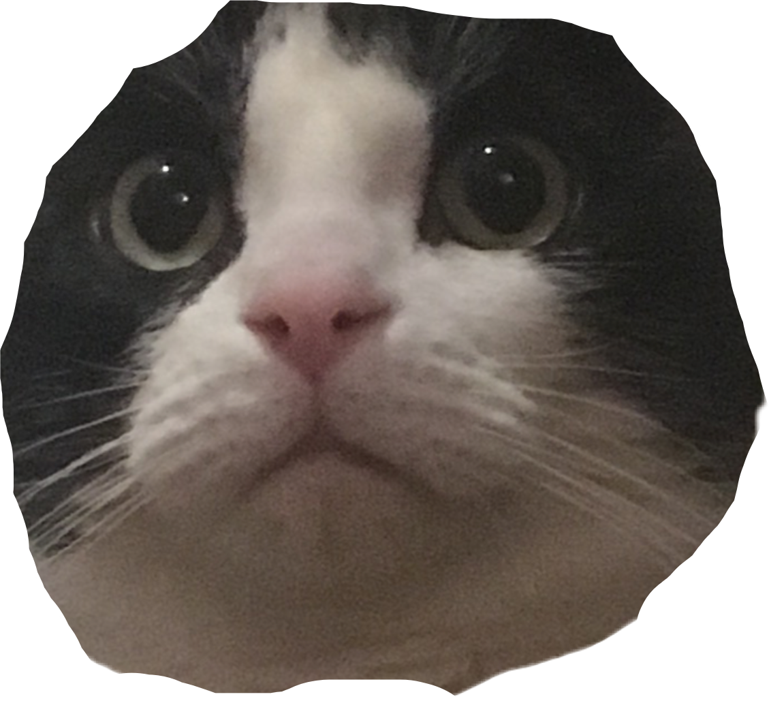
30 minutes on the clock
Right now you are…
Retaking the MARSI (if you haven’t already)
Reviewing your previous paper
Downloading the Metacognitive Reading Reflection Paper Part 2 template
Filling in your new scores
Answering the 5 reflection questions
Submitting (when you’re done)

Slide 19
Strategy Use Portfolio Project
Purpose
The purpose of this assignment is to collect examples of work that you've done this semester that exemplifies your mastery of certain reading strategies or skills and demonstrates your achievement of the course's learning outcomes.

Slide 20
Strategy Use Portfolio Project
Brief Summary
Part 1 – Introductory paragraph.
Part 2 – Inclusion of at least 6 assignments that you’ve completed for this class.
Part 3 – A brief reflection on each assignment that you include
(i.e. – why is this assignment a good example of your work?
Extra – images of annotations, notes, cats, etc.

Slide 21
Prepping for the Final
Reading: Wesley Morris “My Mustache”
Worth 50 points
5 questions (1 vocabulary in-context, 3 paragraph-length responses, 1 essay response

Slide 22
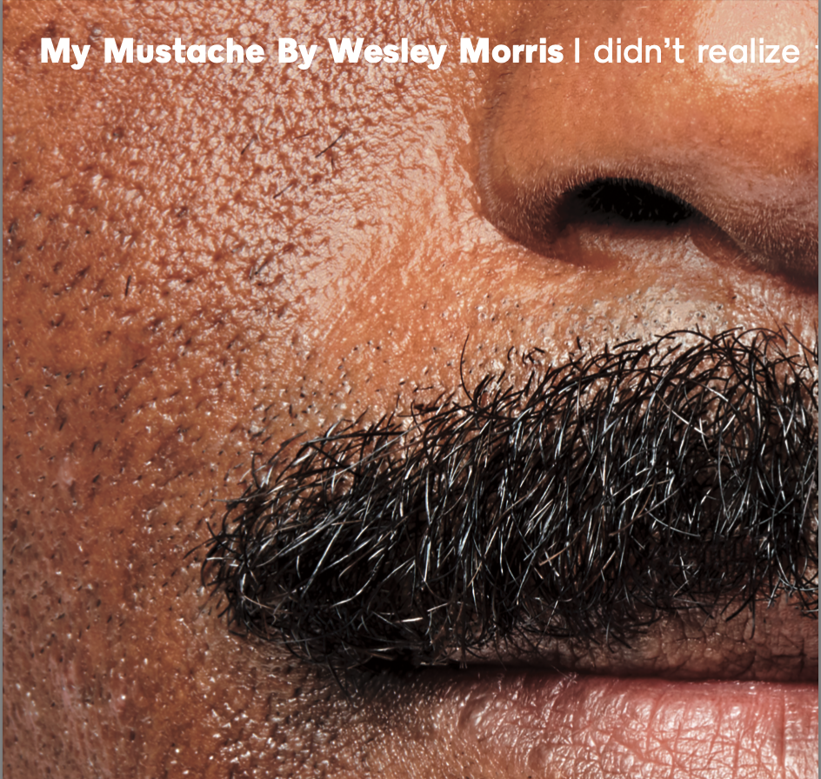
I promise, I planned on assigning this before I had a mustache

Slide 23
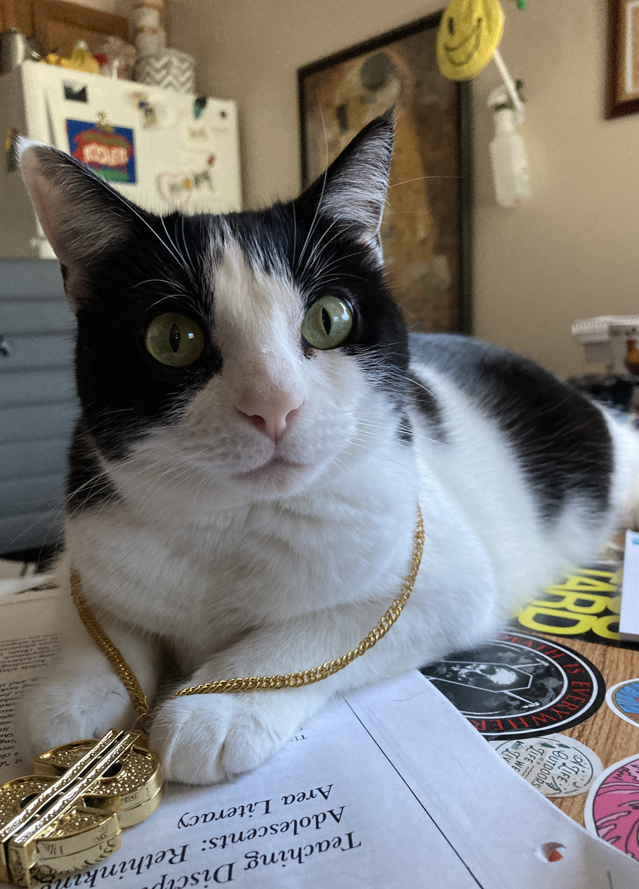
Course Evaluation
Have you all received an email about this?

Slide 24
For next time…
Get caught up on missing assignments (and I’ll do the same!)
Finish Metacognitive Reading Reflection (Part 2)
You should be mostly done!
If you haven’t yet, read Wesley Morris “My Mustache”
Have a happy Thanksgiving!

