Slide 1
RDG 1300-P07 Thursday, 11.11
For the start of class:
Have access to the source that you brought in for your critical reaction paper

Slide 3
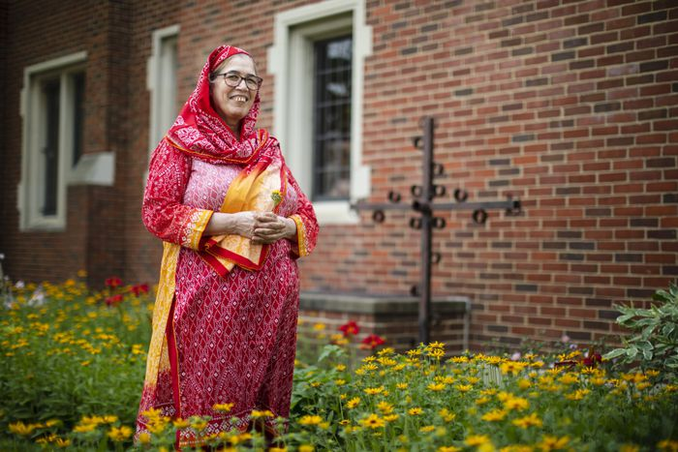
Narrative Analysis Tools
Perspective: whose perspective, view or side, is being shown in the article that you selected?

Slide 4
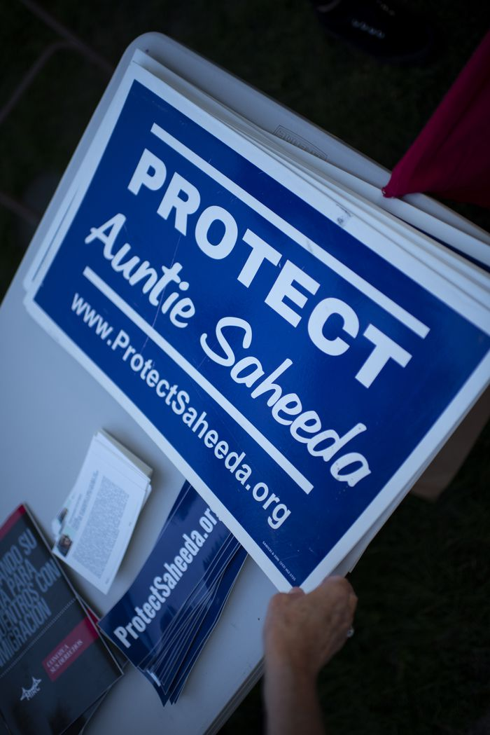
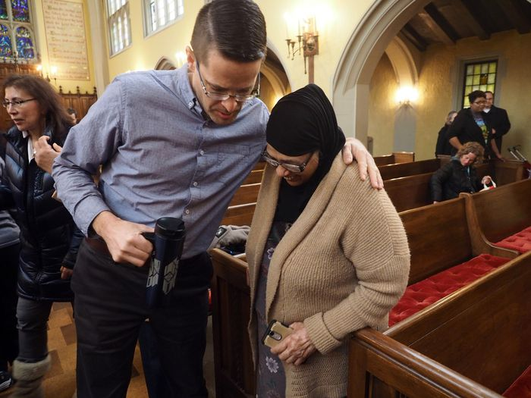
Narrative Analysis Tools
Character Development: How does the image/text try to connect the reader to the figures that are depicted?

Slide 5
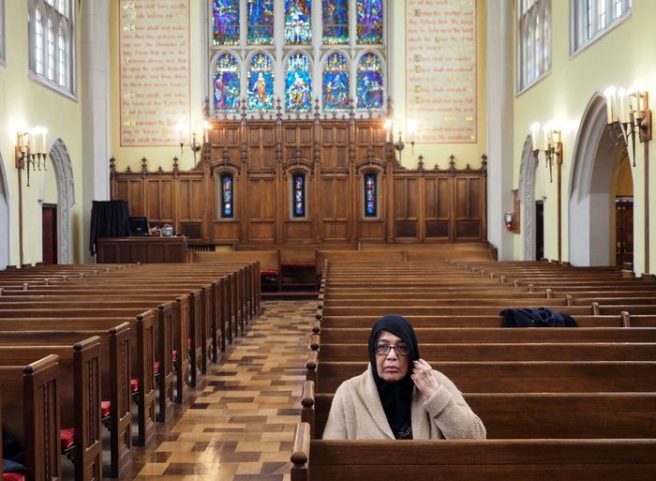
Narrative Analysis Tools
Omission: What’s left out of your image? Was this done purposefully, do you think?

Slide 6
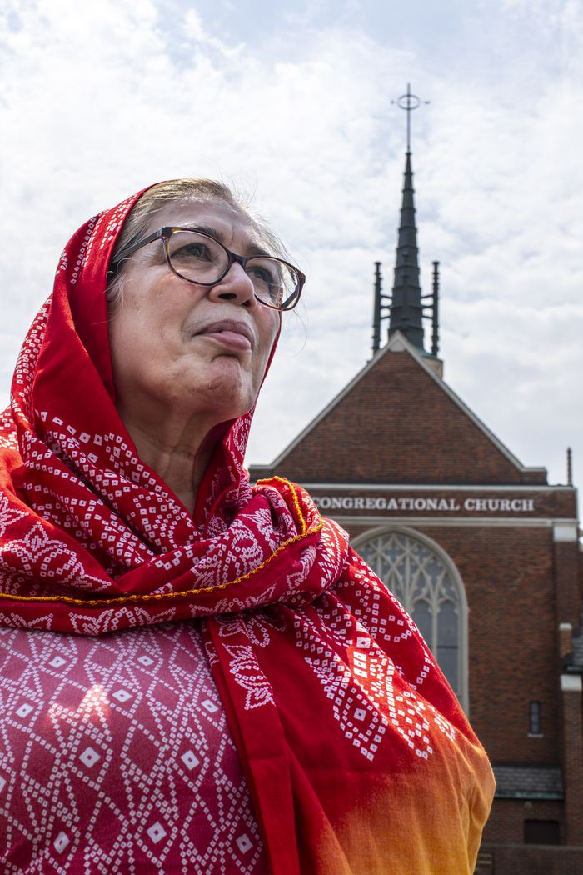
Narrative Analysis Tools
Cinematography: Describe how lighting, image composition or cropping is used to convey a certain message in the article that you’ve selected

Slide 7
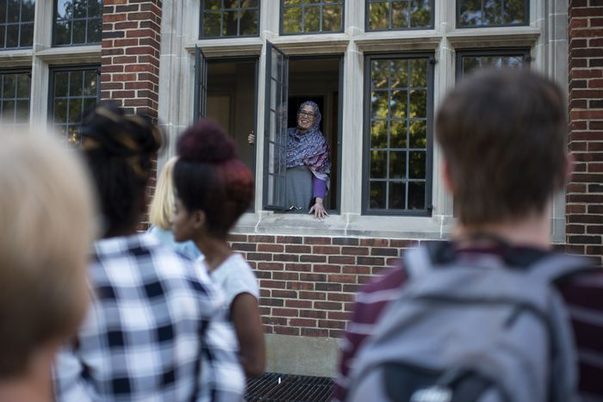
Narrative Analysis – Understanding Your Perspective
Distortion: Does your article distort the reality of an event or exhibit some sort of bias?
Decontextualization: does the article present an event or information without the context (surrounding information) That is necessary to fully understand it?

Slide 8
What is a bias?
Googled definition
“A preference or an inclination, especially one that inhibits impartial judgment”

Slide 9
“A preference or inclination” – where does this come from?
My personal experiences as an teacher
Working with former refugees in Cambodia
Working with refugees and immigrants (both documented and undocumented) in the US
Knowledge/experiences gained from my work as a researcher in adult education
My relationship to the politics/ideologies surrounding this issue

Slide 10
Understanding our Personal Biases
A narrative happens between the lines
Operates on shared assumptions or ”truths” held by an audience
Often much easier to spot if you’re not in the intended audience
And that’s by design!
How might my personal biases affect my ability to view this article critically?

Slide 11
What do we do about bias?
Our biases?
The biases of others?

Slide 12
In-Class Writing - Reflecting on Personal Biases
For your Critical Reaction Papers, I asked you to select a reading from this semester that you’d like to respond to.
In a short post, reflect on your own potential biases.
What are these biases, perspectives, or prior opinions regarding the reading you selected?
How do you think these biases might affect your response to this reading?

Slide 13
Getting GOING with your Critical Reaction
Second step: Which sources did you pick for this assignment?
What’s your overall approach?

Slide 14
Your goal
To reflect on ideas that are present in academic readings and form your own response to those ideas.
To make your own connections to outside texts (other articles, books, videos, tiktoks, etc.)

Slide 15
Critical Reaction Outline
For the rest of class, I want you all to get started on your critical reaction outlines (due next class)

Slide 16
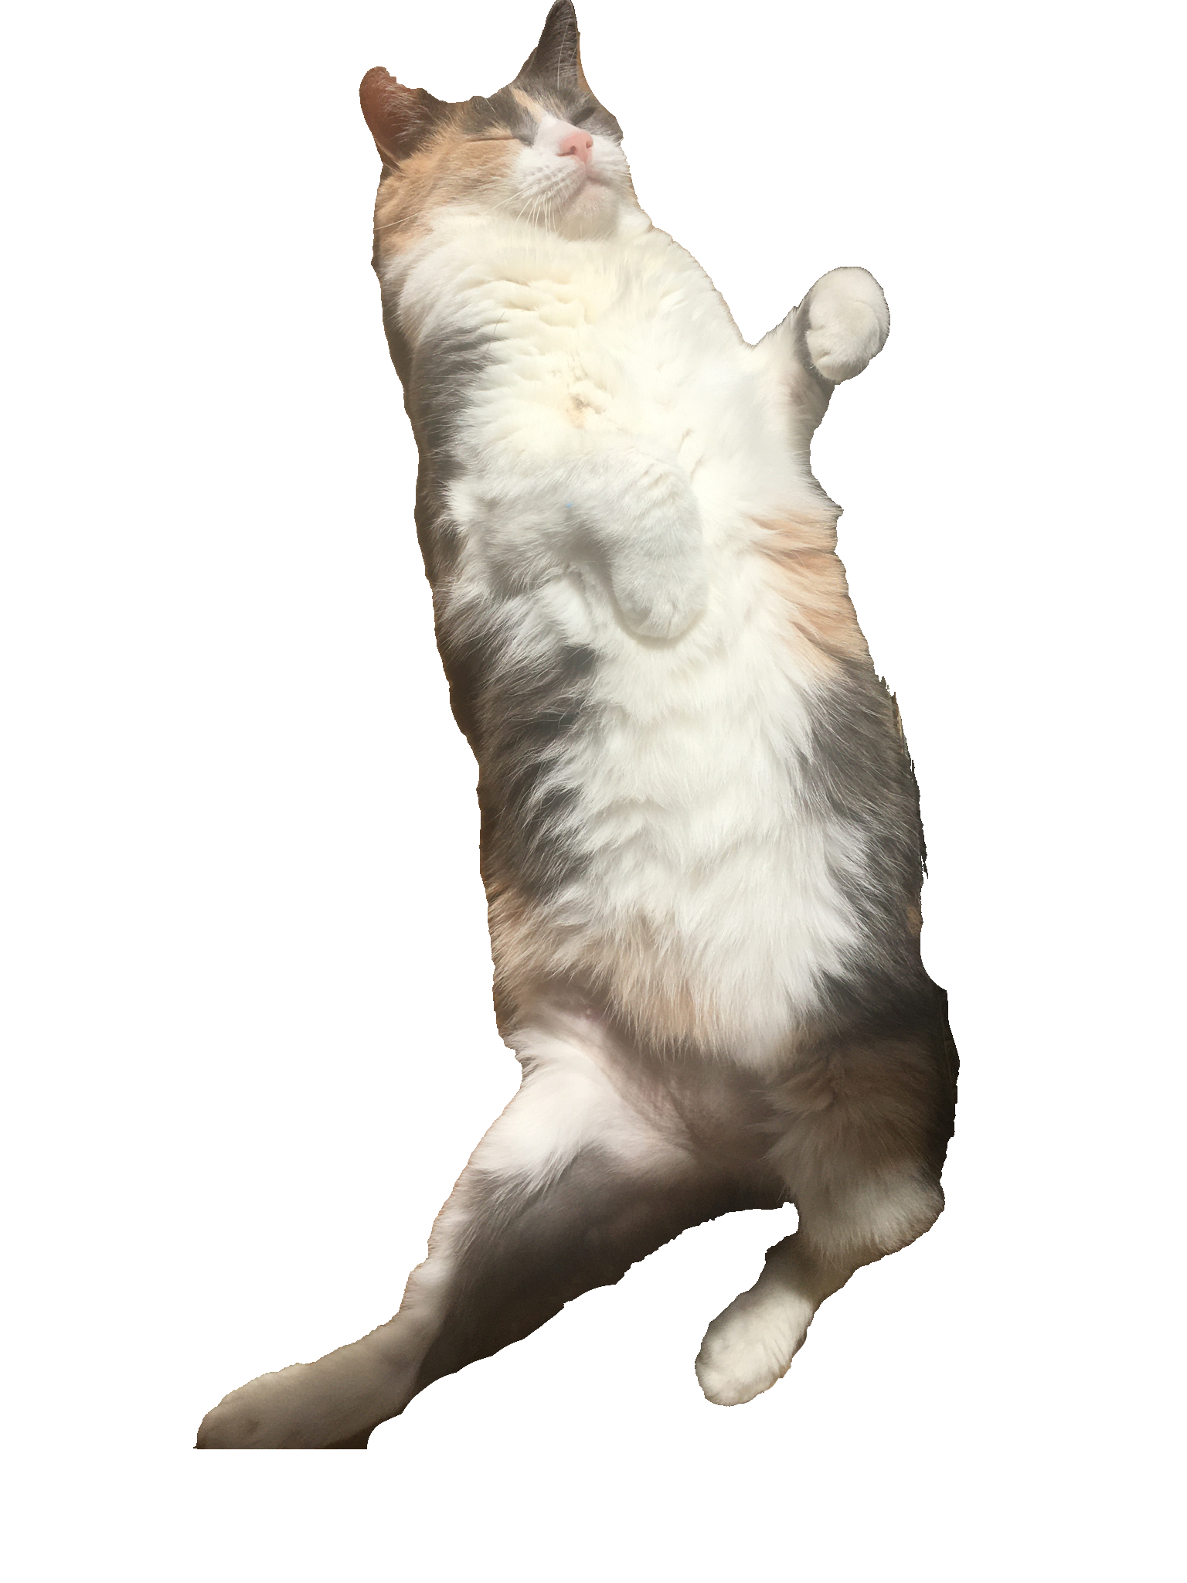
Extra Credit Assignment
Who would take advantage of this to:
Make up an absence?
Substitute for a Reading Log?
Anything else?

Slide 17
For next time
Complete Critical Reaction Outline
Find the template on Canvas:
Find at least 2/3 sources that you intend to use to make connections in your critical reaction paper.
* Note – I pushed back the rough draft. We’re now having it due next Thursday. Your final draft of the paper will be due the following week.

