Slide 1
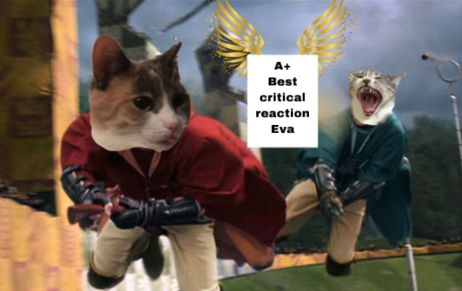
RDG 1300_P07
Tuesday, 11.09
For the start of class:
Have your computer’s open to Canvas
Start working on the in-class writing for today

Slide 2
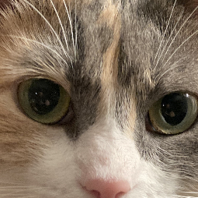
Agenda
Analyzing Logical Fallacies
Getting Started: Critical Reaction Paper

Slide 3
In-class Writing
What reading from our class do you intend to write about for your critical reaction paper?
Explain your decision. Why is this a reading that you’d like to revisit? What are some specific things that you would like to respond to from this reading?

Slide 4
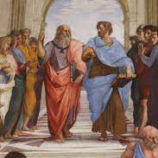
Discussion Question
What is a good argument?
What is a philosophical argument?
What is an academic argument?

Slide 5
Argument Example
Pineapples are delicious. Pizza is delicious. Pineapple pizza is delicious. Pineapple belongs on pizza.

Slide 6
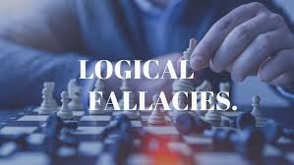
What are Logical Fallacies?
In academic/philosophical arguments, it's important that ideas/concepts/supporting details connect back to the thesis or premise of the argument
Logical fallacies are shortcuts that are sometimes employed to distract or distort this connection

Slide 7
Logical Fallacies – Ad Hominem
•Ad Hominem- Involves attacking the person who advances an argument as opposed to providing a rational critique of the argument itself

Slide 8
Logical Fallacies
•Ad Hominem (Two types)
Circumstantial ad hominem- Involves an attempt to discredit an argument or view by calling attention to the circumstances or situation of those who advance it
Tu quoque- An attempt to discredit an argument or view by suggesting that ones opponent is hypocritical

Slide 9
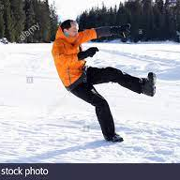
Logical Fallacies
Slippery Slope- an argument that suggests taking a minor action will lead to major and sometimes ludicrous consequences
https://www.youtube.com/watch?v=kIv3m2gMgUU

Slide 10
Logical Fallacies
Hasty Generalization
Making assumptions about a whole group or range of cases based on a sample that is inadequate (usually because it is atypical or too small). Stereotypes about people (“librarians are shy and smart,” “wealthy people are snobs,” etc.) are a common example of the principle underlying hasty generalization.
https://www.youtube.com/watch?v=7kuS2ScZnHQ

Slide 11
Logical Fallacies
False dilemma (false dichotomy)- Occurs when one uses a premise that unjustifiably reduces the number of alternatives to be considered
https://www.youtube.com/watch?v=Dln3DJEcghY

Slide 12
Logical Fallacies
Weak analogy- Many arguments rely on an analogy between two or more objects, ideas, or situations. If the two things that are being compared aren’t really alike in the relevant respects, the analogy is a weak one, and the argument that relies on it commits the fallacy of weak analogy.

Slide 14
Logical Fallacies
False Cause-A false cause fallacy occurs when someone incorrectly assumes a causal relationship between two things; the name of the fallacy is fairly literal. Any time someone thinks, “A causes B,” without a sufficient reason to believe that B is truly caused by A, it’s an example of the false cause fallacy.
https://www.youtube.com/watch?v=oIrobemb5jw

Slide 15
Logical Fallacies
Red Herring Fallacy- Occurs whenever the premises of an argument are logically unrelated to the conclusion
https://www.youtube.com/watch?v=f_ttbfTGs48

Slide 16
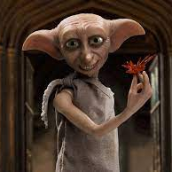
Logical Fallacies
•Begging the question- Occurs when an argument assumes the point to be proved
https://www.youtube.com/watch?v=OAVp6gnIgHY

Slide 17
Can you find the fallacies?
https://www.cc.com/video/5wvrhx/the-daily-show-with-jon-stewart-even-stevphen-death-tax

Slide 18
Analyzing Logical Fallacies in your Critical Reaction
Thesis
Logical fallacies can represent cracks in your argument
They affect how well your argument holds together under scrutiny
They also might be something to analyze in articles that you’re responding to for your critical reaction paper.
Supporting Details
Supporting Details
Ad Hominem
Supporting Details

Slide 19
Getting Started with your Critical Reaction
First step: Which readings did you pick for this assignment?

Slide 20
Searching for things to ”react” to…
For this assignment, you can react to
The “main argument” (check out our class session on finding “main ideas”)
Think also about any logical fallacies that might be present in the text
Different/alternative perspectives through text-to-text connections (!!!)
Visual/narrative elements that you may find
Think about our class on narrative analysis from last week!
Also your peer response assignments!
Reflect on how an article changed your opinion about a particular issue (text-to-self connections!)
This is an invitation to go out and find more information about a topic that interested you from our readings.

Slide 21
For example…
Your reaction could be to offer a different perspective to the Land-Grab University article. Using narrative analysis tools and text connections, you might form an argument that calls for Land-Grant universities to give back their unsold land to the indigenous tribes who initially owned them. You might pull in other articles/examples regarding indigenous issues in the US to support this overall argument.

Slide 22
For another example…
You might decide that you want to write a counterargument to ”Nah, We Straight” in which you argue that Codeswitching is not only not-racist, but a necessary instructional tool for helping students acculturate to an academic environment where standard English is already an established norm. You might point out logical fallacies in Vershawn Ashanti Young’s article and make text connections to other articles about that are mentioned by the author.

Slide 23
Your goal
To reflect on ideas that are present in academic readings and form your own response to those ideas.
To make your own connections to outside texts (other articles, books, videos, tiktoks, etc.)

Slide 24
For next time
Decide Critical reaction topic
Find one source related to your critical reaction reading (bring to class next time)

