Slide 1
RDG 1300_P06
Tuesday, 11.03
At the start of class
Have access to your reading “My Life as an Undocumented Immigrant”
Please take out something to take notes with

Slide 2
Coursework Checklist
Peer Response Paper submitted on Canvas
Read Jose Antonio Vargas “My Life as an Undocumented Immigrant”
Complete Reading Log #9

Slide 3
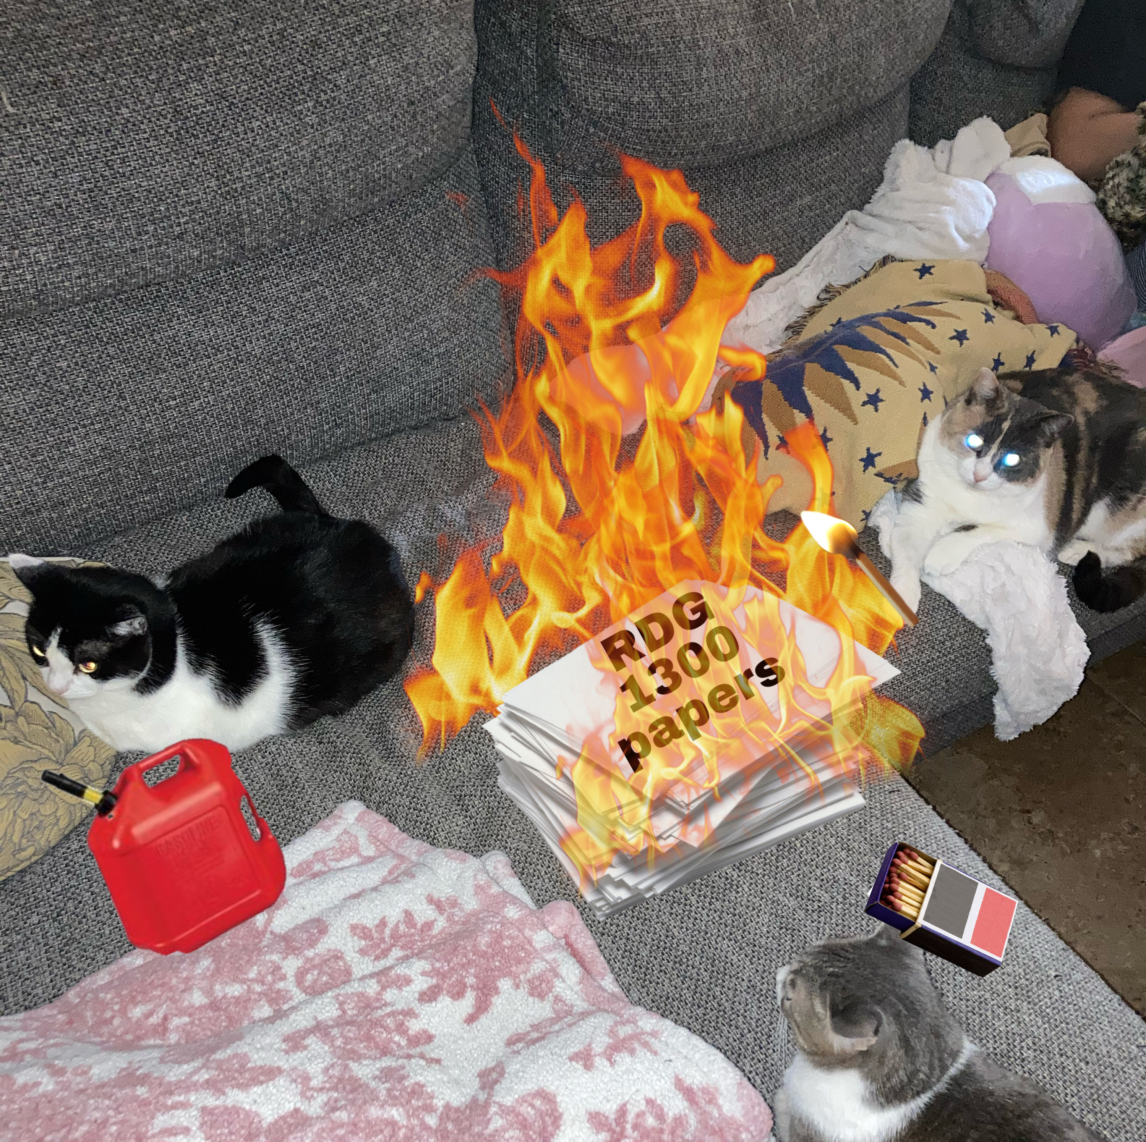
Agenda
Jose Vargas Article Discussion
Visual/Narrative Analysis
Introducing the Critical Reaction Essay
Why I haven’t graded your papers yet…

Slide 4
Legal Immigration
After watching the clip from last week tonight:
What are the pathways to legal immigration?
Which pathways to legal immigration are included in the Vargas article?

Slide 5
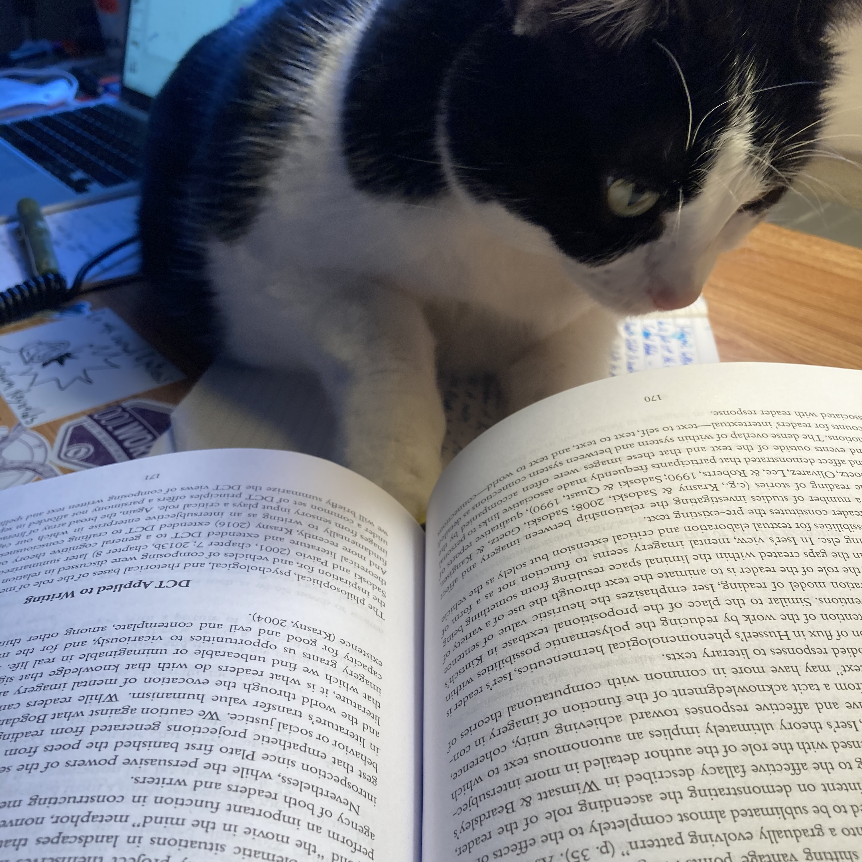
Reading images as texts
What can be considered a “text”?

Slide 6
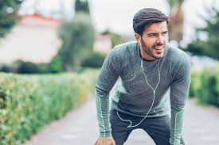
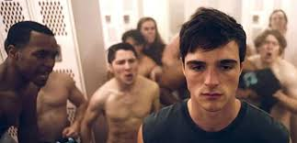
How do Images as Texts Normalize the Way We See the World?
What word(s) come to mind when you see these images?
These are, in order, the first three images which come up in a google image search of one word
Notes:
Men

Slide 7
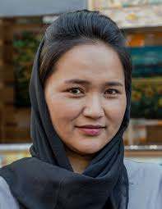
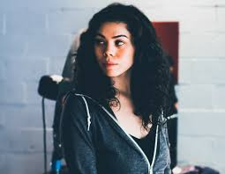
How do Images as Texts Normalize the Way We See the World?
What word(s) come to mind now?
These are, in order, the first six images which come up in a google scholar search of one word
Notes:
Women

Slide 8
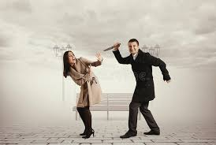
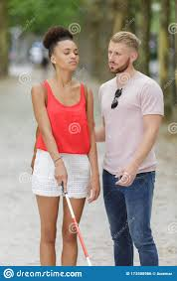
Using the Tools of Visual Narrative Analysis
Narrative analysis: a way to think about a story by focusing on the tools that the author/text producer uses to shape the way people read the story.
“He approached the woman”

Slide 9
How do these two images give different meaning to the sentence: “He approached the woman”?

Slide 10
What is a narrative?
A narrative happens between the lines
Operates on shared assumptions or ”truths” held by an audience
Often much easier to spot if you’re not in the intended audience
And that’s by design!

Slide 11
Images are Texts
Today, we’ll explore how text-producers use images to present and normalize representations of ”Immigrants” or “Immigration”

Slide 12
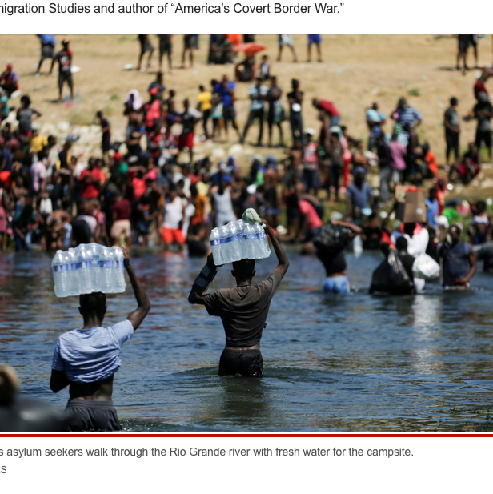
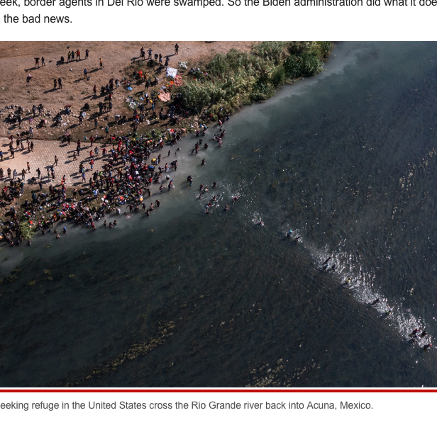
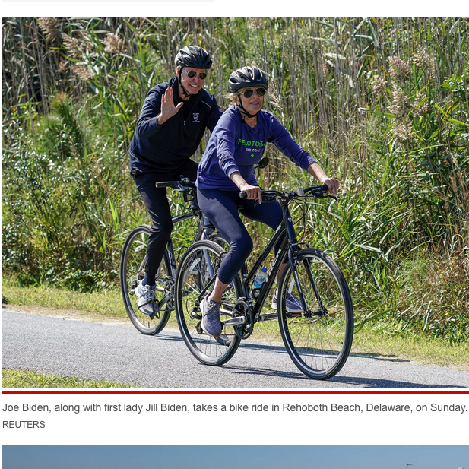
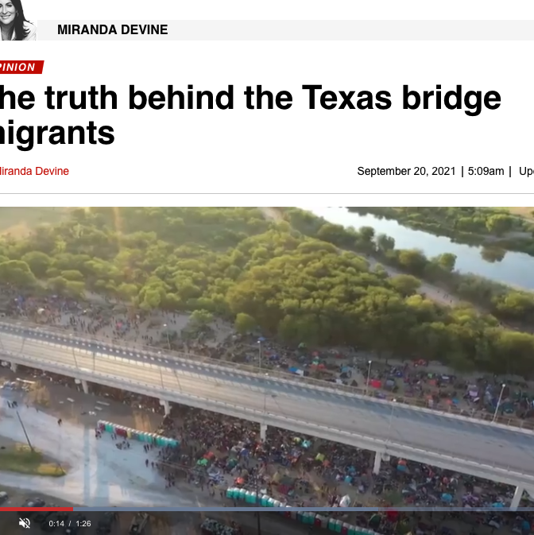
Images are Texts
These images are from a New York Post article on the recent increase in refugees coming from Haiti
What does this text say with its images?

Slide 13
Vargas Article
What kinds of images are present in the Vargas article?

Slide 14
Narrative Analysis Tools
Perspective: whose perspective, view or side, is being shown
Perhaps more importantly, whose is NOT being shown?

Slide 15
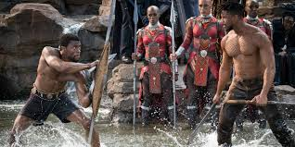
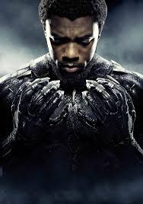
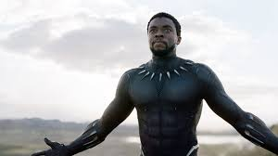
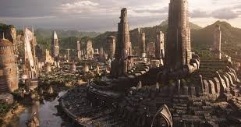
Narrative Analysis Tools
Character Development: ways that the audience becomes connected to the main character

Slide 16
Narrative Analysis Tools
Omission: when things are intentionally left absent from the narrative

Slide 17
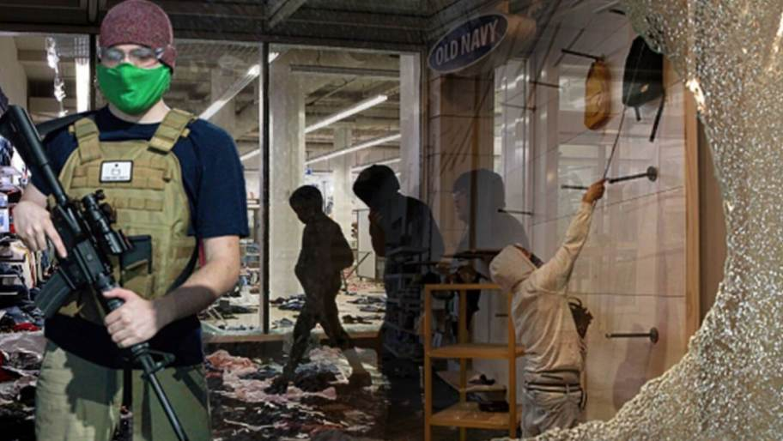
Narrative Analysis Tools
Distortion: when things are not accurately or objectively shared about events, places, or characters in the narrative

Slide 18
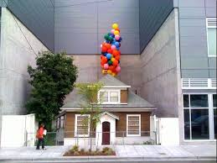
Narrative Analysis Tools
Decontextualization: presentation of an event, situation, or place which removes the context (surrounding information that is necessary to truly understand it)
“Home for Sale”

Slide 19
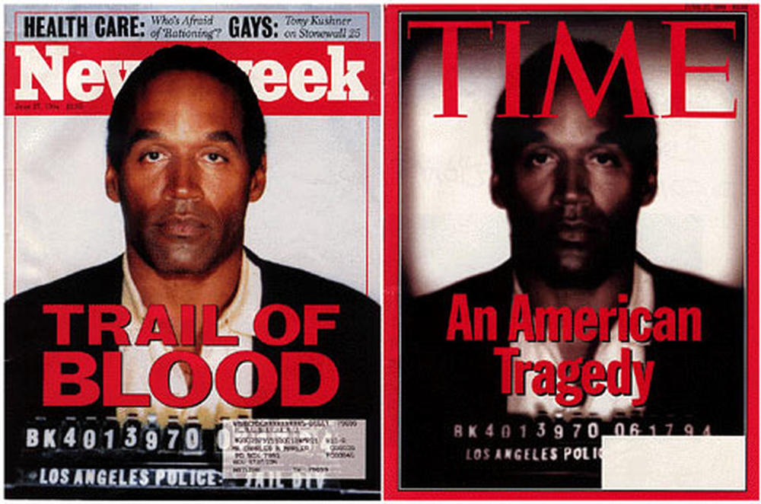
Narrative Analysis Tools
Cinematography: lighting, distance, gaze (where the actor/subject is looking), etc. which help convey a mood or message

Slide 20
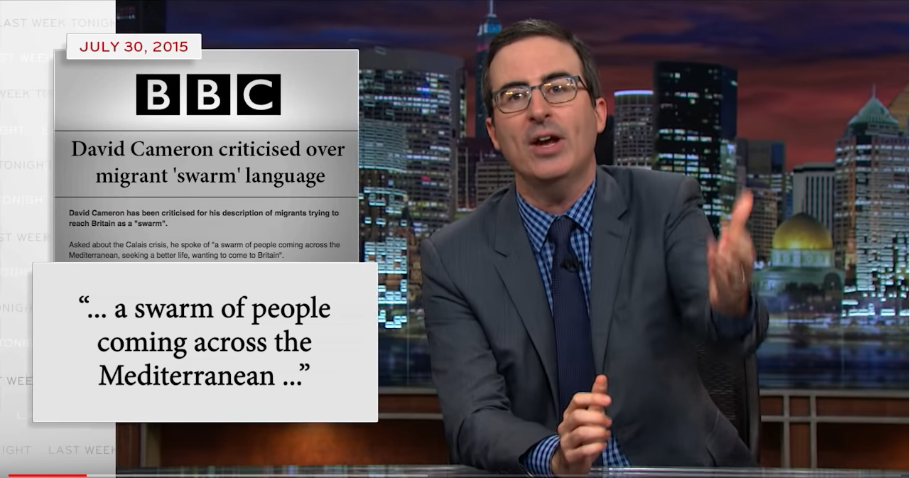
Reading Images from the Last Week Tonight
Review the clip from ”Last Week Tonight” and focus specifically on the news clips that the video makes fun of
How do these news clips present migrants and refugees?

Slide 21
Notes:
Distortion/decontextualiztion

Slide 22
Notes:
Decontextualization

Slide 23
Notes:
Perspective

Slide 24
Notes:
Cinematography

Slide 25
Notes:
Decontextualized/Omission

Slide 26
Reading Log #10 – Show and Tell
For your final reading log, your assignment is to find a local news story regarding immigrants or refugees in Texas
Be prepared to give a brief (very brief!) presentation on your findings next class

Slide 27
Critical Reaction Paper
See description on Canvas
What reading(s) from this semester do you think you would like to respond to?

Slide 28
For next time
Find an article from your local newspaper on immigrants or refugees in Texas
Complete Reading Log #10
Complete Peer Response Final Draft (If you haven’t already!)
Start thinking about Critical Reaction Paper topics

