Slide 1
RDG 1300_P07
Thursday, 10.27
For the start of class:
Questions about the Peer Response paper?

Slide 2
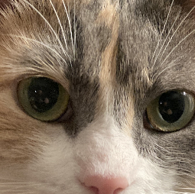
Agenda
Lingering Peer Response Questions?
Murder Mystery

Slide 3
Annotating and Crafting Arguments
But also there’s a murder-mystery
Notes:
SO what have you had to read this week? (discussion)

Slide 4
Learning Objectives
Use annotation strategies to highlight important information
Use textual evidence to craft an argument
Notes:
James and Barrie talk through what the objectives are of the activity.

Slide 5
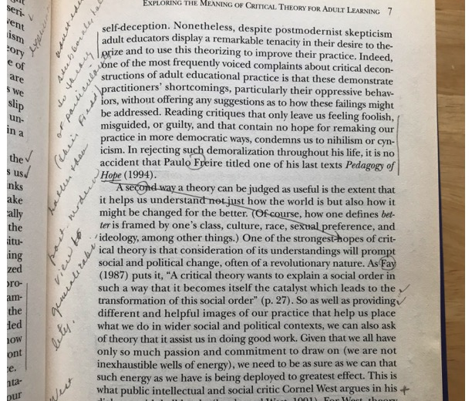
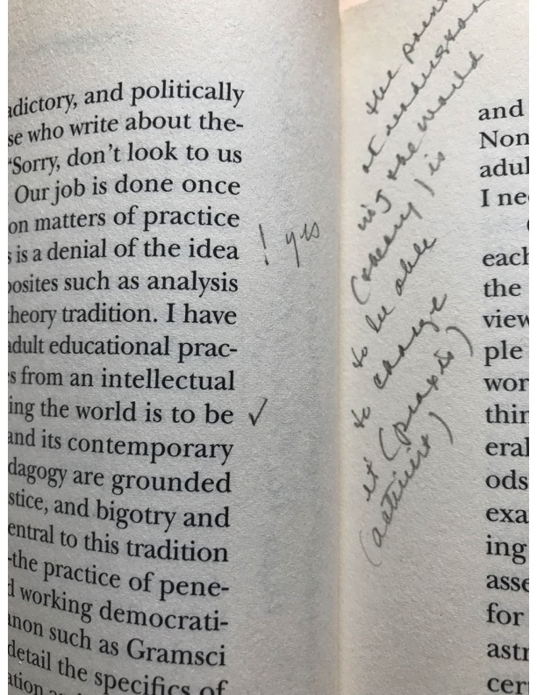
During Reading: Do you write in your books??
Things to consider:
There’s no “right” way to annotate
Symbols?
Highlighting?
Color coding?
What do you use?
Notes:
Barrie outlines the use of annotating to support the reading purpose: my examples and what do students usually do?

Slide 6
Annotating: Making Codes
When I annotate, I follow my own “codes”
My codes include:
***: (Super, duper, important)
Underline or highlight : (The most important info in a paragraph)
Box around a word: (Vocab to remember)
Notes in the margins: (Questions, summaries)
At the top of the page for a bookmark

Slide 7
How do you approach reading?
Incident:
A dead body was discovered on the 4th floor of ASBN at 9:00am. Dr. Owens was identified as the victim. Dr. Owens was a senior professor of Treatology and Kitty Psychology at Texas State University. The victim was found slumped over a table in the locked classroom on top of a half-eaten PB&J sandwich and a folder of papers. Forensic evidence suggests that they were murdered between 7:00am and 8:00am.
Chairs and tables in the room were upright, showing no signs of a struggle. The room was searched for clues. All that officers found were an empty coffee cup, an empty bottle of water, and used worksheets in the recycling bin. The white board in the room had not been fully erased. What appeared to be the numbers 512 and the letters “d-e-a-d” and “l-y” remained on the board.
An interview with President Trauth revealed Dr. Owens had an evening class on Wednesday nights and then locked all the doors on the floor before leaving. Dr. Owens was then usually the first to arrive on Thursday mornings to unlock the hallway. The door to the room and the doors into the hallway were all locked when officers arrived on the scene. While searching the body for treats, detectives found Dr. Owens’ keys in their coat pocket; therefore, the culprit must have had a set of keys to the hallway. Suspects: Dr. Polly, Dr. Marmalade, Dr. Casey, and Dr. Bailey.
Remember this Time!!!
How were they killed??
Notes:
Hand out the Police Report. Barrie: Talk about reading goals and goal of the assignment. Use this document to offer an example of annotating with a purpose: solving a crime of murder! 1. I annotate page one and develop guiding questions with students to help them annotate the suspect descriptions pages.

Slide 8
I love to annotate! …purposefully
Method:
When you’re job is to compare two texts you should use this reading goal to guide your annotations.
This is where I like to use the *** or symbols
As you read, mark the information that seems the most likely to prove who the murderer was.

Slide 9
Take a moment, and read only about Dr. Casey How do you approach reading the Suspect Descriptions?
Dr. Casey is a professor who has worked at the university for 2 years. Dr. Casey was recently hired as a junior professor and works in the same department as Dr. Owens, in office ASBN 511. Dr. Casey is brash and confident, and has ruffled some feathers in the department by gnawing on ankles during important meetings. Dr. Casey has also been vocal about disliking professors who have been at the college for “too long.” Dr. Casey often talked about Dr. Bailey, Dr. Polly, and Dr. Owens who Dr. Casey believed were “past their prime.” Despite being a new hire, when a new position for senior professor was announced, Dr. Casey was the first to apply. The dean recently told Dr. Casey that the promotion had been given to another professor and that Dr. Casey would have to wait for a professor to retire before another promotion opportunity was available. When asked about his whereabouts, Dr. Casey told police that she was having breakfast in the Den with a student, James Dyer, from 7:00am until about 9:15am. They discussed Dr. Casey’s classes in kibble nutrition.
Notes:
Hand out the suspect descriptions: James and students annotate together using the guiding questions to help us. Students work on their own to annotate the other suspect profiles.

Slide 10
The Mystery
In your groups, read through the suspect profiles.
Discuss important information and try to predict whodunnit!
Remember your reading goals
Annotate and mark important information as you go!
Notes:
Hand out the suspect descriptions: James and students annotate together using the guiding questions to help us. Students work on their own to annotate the other suspect profiles.

Slide 11
Whodunnit? Based on available evidence, make an argument for who you think is the murderer.

Slide 12
How do you approach merging information? Suspect Descriptions and the Student Interviews
In order to form an opinion, it is crucial to draw your information from multiple sources.
This is called Intertextuality
Now that you’ve formed an opinion on the murder based on character profiles, integrate these outside sources
How does it change your opinion?
Notes:
Hand out the student interviews.
What does an opinion look like when it only comes from one-two sources?
James: talk through how to merge the information to make an argument about who committed the murder.

Slide 13
Who was the Killer?
In order to form an opinion, it is crucial that you review ALL of the evidence and rule out ALL other options

Slide 14
Crafting an Argument
The rules for crafting any argument apply here. First, what is your thesis?
Support your argument by drawing from your sources of evidence. What are your sources of evidence?

Slide 15
How do I create a thesis?
“The thesis is part of a lengthy thinking process.”
When you get an essay assignment, is writing the thesis the first thing that you do?
No
What must you do before writing the thesis?
Collect and organize evidence (also called support)
“Look for possible relationships between known facts (such as surprising contrasts or similarities)”
Ask what the importance of the relationships is.
Source: https://writingcenter.unc.edu/tips-and-tools/thesis-statements/
Notes:
This slide has animations and is best seen in presentation mode

Slide 16
Organizing an Argument (Big Picture)
Sources and synthesis
Source one – How does this support your argument?
Source two – How does this support your argument?
Synthesis – How do BOTH SOURCES combine to support your argument?
Notes:
Hand out the student interviews.
What does an opinion look like when it only comes from one-two sources?
James: talk through how to merge the information to make an argument about who committed the murder.

Slide 17
Whodunnit? In your groups, work together to make your final prediction.

Slide 18
For next time
Read Jose Vargas “My Life as an Undocumented Immigrant”
Complete Reading Log #9
Complete Peer Response Final Draft (If you haven’t already!)

