Slide 1
RDG 1300_P06
Tuesday, 10.26
For the start of class:
Have your computers open to Canvas
Have access to your peer response “half draft”

Slide 2
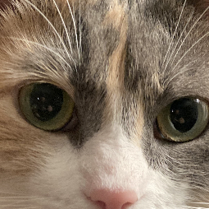
Agenda
Peer Response Pivot
Getting Ready to Submit Peer Response Final Draft

Slide 3
In-class writing
What is the last “meme” that you saw online?
Now, explain this meme to an alien visiting earth for the first time
What social/cultural knowledge is necessary to understand this meme?
Why is the meme funny/relevant?
To whom specifically is it funny/relevant?

Slide 4
What are the trends here?

Slide 5
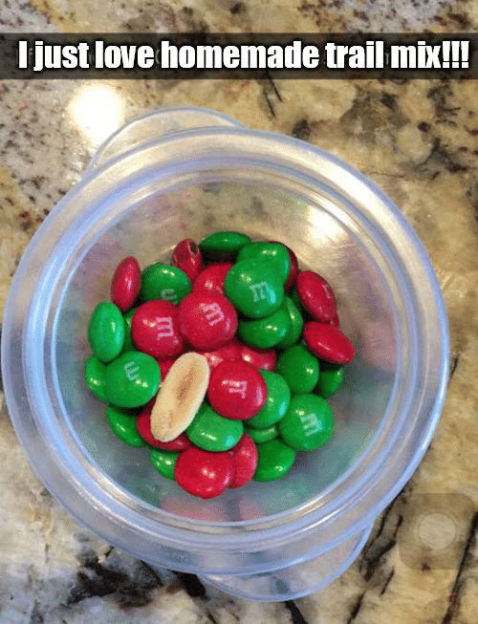
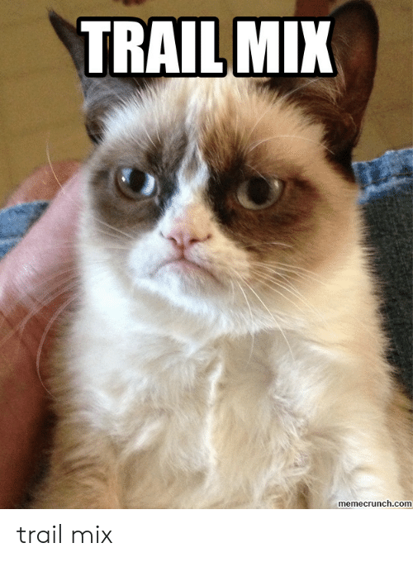

Slide 6
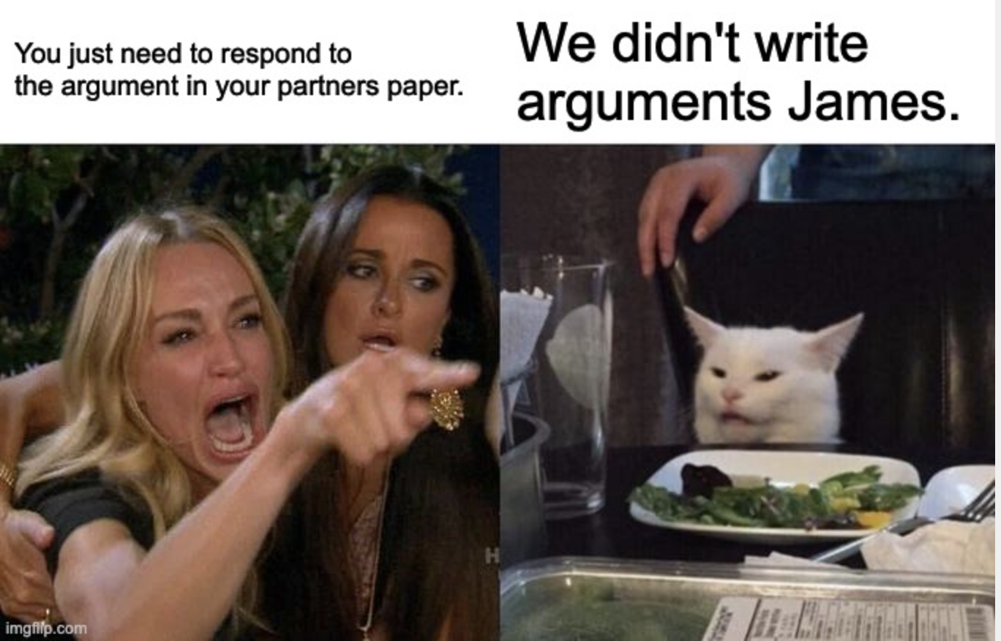

Slide 9
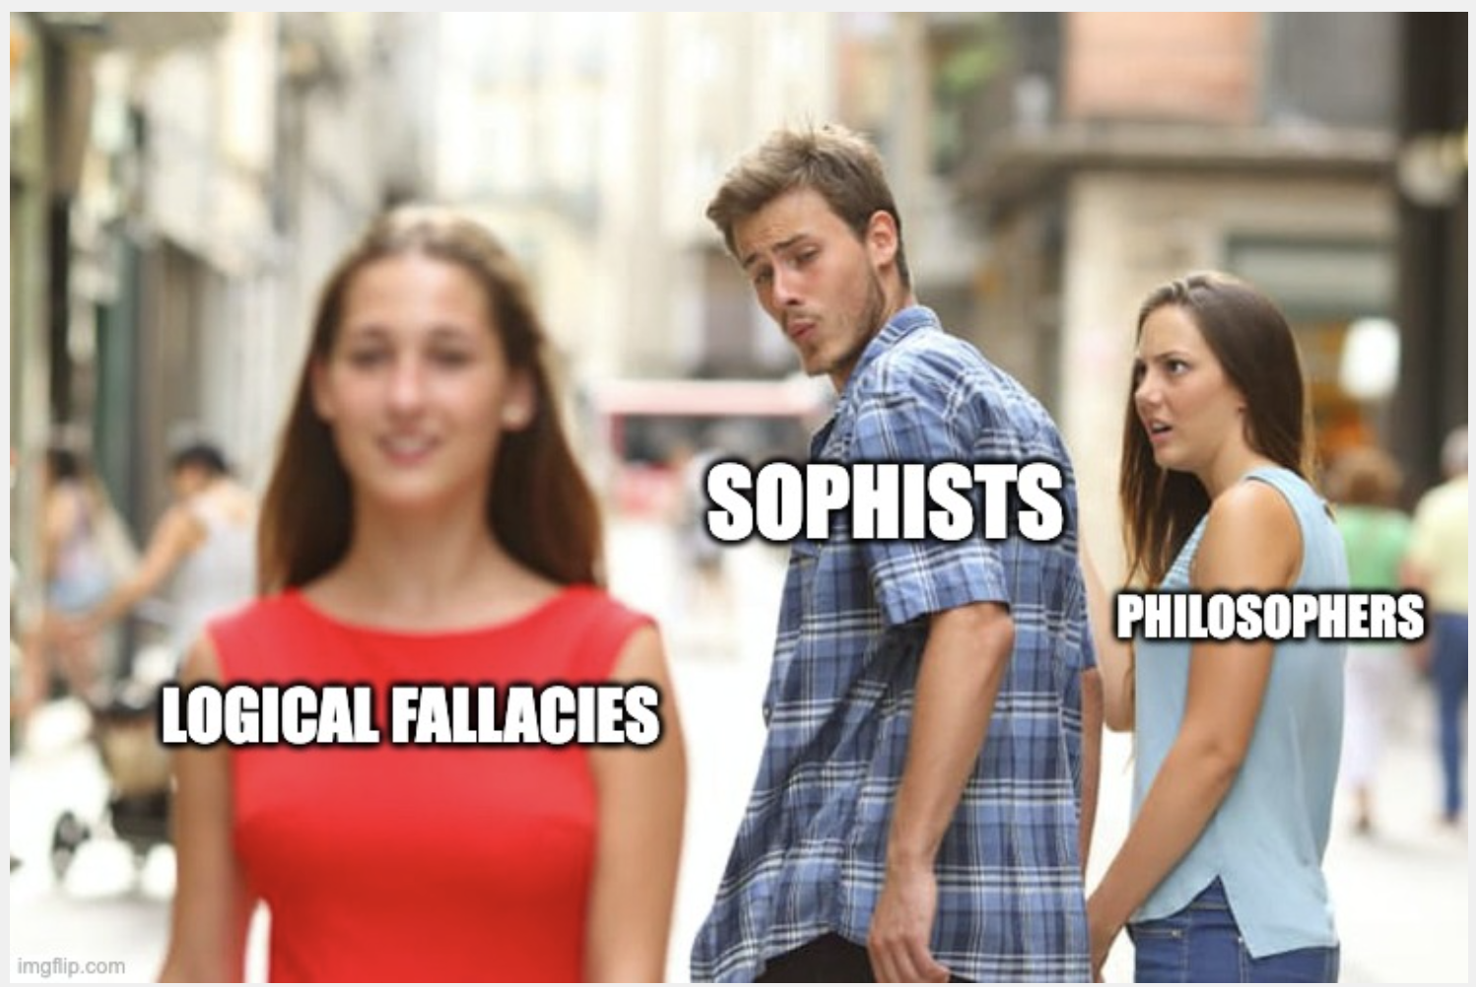

Slide 10
Looking back at the assignment sheet for the Peer Response…
Tasks
You will begin this assignment by reading and annotating your peer’s paper and identifying their position, purpose, and support. You will then construct a response to your peer. A response is a reaction to a specific aspect of their paper. You may, for example, agree or disagree with their position. You may wish to comment upon their use of support.

Slide 11
Peer Response Pivot (What is the goal of this paper?)
Ways in which you may achieve this goal
Responding to an argument that you see present in your classmate’s paper
Responding to a cultural/social media trend
Responding to your classmate’s overall message/moral
Perhaps by making text to self connection?

Slide 12
Responding to an argument
“Embedded” or ”implied” arguments
Requires you to form your own argumentative thesis/supporting details in response
How might a different stance on this argument affect how your partner interprets their social media post?

Slide 13
Responding to an argument example
Your partner wrote about a social media post in which they make fun of protesters demonstrating about the impending perils of climate change
What arguments are embedded in this post?

Slide 14
Responding to a cultural/social media trend
Requires you to explain the trend
History/background
Common uses
Uncommon uses?
Must also take a stance on this trend
What does this social media trend say about our culture/society?

Slide 15
Responding to your partner’s overall message/moral
Requires you to make a text to self connection to the message being conveyed in your classmate’s paper
This could be by telling a personal story about your own life that relates to the message you found in your partner’s paper
Your story might provide support to your classmate’s message, or it might problematize/complicate it

Slide 16
Responding to your partner’s message/moral
Your partner wrote about a time they sent a harmless text that was misunderstood as something negative. The overall message was about the need to see things from other people’s perspectives and to be understanding about how a text can mean different things.
You could respond to this story by making a text-to-self connection to a time when you also sent a text that was misunderstood – how does this story support the message that your classmate is trying to convey?

Slide 17
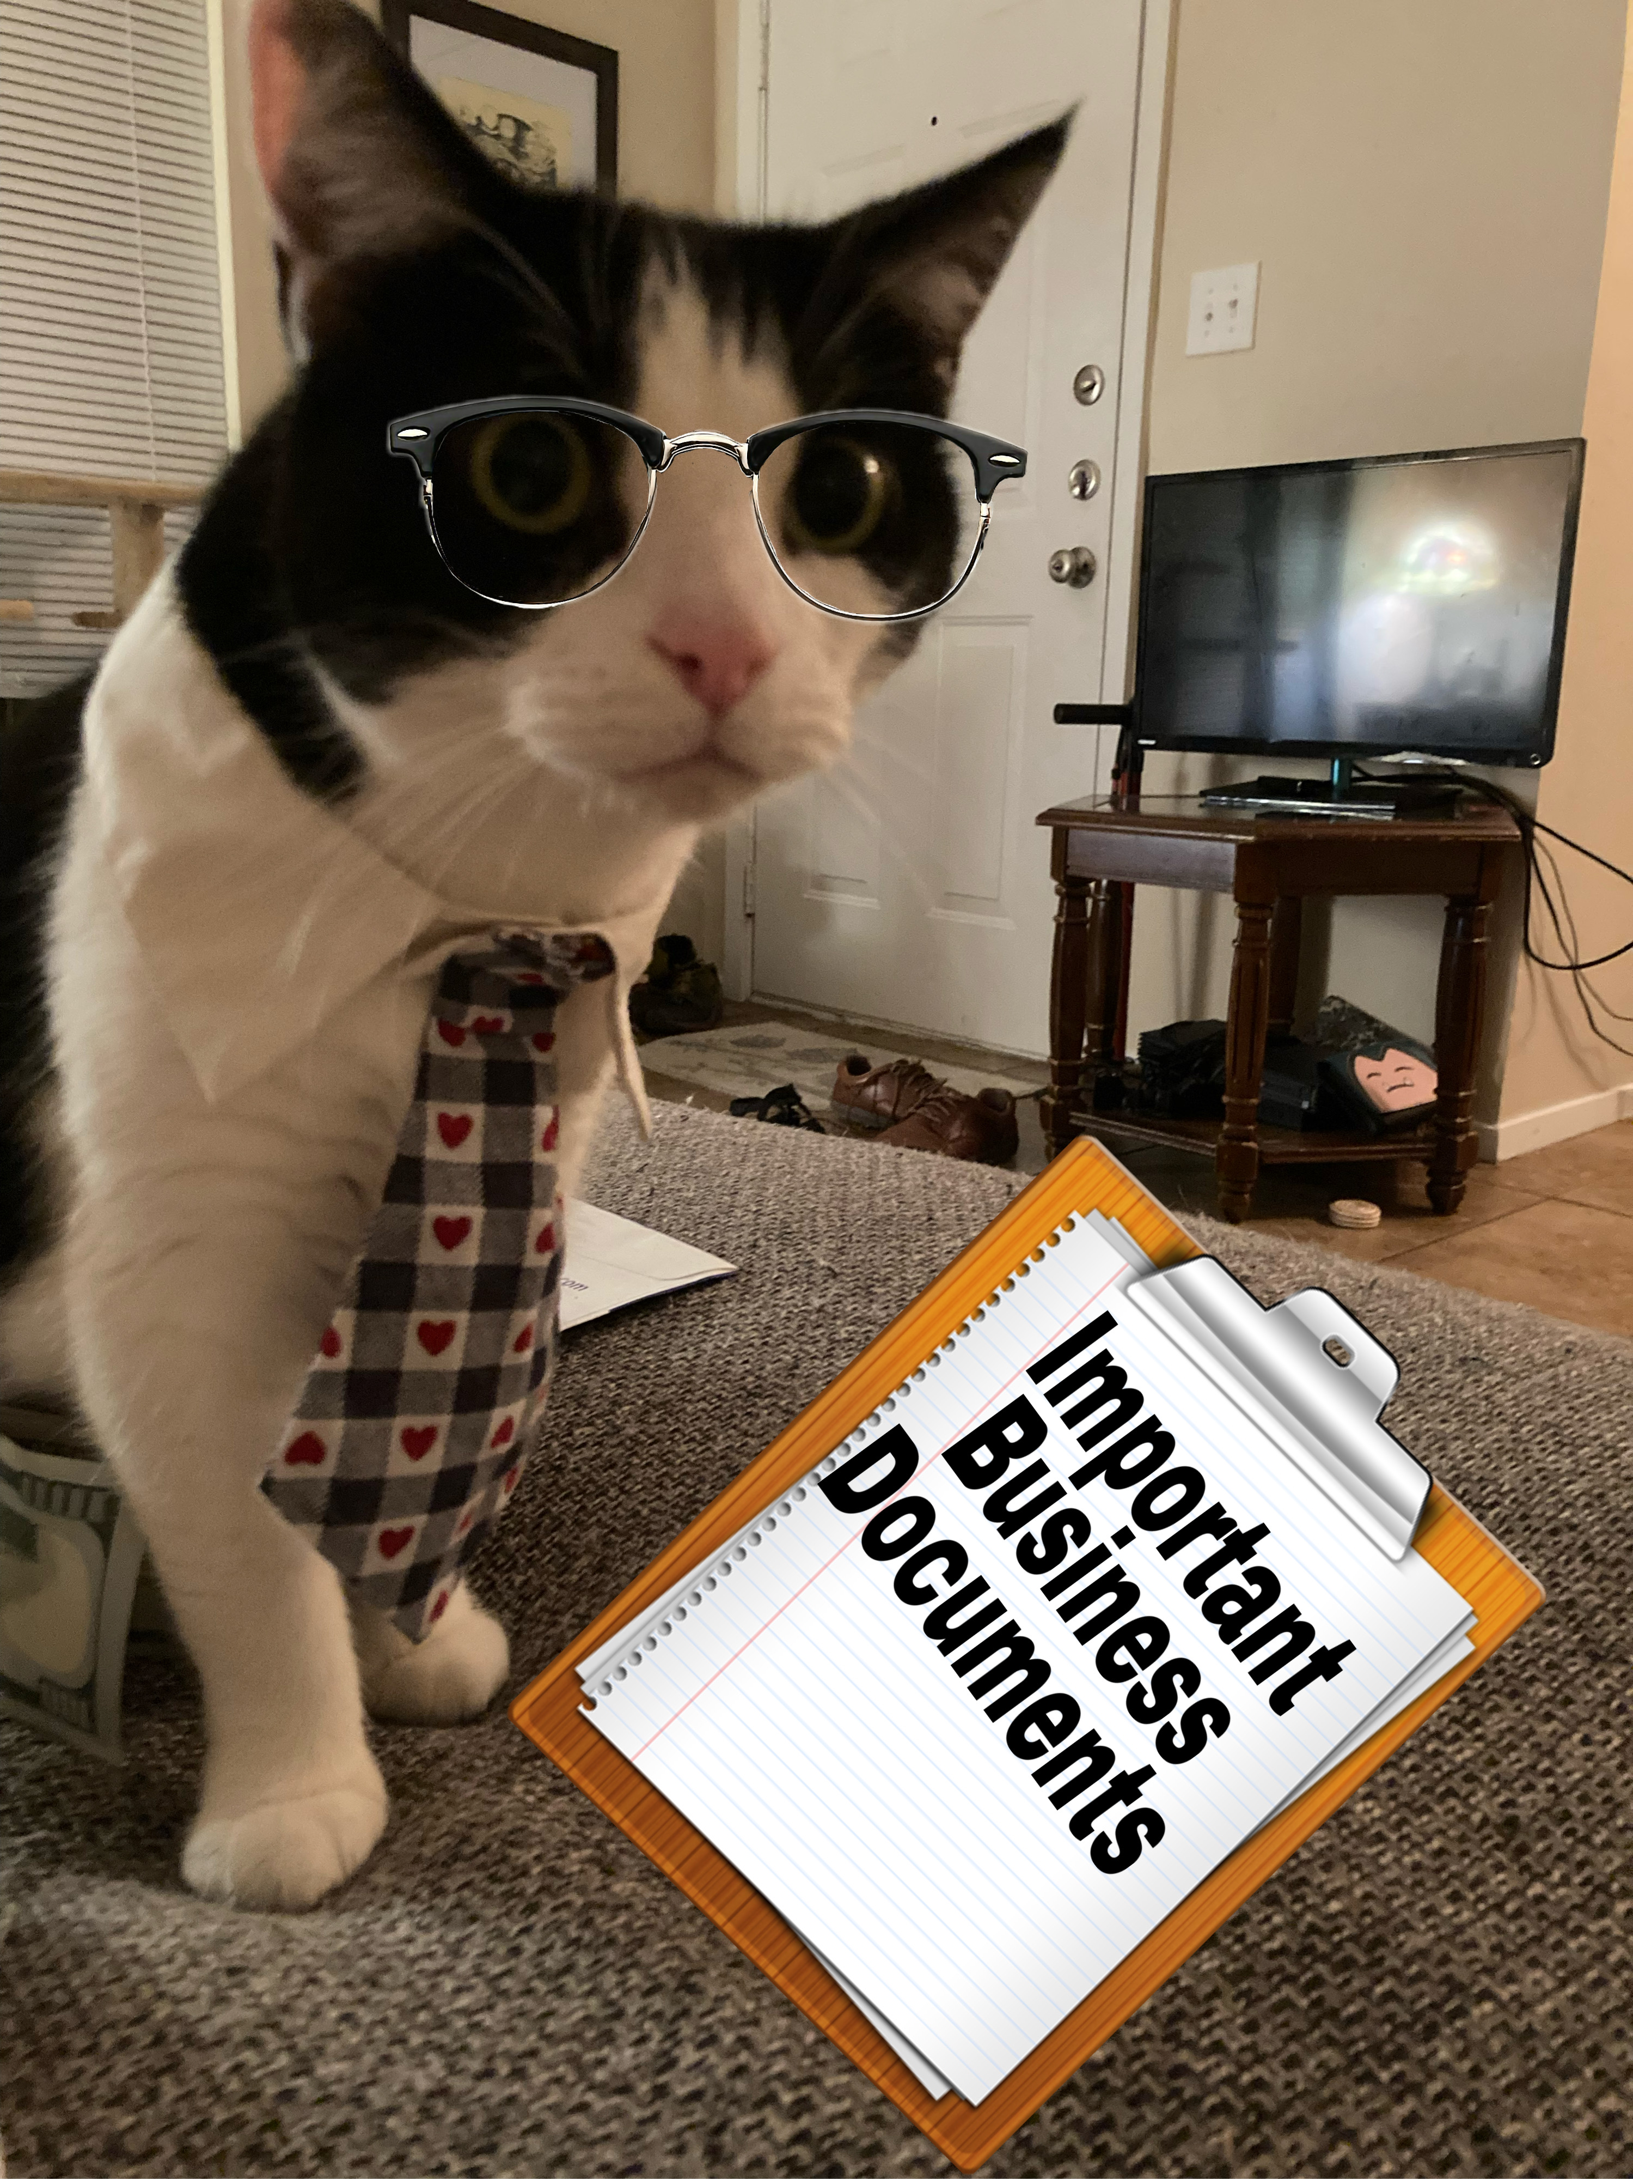
Before you write: Setting up your paper
Font
Paragraph spacing/line spacing
Page Numbers
What is the purpose of this?
Who expects this?

Slide 18
Preparing your final draft
Looking for a polished draft that
Has a clear thesis statement
Has clear connections to the argument being made in your partner's ENG 1310 Essay
Focuses on unpacking your partner's argument with the goal of making it stronger
Also check out the rubric!

Slide 19
In-class work time
Open up a word document and start planning your final draft
What idea, argument, cultural trend, or message do you plan to respond to?
In a sentence, sum up your response to this message
How do you plan on supporting your response?
Work on this in class – if you have any questions, Sam and I will be walking around to check-in with each of you.

Slide 20
For next time
Finish Peer Response Final Draft
That’s it!

