Slide 1
RDG 1300_P07
Thursday, 10.21
For the start of class:
Have your computer’s open to Canvas
Have access to your partner’s ENG1310 paper (the one you read for Reading Response #8

Slide 2
Agenda
Guidelines for Responding Critically
Peer Response – Second Readthrough
Preparing Peer Response “Half-draft”

Slide 3
Peer Response In-Class Writing
For today’s discussion, refer to your partner’s ENG 1310 Essay that you read for today.
Identify a main argument or “thesis statement” in their essay. What point are they trying to make?
Make a list of the things that they use to support their argument.
Do you agree with their opinion(s) here? Explain your response.

Slide 4
Peer Response Paper Overview
Half-Draft – Due Tuesday
Final Draft – Due Thursday

Slide 5
Your Response If you disagree…
You can’t just say, “I disagree”
In an academic context, disagreeing requires you to form your own argument on a topic that can stand independently of what you’re disagreeing with
Example: It’s not enough to say “I disagree that poor people are hard workers.” You must create your own argument that stands alone.

Slide 6
Your Response If you agree…
There would be no point in writing an essay if all you wanted to say was, “I agree with everything this author said because they are the bestest and smartest.”
Adding to their argument with more support (text to text/text to world connections)
Using your own experiences to support the author’s points (text to self connections

Slide 7
The art of “yes, and-ing” and “no, but-ing”
False Dichotomy (the myth that there are only two choices)
It is fully possible (and, honestly, preferable) to agree/disagree partially with an argument, rather than wholesale
When agreeing/disagreeing, it is crucial to give space to a counter-argument

Slide 8
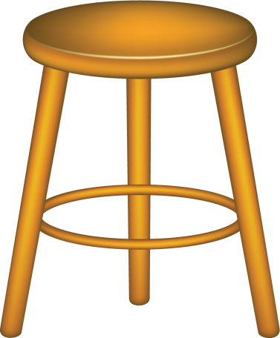
Building the Argument Stool
Thesis
An argument uses an author’s supporting details or rationale to support weight (read: scrutiny, critique, review, etc.).
Every argument has…
A thesis statement (even if it’s not called that)
Reasoning/rationale that supports it
Supporting Details
Supporting Details
Supporting Details

Slide 9
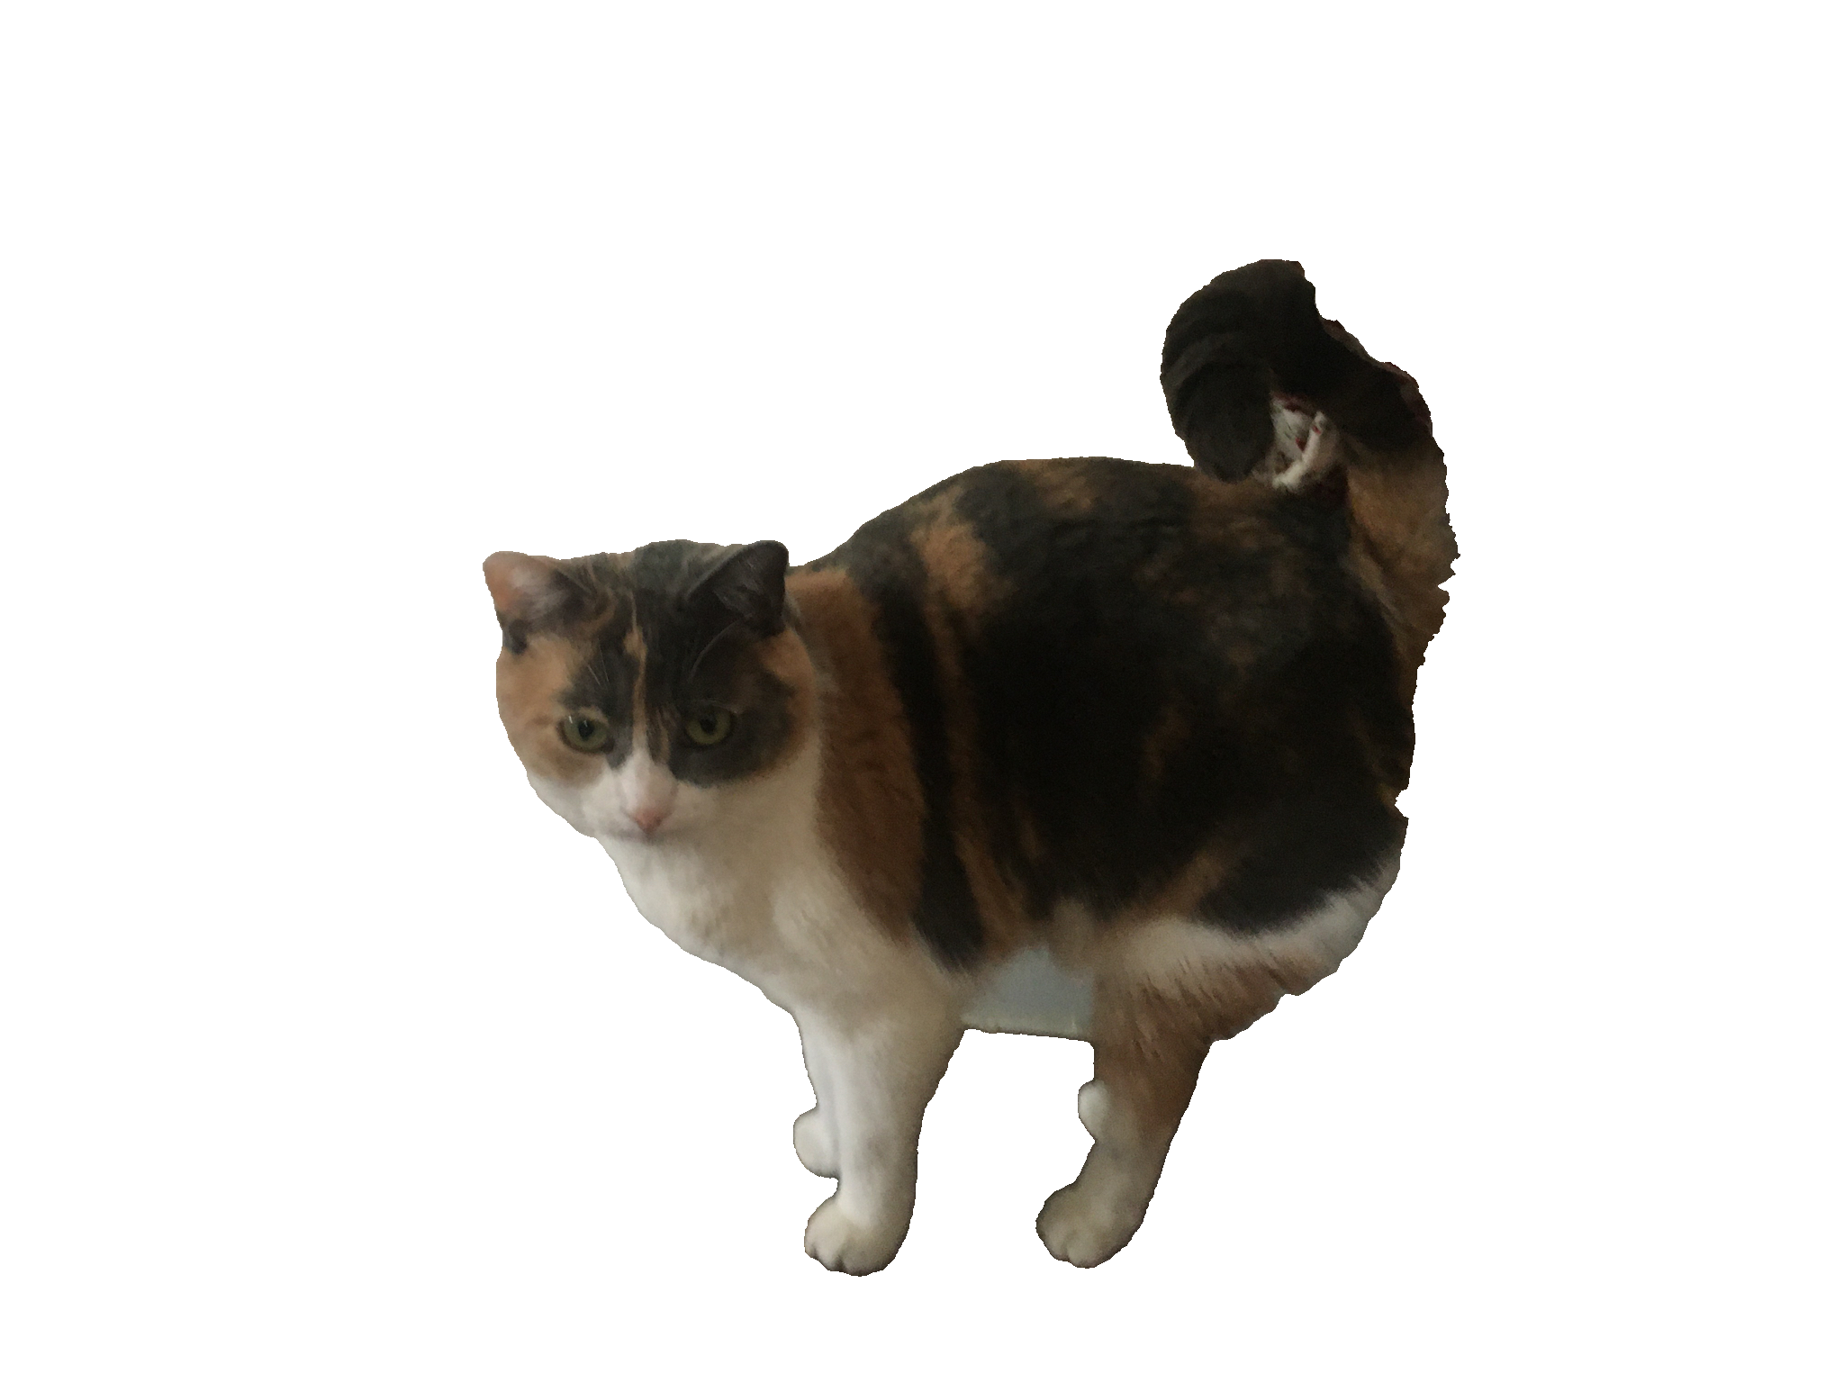
Building the Argument Stool
Thesis
If an argument doesn’t undergo a lot of scrutiny, then it can support itself with a weak rationale or few supporting details
Supporting Details
Supporting Details
Supporting Details

Slide 10
Building the Argument Stool
Thesis
However, additional scrutiny might reveal some weaknesses
The legs might be weak, wobbly or termite-infested
The seat might be splintered, or feel insecure
Supporting Details
Supporting Details
Supporting Details

Slide 11
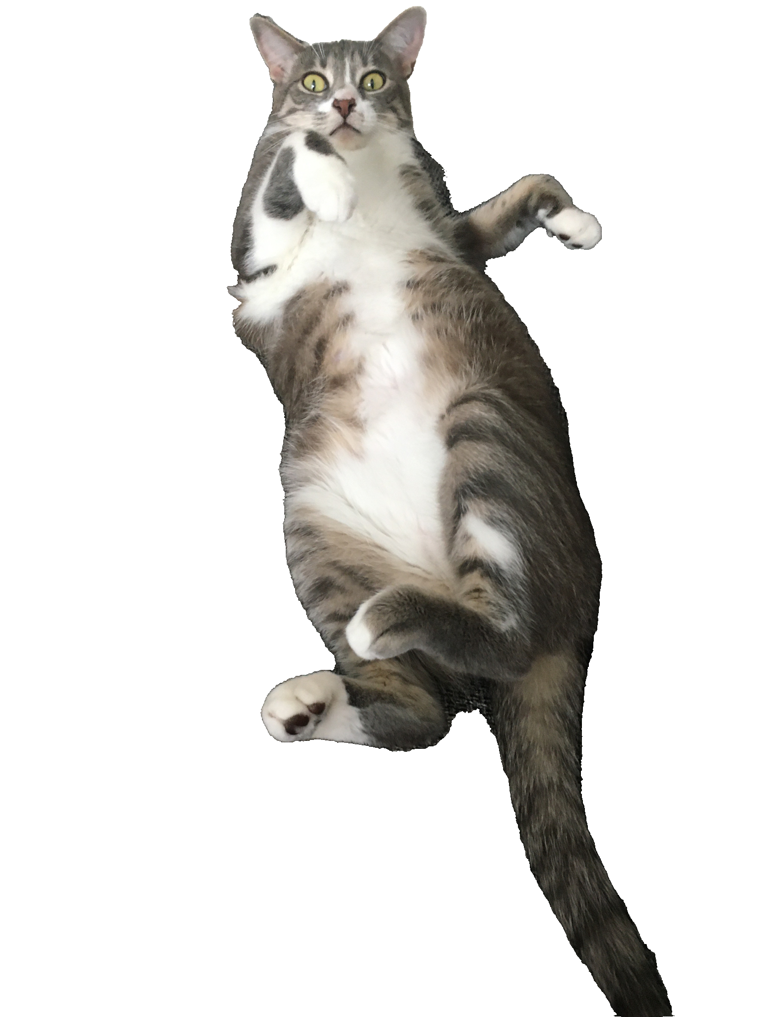
Building the Argument Stool
Supporting Details
Thesis
And an argument like this is just waiting for some asshole to come and tip it over
Supporting Details
Supporting Details

Slide 12
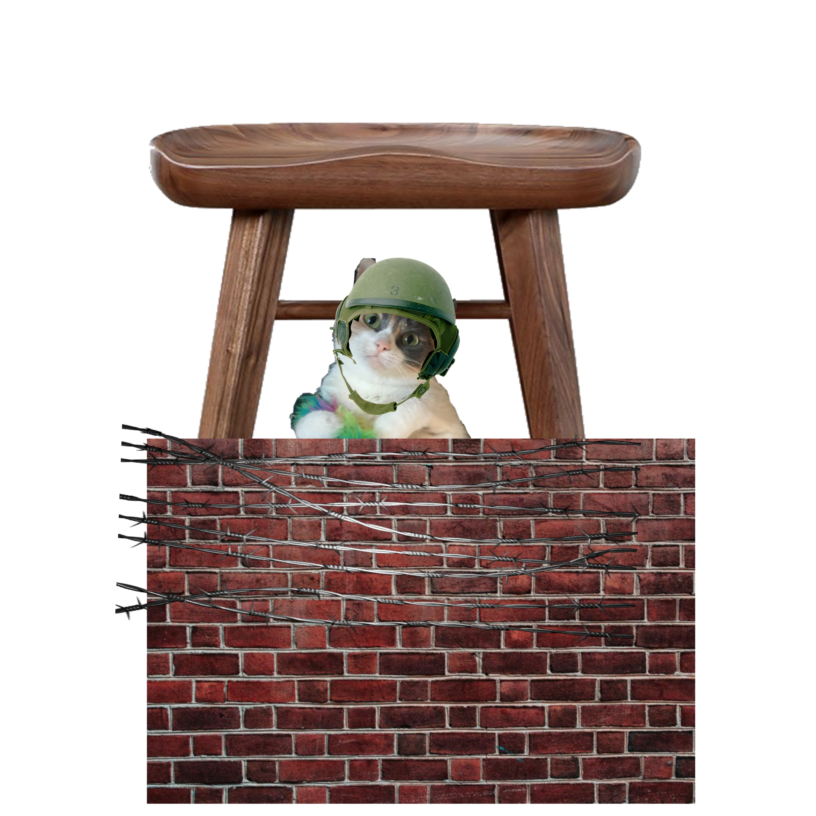
Peer Response Essay: Strengthening Your Partner’s Argument Stool
Your ENG 1310 Essays
Many of you expressed opinions on social-media use…
(right? Am I reading these correctly?)
However your opinions may not have come under much scrutiny
Your mission here is to give these essays that scrutiny, to submit the opinions to a strong critique, and pick apart the structure of the argument stool in order to build a stronger one.

Slide 13
Peer Response – Second Read-Through
A second readthrough is important for doing detailed responses. It allows you to:
Make good use of your annotations
Refine your understanding
”re-watch”

Slide 14
Okay – Open up a word document (or grab a piece of paper). We’re doing this.
At the top write: “Peer Response Half Draft”
Take notes on your paper as you read it through again.

Slide 15
First paragraph(s)
Their paper
Underline or highlight the sentence that you believe identifies most clearly what the author is trying to say with this essay.
Your paper
Write out, in your own words, what you view to be the purpose of this essay. What is the author trying to say here?
Activate your background knowledge. What is your previous understanding of this topic? Is it something you can relate to? Can you connect any personal experiences with it?

Slide 16
Body Paragraphs
Their paper
For each body paragraph, write a sentence in the margin (or on a sticky note) that (1) summarizes the paragraph and (2) connects it back to the purpose of the essay that you identified in the introduction
Your paper
For each body paragraph, look at your summary/connection notes. In your paper, make note of places where you’d like the author to expand upon.
Also identify spots where you were confused or where the point your author was trying to make was a bit unclear.
Also, also, think about organization – would a different type of structure make sense for this paper?

Slide 17
Conclusion
Their paper
Again, underline the sentence that you feel best represents the author’s purpose for writing this essay.
Leave a note to yourself in your annotations – did the author’s purpose change between the intro and the conclusion paragraphs?
Your paper
Look back over your notes that you attached to each body paragraph. Write out how you saw the paper progress through these notes and connect it back to what you read as the author’s purpose.
Make any broad suggestions for improvement

Slide 18
And Finally…
Connect this back to your experience writing your own paper. How did your approaches to this assignment differ? How are they similar?
Connect this back to anything else that you’ve read/watched throughout the course of this semester.

Slide 19
For your Peer Response Paper…
Go over your notes from this second read-through (or third, or fourth)
Your paper should be formatted in MLA style, include a thesis statement
Remember the goal of this assignment – to respond to the ideas and purposes that the author has presented, discuss how they support these ideas, and (if necessary) offer constructive feedback on how to improve.

Slide 20
Your Peer Response
Things to keep in mind:
Remember, your goal is to respond to the author’s message, not provide spelling, grammar, or sentence structure feedback.
Make note of spots that confuse you or sentences that you think are particularly powerful.
You can make constructive comments on how the author may improve their essay. HOWEVER, I’m not looking for a “this is good/this is bad” evaluative response

Slide 21
For next time: Peer Response Half Draft
My Expectations
A half-draft is rougher than a rough draft
You need to have the structure of your paper completed:
Your argumentative thesis responding to your partner’s paper
An outline of body paragraphs that scrutinize your partner’s opinion (i.e. – where are the weaknesses in their argument stool?)
Pointers, suggestions for strengthening the stool
The goal is to get to “half” of the length requirement

Slide 22
For next time…
Complete Peer Response “Half Draft”
Bake a chocolate cake to celebrate Marmalade’s half-birthday
This cake will be worth 100% of your final grade

