Slide 1
RDG 1300_P07
Monday, 10.19
For the start of class, please do this thing but also that thing.

Slide 3
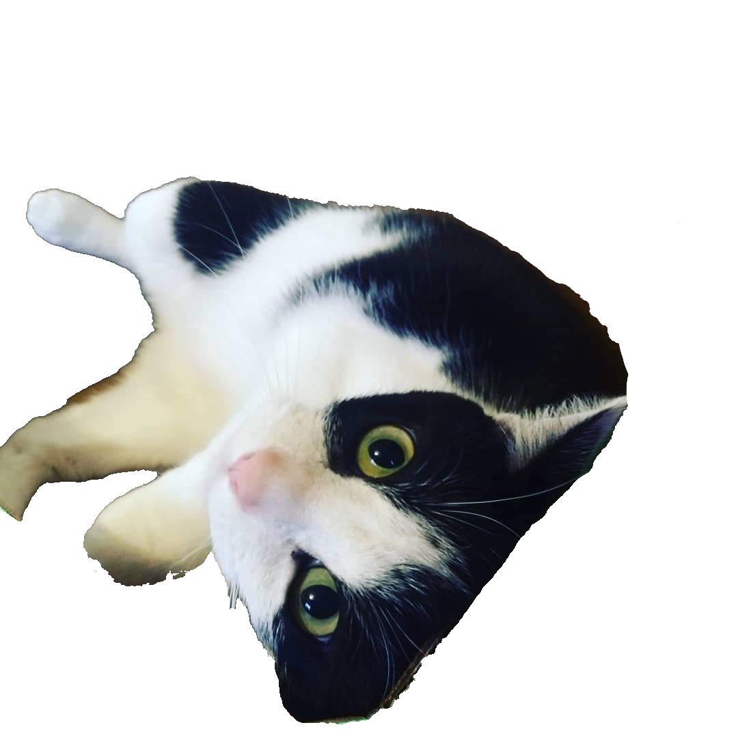
Agenda
Text Review Workshop
Textbook Reading Strategies: T-SEF Scale
Getting Ready for Expansion #4: Peer Response

Slide 4
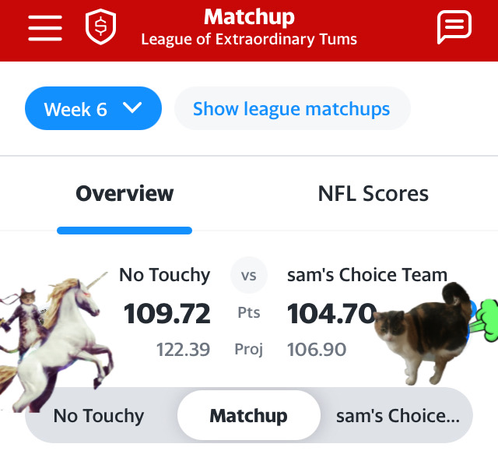

Slide 5
Text Review Workshop
Please find a partner and sit next to eachother.
(Note: You may partner with whoever you please. Don’t mess this up ☺ )

Slide 6
Celebrity Interviews
What we’re going to do:
Congrats on being famous! You and your partner will take turns interviewing eachother about your Text Review paper.
Partner 1: You’re going to start as the interviewer. Please ask the questions provided for you on the form.
Remember! It’s your job as the interviewer to make sure your partner gives full answers and doesn’t dodge any questions.
Record your partner’s answers on the sheet provided. If you run out of room, you may use the back.
Partner 2: You’re famous now! Be polite and do your best to answer the questions that your interviewer asks of you.

Slide 7
Celebrity Interviews: First Question
Partner 1: Ask your interviewee if they’ve completed their assignment yet.
(Note: although I said it was due today, I continue to mess up the due dates on Canvas. If it’s not turned in yet, it’s not late – you have until midnight).
If they’ve already finished and submitted it on Canvas, you need interview #1. If they haven’t yet, you need interview #2.

Slide 8
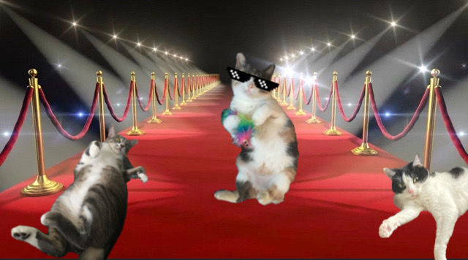
Interviews!
Interview: 5-7 mins.
Compiling Notes: 1-2 mins.
SWITCH

Slide 9
Class Poll
Which number is higher?
109.72
104.70

Slide 10
Textbook Reading Strategies Discussion
What makes a textbook a textbook?
What is the “structure” of a textbook?
What is the purpose of a textbook?
What are the strengths/weaknesses of having a required course textbook?

Slide 11
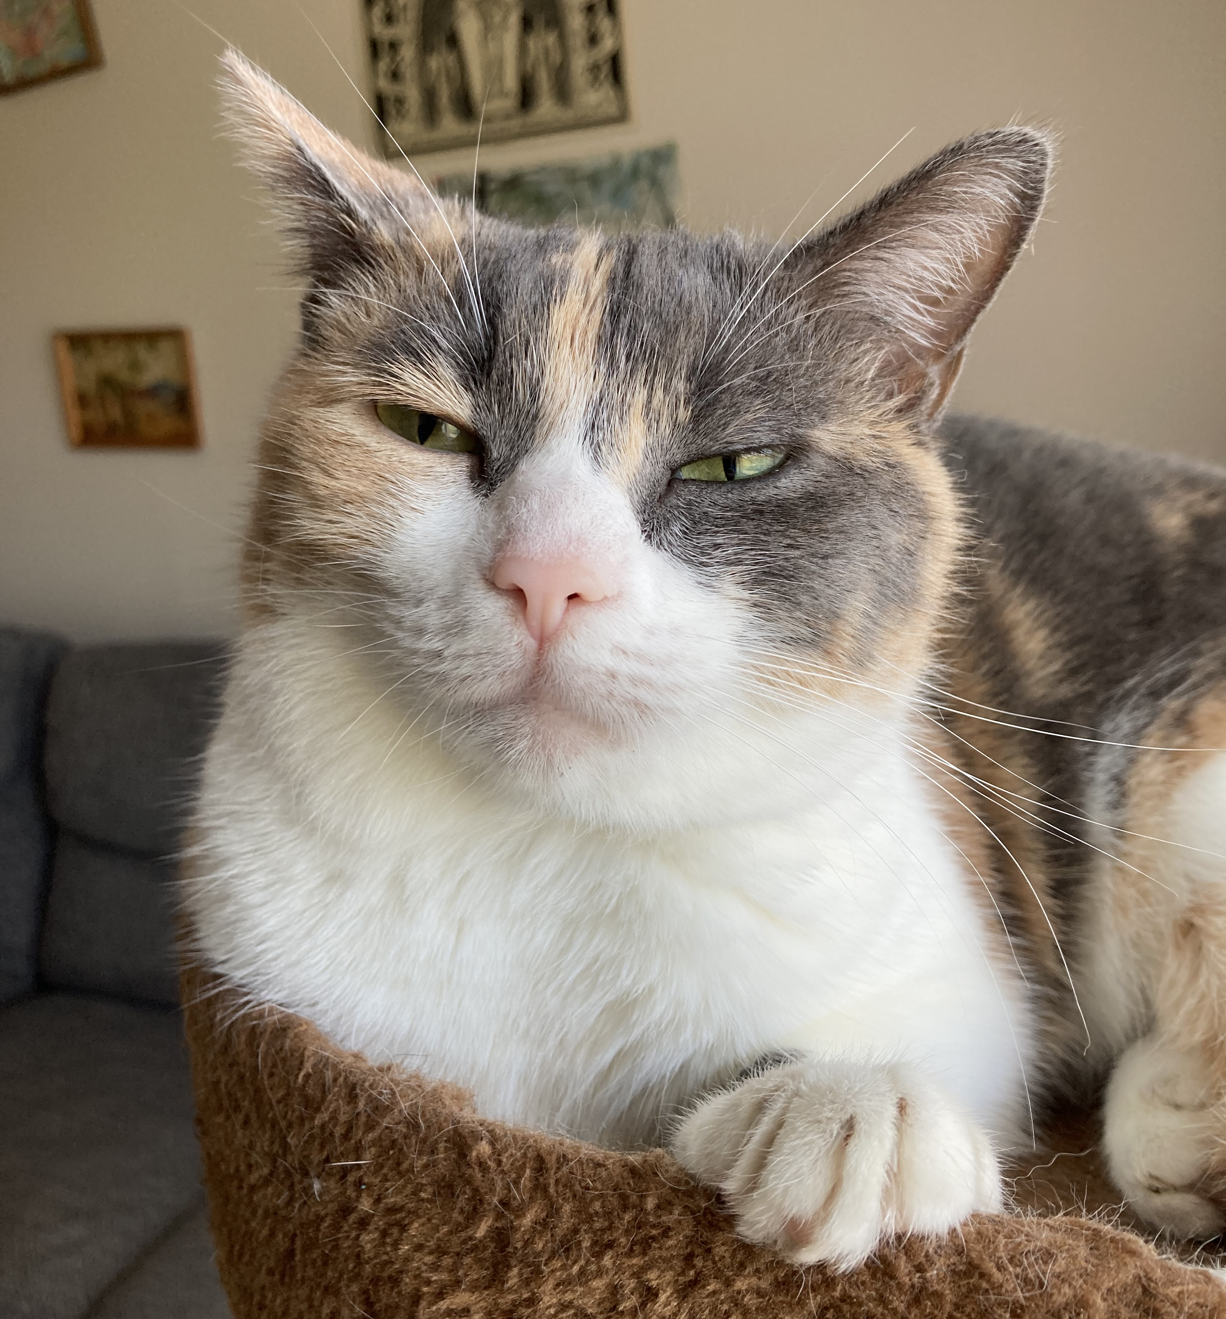
T-SEF Scale
Complete the T-SEF scale
On the left, rate the frequency that you use the given skill while reading for academic purposes.
On the right, rate your confidence with using the given skill.

Slide 12
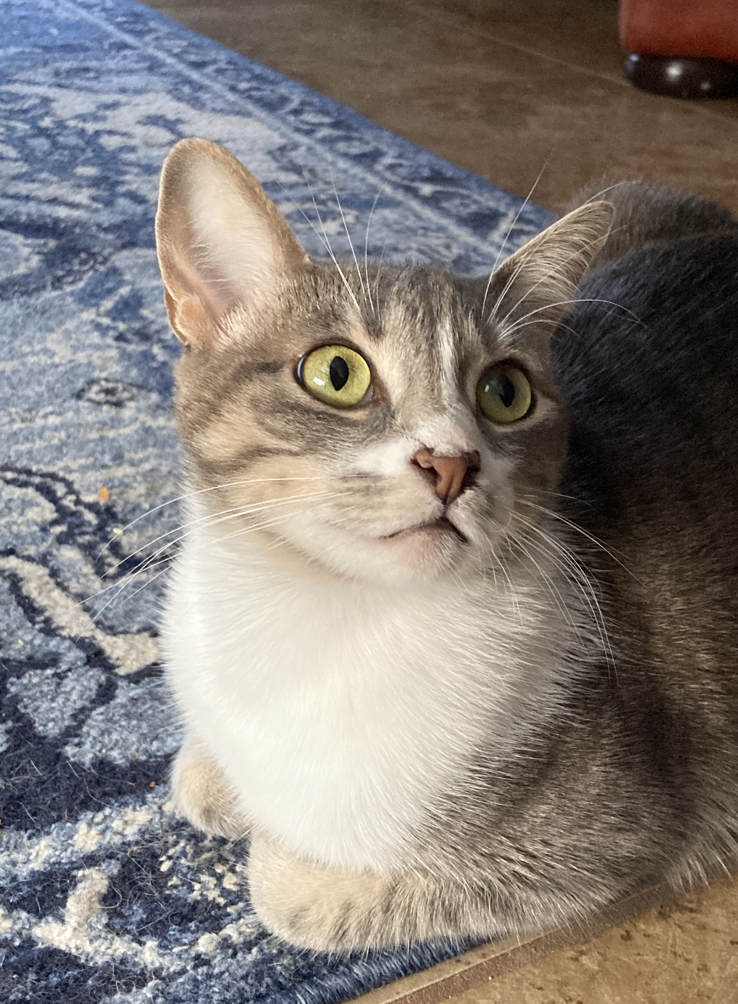
T-SEF Scale Reflection
I shall reflect on my friend Sam’s poor Fantasy Football performance
After completing the scale, complete the discussion post on Canvas.

Slide 13
Expansion #4: Peer Response
Purpose:
The purpose of the Peer Response assignment is to identify the message presented in your peer’s ENG1310 essay and then to respond to that message with additional evidence and explanation of your own.
Nitty-Gritty:
3-4 pages
2 drafts
Rough draft due Monday, Oct. 25

Slide 14
Peer Response Paper Exchange
With your partner, please work out how you will exchange your ENG 1310 paper.
If possible, please exchange via email.
If your partner cannot access their ENG 1310 paper, please request to collect a paper from someone else.
After you have made the exchange, submit your ENG 1310 paper (the one that you wrote) on Canvas.

Slide 15
Reading Log #8
No special twists…
EXCEPT
This time you’re going to be reading and responding to your classmate’s article.
Complete it the same as any other reading log
Mark important quotes
Respond with text connections or reflections on why the quote is important

Slide 16
For next time…
Read and annotate your partner’s ENG 1310 Essay
Complete Reading Log #8
Extra Credit: Give Sam some waiver wire suggestions for next week :’(

