Slide 1
RDG 1300_P07
For the start of class:
Please have your computers open to Canvas to complete the in-class writing assignment
Thursday, 10.14
NOTE: I can’t require masks or vaccines in this class, but university leadership recommends both so that we can remain in-person this semester

Slide 2
Agenda
Review of “Crayola-ification”
Expansion #3: Text Review
Prepping for Next Class
This Photo by Unknown Author is licensed under CC BY-SA

Slide 3
In-Class Writing
Reviewing “Crayola-ification”

Slide 4
Your Review of Crayola-ification
Should include:
Your review should include:
A fun tagline to introduce your review
Example: "If you like root canals and falling down stairs, you'll love reading this article"
Your overall opinion of the article
Come up with some kind of review metric
Example: "4/5 stars" OR “Certified fresh” OR "12 toothless Terry’s"
Your recommendation – would you recommend someone else to read this article?
How would you suggest they approach reading it (ex. What reading strategies might be helpful)?

Slide 5
“The Crayola-ification of the World”
In your small groups
Discuss your review for “The Crayola-ification of the World”
What were your favorite parts? What parts were boring to you?
Evaluate the author’s writing style – what were some features they included? Did it improve your overall reading experience?
What was your purpose for reading this?

Slide 6
Applying Reading Strategies to Different Disciplines
All Reading is NOT Equal
Math vs. English text: What are similarities and differences?
How do we “read” the math text? The English?
How do our purposes for reading these texts differ?

Slide 7
Show and Tell
What text did you bring in today?
What class did you read it in?
Thumbs up? Thumbs down? Why?

Slide 8
Group Discussion
As a group, discuss the texts that you brought in for today’s class.
What was your purpose for reading this text?
What academic tasks were you expected to accomplish?
How does the text (if at all) help you complete these tasks?
Which reading strategies work best for this type of text? (Recommend specific strategies for GLOB, SUP, and PROB)

Slide 9
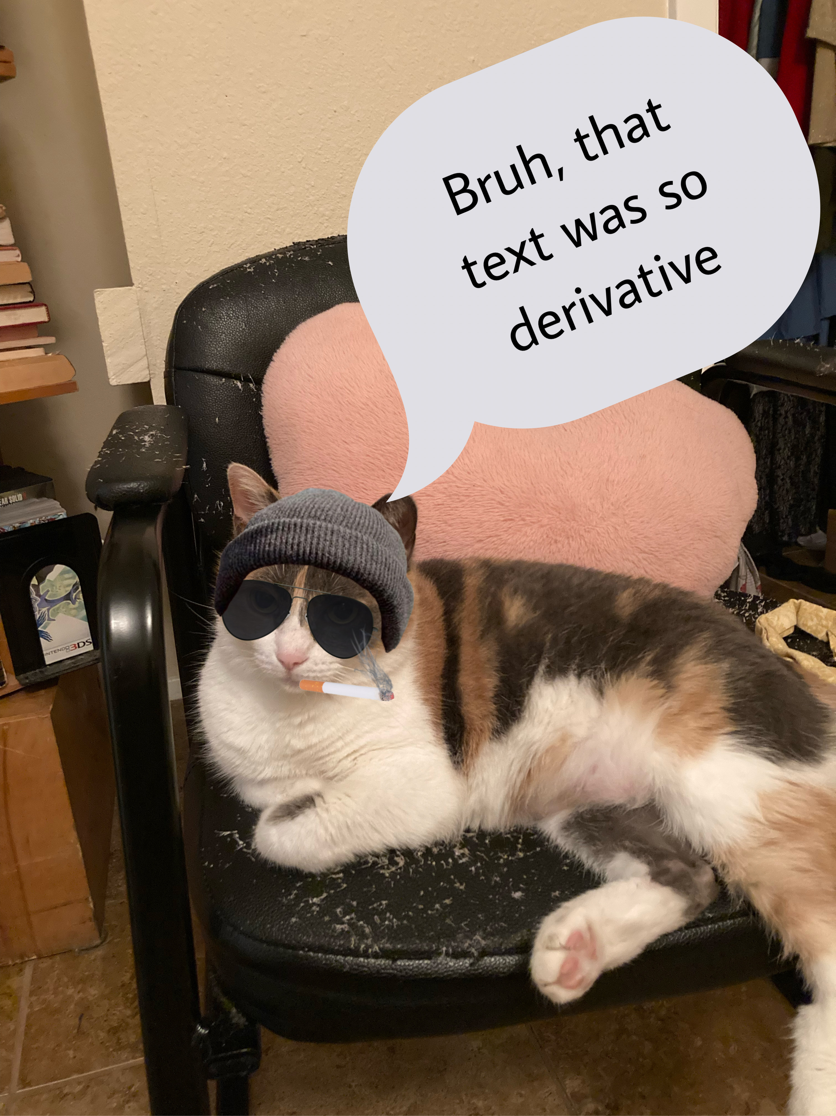
Expansion 3: Text Review
Your purpose
Using the text review rubric, you will write a movie critic-style review of the text that you brought in for class today.
Your review will focus on:
The tasks that you were expected to complete using the text you selected
How the text works with your reading approach
How the author (or your instructor) might re-approach this text to make it more appropriate for use in your class

Slide 10
How to write a movie review

Slide 11
Writing in the style of a film review
Describe, don’t summarize
“What does a text look like?”
“How does it make you feel?”
Explain your opinion
It’s not enough to say it was “good” or “bad”
Your purpose is to help the reader (Me, your instructor, other students) make decisions about this text
Use “compelling” language
This means that your writing style should aim to affect the reader in some way (ex. make them laugh, cry, or run away screaming).
Doesn’t necessarily have to be structured as a “formal” report-style paper.

Slide 12
Text Review Rubric
Fill out the rubric, giving your text a ranking in each category
Introduction
Organization
Extra Features
Usefulness
Attention to MARSI Strategies
Under each ranking, write some brief notes to support your response.

Slide 13
Text Review
After you complete the rubric, at the bottom of the document write a brief (500 word) review of the text that you selected.
First, write a fun tagline as an introduction to your review.
Example: “Bartleby the Scrivener: If you didn’t like Moby Dick, you’re sure as hell not going to like this.”
Second, summarize your comments from the text review rubric into a cohesive review of the text.
Remember – it’s not enough to just say “this was good” or “this was bad.” Give support, and consider how your review might help a reader interact with this same text.
At the end, give a recommendation
Should your instructor include this in their future classes?
How should another student approach this text?
Feel free to have fun with this!

Slide 14
James is lazy
Wikihow? Are you serious?
If you want more examples on writing in a movie review-style, check out this link:
https://www.wikihow.com/Write-a-Movie-Review

Slide 15
Question
What papers have you written for college writing thus far?

Slide 16
For next time
Complete Expansion #3: Text Review
Start planning for "Peer Response"

