Slide 1
RDG 1300_P07
For the start of class:
Please have your computers open to Canvas
Monday, 10.12
NOTE: I can’t require masks or vaccines in this class, but university leadership recommends both so that we can remain in-person this semester

Slide 2
Agenda
Conference debrief
Pre-reading “Crayola-ification”
PILLAR
Prepping for Next Class
This Photo by Unknown Author is licensed under CC BY-SA

Slide 3
Conference Debrief
Well, how did they go?

Slide 4
Pre-Reading
Meow meow, I am a large kitteh
Why is prereading important?
Most neglected stage in the reading process (at least by James).
Most effective strategy for those who “lose focus” or have trouble concentrating
GLOB #4 “I preview the text to see what it’s about before I read”
GLOB #10 “I skim the text first by noting characteristics like length and organization

Slide 5
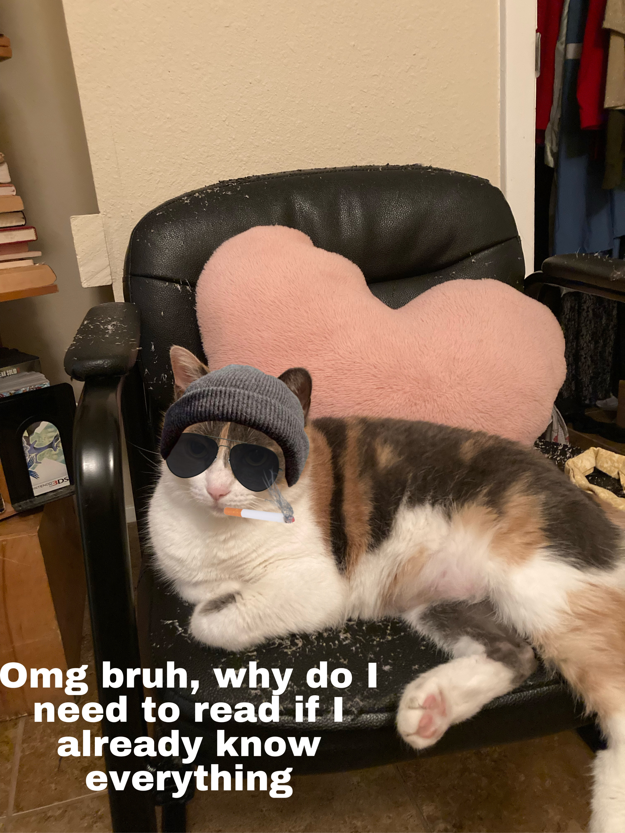
Activate Your Prior Knowledge
Our prior knowledge or understanding of topics can:
Help us make text connections
Help us form a purpose for reading
Help us become more strategic readings
Our prior knowledge or understanding of topics can also:
Form our assumptions about a topic (which may aid or interfere with how we read a text)

Slide 6
In Canvas, follow the link: “The Crayola-ification of the World” Part 1

Slide 7
“The Crayola-ification of the World”
Do
In 5-10 minutes, practice whatever method of prereading you’ve used in the past
Look for answers to the following questions
What are some topics covered by this reading?
What text features do I see (bold words, links, pictures, etc.)?
What type of reading is this? What else do I know about this type of reading?
Record your responses on a blank sheet of paper

Slide 8
On Canvas, follow the link titled “PILLAR Prereading Strategy”

Slide 9
List of topics
***A reading might not just be ONE kind of text. In fact, readings often share features of multiple types of text
In your groups
Select someone in your groups to take notes
The rest of the group should begin skimming the reading.
On the google doc, make a list of topics that you see covered in the article
Be specific (ex. don’t just write “colors” instead write “words for colors in different languages
What do you already know about these topics?

Slide 10
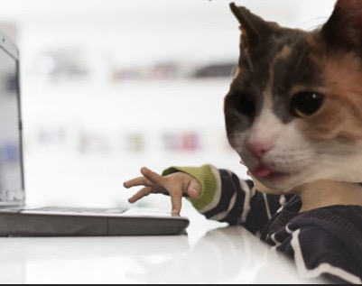
Question: Where do we go for basic information about something?

Slide 11
Look Online
Select 1-2 Topics
As a group, select 1-2 topics from our list.
Using more generalized sources for information, look up information about the topic(s) that you’ve selected.
Record what you find (and where you found it) on the google doc.

Slide 12
PILLAR Method
Preview
Scan the text for text features like pictures, bolded words, section headings, etc.
Identify
Make note of major topics or concepts that you find in the text.
List
Make a list of all of these important topics or concepts.
Make this list as detailed as possible – it will help you later on
Look online (or by using other resources)
First focus on common sources for basic information
Then look at more specific sources (google scholar, Texas State Library, course materials)
Attempt to make sense
Using the information that you’ve found, attempt to define the topic in your own words
Read
(!!!)
Pay attention to how the text confirms (or rejects) information that you found while prereading.
Source: Armstrong, S. L., Lampi, J. P. (2017). PILLAR: A reading strategy for a new era of strategy instruction at the college level. Journal of Adolescent and Adult Literacy, 43, 3-17.

Slide 13
Crayola-ification of the World
Won a lot of awards as a blog post from science writer Aatish Bhatia
Focuses on language, but from a more empirical perspective
Parts 1 AND 2 are linked on CANVAS
There is also a .pdf file that has the two parts merged together

Slide 14
Reading Log 7
For this reading log I want you to focus on the links that the article includes to external information.
Follow 5 of these links as you read. In the left column, tell me what link you decided to follow for more information.
Complete the right column in the way we have always done. Focus on the questions: "Why is this information important?" and "What text connections can I make?"

Slide 15
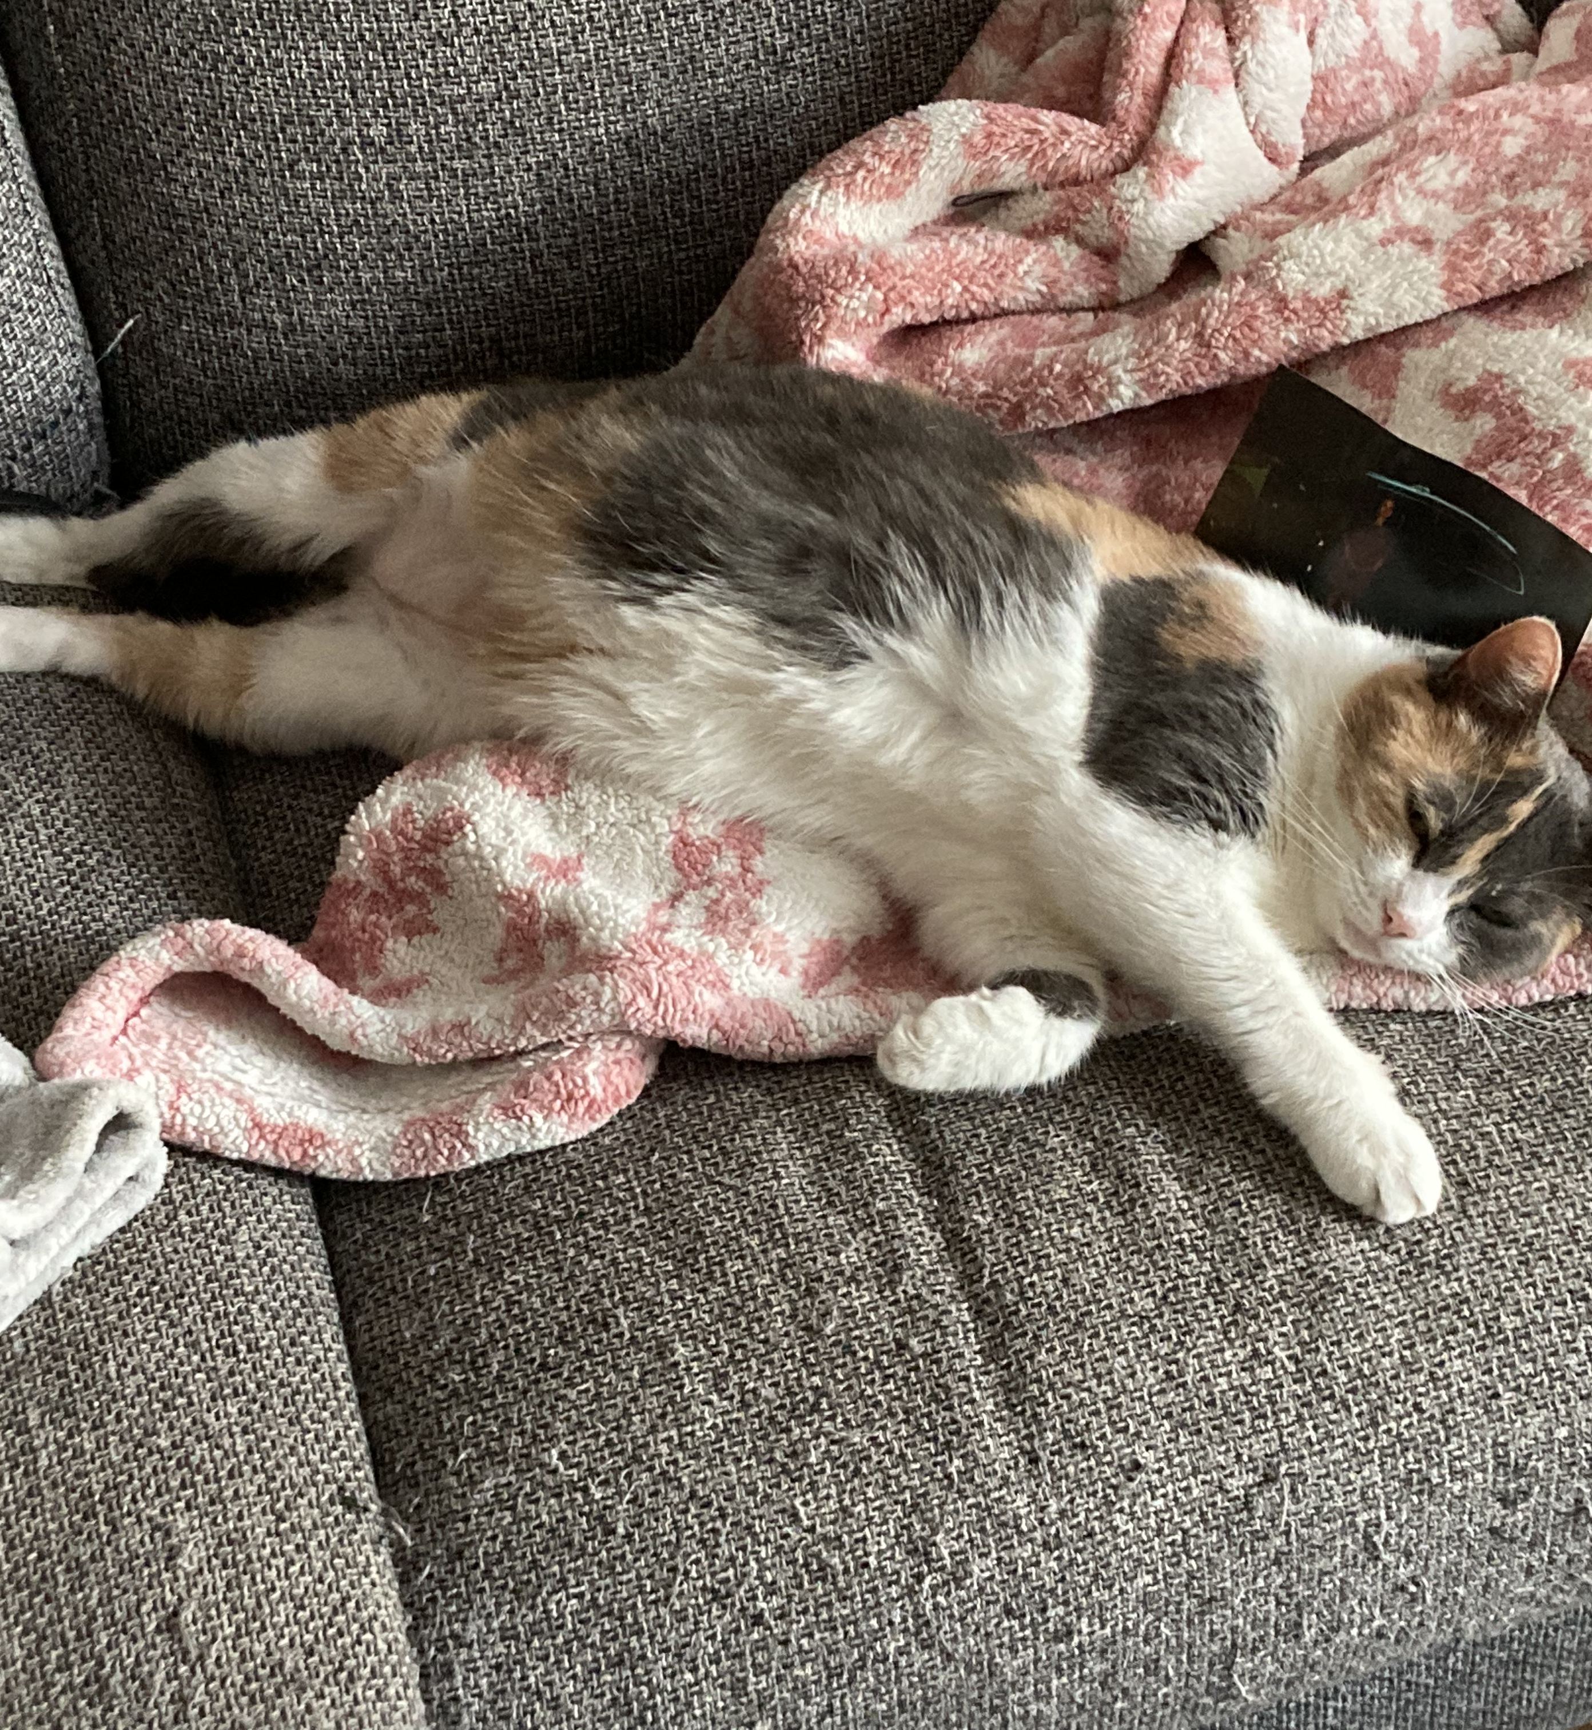
Show and Tell
For next class, bring in a “text” that you are reading (or have read) for another class.
This could be content from a learning module, lecture notes, a textbook, an article, etc.
Have access to it somehow for class Wednesday.
I have this blanket and also this couch and also this broken phone.

Slide 16
For next time
Read “The Crayola-ification of the World” (Parts 1 AND 2)
Complete Reading Log 7
Bring an example of a "text" that you are reading for another class

