Slide 1
RDG 1300_P07
For the start of class:
Please have your computers open to your Midterm Results on Canvas
Tuesday, 10.5
NOTE: I can’t require masks or vaccines in this class, but university leadership recommends both so that we can remain in-person this semester

Slide 2
In-Class Writing Assignment
Using the rubric that I passed out to you, provide a score for your midterm essay assignment in each box. Does this match up with the score that I gave you?
In a few sentences, explain and give your own reasoning for scoring your essay how you did.

Slide 3
Agenda
Midterm review
Preparing for next class..

Slide 4
Midterm Review
Class average: 76%
Most students missed points on the multiple choice
But quite a few got points back for their explanation
Many students did well on the long-answer questions (#9 and #10)
Essay question was difficult – most students got at least 15 points

Slide 5
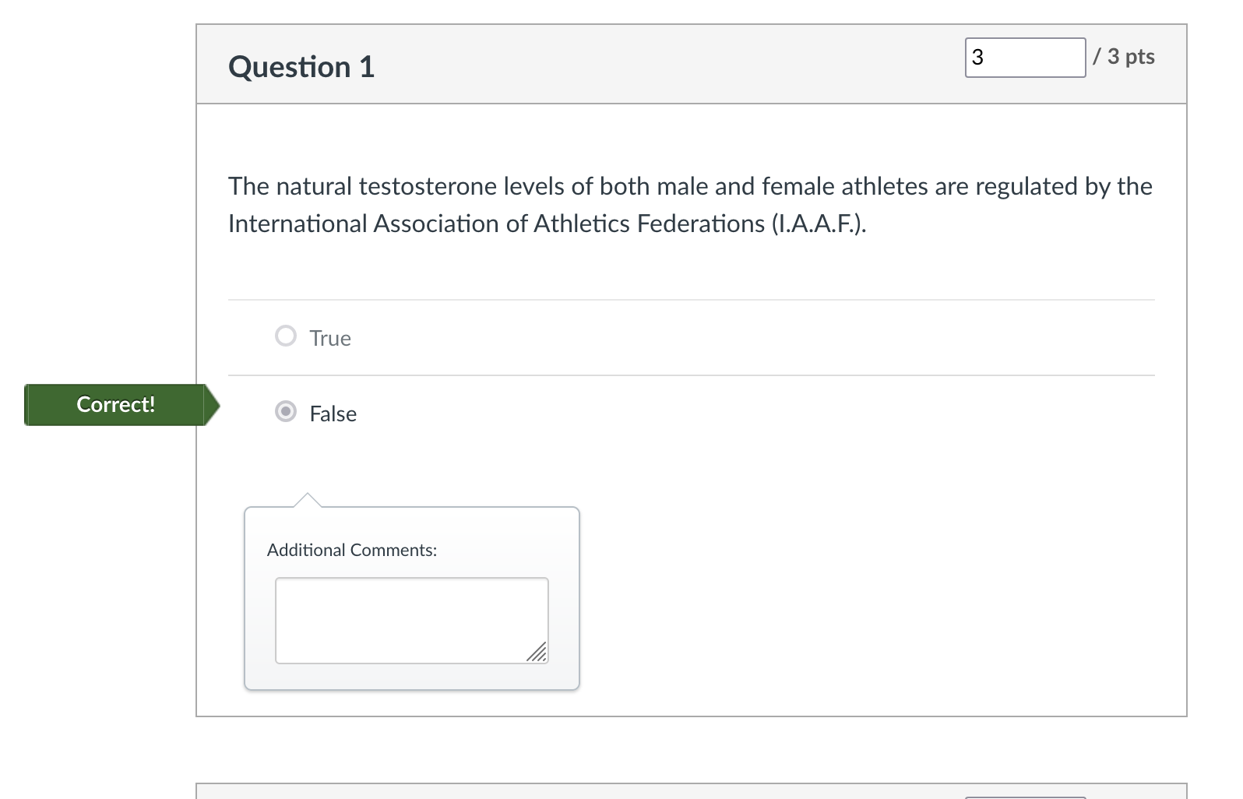
Midterm Review: Question 1
See examples in the text
Something we also talked about in class!

Slide 6
Midterm Review: Questions 2 and 3
Most students got this one right
Most other statements true for other athletes
Fourth option was the reason she was tested, not the reason she was banned from racing

Slide 7
Midterm Review Question 4
Correct responses did the following:
Mentioned that intersectionality refers to multiple social/cultural categories that are a part of one’s identity
Mentioned how the intersection of these categories can affect oppression
Provided an example from
Either text
Their personal lives
“In your own words, briefly define the concept of intersectionality. Support your definition with an example.”

Slide 8
Questions 5 and 6
More students struggled with the multiple choice component...
But were sometimes able to argue for their response using the definition of intersectionality
Intersecting categories/identities mentioend
Latinx students may be discriminated because of ethnicity
Students may come from lower-income backgrounds
As minors, they cannot advocate for themselves

Slide 9
Question 7
“List four strategies that the International Association of Athletics Federations (I.A.A.F) and the International Olympics Committee (I.O.C) used to enforce gender boundaries for Olympic athletes.”
Acceptable responses included
Checking testosterone levels
Gender verification forms/certificates
Chromosome testing
”nude parades”

Slide 10
Question 8
Many folks missed this one – read carefully!
”hermaphrodite” is specifically mentioned as being discriminatory/stigmatizing

Slide 11
Question 9
For this question I was looking for:
A clear explanation of the author’s purpose for using narratives
This could be various things – the important part was that you provided support for your answer
An explanation of how the narratives supported this purpose
A specific example from the text
Quotes weren’t necessary, but I was looking for specificity

Slide 12
Question 10
Looking for a clear argument summary from
The I.A.A.F.
Dutee Chand/Chand’s lawyers
Evidence from the text
NOT copy and pasted
Could use direct quotes, but sparingly
Paragraph format
Loosely enforced, but if you copy and pasted large quotes, you lost points here.

Slide 13
Question 11
See rubric!
Unclear introduction/argument/thesis statement
Forgot to use evidence from both texts

Slide 14
Question 11: Continued
Introduction
Clear and Relevant argument to the question
Read the question carefully!
Supporting Details
Does the content of your essay support/relate to your argument?
Evidence
From BOTH texts!
Citations/quotes were helpful
Organization
Structure = organized paragraphs
Relevance
Usage
Not something I often grade on – we’ll go through specific examples during conferences
*** For revisions, take some extra time to proofread your work. What tone/use of language is a test grader looking for?

Slide 15
Midterm Reflection
Extra credit!
Divided into two sections: Midterm Questions (1-10) and Midterm Essay (11)
Reflecting on ALL sections can earn you ½ of the points you missed back.
For example: if you missed 10 points (40/50) you can complete this reflection for 5 points extra credit.

Slide 16
Midterm Reflection Assignment
Midterm Reflection Assignment is a chance to get points back on your midterm
For each question that you missed points on, write a few sentences reflecting on what you might have done differently
For your essay you may rewrite based on your rubric + feedback from classmates
I will provide more detailed feedback during our conferences
Structure
Intro
What was your grade on your exam?
Was this surprising to you? Why/why not?
For which items did you not receive full credit?
Body
For each item that you answered incorrectly, reflect on your process/reading strategies
Essay
Rewrite based on your rubric
It doesn’t have to be perfect, but I should see an honest attempt

Slide 17
Midterm Reflection
Must be completed by your conference time.
Submit on Canvas!

Slide 18
Conferences!
Purpose of these conferences is to:
Go over your progress in class
Review your midterm responses
Talk about how the class is going to look moving forward

Slide 19
Conferences zoom invitation
Zoom meeting link
https://txstate.zoom.us/j/7439833496
Personal Meeting ID: 743 983 3496
*Watch announcements for zoom invites!

Slide 20
For next time
Midterm Reflection due by your conference time
Come to your assigned conference!

