Slide 1
RDG 1300_P07
NOTE: I can’t require masks or vaccines in this class, but university leadership recommends both so that we can remain in-person this semester
For class today you need:
To have completed Expansion #2: Metacognitive Reading Reflection Paper
When class starts
Open up a word document or have a pen and paper ready – something where you can quickly take notes for the Exam Review
Tuesday, 9.28

Slide 2
Agenda
Types of Test Questions
Midterm Exam Practice
Preparing for the Exam

Slide 3
Prepare for Today’s Class
Where will you keep your notes to prepare for the exam?
Open up a Word document or another place where you can quickly take notes for future review for the exam
Save the document before you start and don’t forget to save your work often!

Slide 4
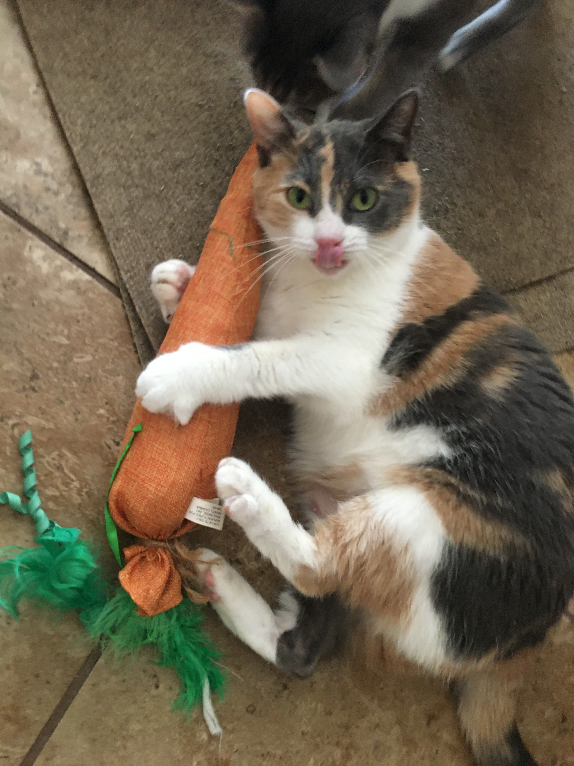
In-Class Writing (10 minutes)
EAT UR VEGGIES!
Essay response – Respond to this question in your midterm study guide notes
In a paragraph, summarize the author’s purpose for writing ”Too Fast to Be Female.” How does this purpose connect to Kimberlé Crenshaw’s idea of intersectionality? Use evidence from the texts to support your answer.

Slide 5
So you’ve got a midterm coming up… How do you study?
What’s the purpose of the exam?
What are the expectations?
What’s the format of the exam?
What types of exams have you completed in this class (or others in this subject)?
What do you need to show you know for the exam?
What does the syllabus or instructor say the test covers?
[As you get answers, add them to your study notes!]

Slide 6
15min: In your small group, look over important ideas (from either “The Urgency of Intersectionality” OR “Too Fast to Be Female” that your wrote in your summaries/marginal annotations
Which of these seems most likely to be on the midterm?

Slide 7
Reviewing the Question Types – True/False
Often times these questions come with clues that make answering them a bit easier.
Look for terms like “always” or “never” or any terms that imply an extreme or absolute position/statement
Typically rely on recalling information, rather than critical thinking.
This means DON’T overthink these
HOWEVER, you should always read these questions very carefully

Slide 8
Reviewing Question Types – Multiple Choice
Similar to true/false, these usually rely on recall
BUT these questions may ask you to select the BEST answer, and may include several correct-ish options

Slide 9
Multiple Choice Strategy #1
Read the question and cover up the possible answers.
Before reading any of the options, how would you answer this question?
Select the response that is closest to your prediction

Slide 10
Multiple Choice Strategy #2
Be skeptical of answers with “100 percent” or ”0 percent” words
All/Never
No/none
Every
Always
Must
Only
Ex: “How does James feel about pickles?”
a.) All pickles belong in the garbage
b.) Most pickles are gross, but homemade pickles are usually okay
c.) James never turns down a pickle
d.) Pickles are the only food that James likes to eat on a hamburger

Slide 11
Multiple Choice Strategy #3
If two options are synonymous (mean the same thing), they are BOTH incorrect, unless the question allows you to select multiple answers.
A good strategy for tricky questions is to group possible answers and try to figure out whether or not two answers are synonymous or mutually exclusive
Ex: “Why does James have so many cats?”
Because he never developed social skills with humans
Because James is really just a bunch of cats wearing people clothes and a realistic human mask
Because James isn’t good at making human friends
For tax purposes
All of the above

Slide 12
Multiple Choice Strategy #4
“All of the above” is not ALWAYS the right answer
If one response is obviously incorrect, you can’t select ”all of the above”
However, if two responses seem correct, and you’re not sure about the other one, “all of the above” might be a good guess

Slide 13
Multiple Choice Strategy #5
If you’re really not sure about an answer, mark it and move on. Sometimes a test author will mess up and imply the correct answer accidentally later on.

Slide 14
Multiple Choice (Bonus)
Instructor errors
Sometimes instructors (or their graduate assistants) are asked to come up with multiple choice exams on very short notice.
Correct answers will usually be pulled directly from a text
Incorrect or dummy answers are usually written by authors on the fly
Thus, these answers MAY be more likely to have grammatical/spelling errors, or rely on ridiculous ideas or emotional language

Slide 15
Short answer items
Typically, these questions are also intended to test your recall of information
BUT these questions usually move a step forward to test your comprehension and often require you to put concepts in your own words, or explain your answers
Remember – the instructor thought this question was significant for a reason. Try to predict what that reason might have been.

Slide 16
Essay/Long Answer Questions
Typically, these questions take the most time.
Preread your exam if you can – make sure to allow for plenty of time to answer essay questions.

Slide 17
Essay/Long Answer Questions - Drafting
If there are multiple questions, make sure to answer each of these questions explicitly.
Seriously (SERIOUSLY) you are much more likely to receive full credit if you plan out your answers first
5 paragraph essay IS relevant here

Slide 18
Essay/Long Answer Questions - Drafting
If there are multiple questions, make sure to answer each of these questions explicitly.
Seriously (SERIOUSLY) are much more likely to receive full credit if you plan out your answers first
5 paragraph essay IS relevant here
Example Outline
Claim (clear thesis statement that summarizes your answer in 1-2 sentences)
Evidence (specific examples from the texts that support your claim)
Explanation (analysis/your interpretation of the evidence to explain how it supports your claim)

Slide 19
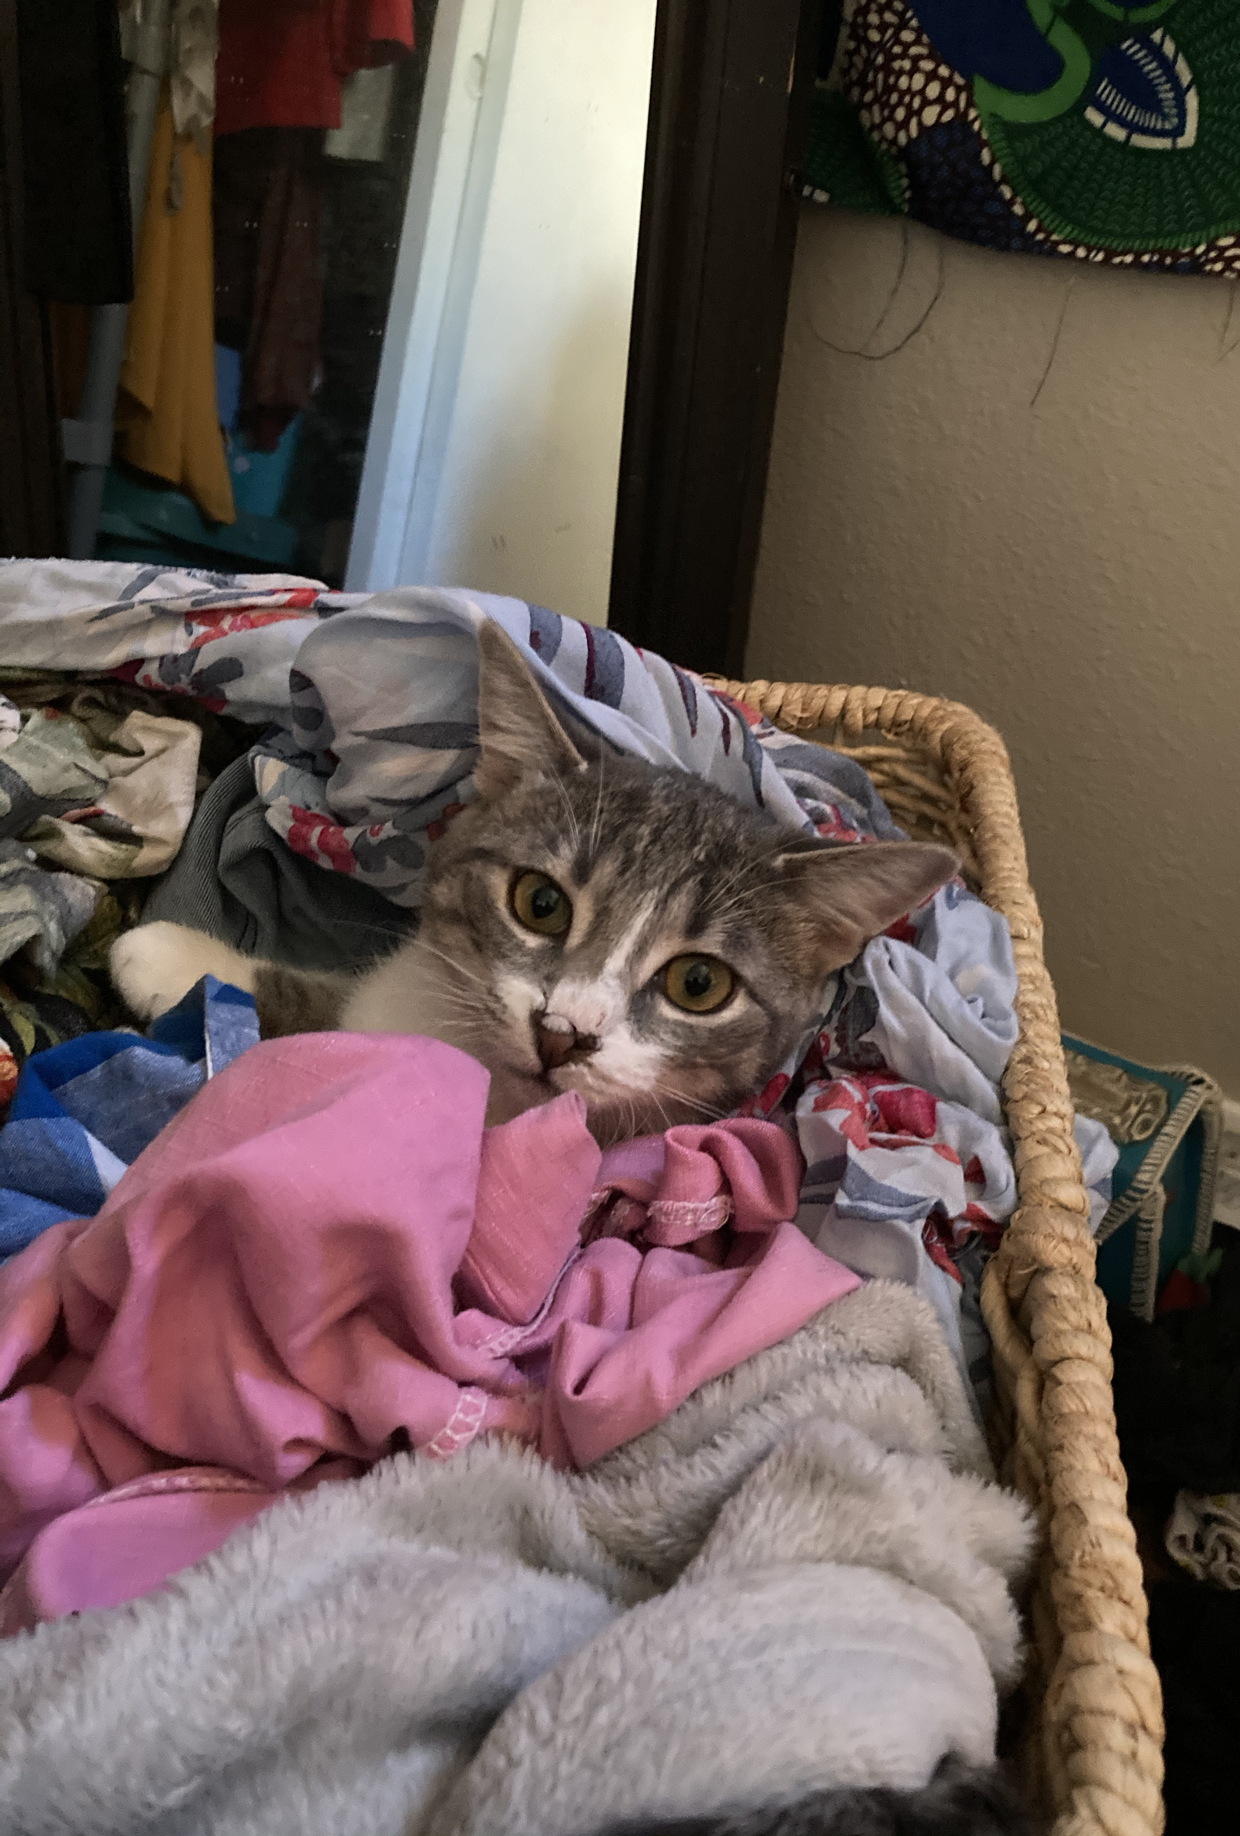
Essay/Long Answer Questions - Style
You probably won’t get style points for these responses.
Avoid flowery or overly dramatic language. Get to the point as fast as possible
Essays responses are usually graded with a rubric
A grader is probably checking off a list to make sure that you answer each portion of the question appropriately
Structure matters
Intro/thesis, Answer part 1, Answer part 2 (etc.), Conclusion

Slide 20
Collaboration
As a group, share your approach to the essay question that we did at the start of class.
Using the test-taking strategies that we discussed, restructure your answer

Slide 21
Midterm Exam Prep
Midterm Components
True/False
Vocabulary in context
Multiple choice + Explanation
Short-answer
Text Connections between “Too Fast to Be Female” and “The Urgency of Intersectionality”
Essay Response
What you can use
Your readings/the video (Open book!!!)
Your notes
Any Canvas resources/discussion posts, etc.
What you need to know
Worth 50 points
We’ll take it in class on Wednesday
Pleasepleaseplease let me know if you need any additional accommodations (Ex. extra time, quiet testing space).

Slide 22
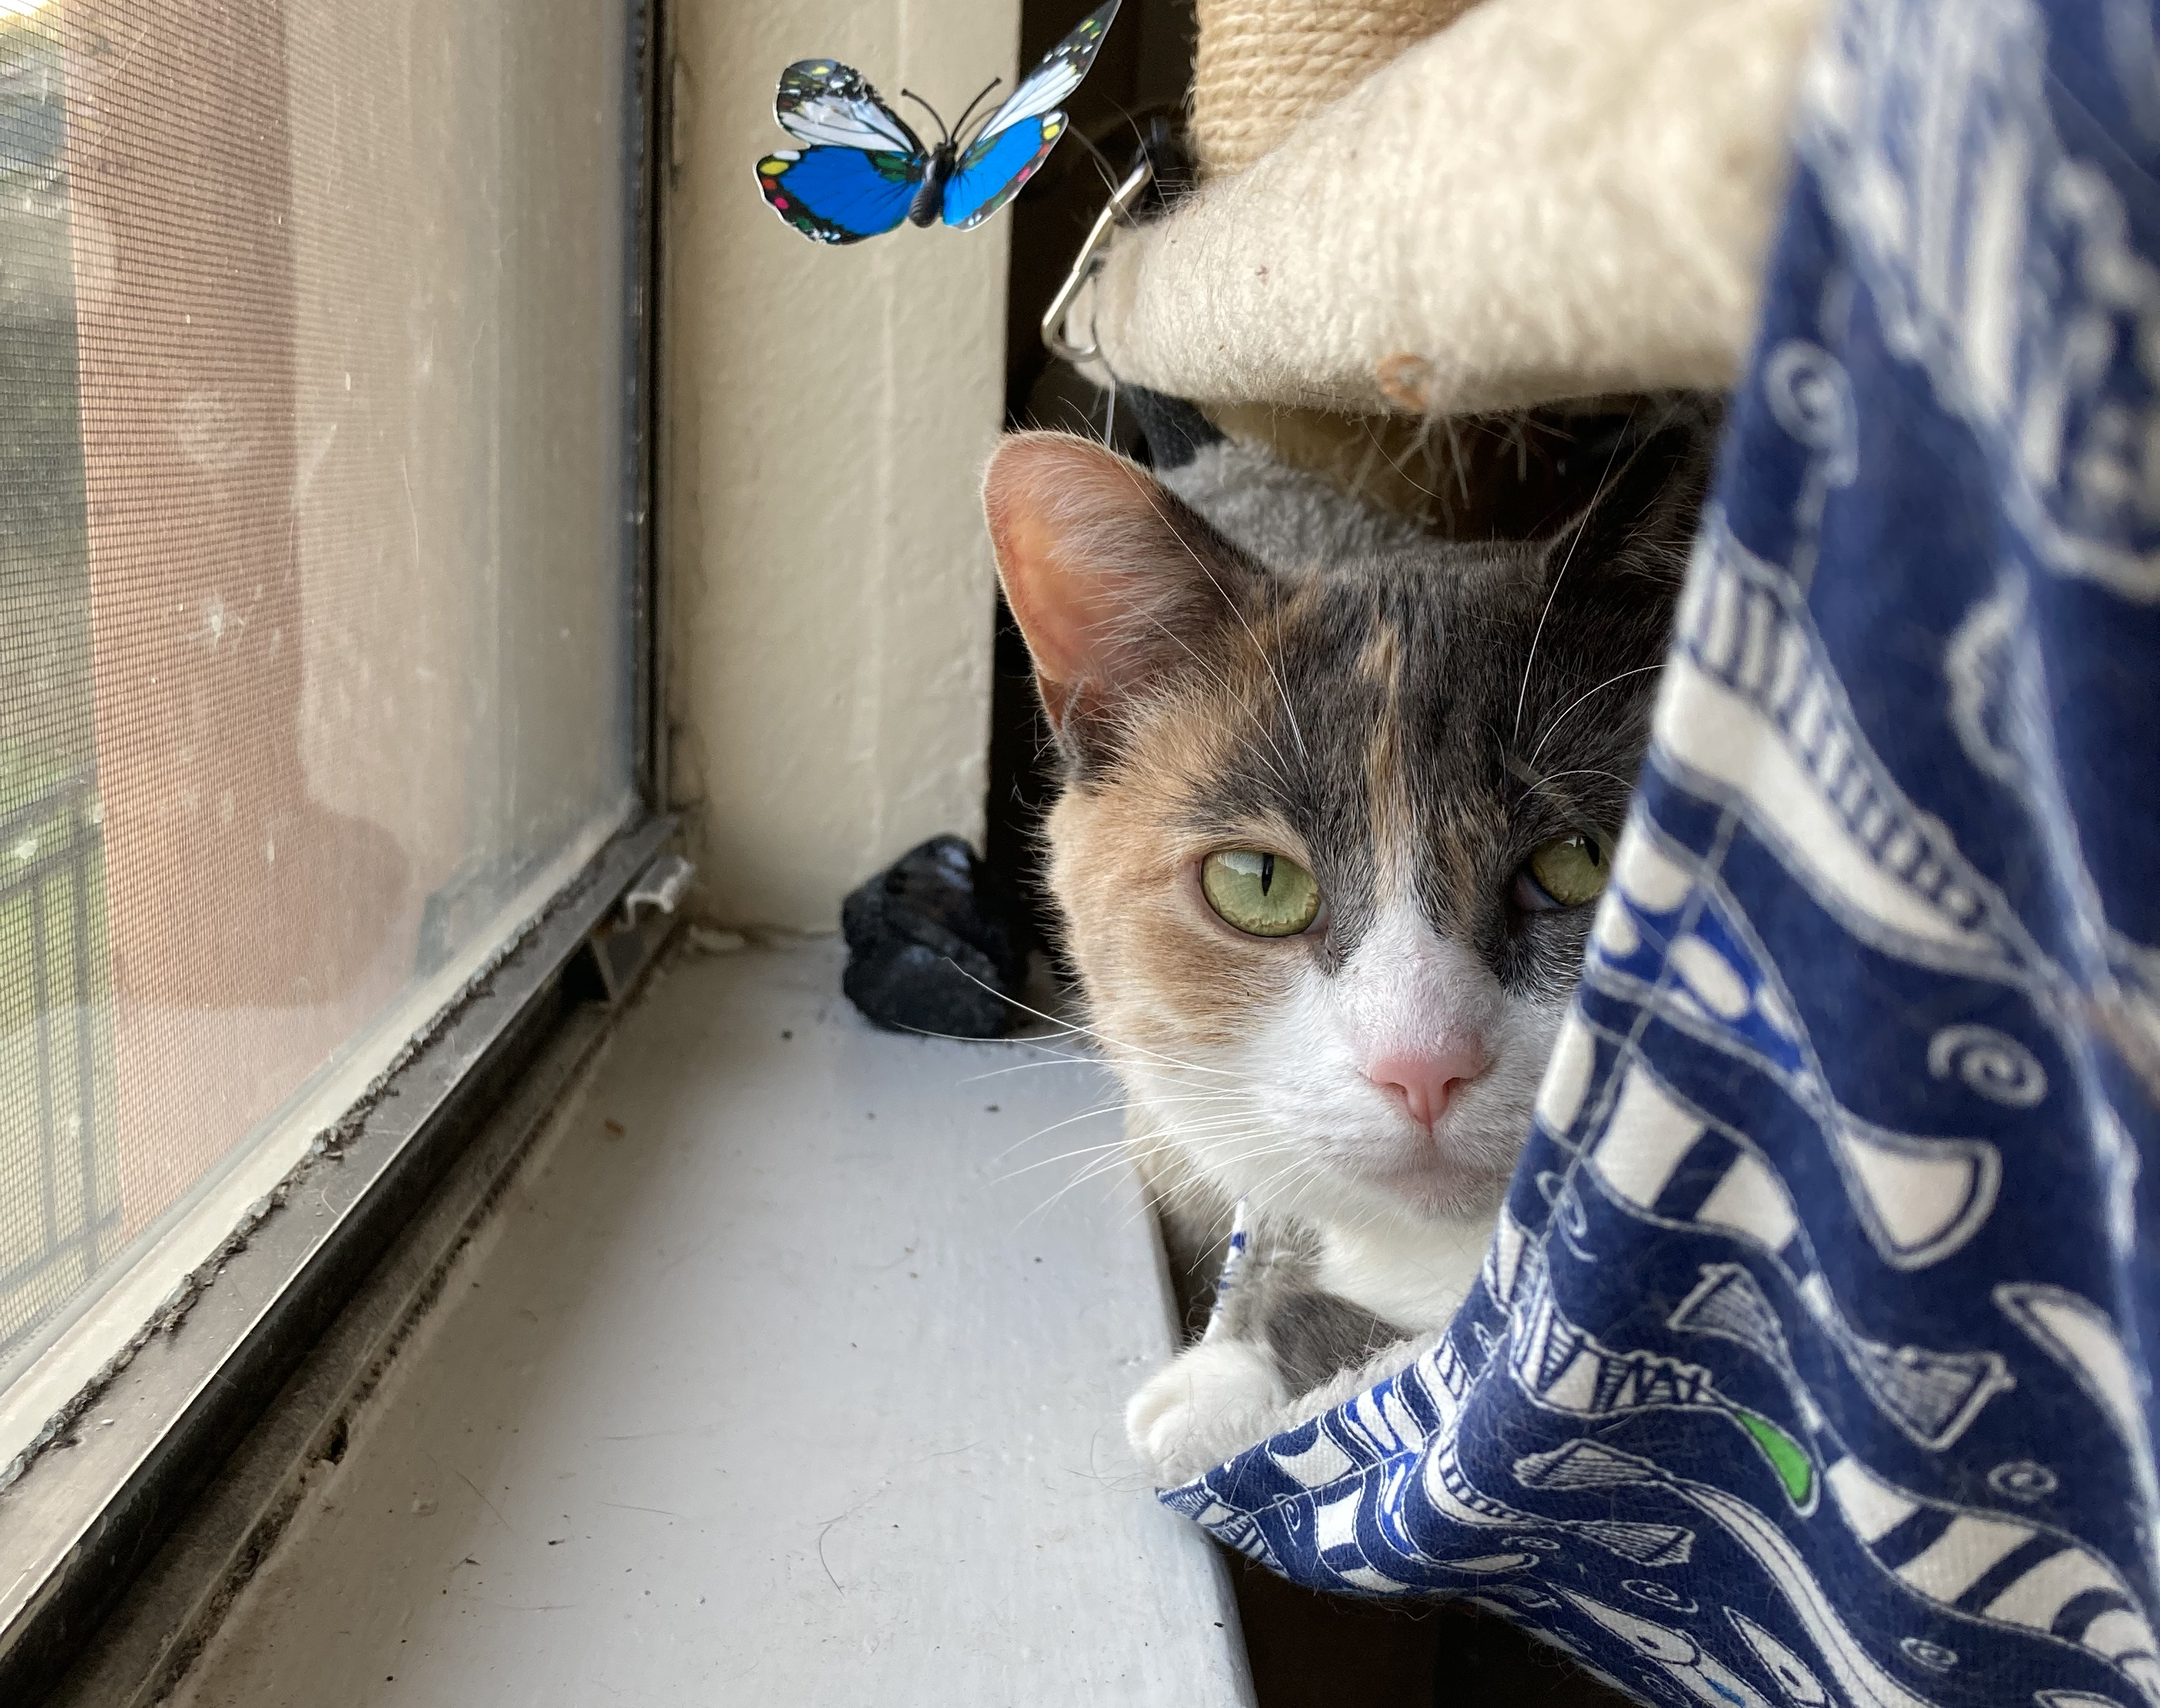
For next time
Prepare for Midterm Exam
Bring Laptops
Have access to readings
Also, DO the readings

