Slide 1
RDG 1300_P07
NOTE: I can’t require masks or vaccines in this class, but university leadership recommends both so that we can remain in-person this semester
For class today you need:
To have read “Too Fast to Be Female
To have completed Reading Log 6.5
When class starts
Have your computer (if you have one) opened to your annotations of “Too Fast to Be Female”
Thursday, 9.23

Slide 2
New Seats!
Front of Class
Jose | Jenise
Kenzee | Kyra
Jayla | Gabe
Collin | Jackson
Cam | Patricia
Ilan | Maddie
Jasmine | Stephanie
Divine | Richard
Delani | Kaia
Courtney | Sophia

Slide 3
Foul Play: Indian Sprinter Dutee Chand’s Challenge Against Gender Testing
Link: https://www.youtube.com/watch?v=u1UYPX4AsNo

Slide 4
Agenda
Using outlines to summarize
Reading Strategy Reflection Paper #1
Dutee Chand Video
What’s a “main idea”?

Slide 5
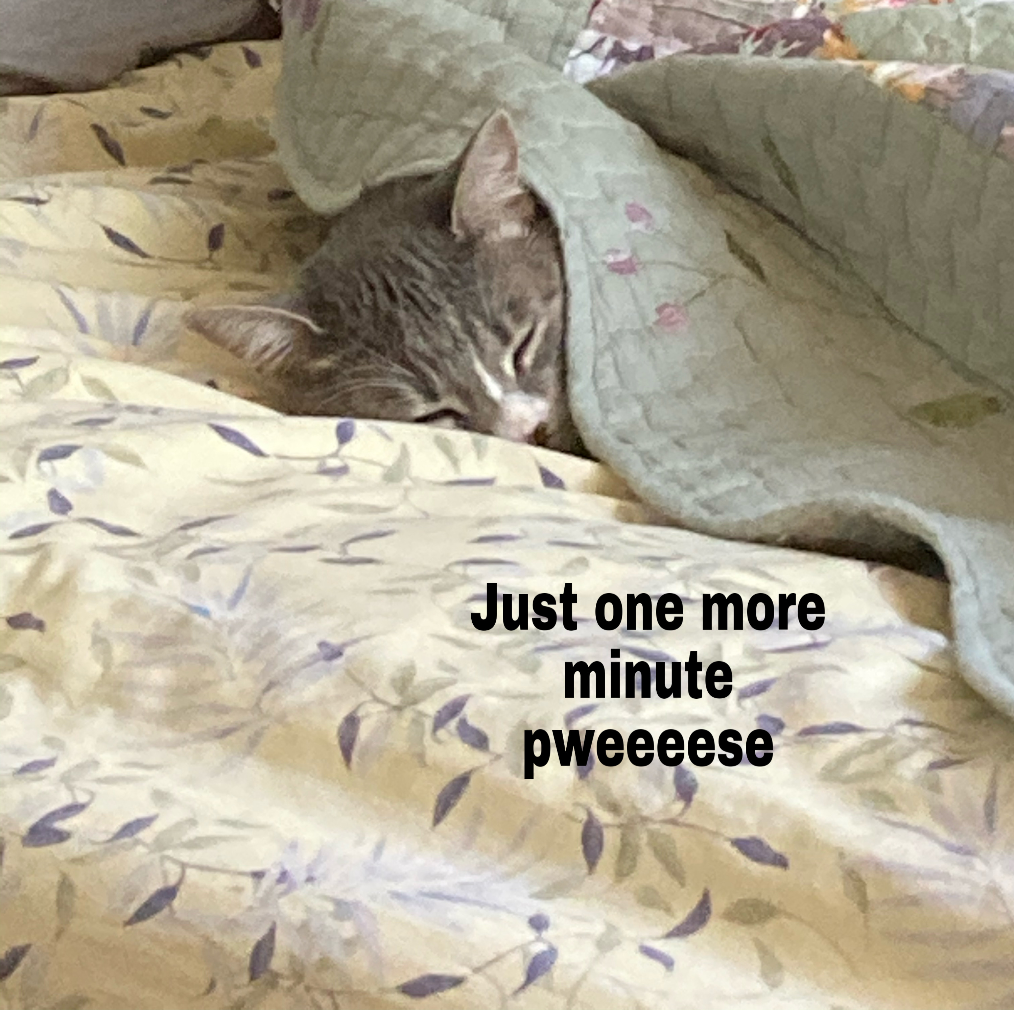
In-Class Writing
Under today’s Canvas module, respond to 9.23 Discussion
In your own words, what is the main idea of “Too Fast to Be Female”?
(Hint) make sure to use evidence from the text
(Hinthint) maybe from your marginal annotations?
What questions do you still have about Dutee Chand’s story?

Slide 6
Let’s talk about MAIN IDEAS … dun dun dunnnnnnnn
So, what is a main idea?

Slide 7
Let’s talk about MAIN IDEAS … dun dun dunnnnnnnn
Often, when an instructor asks for a main idea, they have a single answer in mind
HOWEVER, the actual main idea of a text is dynamic and depends on context.
Not the main idea. Rather, a main idea
A main idea is a message that the author is attempting to convey through a specific text

Slide 8
Okay, but how do I find it?
Different ways instructors ask for a main idea in a reading:
Main point
Gist
Central focus
Thesis (this is also used for the main idea/argument of your own writing)
Controlling idea
Central Thought

Slide 9
No seriously, how do I find it
Literal level
What is the author literally saying in a text?
Ex “The main idea is to tell the story of Dutee Chand and about how she overcame discriminatory gender testing.”
Interpretive Level
What did the author mean by what they said?
Ex “The author wanted to tell the story of Dutee Chand to complicate the idea biology can be used to place people into two distinct gender categories.”

Slide 10
NO SERIOUSLY, SERIOUSLY, HOW DO I FIND IT!?
Applied Level
How does the author’s message apply to other situations?
Ex: (???)

Slide 11
Which main idea, when, and why?
As a student, it can be difficult to determine which main idea an instructor is asking for.
Literal main ideas generally focus on recall of information and summarizing.
Interpretive main ideas involve answering why or for what purpose an author chooses to write a certain text
Applied main ideas are intertextual, which means that they apply to other texts or situations outside of the text

Slide 12
Discussion Response
Go back into the CANVAS discussion board for today’s class.
Respond to two of your classmate’s discussion posts (from your table).
Analyze the main idea that they pulled from the text – if it’s a literal main idea (a summary of the text), discuss how they might turn it into an interpretive or applied main idea
If the main idea they found was interpretive or applied, look at the support they gave. Was it convincing for you? Why or why not?

Slide 13
This is about/This is REALLY about
Summarizing is an important skill, but it can mean A LOT of different things depending on what your purpose for reading is
Compile all of your marginal annotations on “Too Fast to Be Female” into a list. At the top of this list, write down your “main idea.” This list is your rough outline of the reading.
Review your list. Delete items that aren’t directly relevant to what you have determined is the “main idea.”

Slide 14
Google Doc: Two-Sentence Summaries
Summary writing practice!
Using your revised outlines, write a summary of your article using TWO SENTENCES
Work on this as a group, using your collected marginal annotations to create a summary that you all agree with

Slide 15
MARSI Strategies: Summary Outlines
Sup #6: I summarize what I read to reflect on important information about the text
Sup #20: I paraphrase (restate ideas in my own words) to better understand what I read
Sup #24: I go back and forth in the text to find relationships among ideas in it.
Sup #28: I ask myself questions I like to have answered in the text

Slide 16
Expansion #2: Metacognitive Reading Reflection Paper
To complete you need:
MARSI Scores
An understanding of what your own MARSI scores mean
What strategies do I frequently use?
What strategies do I rarely/never use?
To write 4 paragraphs (at least 750 words)
A thesis statement – how do I define my reading style?
3 paragraphs organized around your use of global, support, and problem solving strategies
Talk about how you used/didn’t use these strategies for our reading assignments
Submit a Microsoft word document (.doc or .docx) to the appropriate place on Canvas

Slide 17
Expansion #2: Metacognitive Reading Reflection Paper
Using the MARSI -- write a summary statement that describes your overall reading strategy use (strengths/areas for growth).
Paragraphs on each of the strategy categories + examples of how you use/don’t use them
Conclusion – “Watchu gonna do about it?”

Slide 18
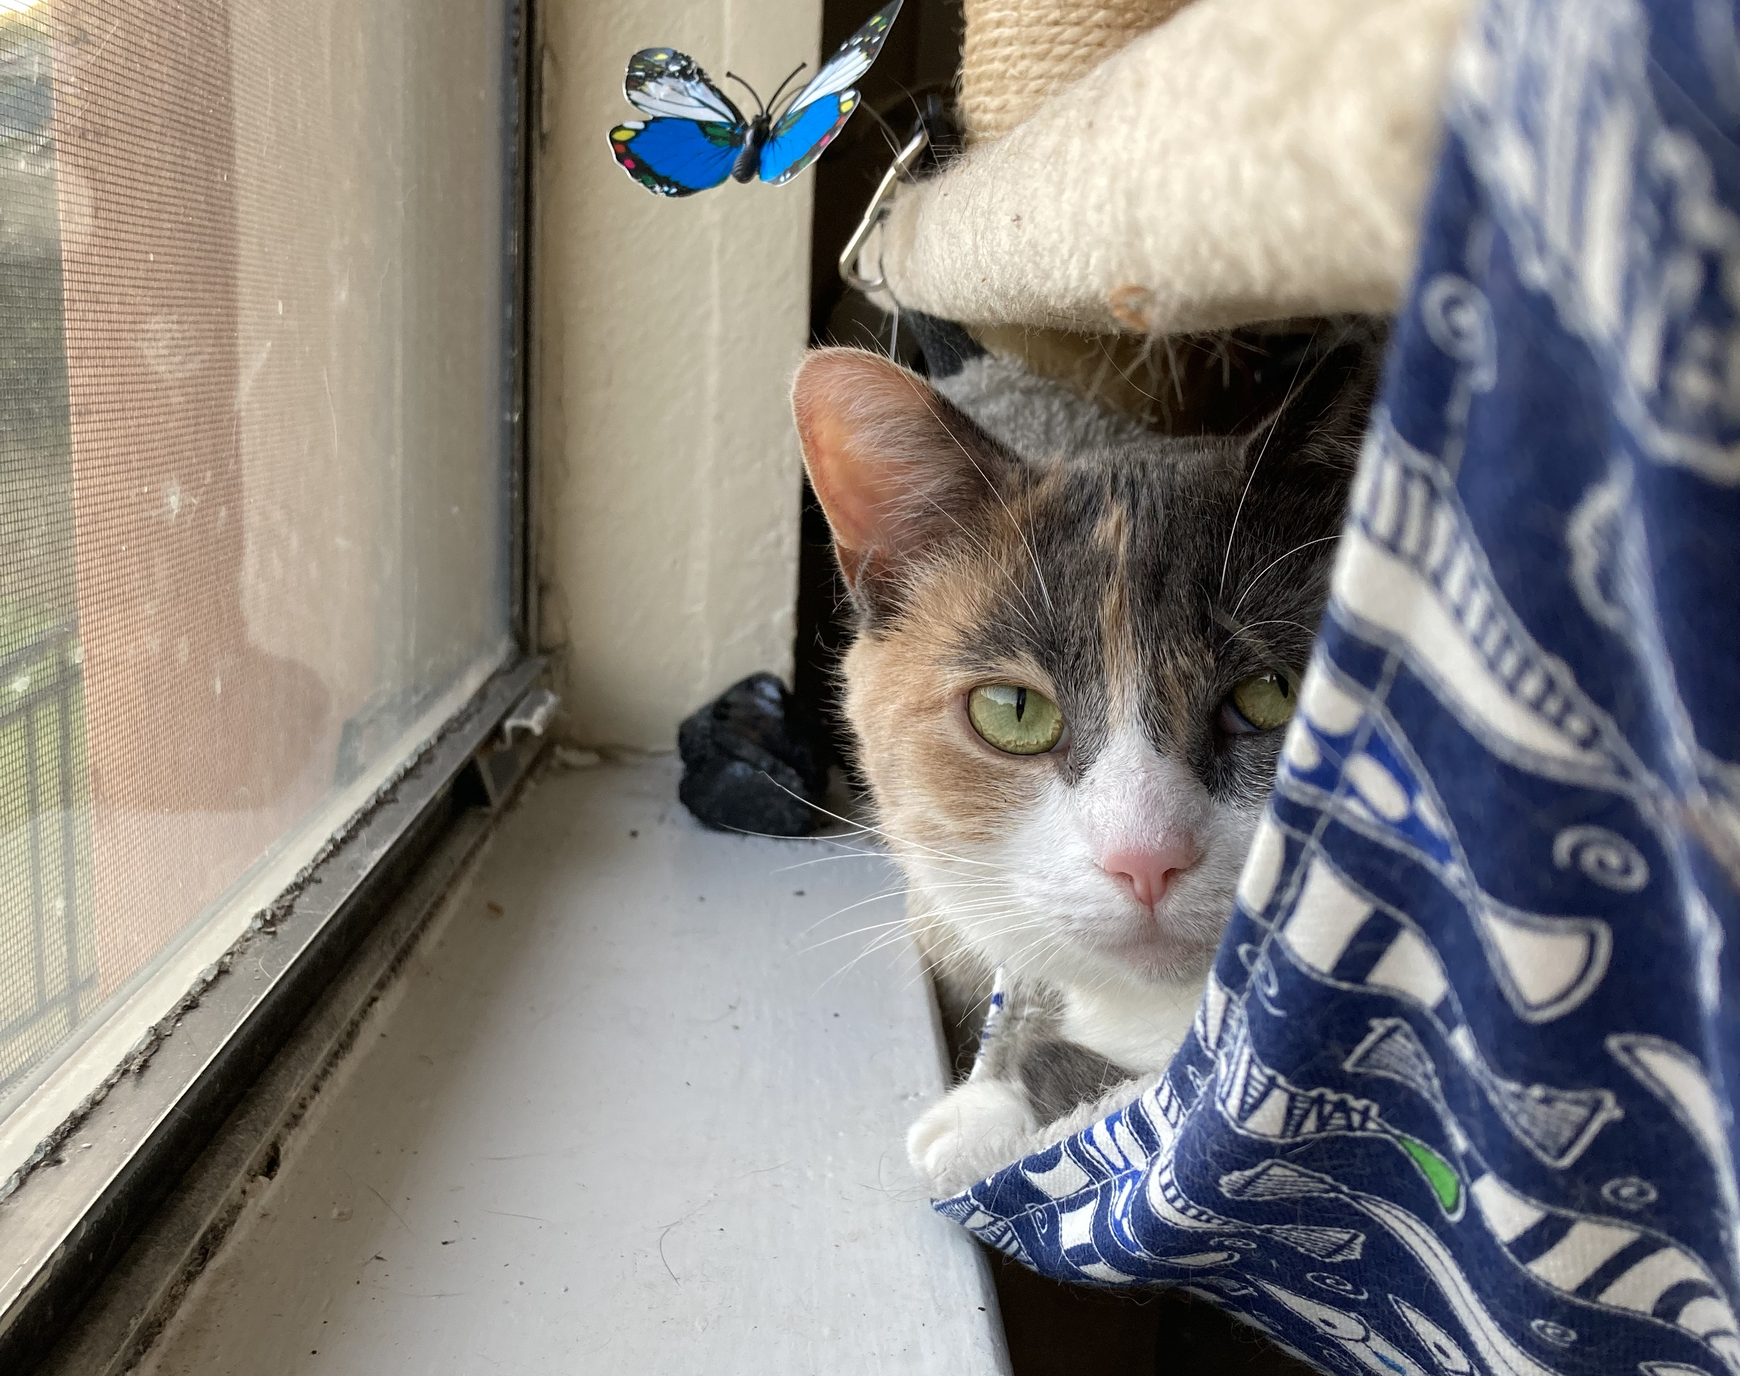
For next time
Metacognitive Reading Reflection paper draft due BEFORE CLASS (!!!)
(that’s it!)

