Slide 1
RDG 1300_P07
NOTE: I can’t require masks or vaccines in this class, but university leadership recommends both so that we can remain in-person this semester
For class today you need:
To have read “Too Fast to Be Female
To have completed Reading Log 6
When class starts
Have your computer (if you have one) opened to Canvas, or take out something to write with
Tuesday, 9.21

Slide 2
New Seats!
Front of Class
Jose | Jenise
Kenzee | Kyra
Jayla | Gabe
Collin | Jackson
Cam | Patricia
Ilan | Maddie
Jasmine | Stephanie
Divine | Richard
Delani | Kaia
Courtney | Sophia

Slide 3
Agenda
Class so far…
“Too Fast to Be Female” discussion
Marginal Annotations and Reverse Outlines

Slide 4
Class so far…

Slide 5
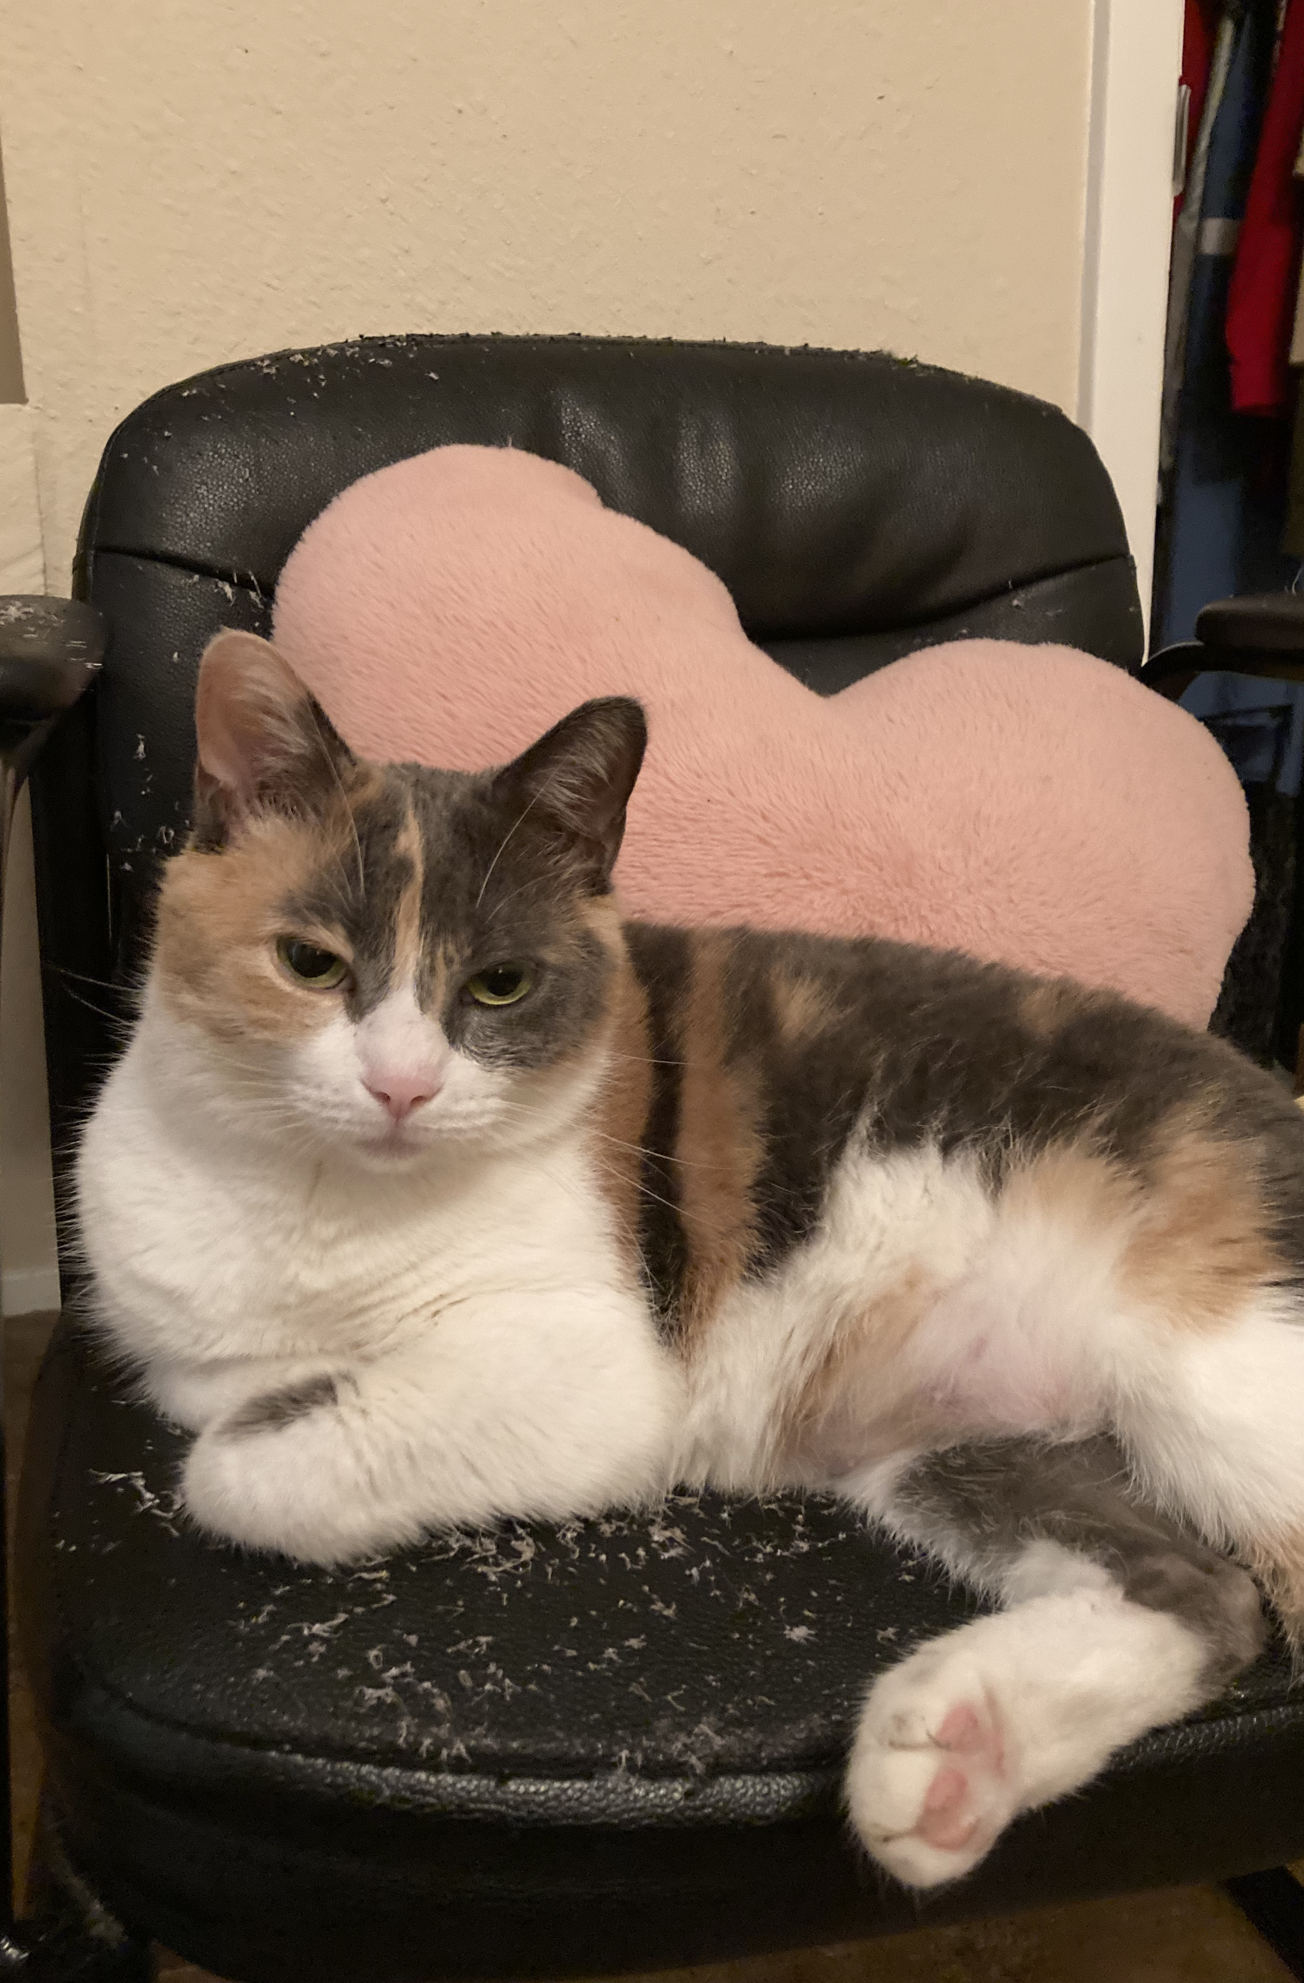
In-Class Writing
In this week’s Canvas module, complete your response under the “In-Class Writing 9.20” assignment.
What reading/discussion/class period has stood out to you as the most challenging so far?
Considering the readings and our class discussions, what gives you hope for the future?
Moving forward, what would you like to see happen in this class? What changes would you like to make?

Slide 6
“Too Fast to Be Female” Discussion
In your small groups, share your responses to the following questions:
Before reading the article, what were some of your predictions about what it was going to be about?
What were sections of text that you included in your reading log?
What were your comments on these sections of text?
As a group, try to use your annotations to create a 1-2 sentence summary of the article.

Slide 7
Reading Strategy: Marginal Annotations
Support Strategy –
Taking notes (MARSI #2)
Summarization (MARSI #6)
Paraphrase (MARSI #20)
Asking questions while you read (
Useful for longer readings or readings that are densely packed with information
Useful to use while you read, but also may be useful as a way to preview a text
If you use it like this it’s more of a ________ kind of strategy

Slide 8
Marginal Annotations – Getting Started
Guiding Questions
You can form guiding questions by skimming the title, looking at the length of the reading, any pictures or charts/graphs, etc.
You can (and should) add to these guiding questions as you read
My Guiding Questions
Does Chand win a medal?
What is the controversy related to intersex athletes?
How long is this after “Too Fast to be Female”?

Slide 9
Marginal Annotations Example
Last Friday evening, I tuned in to watch The Riveter’s Tracking Board on Pinterest star, Dutee Chand, race in her first Women’s 100-meter dash of the 2016 Rio Olympic Games. Her short stature made her stick out when she stood next to her long legged competitors, preparing to take the track. I thought to myself, how could this one athlete stir up this much controversy? Then I saw her run. When the cannon blew, Chand became a 5-foot-tall bullet, zooming past the other racers in her hot pursuit to the finish line. | Chand Controversy in 2016 Rio Olympics Short compared to others and surprisingly fast Imp for blocking – related to stride, less energy 4 reach (pros and cons) Question: Does she win? Question: What is the controversy

Slide 10
Marginal Annotations Practice
Individually, read and make marginal annotations to the “Keeping up with Dutee Chand” article
Start by outlining any additional guiding questions
As you read, make notes in the margins. These notes could be related to:
Keywords
Summaries of the paragraph
Questions that you may have
Text connections
Predictions
Remember, the goal is to make these annotations as short as possible.

Slide 11
Marginal Annotations Discussion
What are some of the benefits of this approach to annotation?
What kinds of readings does this work well for?
What kinds of readings might it not work well for?
How might you adapt this to your re-reading of “Too Fast to Be Female”?

Slide 12
“Too Fast to Be Female” re-read
Individually, adapt the Marginal Annotations strategy for use with “Too Fast to Be Female”
Your goal for these annotations is to create a rough outline of the article
In Wednesday’s class, we will use these outlines to write a rough summary of the article.
It doesn’t have to be every paragraph, but don’t skip more than two in a row

Slide 13
Reading Log 6.5
For reading log 6.5, the purpose is to re-read and re-annotate the article, "Too Fast to Be Female."
To complete this assignment:
Print out the article "Too Fast to Be Female" (you may also add your annotations to a .pdf file).
Using the marginal annotation strategy that we practiced in-class, write short notes in the margins (incomplete sentences and phrases are fine)
You don't have to make notes for every paragraph, but don't skip more than two in a row.
These notes might be short summaries, questions that you have, definitions of terms, or text connections.
In Wednesday’s class, we will use these outlines to write a rough summary of the article

Slide 14
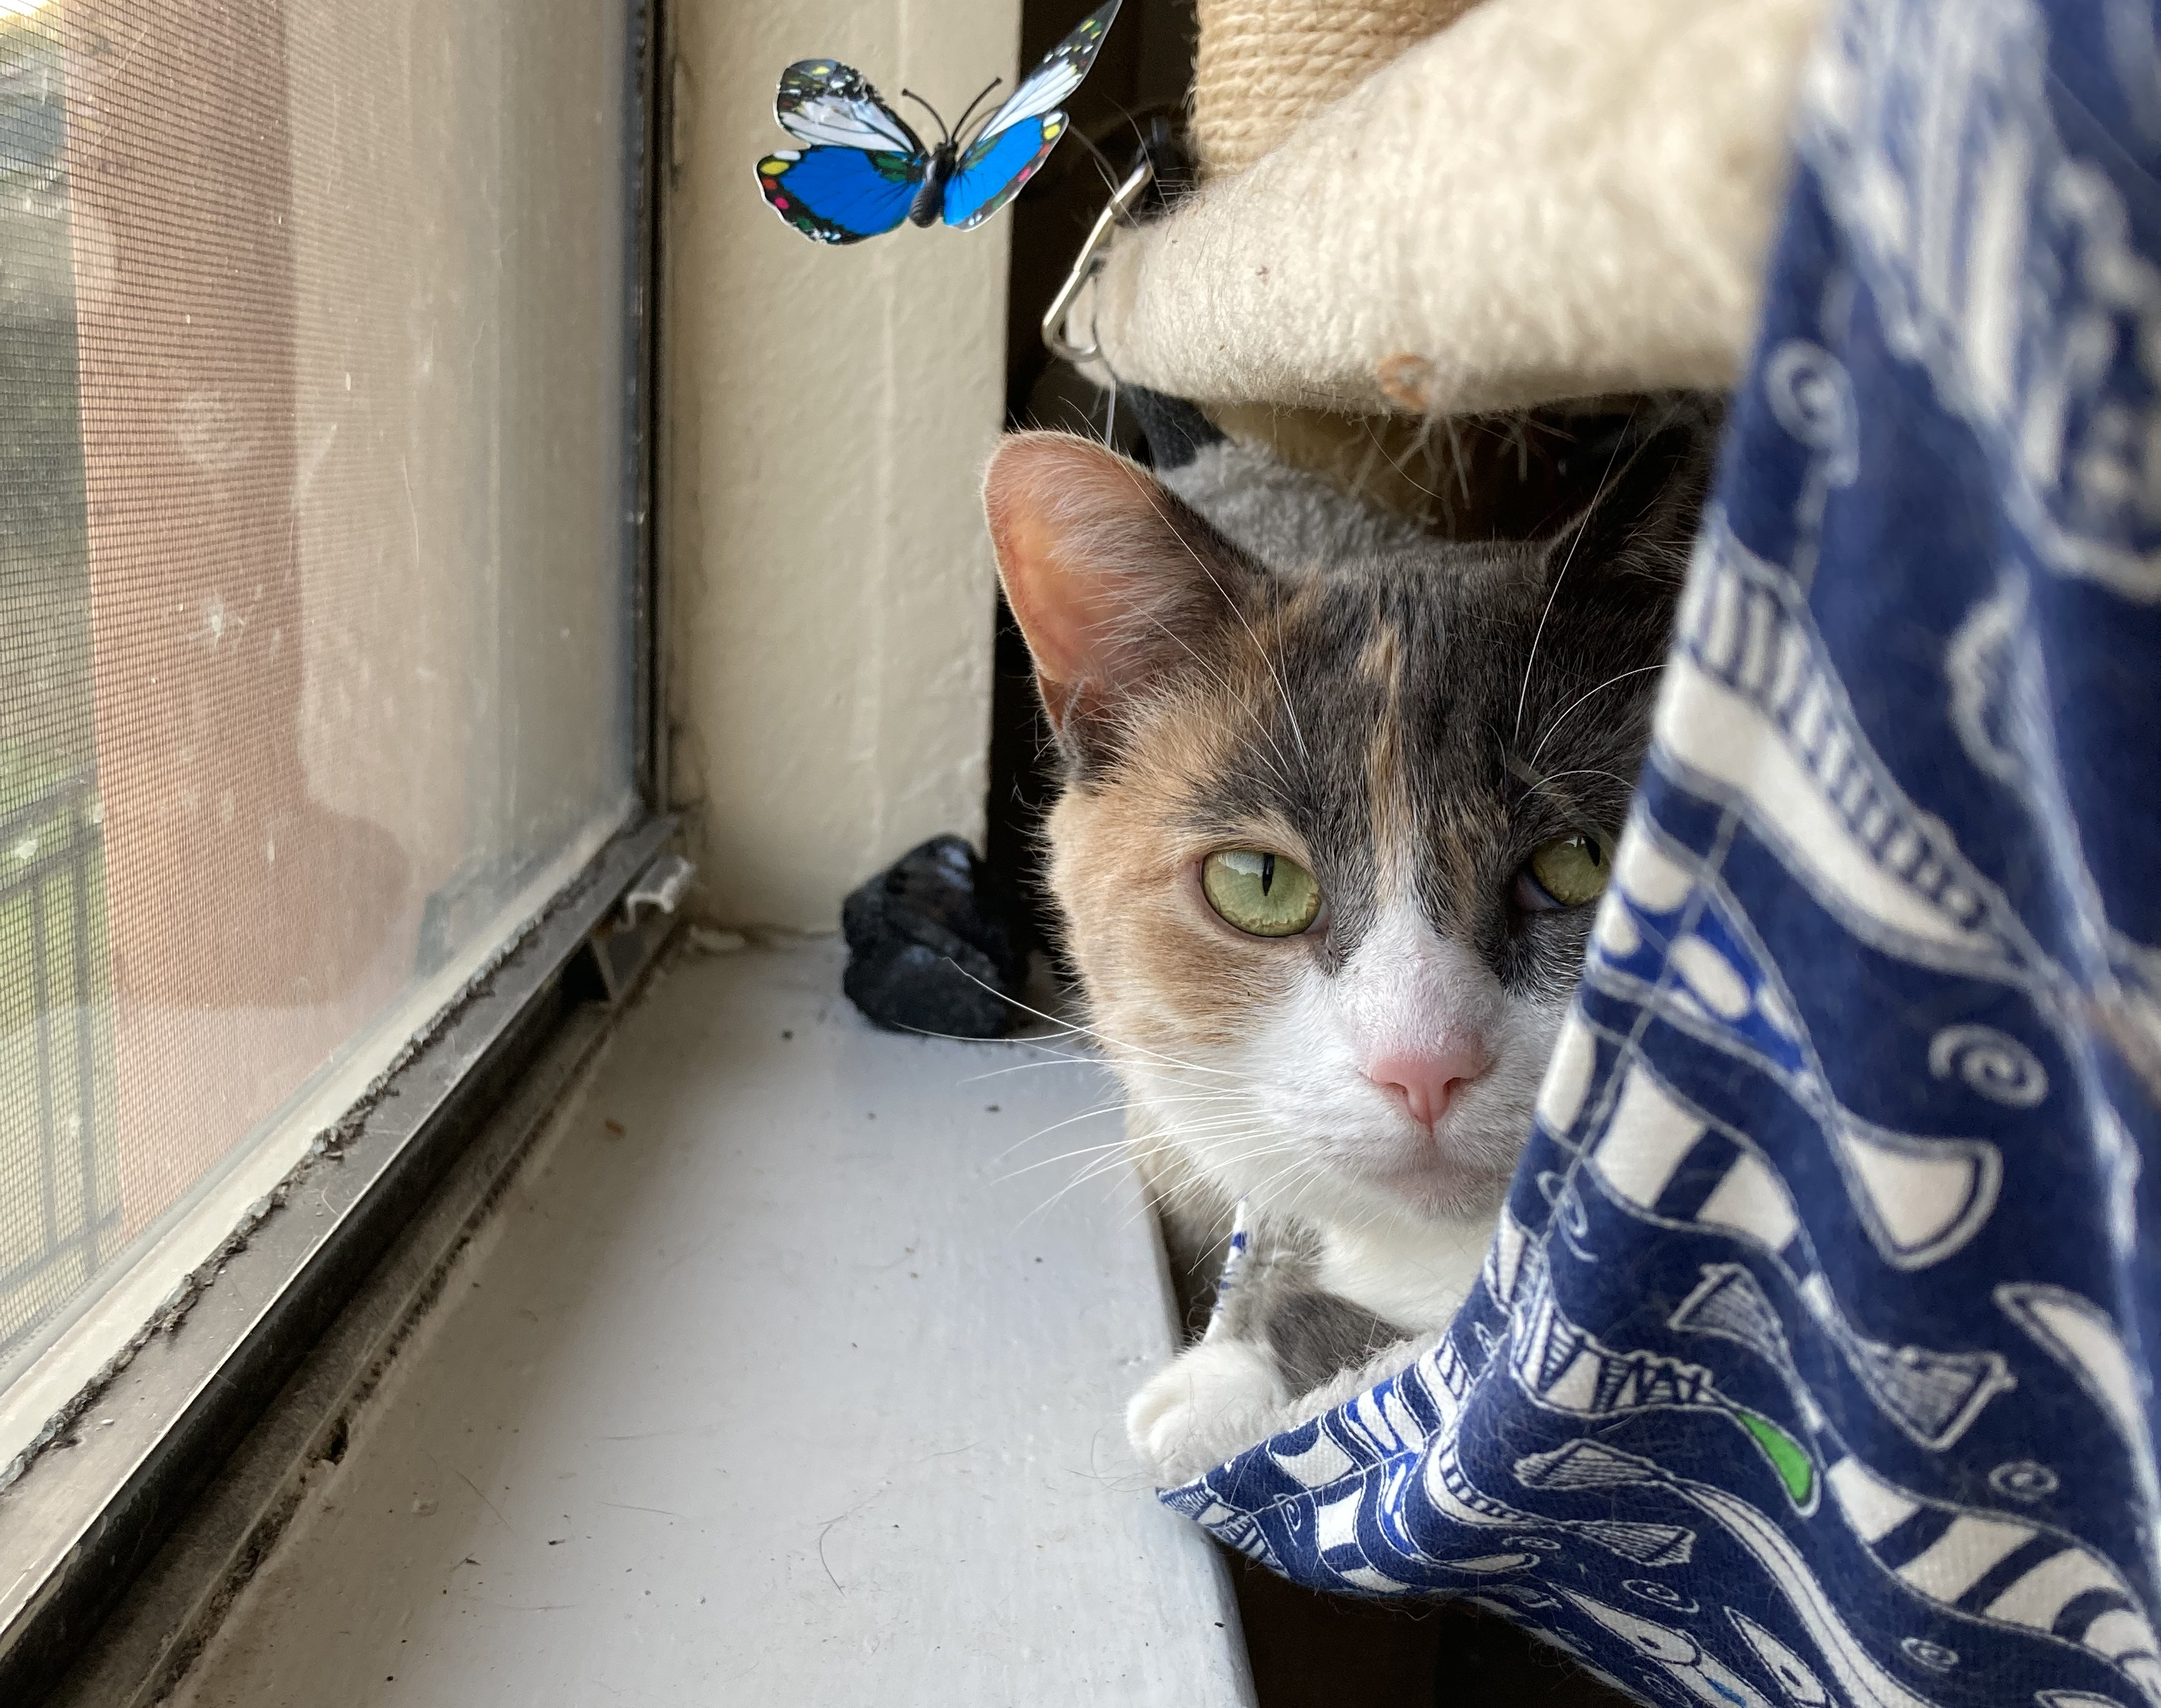
For next time
Re-read ”Too Fast to Be Female”
Reading Log 6.5
Either on paper or electronically using a .pdf, complete a marginal annotation of “Too Fast to Be Female”
Upload your annotations (using a photo or .pdf) and the rough outline to the assignment “Reading Log 6.5”

