Slide 1
RDG 1300_P07
NOTE: I can’t require masks or vaccines in this class, but university leadership recommends both so that we can remain in-person this semester
Thursday, 9.16

Slide 2
Agenda
Expansion Assignment #1 – Finishing Touches
Kimberlé Crenshaw Discussion
MARSI Reading Strategy Domains

Slide 3
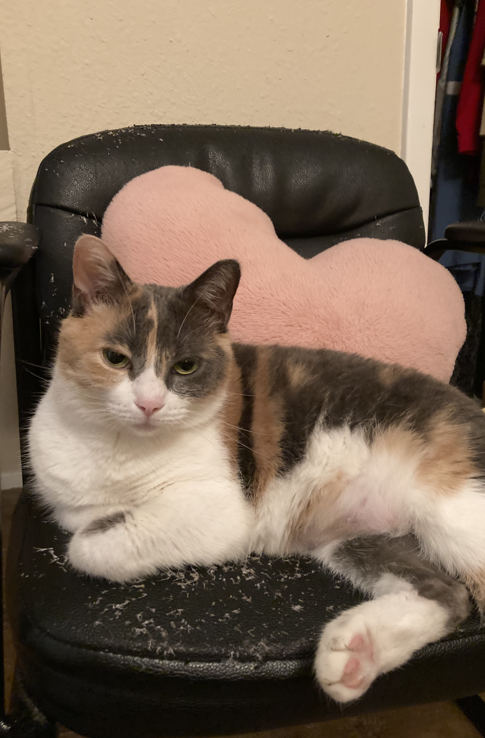
Campus Scavenger Hunt
When you have found all of the locations listed below, your group will create a Powerpoint presentation. Each slide should include the following:
The name of the service
A picture of the location/service
A one-sentence summary of what the service provides for students
Information about how to access the service (i.e., how to schedule an appointment, contact the office, etc.)

Slide 4
Campus Scavenger Hunt (continued)
Make sure that each member of your group submits the completed powerpoint.
Due by tonight at midnight ☺
We’ll have a short presentation on Monday’s class

Slide 5
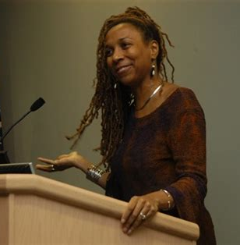
Kimberlé Crenshaw
Professor at UCLA school of law
One of the founders of critical race theory
Introduced theory of intersectionality, which integrated components of critical race theory and feminism

Slide 6
Revisiting Crenshaw
Using your printed transcripts, follow along with the video, annotating as you go.
We will stop periodically to discuss certain concepts

Slide 7
Purpose for reading
The purpose that we are trying to fulfill with our revisiting of this video/transcript is to address the following questions:
What does intersectionality mean?
How could you summarize Crenshaw’s argument in one sentence?
What evidence does she give of the importance for considering intersectionality in the present day?
(maybe write these down)

Slide 8
Applying our reading strategies to Crenshaw
Three types of reading strategies (see the MARSI assessment you completed)
Global (GLOB)
Support (SUP)
Problem Solving (PROB)
Which strategies have we used to read Crenshaw?
Mark the evidence of these strategies in your Crenshaw annotations

Slide 9
Global Strategies
Skim MARSI questions labeled GLOB
What do these strategies have in common?
How can we define or summarize “Global Strategies”?

Slide 10
Support Strategies
Skim MARSI questions labeled SUP
What do these strategies have in common?
How can we define or summarize “Support Strategies”?

Slide 11
Problem Solving Strategies
Skim MARSI questions labeled PROB
What do these strategies have in common?
How can we define or summarize “Problem Solving Strategies”?

Slide 12
SUPPORT STRATEGIES: Identifying Main Ideas, Creating a Thesis Statement
Not all of the texts that we read have a hard thesis statement
BUT drafting a hard thesis is a great way to summarize and condense our understanding of the text to the most important ideas
Work with your small group to create a hard thesis statement about Crenshaw’s Intersectionality TED Talk (add this thesis statement to the top of your annotated notes)
Subject + Opinion + Support/Reasons for the Opinion
What are Crenshaw’s Subject, Opinion, and Reasons?

Slide 13
Preview for next class
”Two Fast to be Female”
Longer reading, but more narrative-focused than “Land-Grab Universities”
How does this article speak in conversation with Crenshaw’s idea of intersectionality?
BOTH of these texts will be featured on your midterm

Slide 14
Ticket to exit
On a piece of paper
Write down any questions that you have about the Crenshaw or the concept of intersectionality
Write down any questions/comments about your use of reading strategies from the MARSI

Slide 15
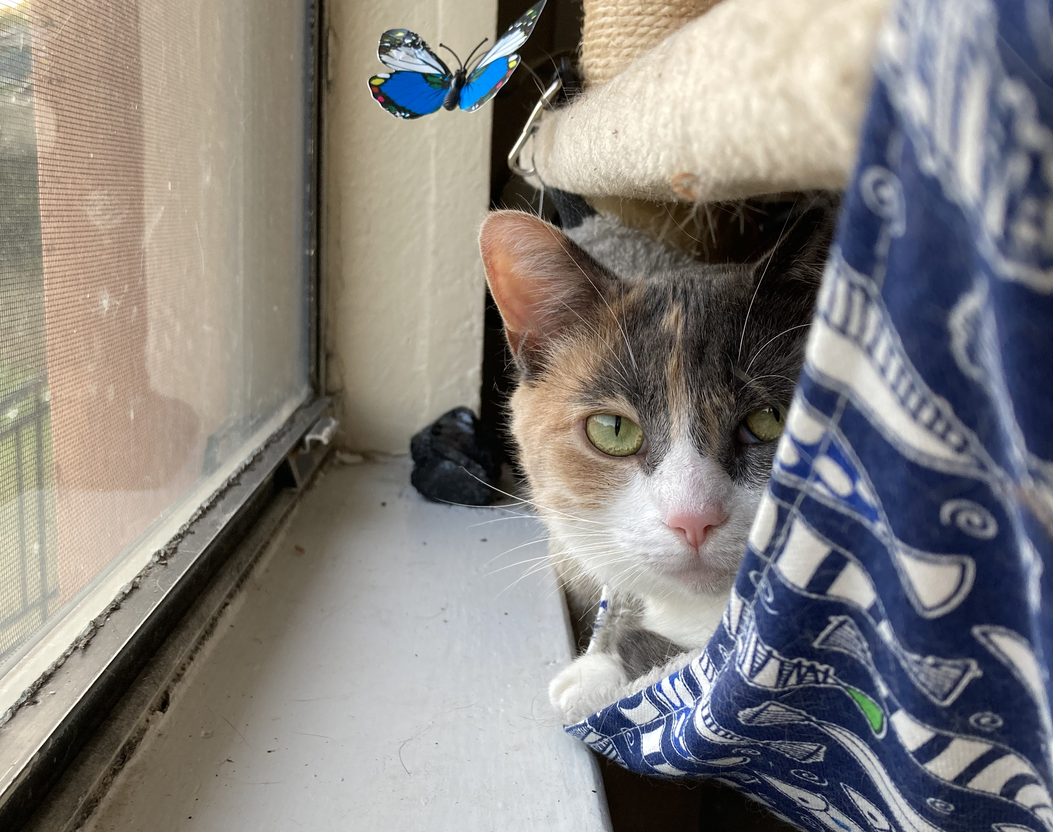
For next time
Read “Two Fast to be Female”
Complete Reading Log 6
Focus on identifying text connections
Focus on identifying your use of reading strategies from the MARSI

