Slide 1
RDG 1300_P07
NOTE: I can’t require masks or vaccines in this class, but university leadership recommends both so that we can remain in-person this semester
Tuesday, 9.14

Slide 2
Agenda
Land-Grab Universities (Chapter Tour)
Expansion Assignment #1

Slide 3
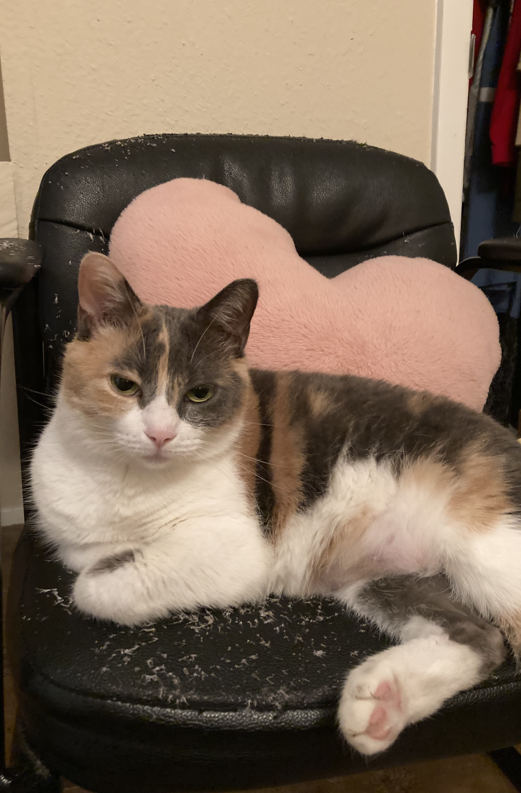
Small Group Discussions
With your small group, talk about the authors’ purpose for writing this article
As a group, make a list of important terms, concepts or ideas from this article.

Slide 4
Reading Strategy: Chapter Tours
Global Strategy – prereading, skimming, use of tables/figures
Useful for textbooks or other readings that have a lot of figures or graphics
Useful to use before you read, but also useful if you’ve skimmed something already and need to get a deeper understanding or check your comprehension
If you use it like this it’s more of a ________ kind of strategy

Slide 5
Reading Strategy: Chapter Tours
Skim a reading to see if it is divided into different sections or if it uses subheadings
Make a list of all the different “text features” that you notice in each section:
This could be bolded words, pictures, figures, graphs, etc.
Describe each text feature briefly
Connect each feature back to the text
Find the part of the text that the graphic, picture, figure, etc. is meant to support
How does this text feature enhance your understanding?

Slide 6
Chapter Tour Example
Introduction (pg 34-36)
Page 34 - Picture of an old, abandoned railway with a caption below that lists where/who the land was taken from, what university benefited from it, and how much it cost/how much money it made.
I thought it connected back to a quote on page 34, and gave a good example for where the authors talk about how a lot of land was seized by the government through unratified treaties and sold at a huge profit

Slide 7
Chapter Tour Practice
With your group, you will be assigned to give a chapter tour of a certain section from our reading, “Land-Grab Universities”
Make a list of all the text features (images, graphs, charts, etc.) that you see in your section.
Select at least two of these text features from your section
Provide a short description
Connect each feature back to the text by finding a quote, idea, or concept from the text that the feature is meant to support.

Slide 8
Exploring Land Grab University Data
https://www.landgrabu.org/universities/

Slide 9
Review
On a piece of paper
Write down any questions you have about the chapter tours reading strategy
Do you think this is a strategy you will use in the future?

Slide 10
Expansion #1 - Campus Scavenger Hunt
Get into a group of 4(ish) students
Using your knowledge of campus, your smartphone, and your teammates, key student support services on the Texas State University campus.
Take a picture of yourselves in front of each location/service on the scavenger hunt and make a note about what services are offered at the different locations you visit on campus.

Slide 11
List of Locations to Find
Your Instructor’s Office
SLAC (Student Learning Assistance Center)
Office of the Dean of Students
The Writing Center
The Counseling Center
An additional service of your choice

Slide 12
Campus Scavenger Hunt Presentation
When you have found all of the locations listed below, your group will create a Powerpoint presentation. Each slide should include the following:
The name of the service
A picture of the location/service
A one-sentence summary of what the service provides for students
Information about how to access the service (i.e., how to schedule an appointment, contact the office, etc.)
*** Extra-credit if you include a pic of a cat that’s cuter than my cats

Slide 13
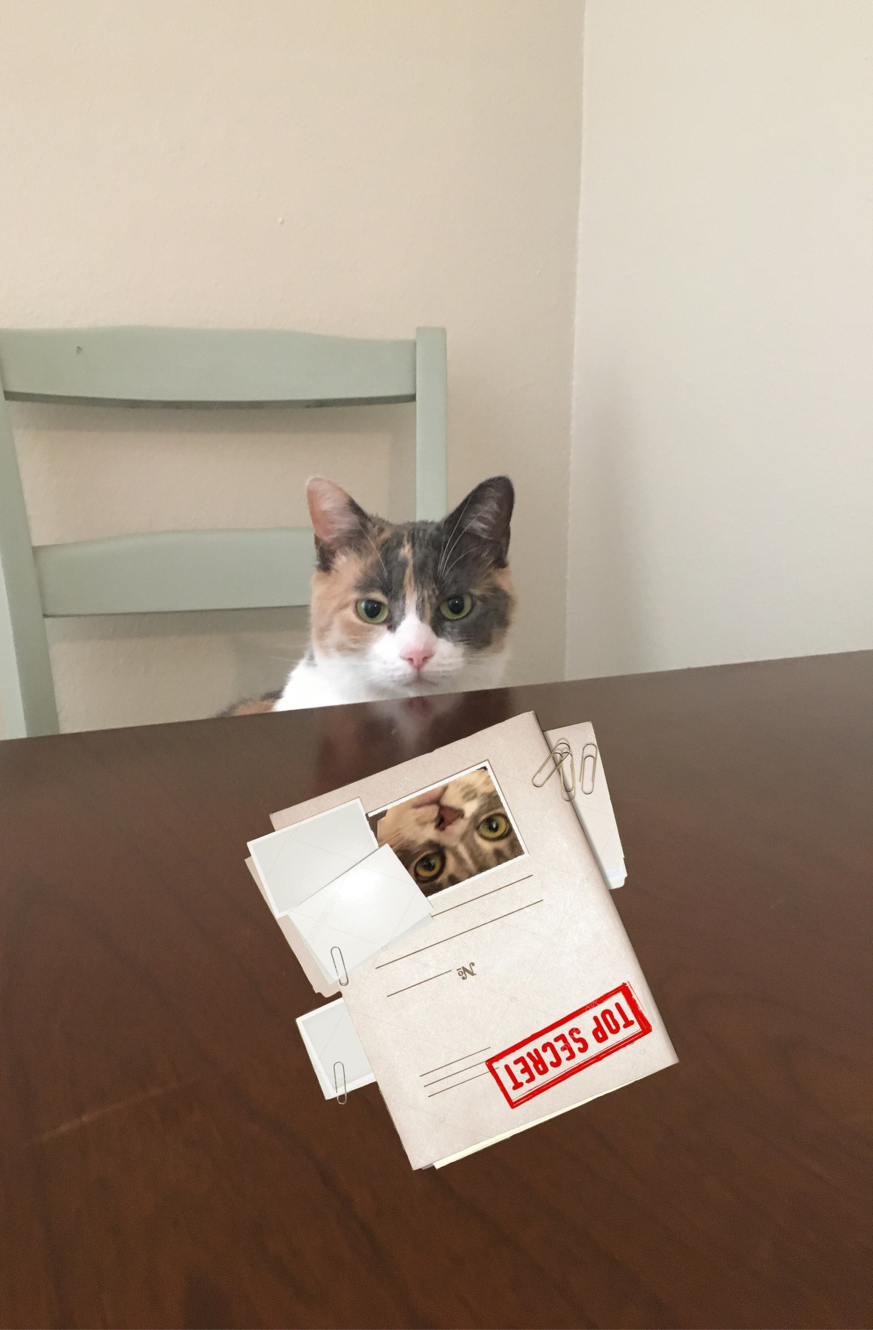
Planning Time
With your group, take time to plan your approach to this assignment
You have 30 minutes of class time to track down each of these locations (it’s okay if you can’t finish now). I expect you to check back in with me before you leave for your next class.

Slide 14
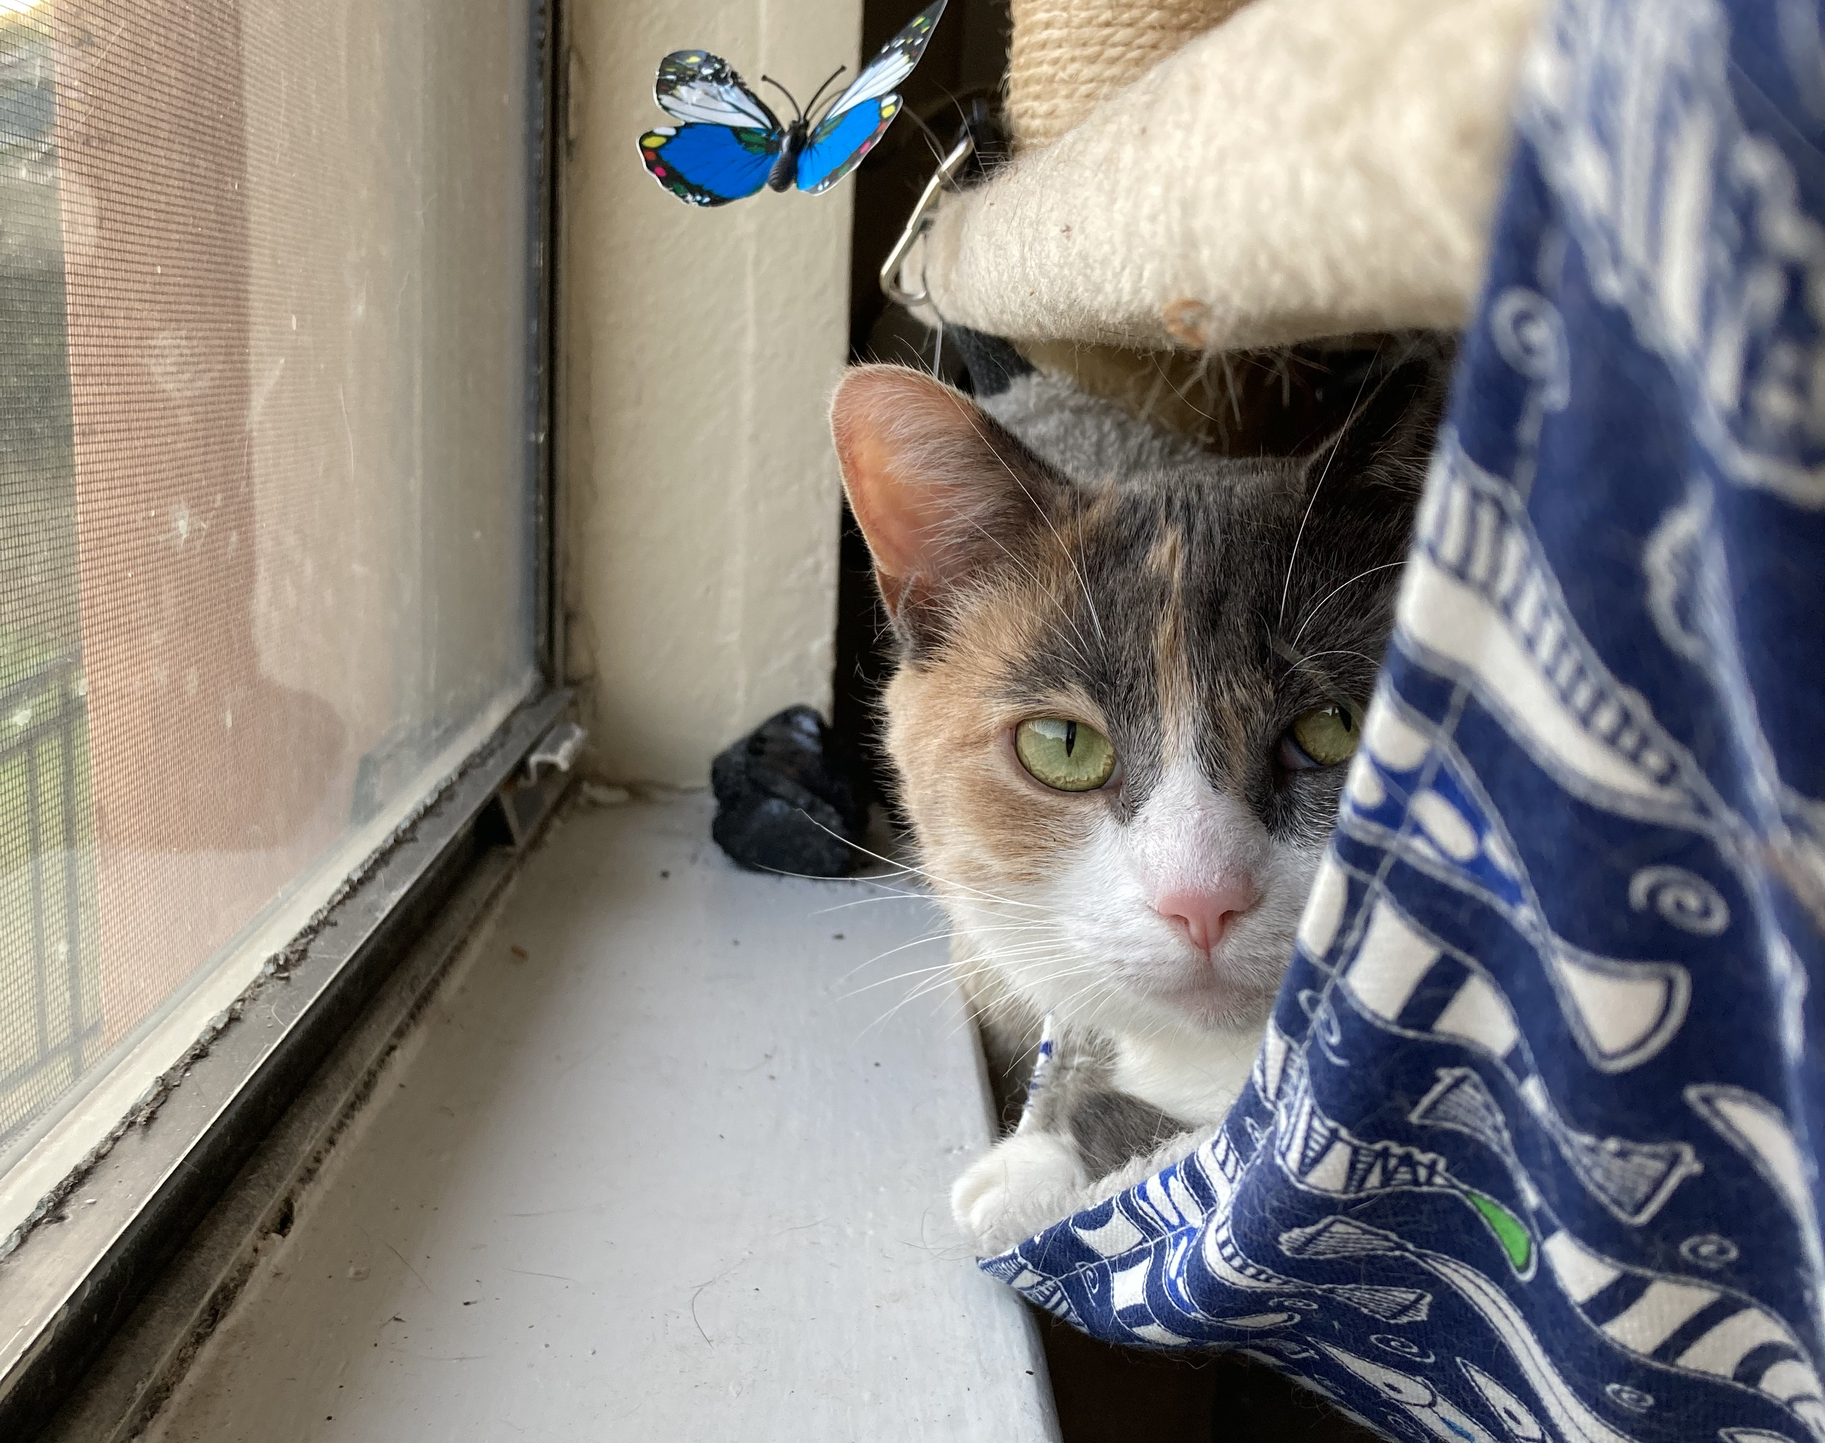
For next time
Read/watch “The Urgency of Intersectionality”
Complete Campus Scavenger Hunt Presentation
No Reading Log ☺

