Slide 1
RDG 1300_P07
NOTE: I can’t require masks or vaccines in this class, but university leadership recommends both so that we can remain in-person this semester
Thursday, 9.09

Slide 2
Agenda
Guidelines for Academic Discussions
Making Text Connections – Strayhorn Chapter
Introduction to the MARSI

Slide 3
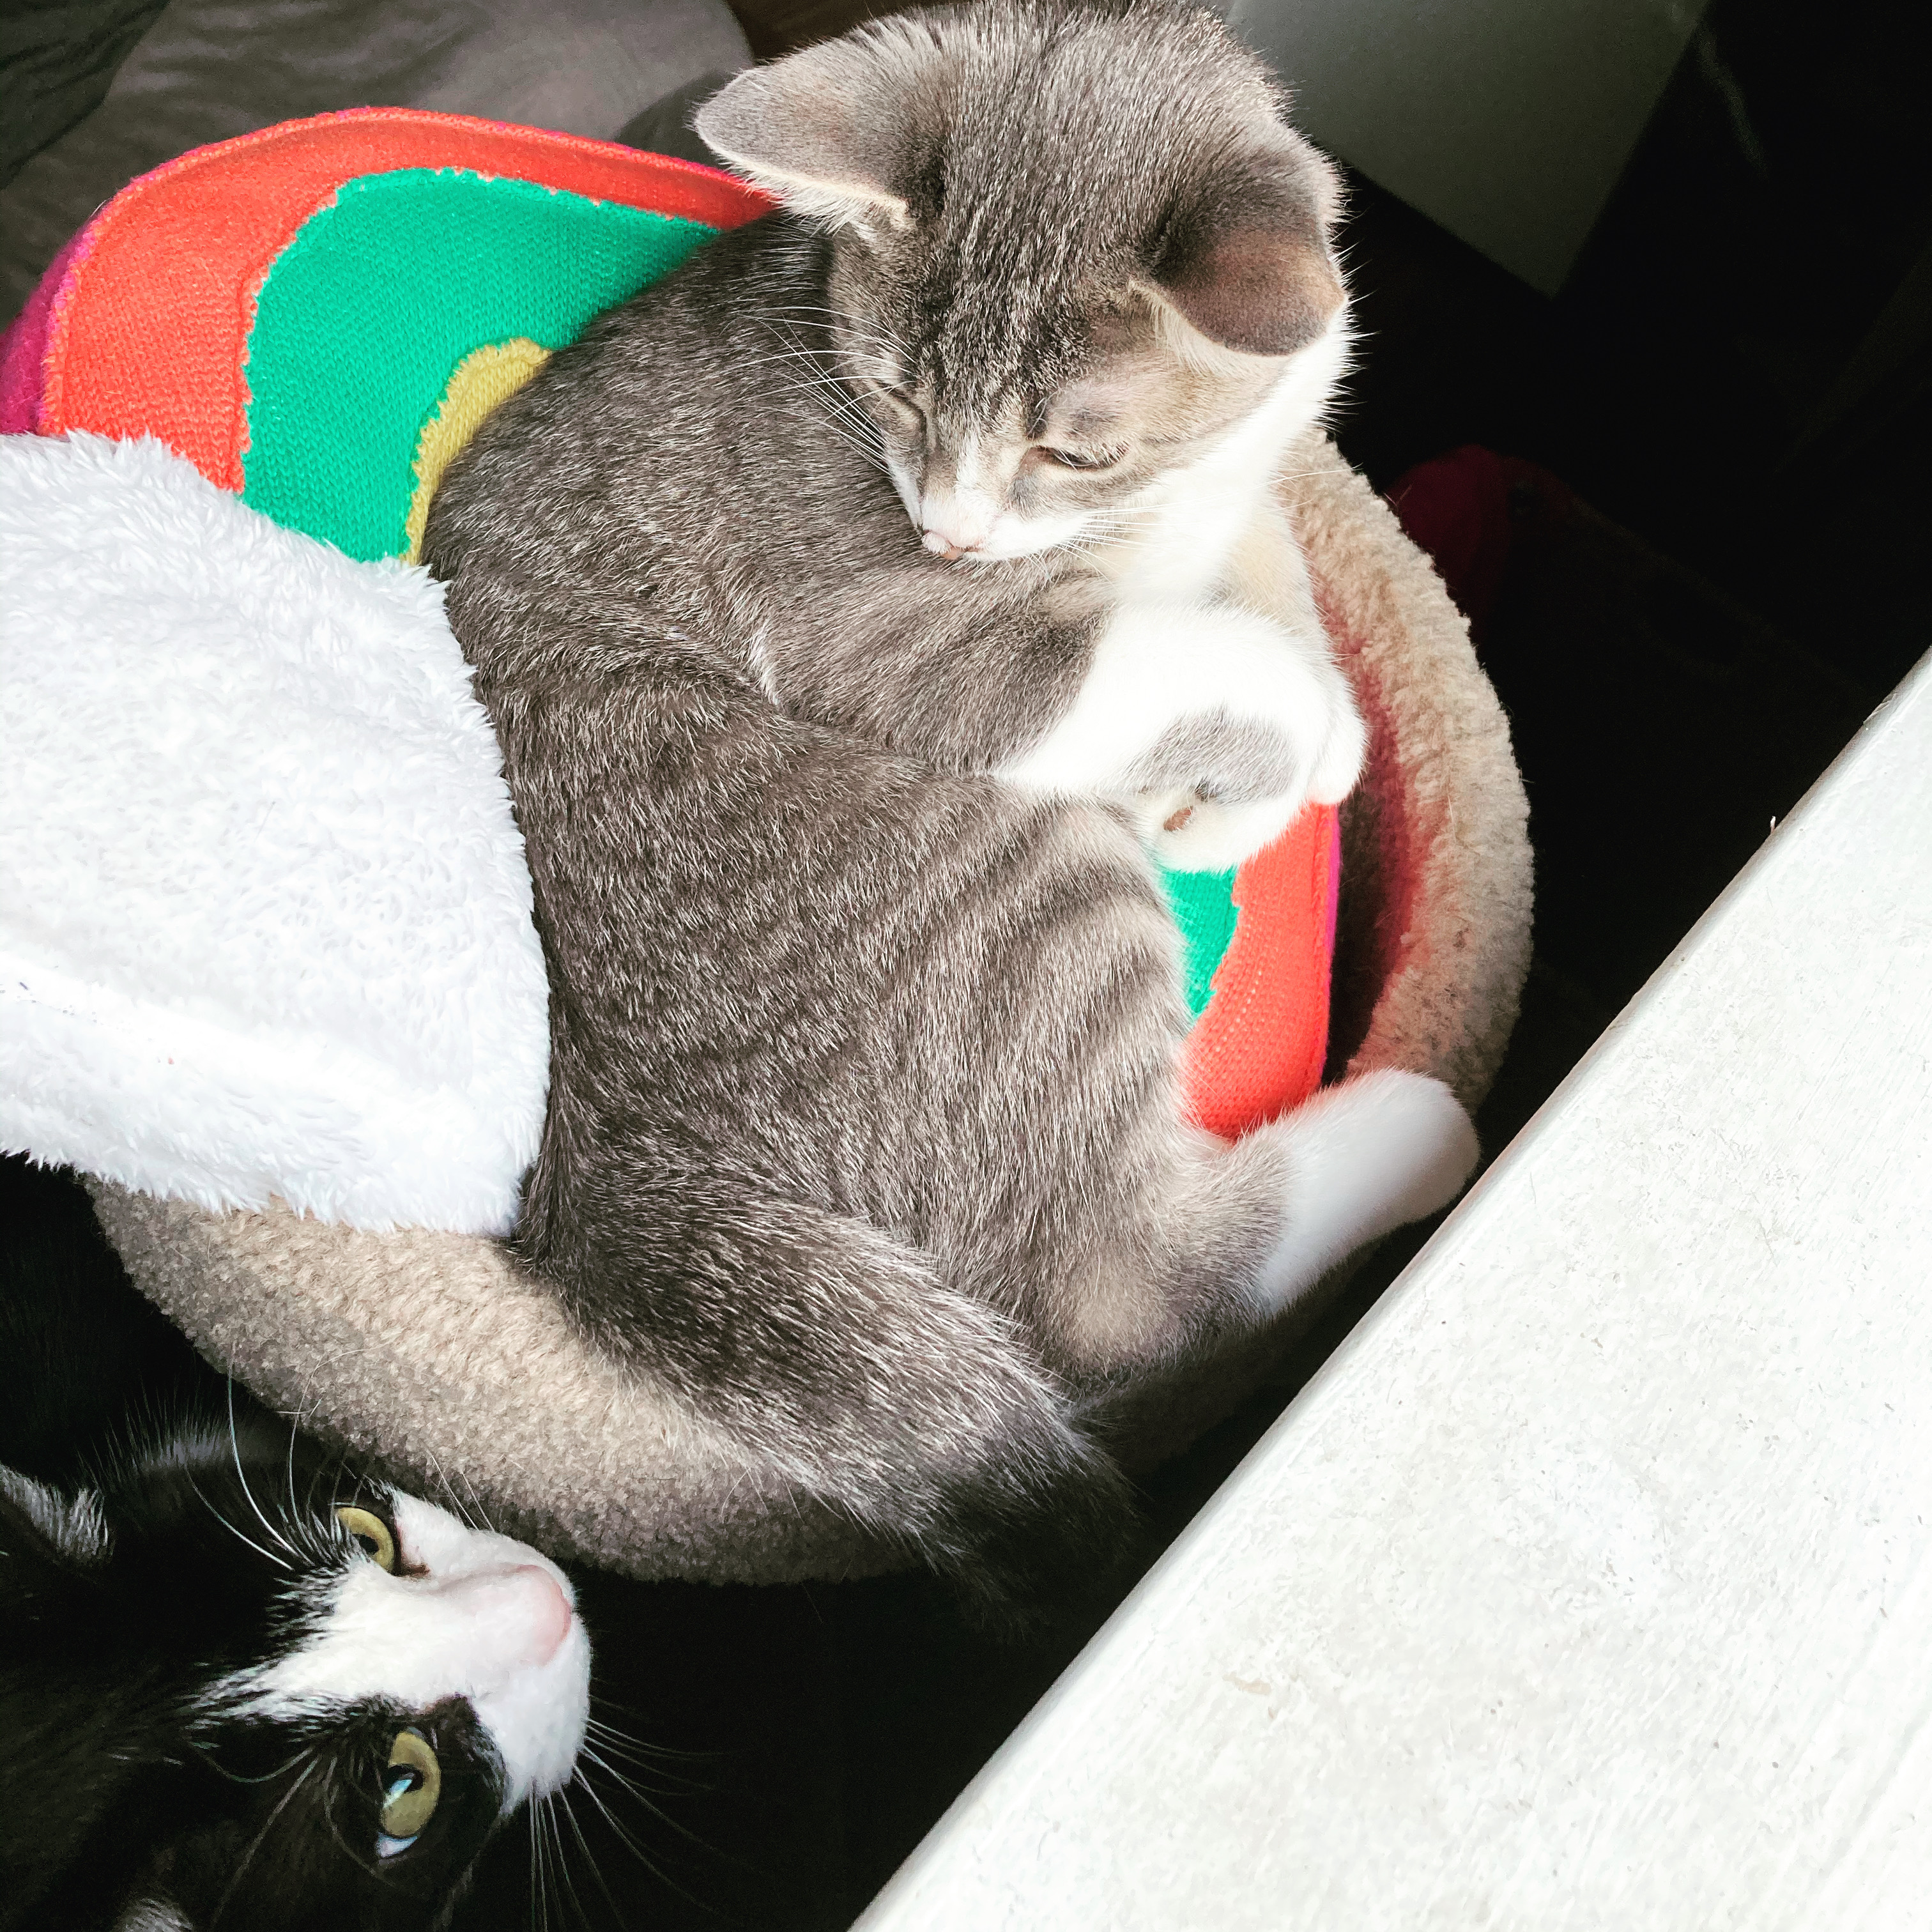
Academic Discussions Wrap-Up
I can has opinion?
Maybe

Slide 4
Strayhorn Discussion
Please complete the discussion posted in today’s Canvas module (on paper is okay if you didn’t bring a computer.
Once you have finished, respond to at least one classmate’s post. Aim for making either a text-to-self connection or a text-to-text connection.
Text-to-self example: was your experience with a certain community similar to another students’?
Text-to-text example: Did you pick up on something from the Strayhorn chapter that one of your classmates may have missed?

Slide 5
Discussion Prompt
The introductory chapter to Stayhorn's book, College Students' Sense of Belonging: A Key to Educational Success for All Students carries a bit of a different tone than other things that we've read this semester. In this discussion post, please respond to the following prompts:
In your notes, find Strayhorn's definition for "Sense of Belonging." Rewrite this definition in your own words.
Thinking back to the Young article, "Nah, we straight" how does Strayhorn's work on college students' sense of belonging relate to our conversation about "standard," "proper," or "formal" English?
Strayhorn talks about the importance of communities in creating a sense of belonging in college. Write briefly about your own feelings of belonging (or not belonging) at Texas State. How do the communities that you are a part of (or that you want to be a part of) affect this sense of belonging?

Slide 6
Grading the Reading Logs
For each of these reading logs, I grade loosely based on the following rubric
Effort: Does the reading log clearly show engagement through length/depth of responses and a willingness to reflect on the students’ reading process?
Technical Aspects: Does the reading log follow the appropriate reading log format? Did the reading log include page numbers for quoted text?
Relevancy: Are the reading log entries relevant to the assigned reading? Does the author provide an explanation/support for why they included each log entry?

Slide 7
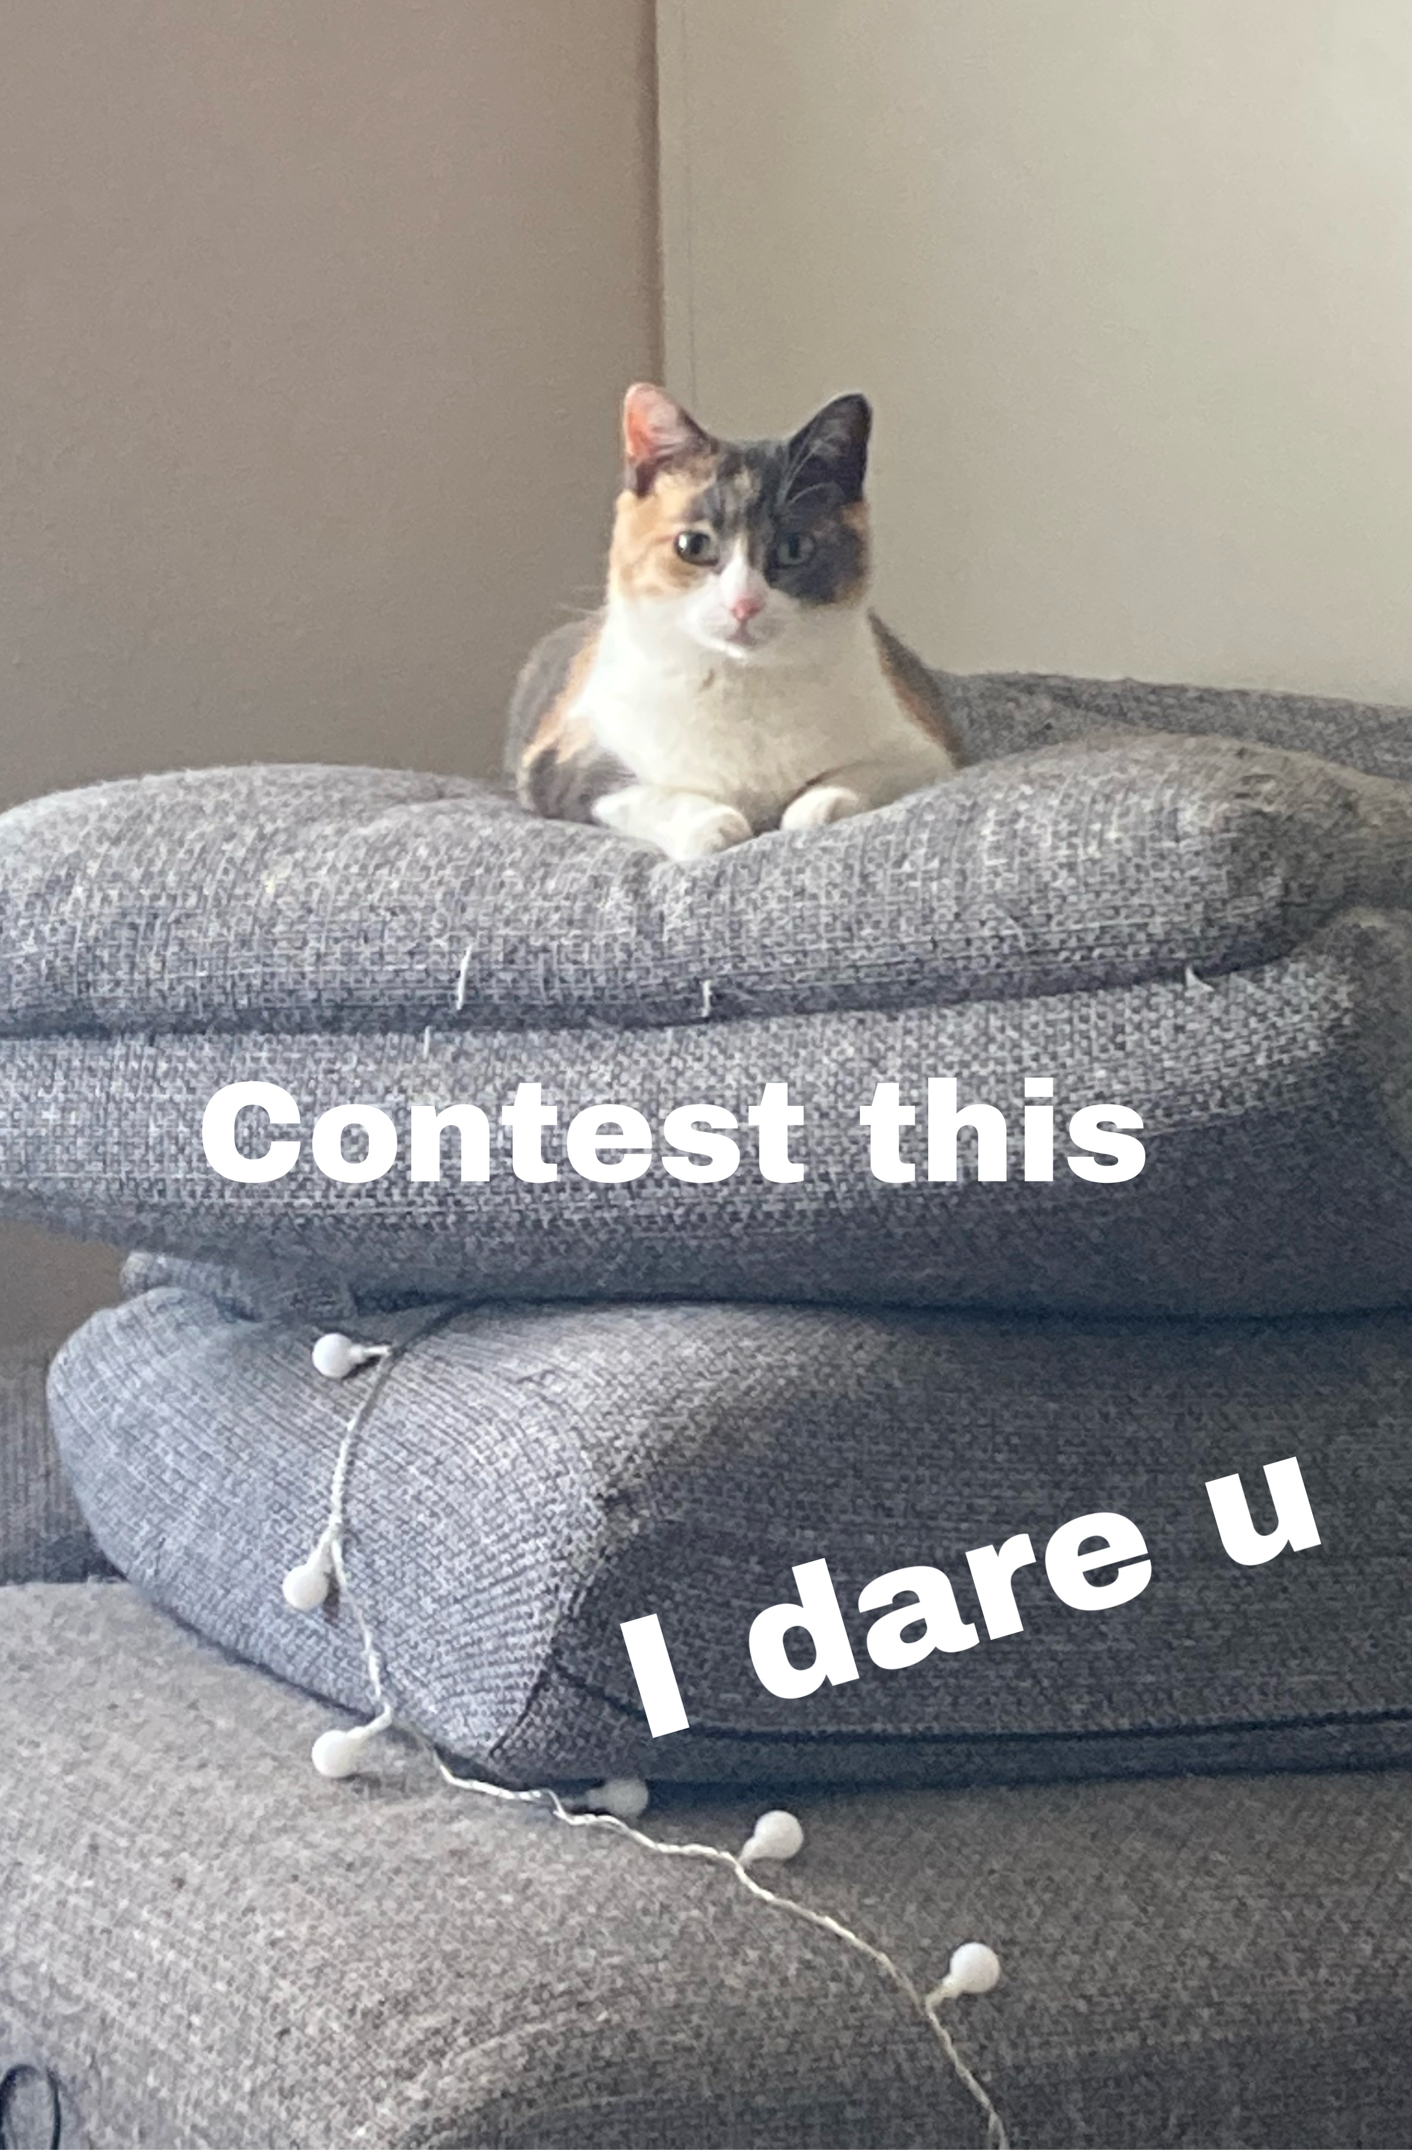
My approach to grading
I want all grades in this class to be a dialogue. This means that if you wish to “contest” a grade, I will always hear you out.
All grades will come with specific directions on how to improve for future assignments (at least I hope)
If you ever wish to re-submit an assignment for a higher grade, let’s talk. For some assignments (not for all) I’m happy to accommodate this.

Slide 8
The Metacognitive Awareness of Reading Strategies Inventory (MARSI)
Qualtrics survey
Meant to assess the reading strategies that you already use
This will be important for future assignments

Slide 9
What is Metacognition
Metacognition is “Thinking about thinking”
So when I say “metacognitive reading strategies,” I mean…
Why is it important for us to know this?

Slide 10
Global Reading Strategies
Global reading strategies – more general. These are the things that you do to prepare yourself to read. Examples:
setting purpose for reading and checking whether text content fits purpose
predicting what text is about and confirming these predictions
making decisions on what to read closely

Slide 11
Problem Solving Reading Strategies
Problem solving reading strategies refer to what you do when a text gets difficult.
Reading slowly/carefully
Reading out loud
Using context clues to figure out the meaning of difficult vocabulary
Pausing to reflect on content that you’ve just read

Slide 12
Support Reading Strategies
Extra things that you do to support yourself while you read.
Taking Notes/paraphrasing information so that you can refer to it later
Rereading previous information
Using reference materials (dictionary, internet, other text source)
Discussing the reading with classmates, friends

Slide 13
Interpreting your MARSI (James Example)
James’ Scores
Global Strategies Mean: 3.23
Problem Solving Strategies Mean: 3.375
Support Strategies mean: 3.4
Key to Averages (as a guide, not a rule)
High – 3.5 or higher
Medium – 2.5-3.4
Low – 2.4 or lower

Slide 14
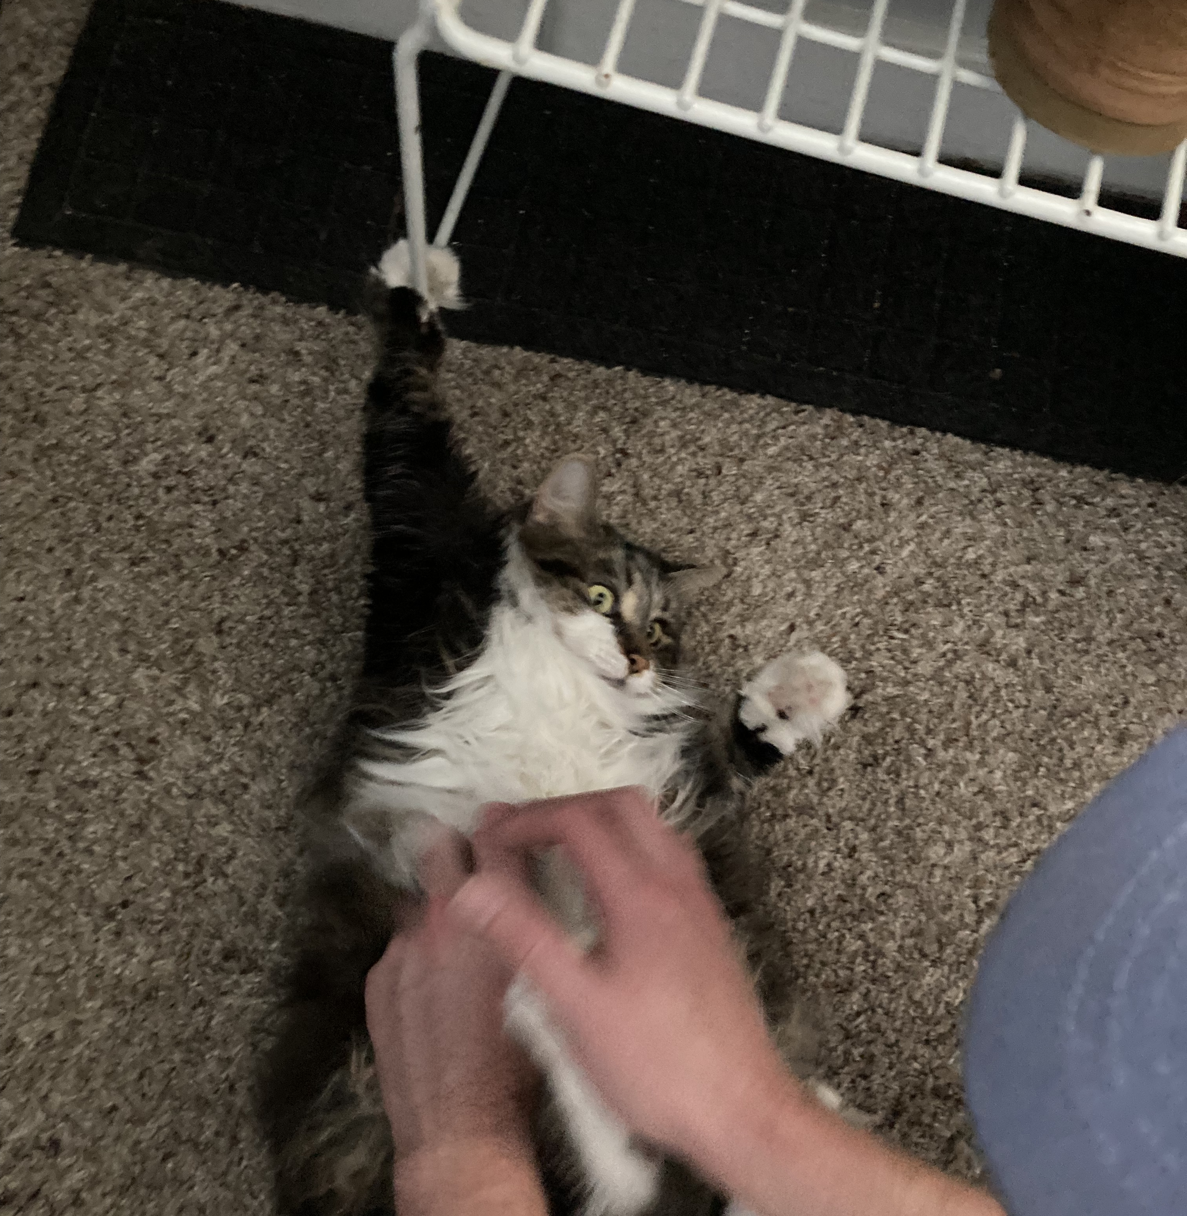
How I interpret my MARSI
High Score?
I use a lot of support strategies, like taking a ton of notes, circling content, annotating, and usually I write up a summary at the end of a reading
I need to work on global reading strategies. Often I don’t really prepare myself for a reading by previewing or skimming the text to find out what’s coming.
I also need to work on problem solving strategies, though perhaps not as much.
Honest Score

Slide 15
Partner Discussion
Bring up your own MARSI on your computer. If you haven’t done this yet, tally up your scores. If you need help, ask your partner!
Once you’ve done this, go through your results with your partner. Which areas do you rock at? What areas need work?
Take notes!

Slide 16
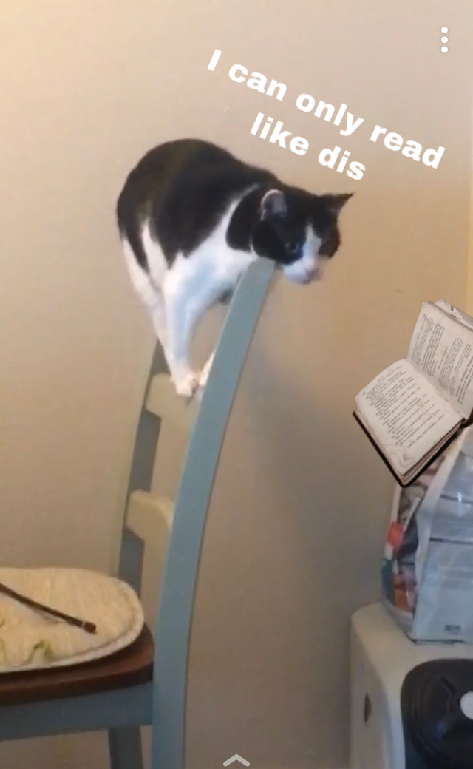
How my partner interprets my MARSI scores
With your partner, you’re going to interpret each other’s MARSI scores (much like I did on a previous slide).
Go back to our Canvas discussion board for today’s class.
Your partner will write up a summary of your MARSI scores based on your discussion
You will write up a summary of your partner’s MARSI scores, also based on your discussion.
Focus on interpreting the three strategy areas: Global, Problem Solving, and Support
But also relay any interesting reading habits that your partner has (ex. what’s the name of the cat that sits on their lap when they read?)

Slide 17
Preview for Next Week
Reading: “Land-grab universities”
Longer read
Long-form journalism genre
Reading Log 5:
Extra focus on writing about our reading strategy use

Slide 18
For next time
If you haven’t already, take the MARSI Assessment!
Read/Annotate “Land Grab Universities”
Complete Reading Log 5
Remember to look for your use of reading strategies!

