Slide 1
RDG 1300_P07
NOTE: I can’t require masks or vaccines in this class, but university leadership recommends both so that we can remain in-person this semester
Tuesday, 9.06

Slide 2
Agenda
Academic Discussions wrap-up
Making Text Connections – Venus Williams, Gender Pay Gaps
Introduction to the MARSI

Slide 3
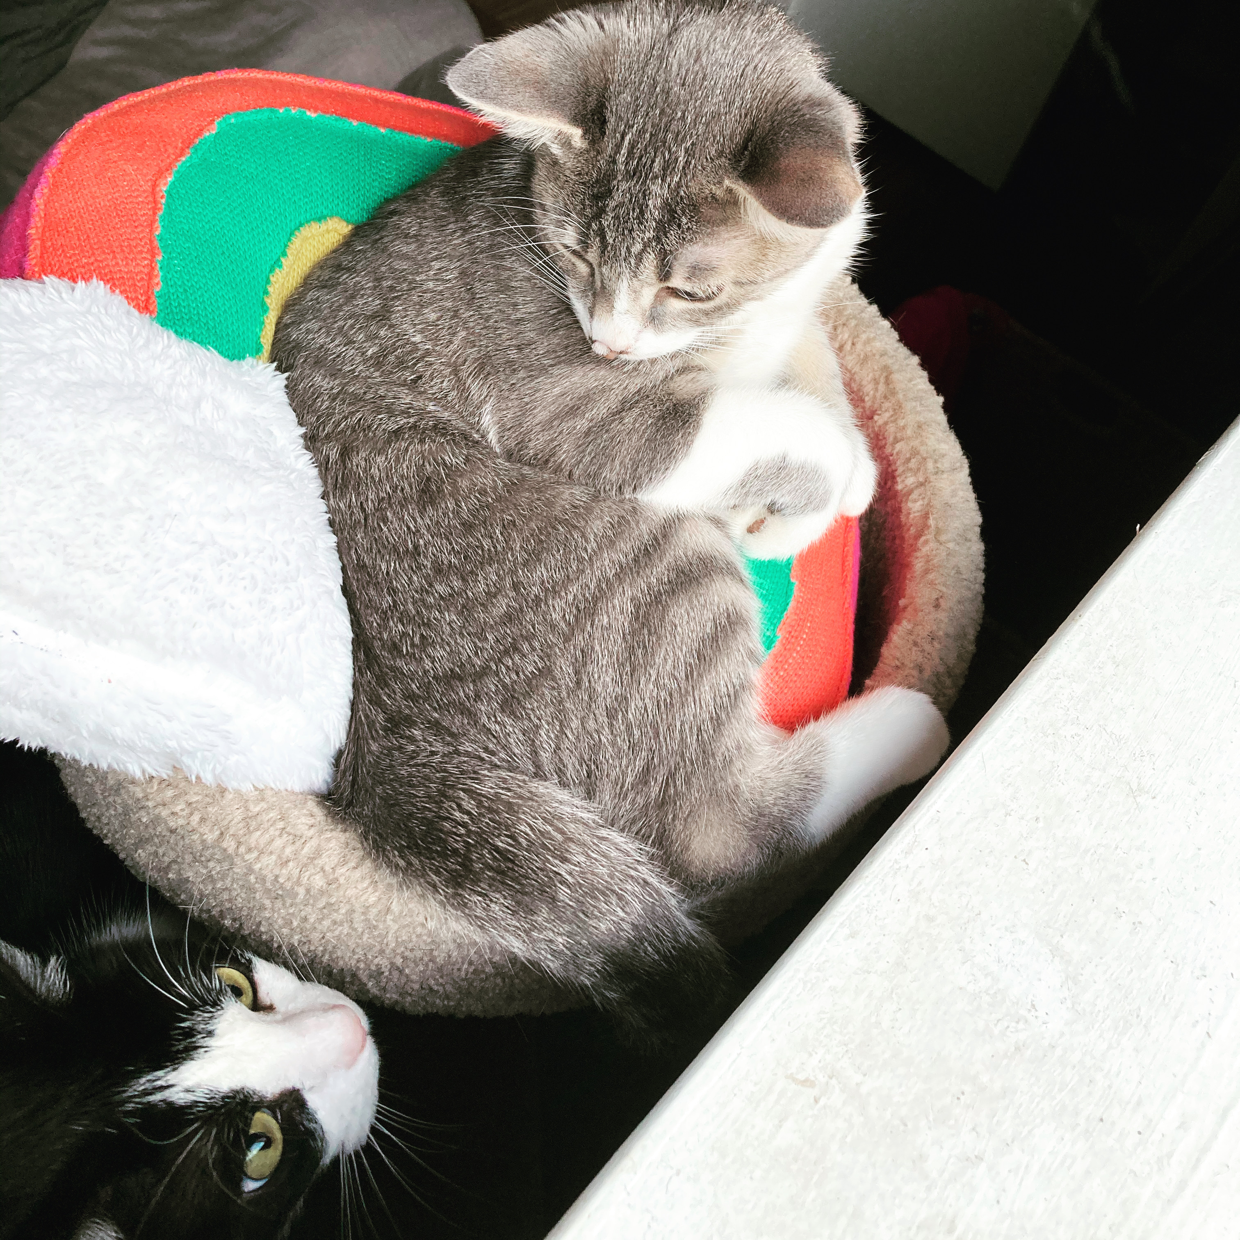
Academic Discussions Wrap-Up
I can has opinion?
Please open up Canvas and participate in the discussion prompt under today’s module
Maybe

Slide 4
Guidelines for Academic Discussions
Rules for speaking
Rules for listening

Slide 5
Responding
Now, go through and respond to another student’s post, keeping in mind our guidelines for academic discussions.
Question: Do these rules work differently in an online space?

Slide 6
Text Connections
Text connections are often informed by our purpose for reading a text, and they can often help us identify main ideas and themes present in a text.
Text connections happen naturally – but depending on your purpose for reading, an instructor may ask you to make different kinds of connections

Slide 7
Text to Self
These are connections that occur when you make connections between your personal experiences and the text.
Remember our theme is Truth and (Re)Presentations of the American Identity. How does what we’ve read so far help you understand your own representations of truth and American-ness?
Up to this point, these are the most common text connections that I see in reading logs

Slide 8
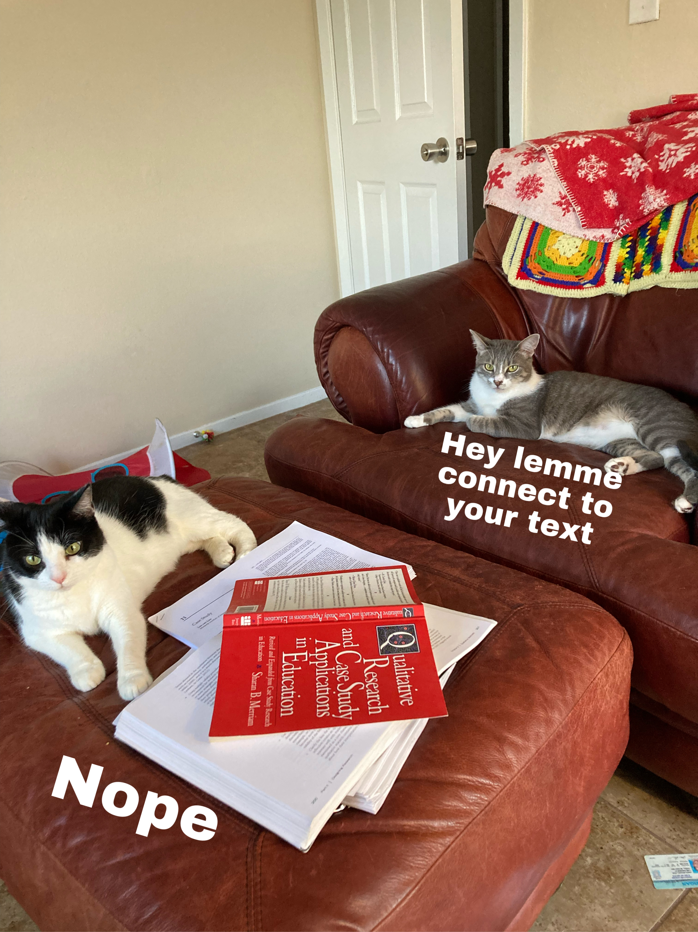
Text to Text
These are connections that occur when you make connections between the text you selected and the other texts we are reading.
To make a text to text connection asks you to explain how two (or more) texts are in conversation with each other, and/or how they are building on each other.
When you make these in your academic work, it’s extra important to cite the sources that you are referencing

Slide 9
Text to World
These are connections that occur when you make connections between the text and the world as you know it.
Ask yourself, how does a text inform your understanding of current or historic events?
Example from our reading:
How does the texts we’ve read help you understand global issues about identity, race, and culture in education?

Slide 10
Reading Log #3 (rewind)
Open up (or take it out if you did it on paper) you’re reading log #3, which was due for class today.
Go through each of your log posts and look at the different text connections that you are making.
Which are text to self (connections to your own personal experiences)?
Which are text to text (connections between multiple texts)?
Which are text to world (connections to more global ideas or current events)?
Notes:
Reading log 1
First line
“Sanctified”
“When our elders presented school to us, they did not present it as a place of high learning but as a means of escape from death and penal warehousing”
Coates – Why does he resent the schools more than the streets?

Slide 11
Previewing Reading Log #4
For reading log #4, you will be adding text connections to your log posts.
Same process, added text connections
Make sure to emphasize different types of text connections

Slide 12
The Metacognitive Awareness of Reading Strategies Inventory (MARSI)
Qualtrics survey
Meant to assess the reading strategies that you already use
This will be important for future assignments

Slide 13
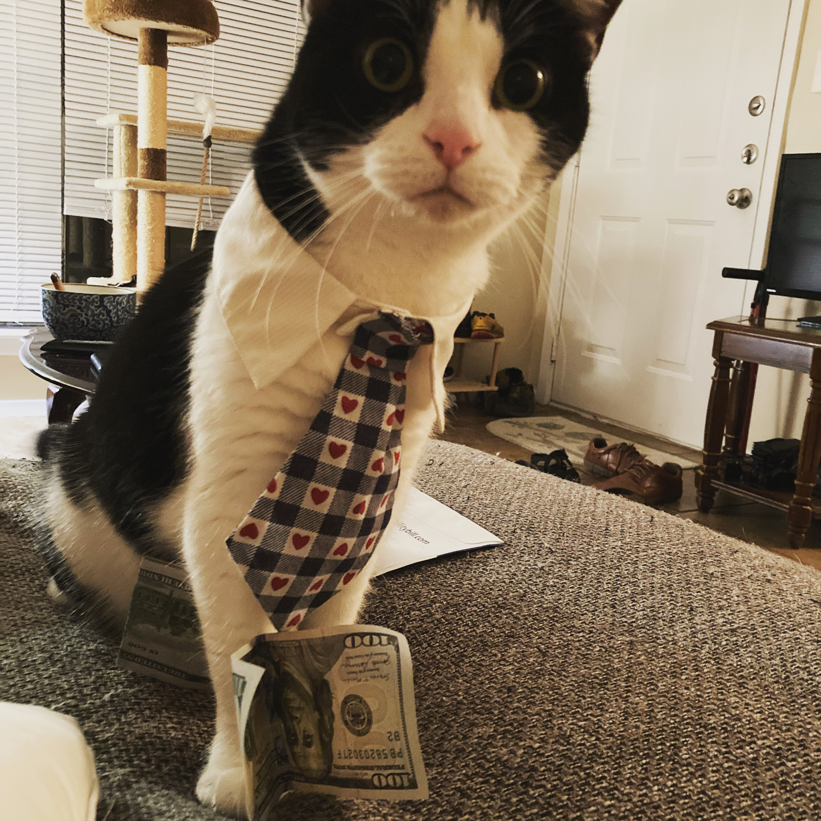
For Next Time
Take the MARSI assessment (Look to Canvas module for instructions/link or use paper copy)
Read/Annotate Strayhorn (2019)
Complete Reading Log 4
Business cat means business

