Slide 1
RDG 1300_P07
NOTE: I can’t require masks or vaccines in this class, but university leadership recommends both so that we can remain in-person this semester
Thursday, 9.02

Slide 2
Agenda
Community Guidelines for Academic Discussions
Unpacking the Young and Coates
Making Text Connections - Venus Williams Gender Pay Gaps
Taking the MARSI

Slide 3
Guidelines for academic discussions
What does “respect” mean in an academic space?
On the google doc under today’s canvas module, work with your small group to create a list of guidelines for academic discussions
Notes:
What does it mean to be “disrespectful”?

Slide 4
Unpacking the Readings
Take out a piece of paper and a pencil (or type if you prefer)
Freewrite for five minutes and respond to the following prompts:
Pick one of the readings that we did last week (Coates - ”Between the World and Me” or Young - “Nah, we straight”). What were your strongest reactions, opinions, or takeaways from that reading?
How can you connect the content of this reading to your own personal experiences with education?

Slide 5
Small group discussions
As a small group, share your responses to the freewrite prompt. You don’t have to read it exactly as you wrote it -- use it as a conversation starter.

Slide 6
Small Group Discussions
In your small groups, think about the two readings (Coates and Young) together.
Make a list of shared themes or topics that are present in both readings. What specific opinions do you think that both authors share?

Slide 7
Small Group Discussions
Finally, look back to the last question on the diagnostic exam.
Question 5
Refer to the author's conclusion on page 72:
“It’s clear that my case has been to eliminate code switching as both an ideological and pedagogical feature within literacy instruction and to replace it with code meshing. Code switching spells failure for most students—and worse, it’s covered in the residue of racism. Code meshing is a better resolution to the minority language debate because it allows minoritized people to become more effective communicators by doing what we all do best, what comes naturally: blending, merging, meshing dialects” (Young 72).
Using passages from the text, write a summary of the argument that the author is making for code meshing instead of code switching. Then, explain how you agree or disagree with this argument. Use at least two facts from the article that support your argument. Reference these facts specifically. Your response should show evidence of clear organization with a main idea and supporting details. Your response should be at least two paragraphs in length.
In your small groups, share your response to this question.
After discussion with your classmates, would your response change at all?
Notes:
How does your opinion change when confronted with different perspectives

Slide 8
Text Connections
Text connections are often informed by our purpose for reading a text, and they can often help us identify main ideas and themes present in a text.
Text connections happen naturally – but depending on your purpose for reading, an instructor may ask you to make different kinds of connections

Slide 9
Text to Self
These are connections that occur when you make connections between your personal experiences and the text.
Remember our theme is Truth and (Re)Presentations of the American Identity. How does what we’ve read so far help you understand your own representations of truth and American-ness?

Slide 10
Text to Text
These are connections that occur when you make connections between the text you selected and the other texts we are reading.
To make a text to text connection asks you to explain how two (or more) texts are in conversation with each other, and/or how they are building on each other.
When you make these in your academic work, it’s extra important to cite the sources that you are referencing

Slide 11
Text to World
These are connections that occur when you make connections between the text and the world as you know it.
Ask yourself, how does a text inform your understanding of current or historic events?
Example from our reading:
How does the texts we’ve read help you understand global issues about identity, race, and culture in education?

Slide 12
Reading Log #3 (rewind)
Open up (or take it out if you did it on paper) you’re reading log #3, which was due for class today.
Go through each of your log posts and look at the different text connections that you are making.
Which are text to self (connections to your own personal experiences)?
Which are text to text (connections between multiple texts)?
Which are text to world (connections to more global events or experiences)?
Notes:
Reading log 1
First line
“Sanctified”
“When our elders presented school to us, they did not present it as a place of high learning but as a means of escape from death and penal warehousing”
Coates – Why does he resent the schools more than the streets?

Slide 13
The Metacognitive Awareness of Reading Strategies Inventory (MARSI)
Qualtrics survey
Meant to assess the reading strategies that you already use
This will be important for future assignments

Slide 14
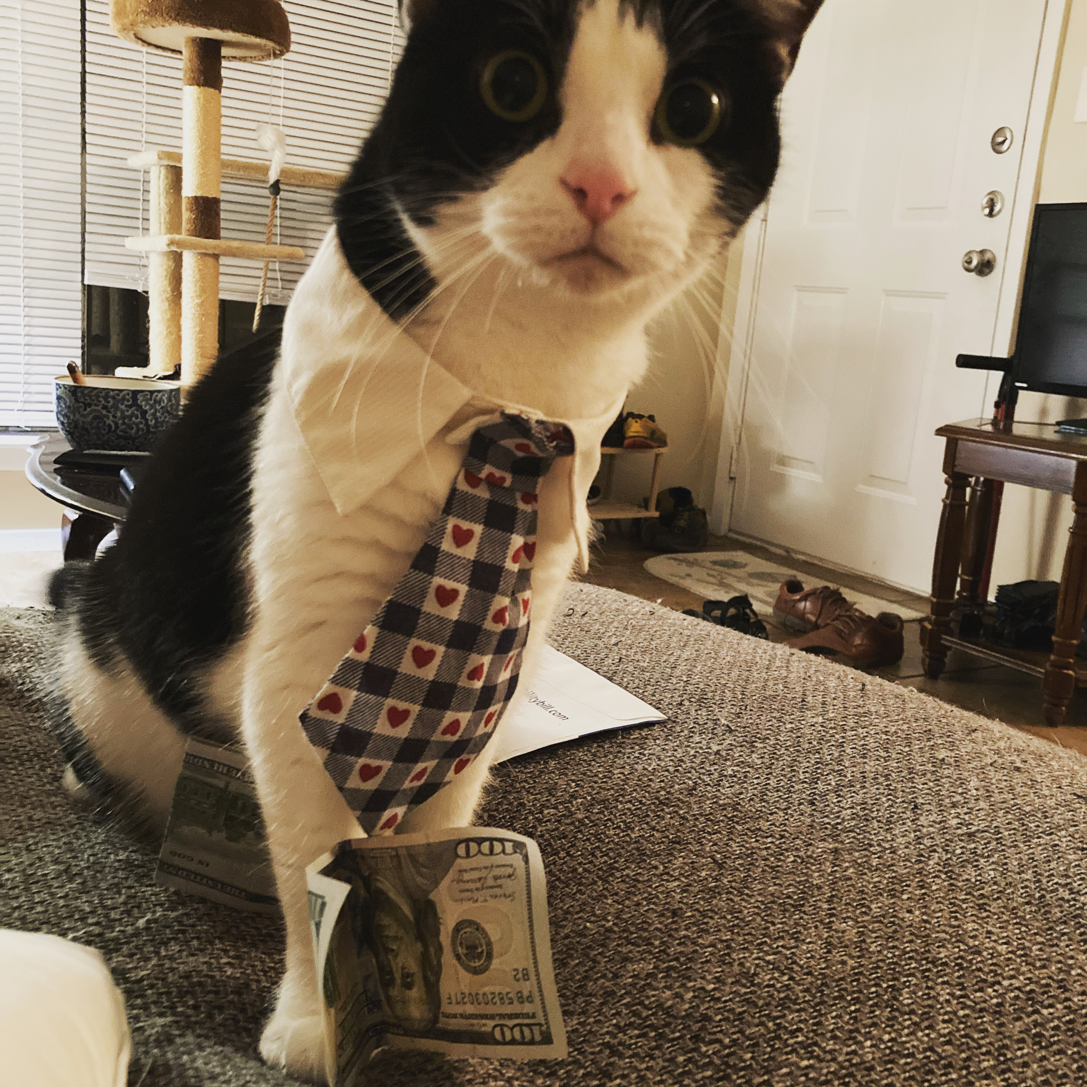
For Next Time
Take the MARSI assessment (Look to Canvas module for instructions/link)
Read/Annotate Opinion Article from University Star
Ignore schedule until I send out an update
Business cat means business

