Slide 1
RDG 1300_P07
NOTE: I can’t require masks or vaccines in this class, but university leadership recommends both so that we can remain in-person this semester
Tuesday, 8.31

Slide 2
Agenda
Housekeeping
Diagnostic Exam
Preview for next class

Slide 3
Technology stuff

Slide 4
Diagnostic Exam
5 Questions
Varying lengths, 1 essay question
Must complete in 90 minutes unless other arrangements have been made
Feel free to ask questions

Slide 5
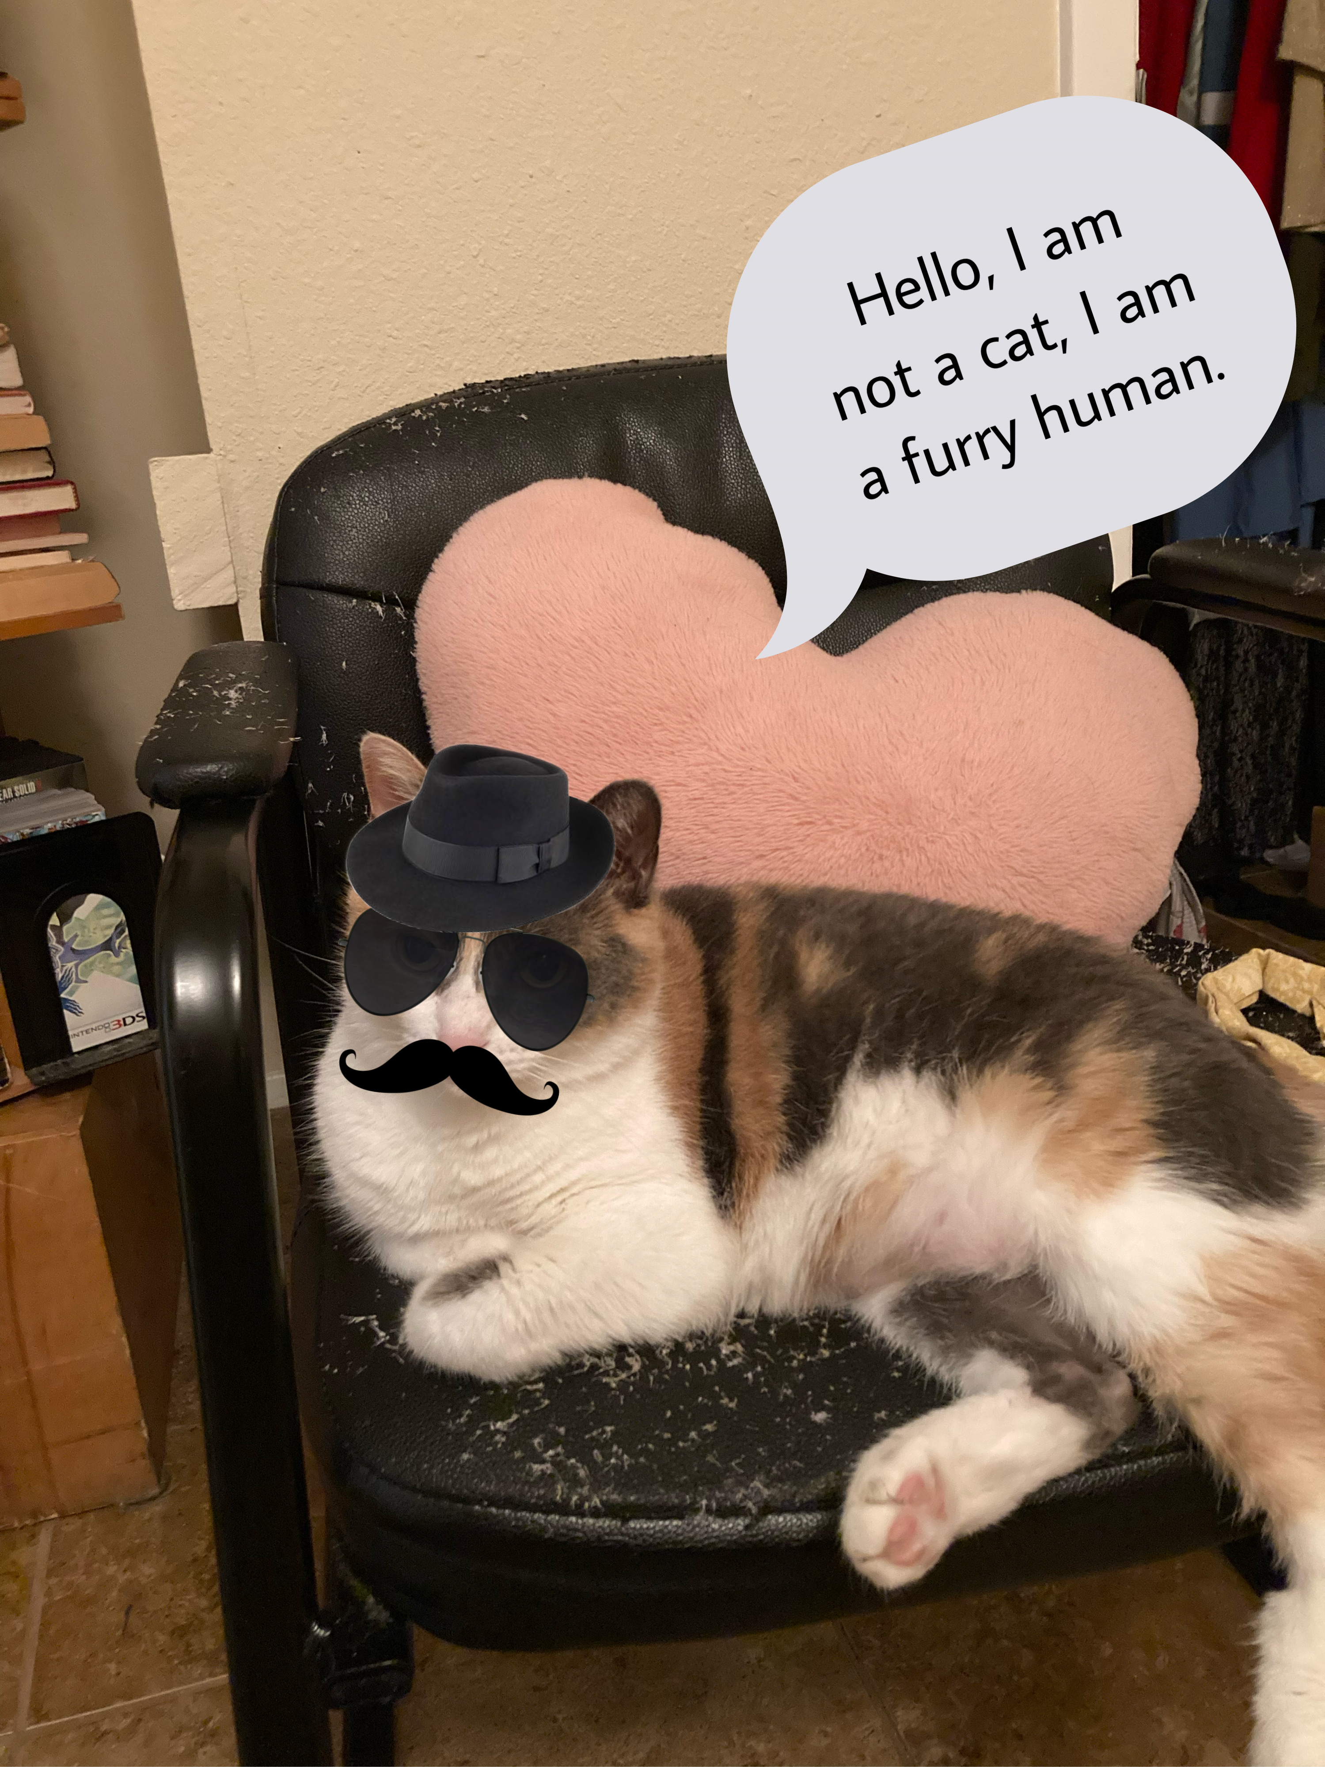
For Next Time
Read Williams (2020) ”Sexism Isn’t a Women’s issue”
Explore website “Black Women Aren’t Paid Fairly”
Complete Reading Log 3 (Submit in Canvas)
Try to find connections with the other readings that we’ve done this semester so far

