Slide 1
RDG 1300_P07
NOTE: I can’t require masks or vaccines in this class, but university leadership recommends both so that we can remain in-person this semester
Monday, 8.23

Slide 2
Agenda
Introduction to the Course
Your instructors
Syllabus overview + Canvas tour
Discussion: What is an academic text?

Slide 3
RDG 1300 – What is this class?
“Corequisite” with ENG 1310
Provides reading/writing support to ENG 1310 and other courses that you may be taking currently
Placement in this course based on your TSIA score

Slide 4
Your Instructors
James Dyer (him/him/his)
4th year doctoral student
Experience teaching students from ages 2-70
Likes cats
Once published a poem about a ham and cheese sandwich
From Michigan (and WILL bring it up)

Slide 5
You instructors
Sam Owens (They/them/theirs)
3rd year doctoral student
Something something philosophy
From California (will also bring it up constantly)
My girlfriend and I have 11 snakes
Not a photo of Sam

Slide 6
What about you?
Name (preferred name as well)
Major
Hometown
Eating spot that James/Sam have to go to if they visit your hometown
And like, why’s it so good?
Strangest thing to happen in college so far

Slide 7
Syllabus Overview
Course at a glance
Refer to this section when you’re shuffling through papers trying to remember what the heck this class is about
Don’t forget the absence policy…

Slide 8
Syllabus Overview
Welcome!
The overall purpose of this class is to help scaffold the academic reading and writing tasks that you will have to complete in your college courses
My goals for this class:
Thinking about language
How do we communicate in academic settings?
Thinking like a disciplinary expert
How do experts in my field of study communicate?
What are the norms?
And how/when/should we subvert them?

Slide 9
Syllabus Overview:
Course goals and objectives

Slide 10
Syllabus Overview
Learning Assistance and Other Forms of Support
Writing center
Help with ENG 1310 or RDG 1300 papers
Can help with ANY writing assignment (but don’t expect them to do it for you)
SLAC
Tutoring services for a wide variety of classes
Get in early (it’s worth it)
ADA
If you have any documented disabilities, contact the office of disability services for additional accommodations (or meet with me and we can work something out)

Slide 11
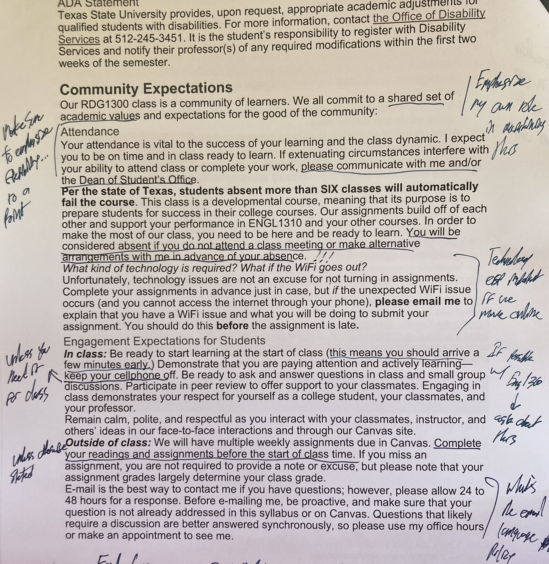
Syllabus Overview
Community Expectations
What I expect from YOU
What you can expect from ME

Slide 12
In-Class Engagement | 50 pts (10%)
Expansion Assignments | 150 pts (30%)
10 Reading Logs (10points/log) | 100 pts (20%)
Midterm Exam | 50 pts (10%)
Critical Reaction Paper | 50 pts (10%)
Final Exam | 50 pts (10%)
Portfolio | 50 pts (10%)
Total | 500 pts (100%)

Slide 13
Canvas Tour
First point of entry: MODULES
Weekly modules opened a week at a time
Still adjusting deadlines for assignments – will be fully adjusted by next class

Slide 14
Questions?

Slide 15
What do I mean by an “academic text”
In short, it’s not what it is, but what you do with it

Slide 16
For Next Time
Read Ta-Nehisi Coates (links on canvas)
Make note of specific sections or quotes that stand out to you as important
Re-Read syllabus (And annotate it)
Same – make note of specific sections or quotes that stand out to you as important
Complete syllabus scavenger hunt (submit on canvas)
Download adobe reader (link/instructions on Canvas)
It’s free, DO NOT get the paid version ☺

