Slide 1
Today is Wednesday, 21 October 2020
Reminders
Cameras on!
Due today:
Complete Draft of Your Peer Response Paper—e-mail the paper to your partner BEFORE today’s class
Complete Discussion Response 6

Slide 2
Today is Wednesday, 21 October 2020
Reminders:
Due for next class:
Create a semi-final draft of your author’s note (next slide)
A completed rubric assessing your paper that is due on Wednesday, 28 October (one week). Emily and I will check it in the small groups.

Slide 3
Today is Wednesday, 21 October 2020
IMPORTANT:
TONIGHT: 6:30pm El Sembrador viewing
OCTOBER 28: New due date for your peer response paper
Please Check for Additional Updates in Announcements (you can set Canvas up to e-mail them to you, talk to KBECK)

Slide 4
Let’s get the energy going to the brain.

Slide 5
Text this
to this number: 37607

Slide 6
Notes:
Poll Title: One word that describes your personality. https://www.polleverywhere.com/free_text_polls/m1tx2Gw8ZDojHX1tQB537

Slide 7
Notes:
Poll Title: What is critical thinking? https://www.polleverywhere.com/multiple_choice_polls/sfibbNYMZuPFuZk2C4DqR

Slide 8
Notes:
Poll Title: I want to improve my annotation skills. https://www.polleverywhere.com/multiple_choice_polls/heCvQQEYnxKsOAuWeMNtE

Slide 9
Notes:
Poll Title: Have you ever used your identity to have power over someone? https://www.polleverywhere.com/multiple_choice_polls/E340g4Xqn8yaYsnqOpRcS

Slide 10
Notes:
Poll Title: Who? https://www.polleverywhere.com/free_text_polls/ZKx4iJqYjvq1m5LQKIAfp

Slide 11
Notes:
Poll Title: Has somebody ever used their perceived identity to have power over you? https://www.polleverywhere.com/multiple_choice_polls/lEdSoOAcnsbhID7n8Sxfq

Slide 12
Notes:
Poll Title: Who? https://www.polleverywhere.com/free_text_polls/OxqmAQ64ZPVRaudtZAa22

Slide 13
Notes:
Poll Title: Why was the reading for today titled "A Most American Terrorist"? https://www.polleverywhere.com/multiple_choice_polls/cUquBgwdmHot2TgqE2ARI

Slide 14
Notes:
Poll Title: How does A Most American Terrorist "best" fit into the theme of "Intersecting Identities and Power"? https://www.polleverywhere.com/multiple_choice_polls/qMScoZ1lNMo4n8Lc4lkI7

Slide 15
Notes:
Poll Title: Based on your understanding of "visual narrative analysis", do you feel that the photos included in the article were appropriate or detracted from the story. https://www.polleverywhere.com/multiple_choice_polls/E3gKzteOmRYXiStrhJk4x?flow=Default&onscreen=persist

Slide 16
Thesis writing
Practice

Slide 17
Lesson: Improving Annotation
Today’s objective:
Determine at least one way I can improve my annotating skills to help me create a thesis statement.
Secondary objective:
Use annotations to create supporting statements.
Another practical use:
Using your annotations to create a thesis statement.

Slide 18
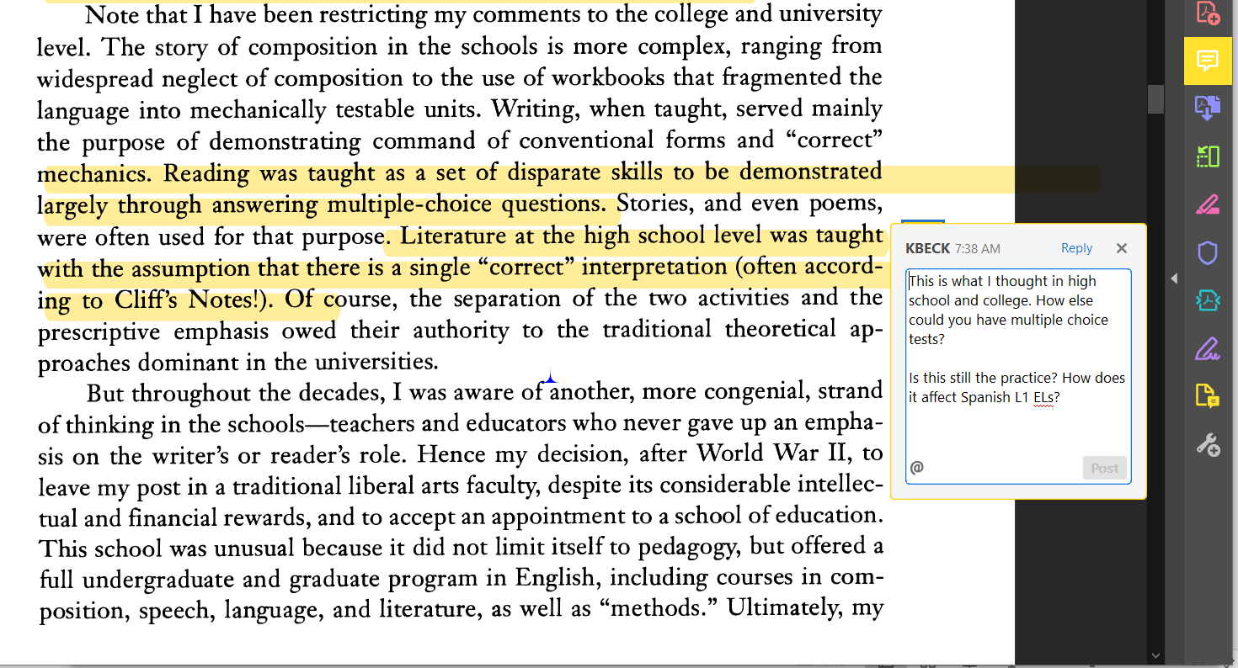
Example (you will be working with your annotations for today)

Slide 19
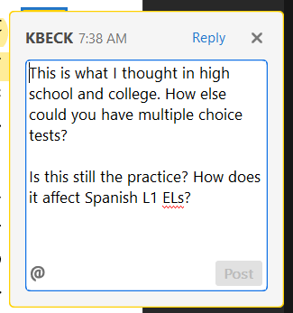
Example (you will be working with your annotations for today)
What are some topics that I could argue (discuss)?
As people learn their perceptions change.
Standardized multiple choice tests are often biased.
Students & Teachers rely too heavily on Cliffs and Sparks Notes to form an opinion.

Slide 20
Example (you will be working with your annotations for today)
What are some topics that I could argue (discuss)?
Multiple choice tests continue systemic oppression in education.
Multiple choice tests do not promote critical thinking.

Slide 21
As you go through the following practice: Think of ways that you can improve your annotations to help with thesis writing and support statements. You will send me an e-mail about it after the practice.

Slide 22
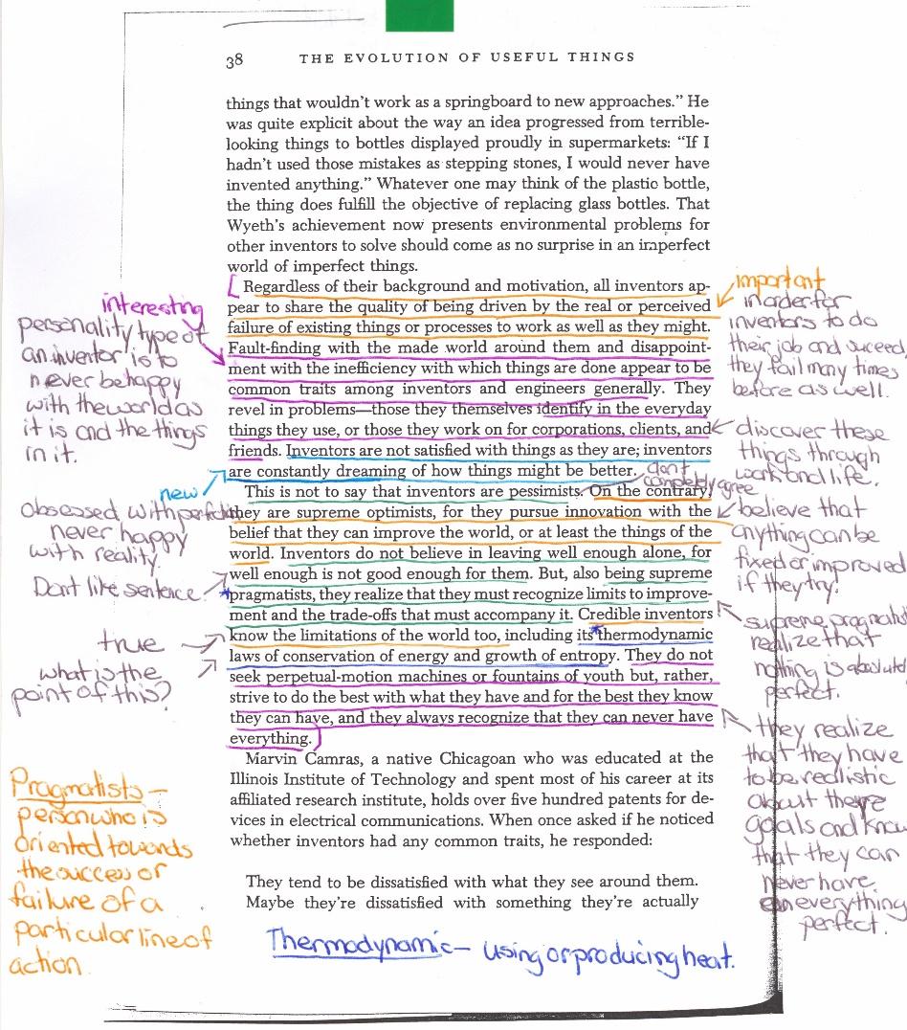
Now you: practice using annotations for thesis writing.
Choose an annotation or combination of annotations to argue.
Write at least one argument (thesis). If there is still time, write a supporting statement using your annotation.
After 7 minutes, you will break into groups.
In your groups you will share your theses (the plural of thesis).
Choose the argument that is most clearly written (5 minutes).
Return to big group and share with the class.

Slide 23
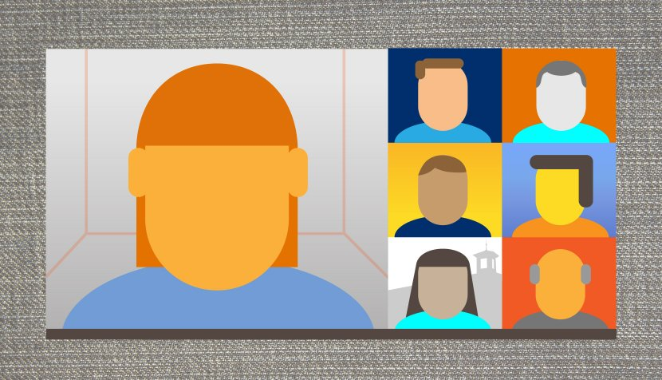
Share with the class.
Who came up with supporting statements?

Slide 24
Again! Practice using annotations for thesis writing.
Choose an annotation or combination of annotations to argue.
Write at least one argument (thesis). If there is still time, write a supporting statement using your annotation.
After 7 minutes, you will break into groups.
In your groups you will share your theses (the plural of thesis).
Choose the argument that is most clearly written (5 minutes).
Return to big group and share with the class.

Slide 25
Share with the class.
Who came up with supporting statements?

Slide 26
REFLECT: 5 minutes
“How should I change my annotation practices to make them more useful for the argument (thesis) and evidence (support) creation?”
Send me an e-mail at profe_kbeck@txstate.edu.
This Photo by Unknown Author is licensed under CC BY-SA-NC

Slide 27
Notes:
Poll Title: Use one word to describe your thoughts or feelings in regards to the article A Most American Terrorist. https://www.polleverywhere.com/free_text_polls/tpogjjRXhsQekwLS5Foqp

Slide 28
Switching Gears.

Slide 29
Practice #2: Peer Review

Slide 30
Notes:
Poll Title: A thesis is a statement that a person wants to discuss or prove. https://www.polleverywhere.com/multiple_choice_polls/fPllweQFUeCHvaCHJ4MUt

Slide 31
Notes:
Poll Title: In regards to writing, what does acronym P.I.E. represent? https://www.polleverywhere.com/multiple_choice_polls/W3oX7CoNV2ch6SO8dO7Xs

Slide 32
Notes:
Poll Title: The purpose of a peer review is to get feedback on grammar and spelling. https://www.polleverywhere.com/multiple_choice_polls/7XZcqeZS4U7J8uN0wgKNh

Slide 33
Notes:
Poll Title: The purpose of our peer reviews is to recognize the thesis and P.I.E. (point, illustration, explanation), and give thoughtful feedback about those sections. https://www.polleverywhere.com/multiple_choice_polls/klPM19tKzF2ZB4hObSIZf

Slide 34
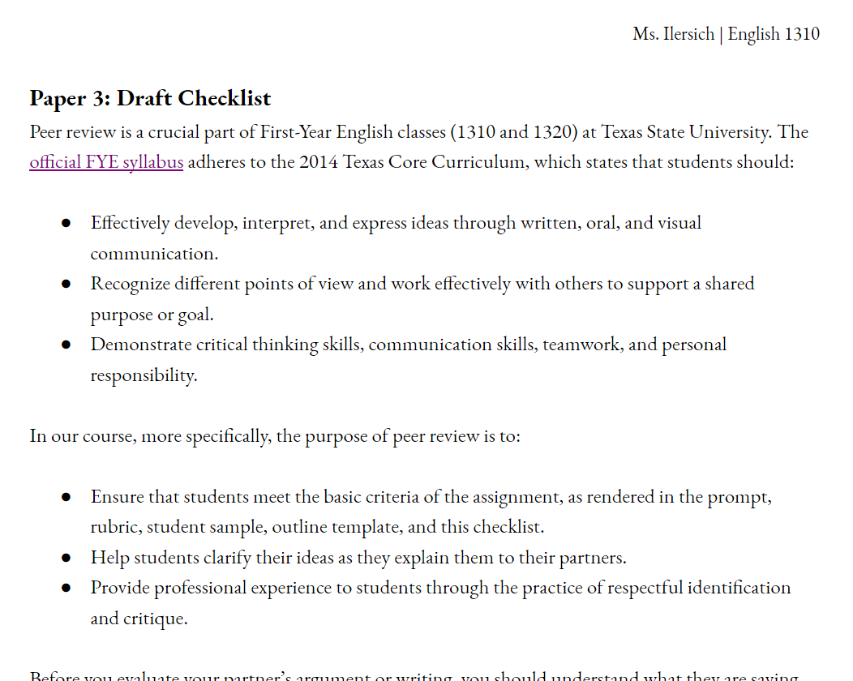
Illersuch’s Peer Review Guide

Slide 35
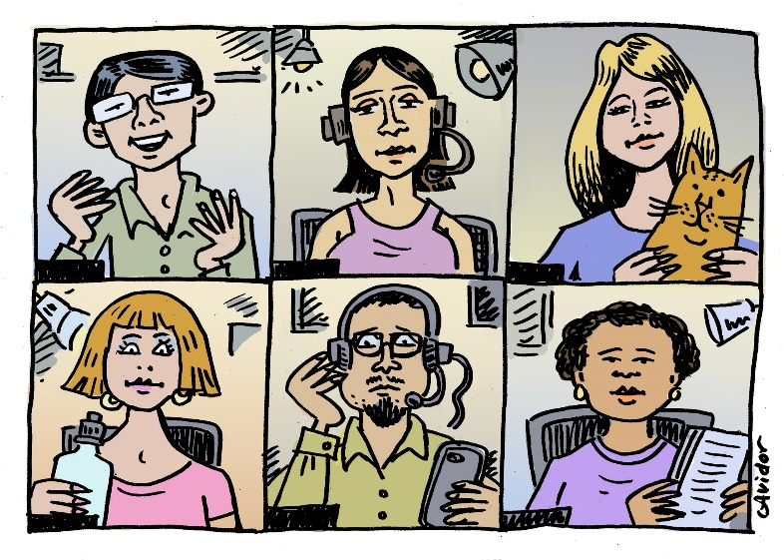
While with your partner:
Cameras on!
When Emily and I enter your room, make sure that we see you.
Make sure your partner sees you.
We will be stopping by to ask about your progress and answer questions.
We should hit each group at least twice (goal is three visits).
Leave at 12:20 or meet back in the main room to talk to KBECK or Emily
This Photo by Unknown Author is licensed under CC BY-NC-ND

