Slide 1
Reflecting and Moving Forward
Reminders:
Cameras on!
For today:
MARSI pretest—have this accessible for class today
Join the Google Slides Active Reading Presentation
5-T Chart of Text Previewing
Due next class:
Complete Discussion Board Post 3 in Canvas
Read and annotate, Issa Rae, p. 77-86, in American Like Me
IMPORTANT:
Check Announcements for Additional Updates

Slide 2
Today’s Game Plan:
Brief MARSI Reflection
5T Chart Review
Active Reading and Listening
You will need a copy of the MARSI Pretest

Slide 3
Brief MARSI Reflection (What did you learn about your reading strategies usage?)

Slide 4
MARSI Strategy Types
Skim the MARSI Pretest for one strategy type
Global
Support
Problem Solving
What do the strategies have in common?
How would you define the strategy type?
Contribute to the class resource In Google Slides by adding to the graphic organizer about Reading Strategies

Slide 5
Text Previewing Review: 5T Chart Review (What was the purpose of this assignment?)

Slide 6
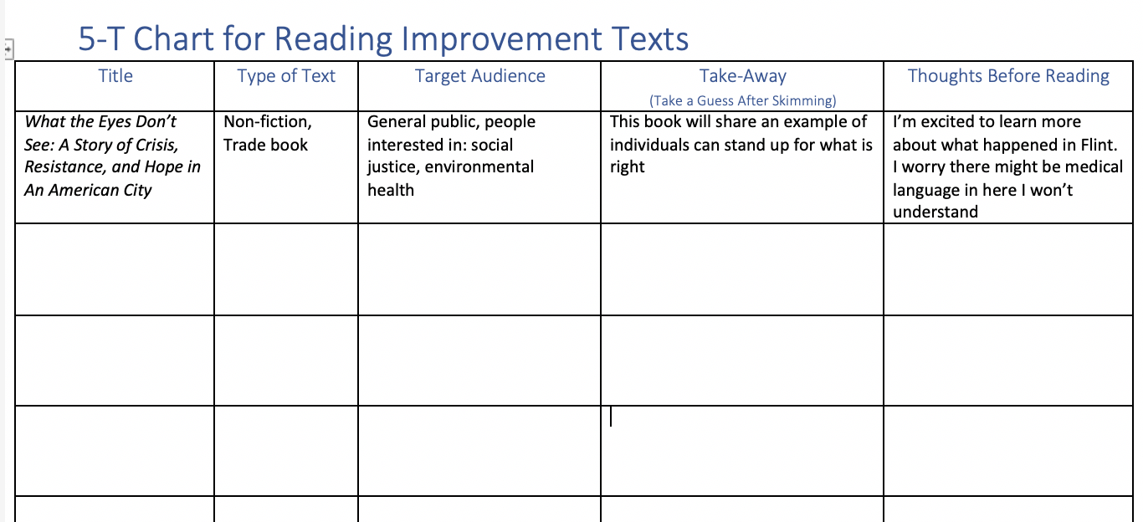
Previewing Texts for Our Class: How will the readings in our class help you achieve your academic goals?

Slide 7
Active Reading Skills (How do you use active reading skills?)

Slide 8
Small Group Work (10min)
In your small group, skim your assigned slide AND the list of GLOB, PROB, and SUP strategies in the MARSI Pretest
Briefly Summarize your section’s advice in the Google slides AND include at least two MARSI strategies relevant to your active reading advice
Add an image that represents your section’s advice
Notes:
Small groups will skim their assigned slides and add notes to the shared google slides to summarize key information for their reading strategies.
Groups:
Preview Text and Vocabulary
Read with a Purpose
Annotate
Make Connections
Summarize

Slide 9
Active Reading Strategies
What strategies do you use to “Preview Text and Vocabulary”?

Slide 10
Active Reading Strategies
Preview Text and Vocabulary Strategies
Skim titles, subheadings, charts, graphs, captions
Make predictions
Scan for new/confusing vocabulary
Text Purpose and Structure
Notes:
Preview Text and Vocabulary Strategies
Skim titles, subheadings, charts, graphs, captions
Make predictions about the text
Scan the text for new/confusing vocabulary
Text Purpose and Structure
How do you know the text purpose/author’s goals?
How do text features connect to purpose?

Slide 11
Active Reading Strategies
What does it mean to “Read with a Purpose”?
What are some purposes for reading?

Slide 12
Active Reading Strategies
Reading Purposes
Understand the message
Find specific details
Answer a specific question
Evaluate/Analyze what you are reading
Be entertained

Slide 13
Active Reading Strategies
How do you “Annotate” a reading?

Slide 14
Active Reading Strategies
Annotate
Prereading Questions
Unknown Vocabulary
Word parts, parts of speech, context clues
Important Ideas
Connections
Metacognitive Knowledge
Post-Reading Summary
Notes:
Annotate (See handout)
Prereading Questions
Why am I reading this in the first place? (Set your purpose!)
What am I going to do with this reading when I’m done? (Set your goal!)
Unknown Vocabulary
Word parts, parts of speech, context clues
Important Ideas
Connections
Metacognitive Knowledge
Post-Reading Summary

Slide 15
Active Reading Strategies
How do you “Make Connections” with a Text?

Slide 16
Active Reading Strategies
Make Connections
Text-to-Text
Text-to-Self
Text-to-World

Slide 17
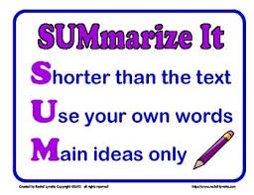
Active Reading Strategies
What should we “Summarize”?

Slide 18
Active Reading Strategies
Summarize
Important Ideas: Author’s Main Ideas/Arguments
Essential Details: Details that support the main idea/argument
Key Vocabulary: New vocabulary or essential technical terms

Slide 19
Group Share

Slide 20
“Adapt to Any Class”: Applying Active Reading and Listening Skills to Lectures (What do you think this lecture will be about?)

Slide 21
Turning Active Reading into Active Lecture Listening (What does it mean to Listen Actively? How can listen active in lecture? How can you demonstrate your active listening?)
Notes:
Principles of Active Listening
Focus on what is being said.
Give the speaker your undivided attention.
Don’t prejudge.
Repeat what you just heard.
Ask speaker to expand or clarify.
Look for nonverbal signals: facial expressions, body positioning, arm gestures, and tone of voice.
Listen for requests. A speaker will often hide a request as a statement of a problem. If a friend says, “I hate math!” this may mean, “Can you help me figure out a solution to this problem?”
Importance of Body Language
What body language demonstrates your listening?

Slide 22
Active Reading Strategies for Lectures
Get your mind and body in the right space
Have a purpose for listening
Look for key words/ideas
Make connections
Annotate/Take notes
Summarize
Ask questions
Notes:
What connections can you make between active reading and active listening skills?
(from UMN Active Reading Strategies)
Get your mind in the right space. Prepare yourself mentally to receive the information the speaker is presenting by following the previous prep froquestions and by doing your assignments (instructors build upon work presented earlier).
Get yourself in the right space. Sit toward the nt of the room where you can make eye contact with the instructor easily. Most instructors read the body language of the students in the front rows to gauge how they are doing and if they are losing the class. Instructors also believe students who sit near the front of the room take their subject more seriously and are more willing to give them help when needed or to give them the benefit of the doubt when making a judgment call while assigning grades.
Focus on what is being said. Eliminate distractions. Turn your cell phone off and pack it away in your backpack. If you are using your laptop for notes, close all applications except the one that you use to take notes. Clear your mind and keep quiet. Listen for new ideas. Think like an investigative reporter: you don’t just want to accept what is being said passively—you want to question the material and be convinced that it makes sense.
Look for signals. Each instructor has a different way of telling you what is important. Some will repeat or paraphrase an idea; others will raise (or lower) their voices; still others will write related words on the board. Learn what signals your instructors tend to use and be on the lookout for them. When they use that tactic, the idea they are presenting needs to go in your notes and in your mind—and don’t be surprised if it appears on a test or quiz!
Listen for what is not being said. If an instructor doesn’t cover a subject, or covers it only minimally, this signals that that material is not as important as other ideas covered in greater length.
Sort the information. Decide what is important and what is not, what is clear and what is confusing, and what is new material and what is review. This mental organizing will help you remember the information, take better notes, and ask better questions.
Take notes. We cover taking notes in much greater detail later in this chapter, but for now think about how taking notes can help recall what your instructor said and how notes can help you organize your thoughts for asking questions.
Ask questions. Asking questions is one of the most important things you can do in class. Most obviously it allows you to clear up any doubts you may have about the material, but it also helps you take ownership of (and therefore remember) the material. Good questions often help instructors expand upon their ideas and make the material more relevant to students. Thinking through the material critically in order to prepare your questions helps you organize your new knowledge and sort it into mental categories that will help you remember it.

Slide 23
“Adapting to Any Class” (Professor Maggie Ilersich)
Notes:
This lecture was recorded for ENG1310 and US1100
We will watch the first 15-20 minutes of the lecture, practicing applying active listening strategies

Slide 24
Notes:
Based on the title, what is your purpose for listening?
Based on the Agenda, what key words/ideas are you listening for?
What unknown vocabulary do you anticipate?
We will watch the first 10 minutes of the lecture, practicing applying active listening strategies

Slide 25
Notes to Guide Our Listening
[your notes here]
What’s Next? What aspects of active listening for lectures have we not yet covered? (What will you be doing/taking notes on as you finish the lecture?)
Notes:
**What key terms are we trying to define?
VARK Definition [0:57]
**What is the main idea or problem that the professor is trying to address?
Reality of Learning Styles [2:27]
**The professor says she has two studies to share, what should we be annotating from the discussion of these studies?
(study names and main findings)
@5min mark **What language does the professor use to show that a transition is coming up?
Problems of Learning Style Lens [5:07]
**What subpoints does the professor identify and how does she signal transitions between subpoints, between subpoint and example?

