Slide 1
Using ADOBE Reader to Annotate
KBECK
Texas State University, 2020

Slide 2
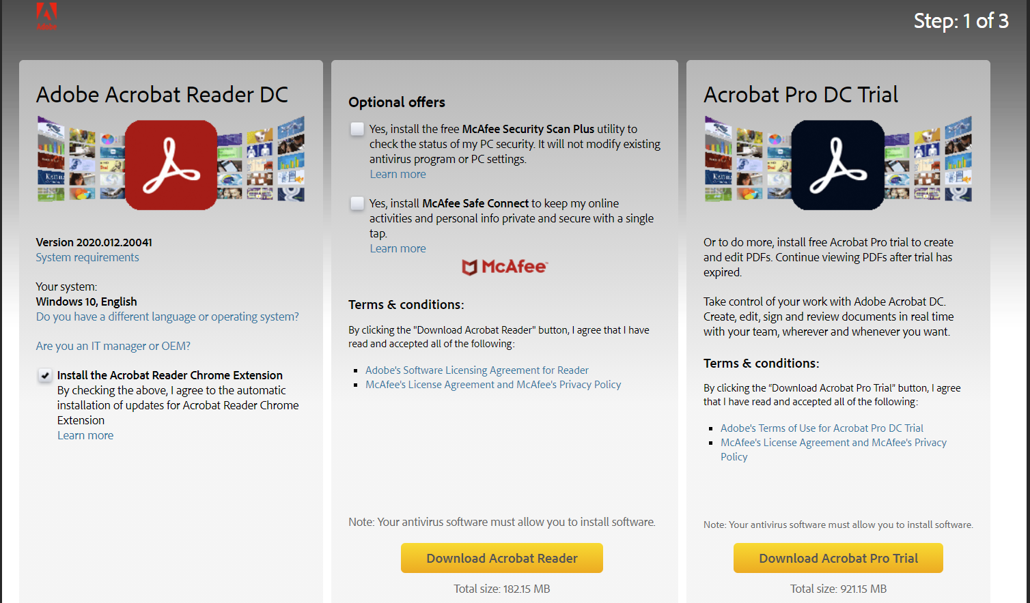
Download Adobe Reader
Go to: https://get.adobe.com/reader/
If you are using Chrome (preferred), install the Acrobat Reader Chrome Extension
Uncheck the optional offers
Download the application

Slide 3
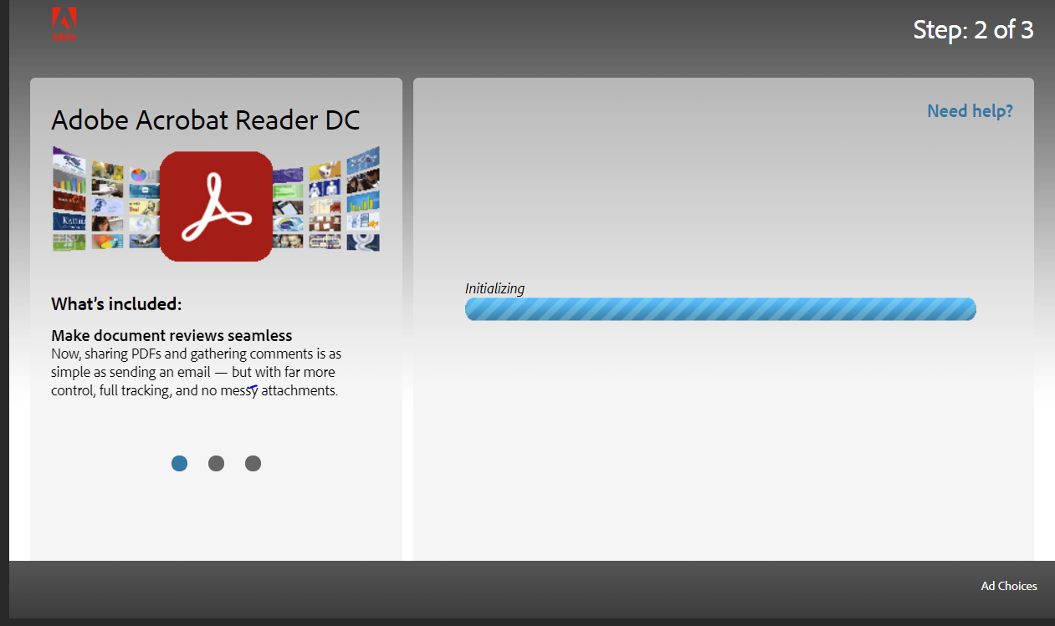
The Download
Your screen will show you this:

Slide 4
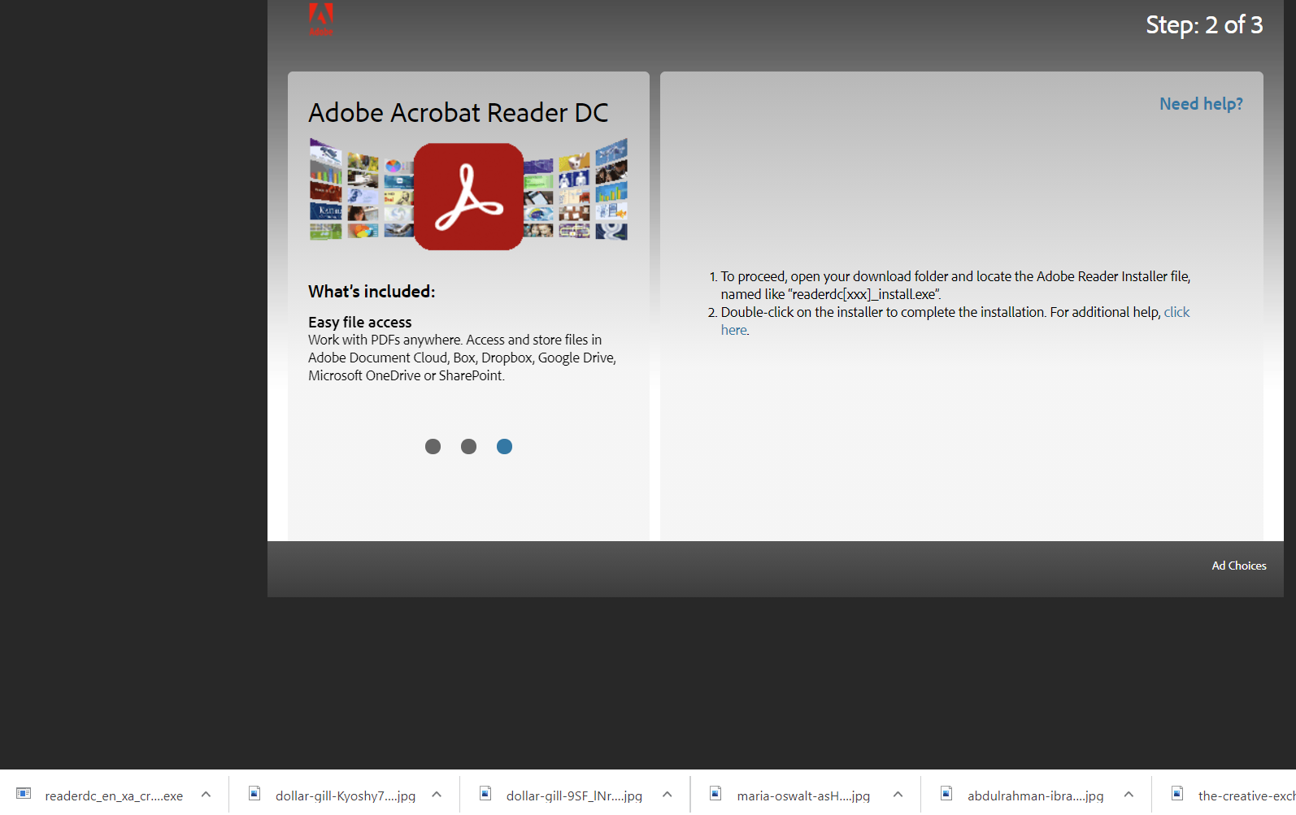
The Download, part 2
And then this:
You can follow these steps or just double click down here to start the download

Slide 5
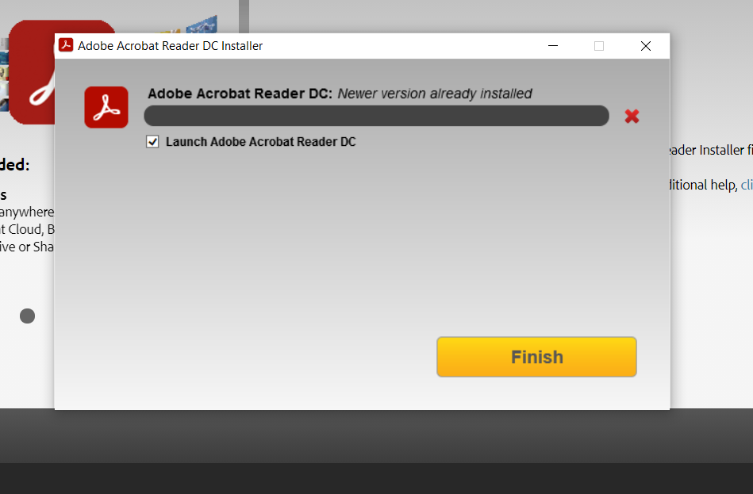
The Download, part 3
When the download is complete, check the box that reads “Launch Adobe Acrobat Reader DC
Click Finish

Slide 6
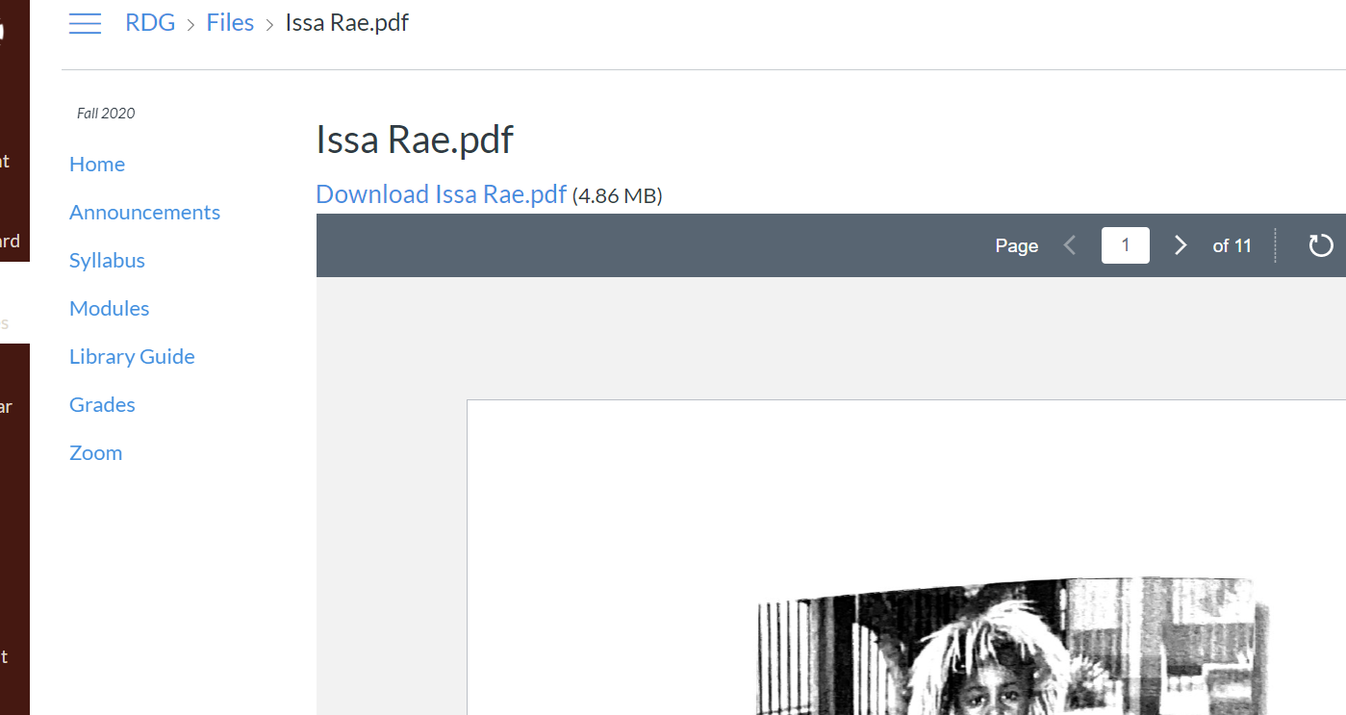
Download your pdf file from Canvas
NOTE: I recommend creating a separate folder for each of your classes so that you stay organized.
Click on Download …

Slide 7
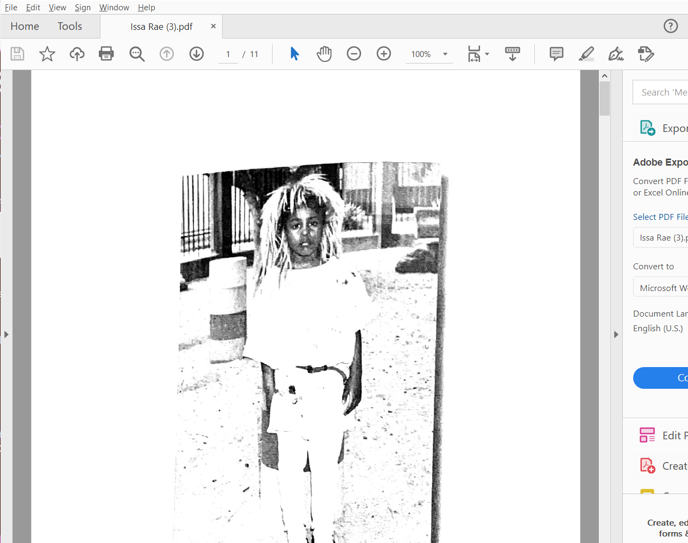
Download your pdf file from Canvas, 2
If Adobe Reader is not already open, it will automatically open and you will be able to start annotating.

Slide 8
Annotating your pdf file
The only tools you will need are at the top

Slide 9
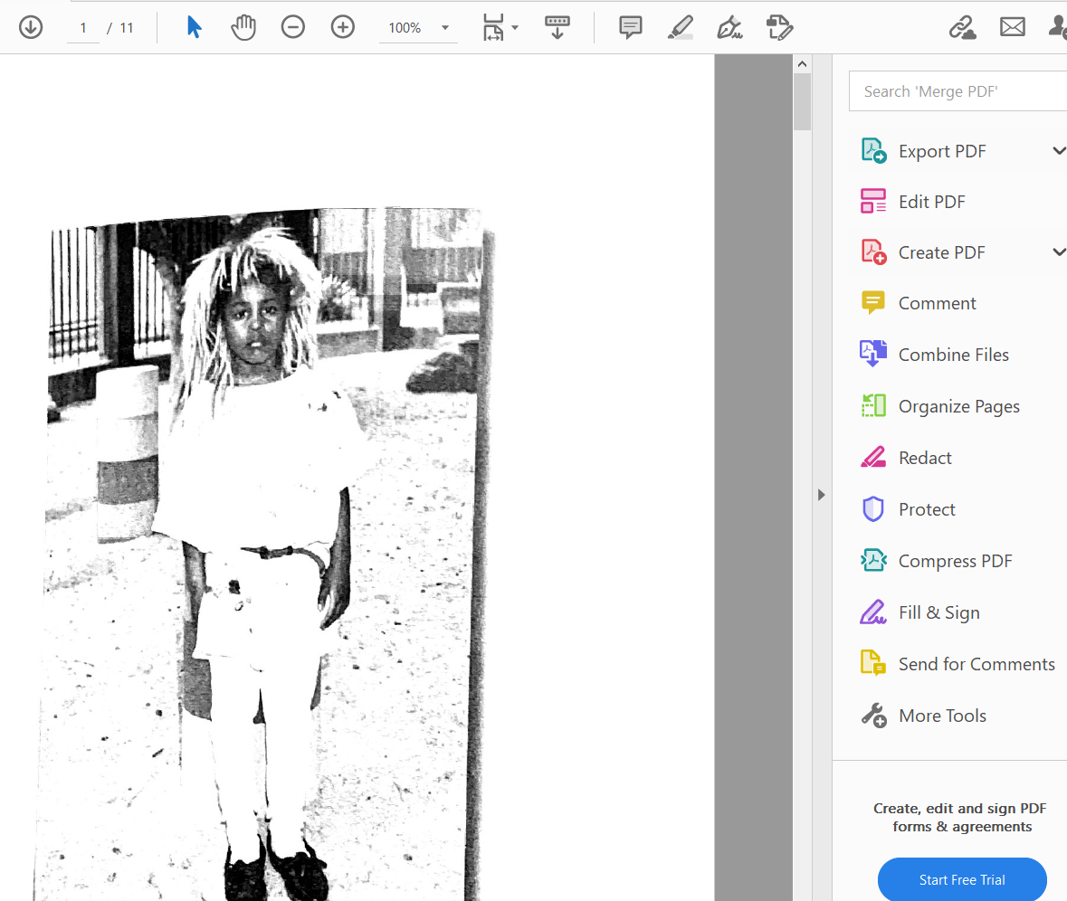
Annotating your pdf file, part 2
STAY AWAY FROM ALL OF THESE OPTIONS. They are for the PAID version. You do not need them.
YOU ARE NOT EDITING THE PDF, you are writing on top of it.

Slide 10
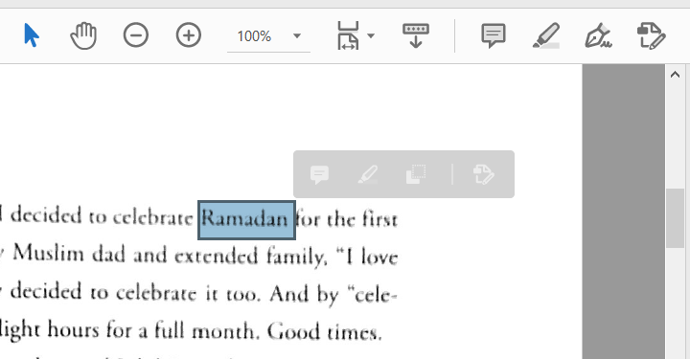
The most common tools: Highlighting
Depending on the quality of the *.pdf, you will find that sometimes it is much easier to highlight.

Slide 11
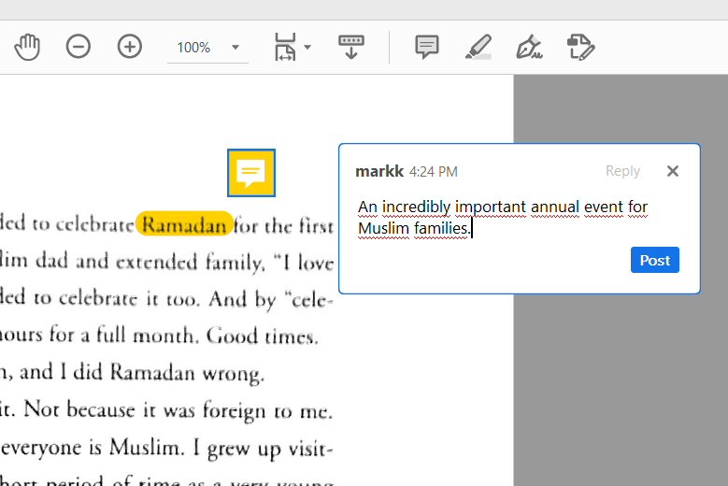
The most common tools: Notes
Click on the icon that looks like a conversation bubble.
Enter your notes.
Note: When you click elsewhere in the document, the text box will close. Click on the bubble that has been created to show your notes.

