Slide 1
Behavior, Measurement, and Graphing
Dr. Katherine Ledbetter-Cho

Slide 2
Agenda
What kind of skills can you measure?
Operational definitions
Measurement systems
Practice
Goal writing and data sheet creation considerations
Tracking progress – Graphing and visual analysis
Practice

Slide 3
What kind of skills can you measure?
Behavior or academics?
Any skill that is socially valid for that individual
Skills assessments track things like:
Verbal Behavior-Milestones Assessment and Placement Program (VB-MAPP): communication, play, visual performance skills, listener responding (e.g., “come here”, “stop”, “touch the star”)
Assessment of Basic Language and Learning Skills (ABLLS) – language, self-help, motor, and academic
Assessment of Functional Living Skills (AFLS) – daily living and self-help skills across environments
Variety of social skills assessments
CARES Safety and Risk Survey – daily safety skills such as eating, stranger danger, knowing personal information, traffic safety, etc.

Slide 4
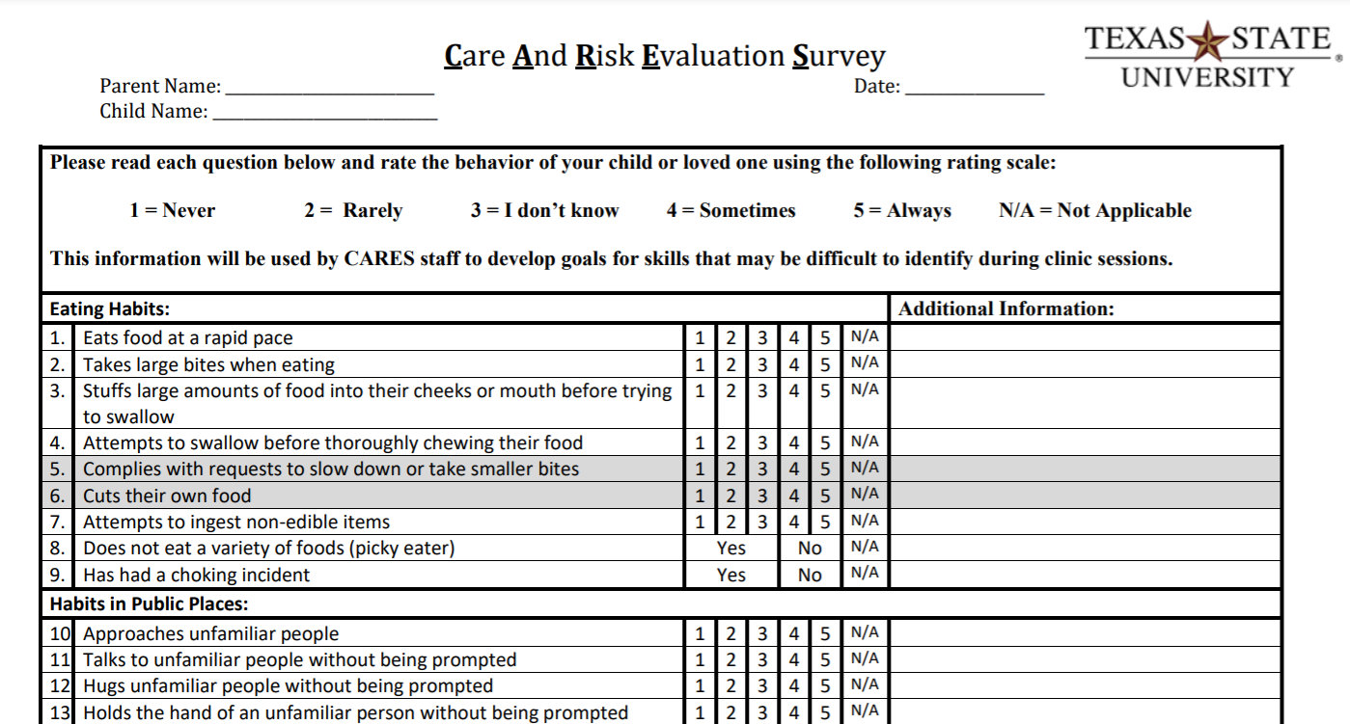
Safety Skills

Slide 5
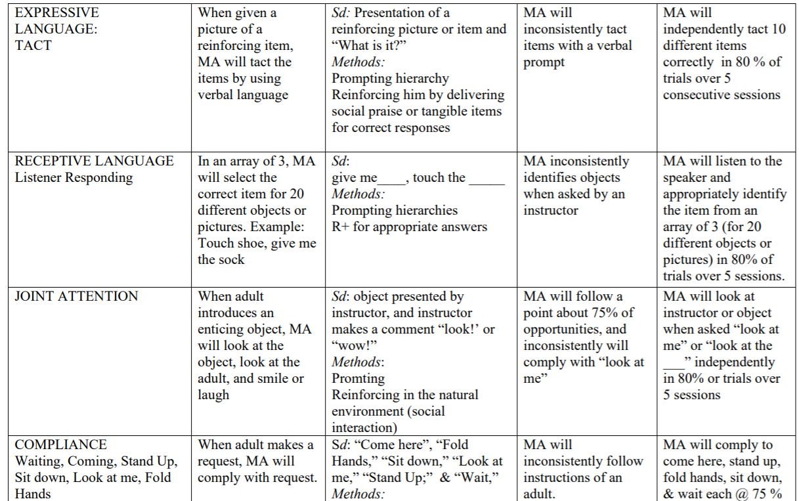
Example Program – 3.5-year-old

Slide 6
Example Program - Teenager
Tolerating insects
Decrease negative self-talk, arguing with brother, and worrying about others
Learn to self-monitor (accuracy of using system and then decreasing challenging behaviors)
Initiating conversations
Responding to questions or initiations from others (peers and adults)
Asking follow-up questions
Academic skills

Slide 7
Operational Definitions
They clearly describe a behavior’s topography (the way it looks)
Important so you and other observers can agree on how often it is occurring (i.e., accurately measure it)
Examples:
Aggression: any instance of hitting, biting or scratching another person
Self-injurious behavior: any instance of hitting, biting, or scratching herself anywhere on her own body
Paying attention: body facing toward the teacher/presentation materials or eyes looking at teacher/presentation materials/worksheet, quiet mouth, and not doodling

Slide 8
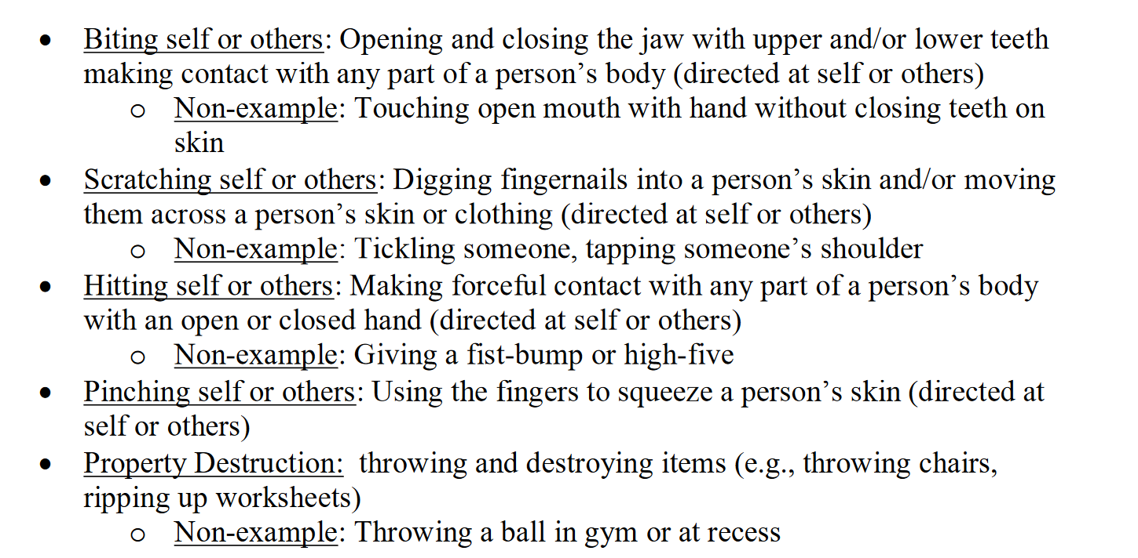
Operational Definitions continued

Slide 9
Measurement Systems
Most accurate and specific would be writing down the time the behavior started and the time it stopped; this would tell you how often the behavior occurred and how long it lasted each time
Frequency/event recording – mark each time the behavior occurs
Rate – mark each time the behavior occurs; divide by time
Interval – partial, momentary, or whole – mark if behavior does or does not occur during interval
Duration – measure how long a behavior lasts
Percent of opportunities aka trial by trial – mark incorrect or correct each time you present an opportunity
Cold probe – mark whether response was correct or incorrect on the first opportunity

Slide 10
Direct Observation Measurement Systems
Frequency/ Event recording (can calculate rate by dividing by time) – marking each time a behavior occurs
Gives you an exact count of the behavior
Used when you want to increase or decrease the number of times a student engages in a behavior
Good for discrete behaviors (e.g., leaving the room, hitting a peer)
Good for skills that you task analyze (e.g., academics, self-help skills)
Difficult for continuous behaviors (e.g., singing, drumming on surfaces) and behaviors that happen very frequently

Slide 11
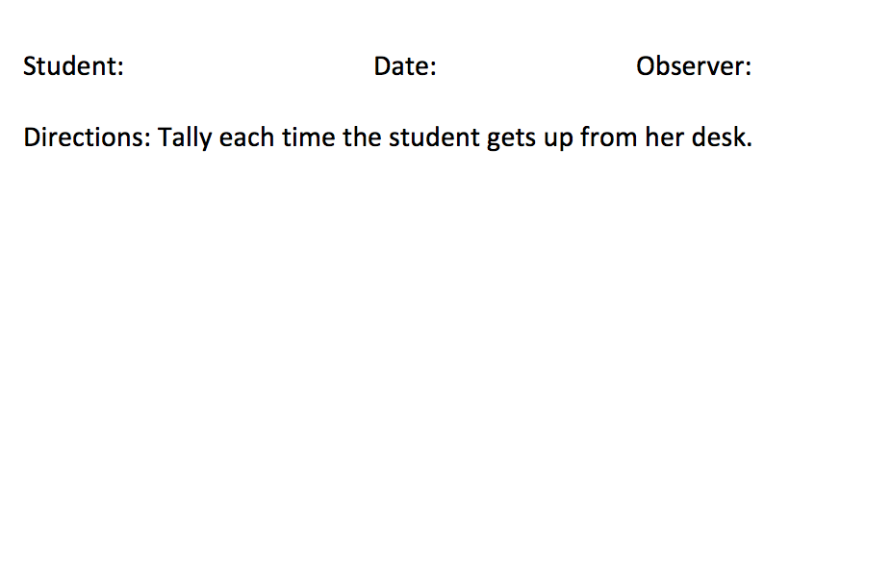
Measurement Systems – Data Sheets
Event recording

Slide 12
Measurement Systems – Data Sheets
Event recording

Slide 13
Measurement Systems – Data Sheets
Event recording with trial-by-trial data

Slide 14
Direct Observation Measurement Systems
Partial interval recording
Divide an observation period into equal intervals; smaller intervals will yield more accurate data
Behavior is marked if it occurs at any time during an interval
Good for continuous and high frequency behaviors
Does not give you a count of how many times the behavior occurred; approximates duration of occurrence
Drawbacks: may overestimate how often a behavior occurred (e.g., could only tap pencil once every 15 seconds but for 100% of intervals); requires continuous observation

Slide 15
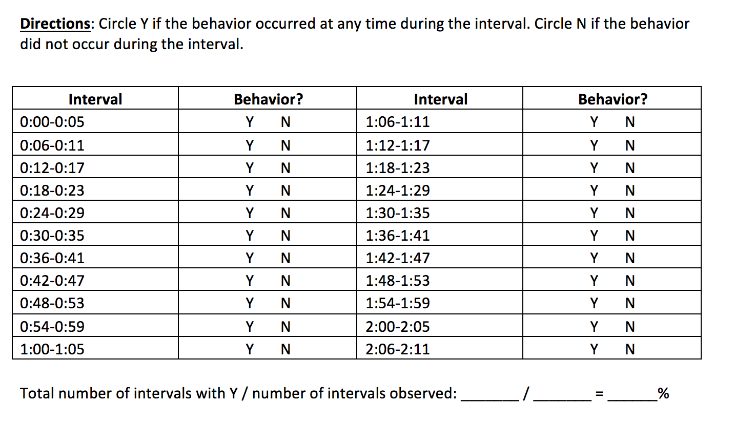
Measurement Systems – Data Sheets
Partial-interval recording

Slide 16
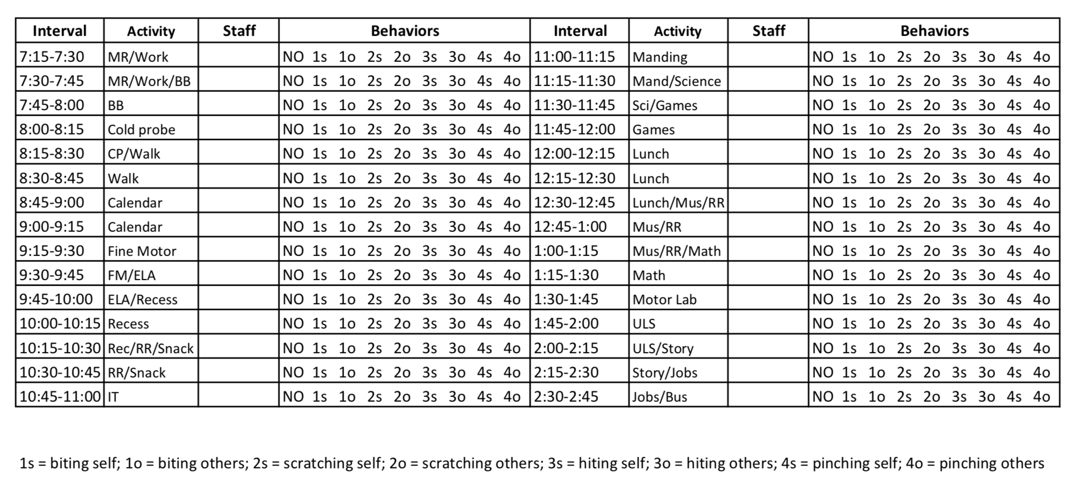
Measurement Systems – Data Sheets
Partial-interval recording

Slide 17
Direct Observation Measurement Systems
Momentary Time sampling
Divide an observation period into equal intervals; smaller intervals will yield more accurate data
Behavior is marked if it occurs at a specified time during an interval (most commonly marked at the end of the interval)
Good for continuous and high frequency behaviors; only need to observe at the specified time in the interval
Does not give you a count of how many times the behavior occurred; approximates duration of occurrence
Drawbacks: may underestimate how often a behavior occurs/miss a lot of behavior (e.g., the student could engage in self-injury for the entire interval except the end and you would record 0% of intervals)

Slide 18
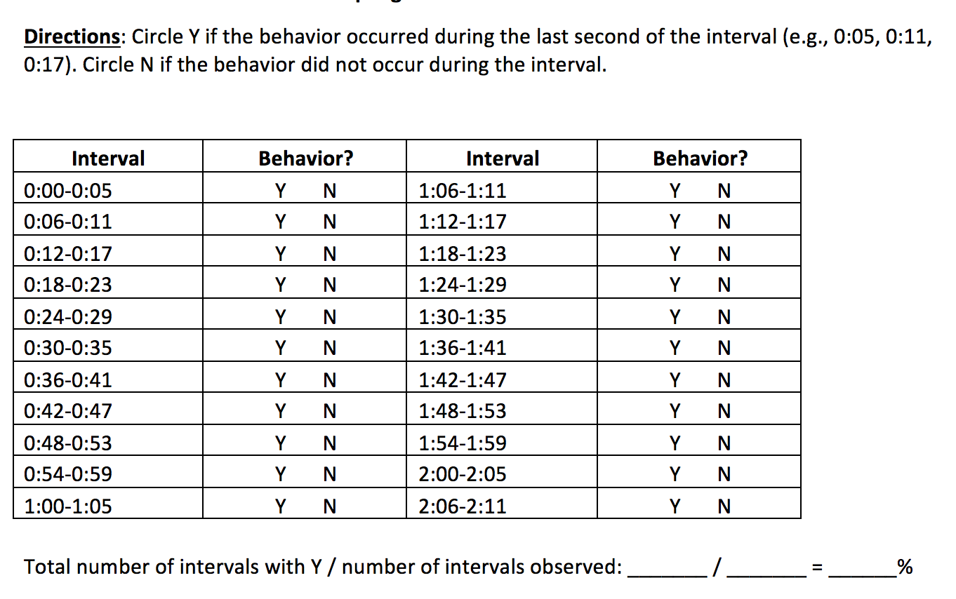
Measurement Systems – Data Sheets
Time Sampling

Slide 19
Direct Observation Measurement Systems
Whole interval Recording
Divide an observation period into equal intervals; smaller intervals will yield more accurate data
Behavior is marked if it occurs throughout the entire interval
Good for continuous and high frequency behaviors
Does not give you a count of how many times the behavior occurred; approximates duration of occurrence
Drawbacks: may underestimate how often a behavior occurs/miss a lot of behavior (e.g., the student could engage in self-injury for almost the entire interval and you would record 0% of intervals)

Slide 20
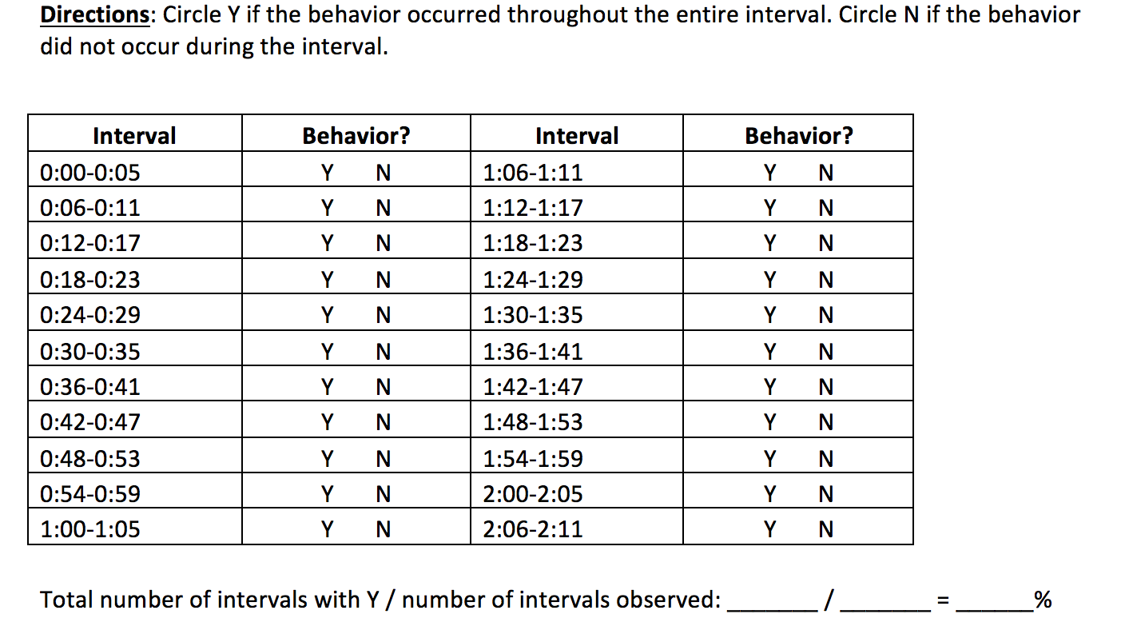
Measurement Systems – Data Sheets
Whole-interval recording

Slide 21
Direct Observation Measurement Systems
Duration
Used to measure the amount of time an individual engages in a behavior
Requires target behaviors with a clear beginning and end

Slide 22
Measurement Systems – Data Sheets
Duration

Slide 23
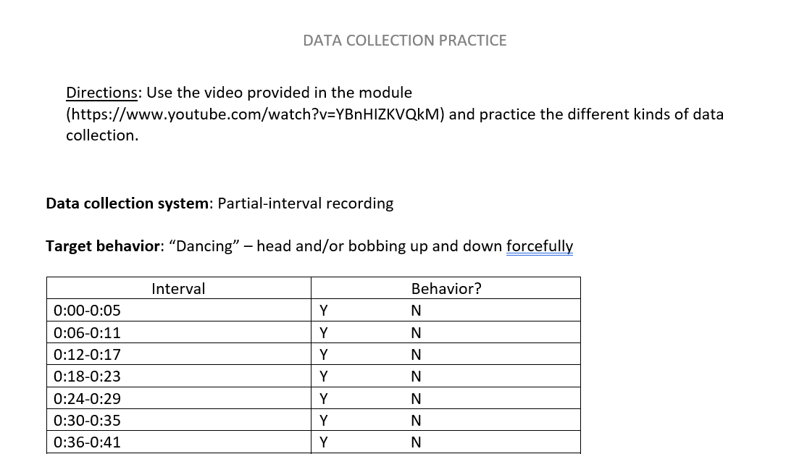
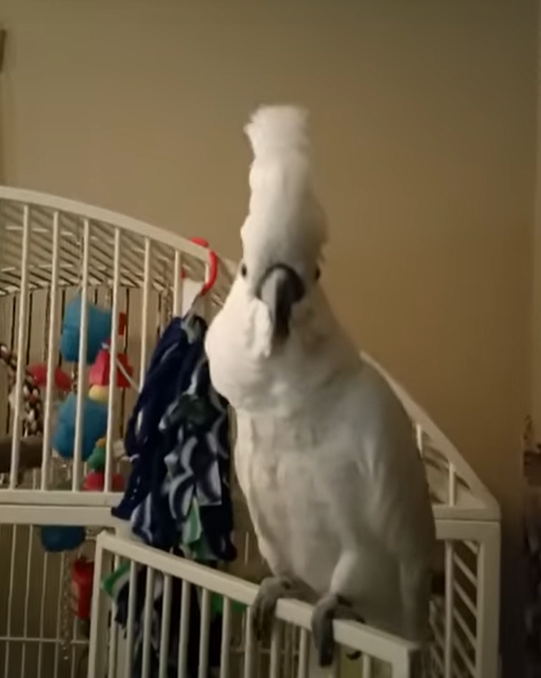
Let’s Practice!

Slide 24
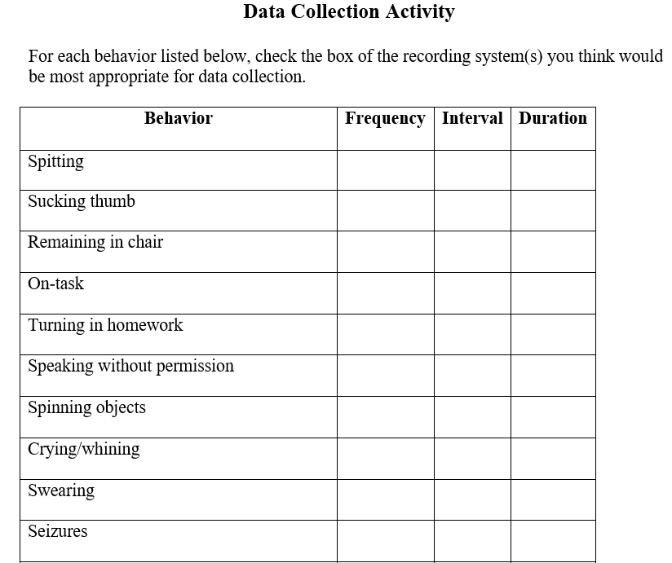

Slide 25
Measurement Systems – with goals
Frequency/event recording – mark each time the behavior occurs
Amit will raise his hand five times during circle time for five consecutive circle times.
Rate – mark each time the behavior occurs; divide by time
Amit will raise his hand 1.5 times per hour for five consecutive circle times.
Interval – partial, momentary, or whole – mark if behavior does or does not occur during interval
Amit will raise his hand for 15% of 5-minute intervals during circle time for five consecutive circle times.
Duration – measure how long a behavior lasts
Amit will keep his hand raised for a minimum of 3 seconds each time he raises his hand for five consecutive circle times.
Percent of opportunities aka trial by trial – mark incorrect or correct each time you present an opportunity
When the teacher says, “raise your hand,” Amit will raise his hand with 80% accuracy for five consecutive sessions.
Cold probe – mark whether response was correct or incorrect on the first opportunity
During the first opportunity, Amit will raise his hand when the teacher says, “Raise your hand” for five consecutive sessions.

Slide 26
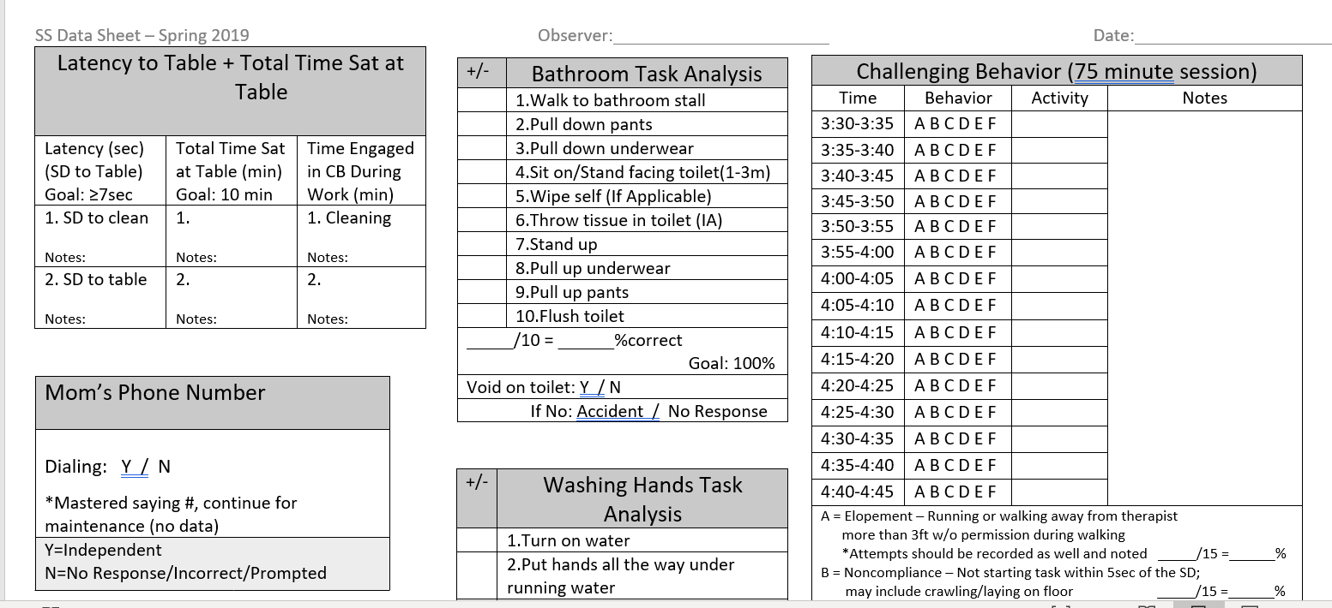
Multiple Goals on One Data Sheet

Slide 27
Goal Writing Considerations
A – Audience (this should be the student’s behavior, not the teacher)
B – Behavior
C – Criteria (independently, 80% opportunities, etc.)
D – Determinate (4 out of 5 sessions, 4 consecutive sessions, 3 consecutive data days, etc.)
You can write goals to increase appropriate behaviors or to decrease challenging behaviors

Slide 28
Goal Writing continued
Directions: Label the ABCD and measurement system.
Goal: Chris will engage in verbal protests in fewer than 20% of intervals for 5 consecutive data days.
Goal: Chris will remain in his seat for 5 minutes for 10 consecutive math classes.
Goal: Chris will not elope during a school day for 5 consecutive data collection days.

Slide 29
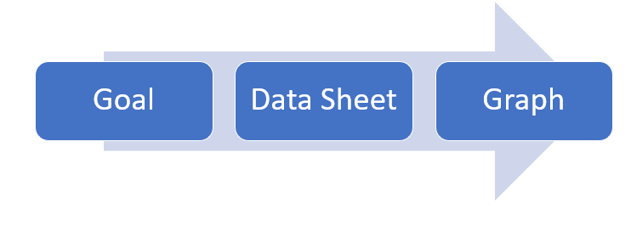

Slide 30
Creating a Data Sheet
Your data collection system must match your goal
Leave a place for the date, observer, and length of the observation session
Consider putting your goal on the data sheet
Have a place where the total for the session can be calculated. (This is what will go on your graph.)
See examples on Canvas:
Interval
Percent of Opportunity
Frequency/rate
Probe data sheet
Combined – working on multiple goals at the same time

Slide 31
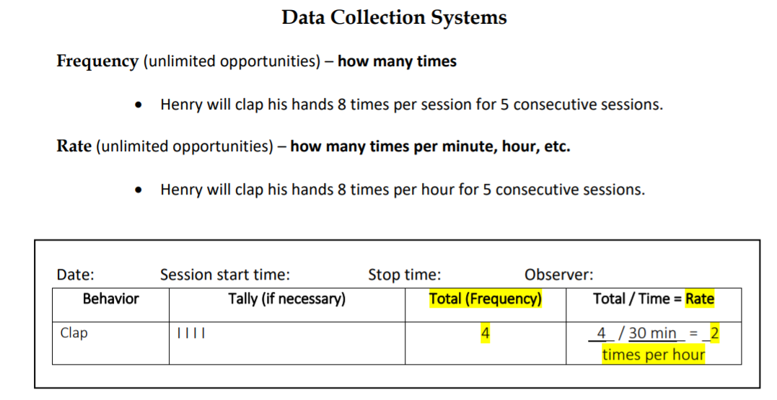
Data Sheet Example

Slide 32
What should I do?
Graphing

Slide 33
What should I do?

Slide 34
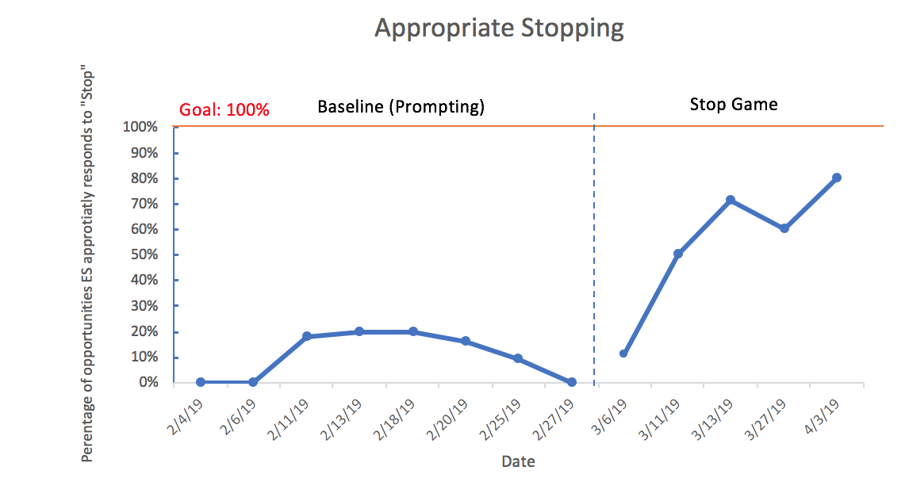

Slide 35
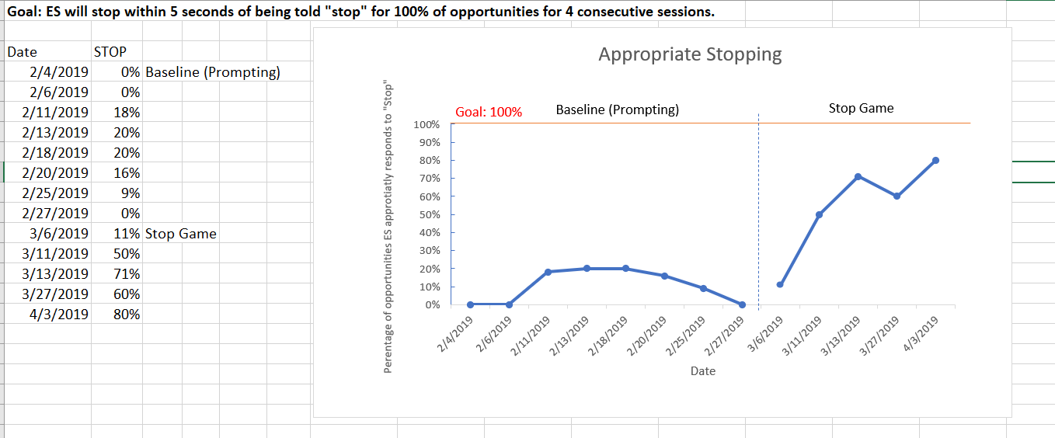
How can I create graphs?

Slide 36
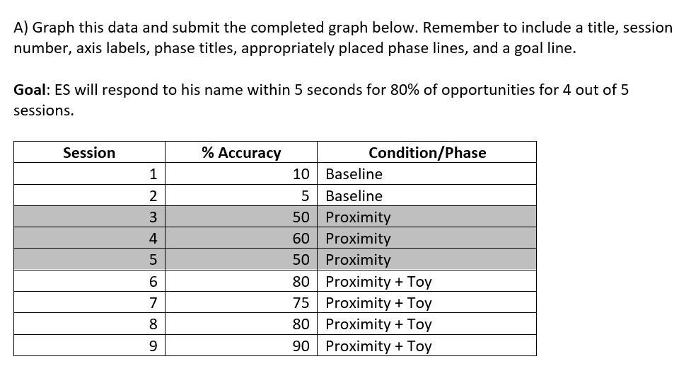
Let’s Practice Together

Slide 37
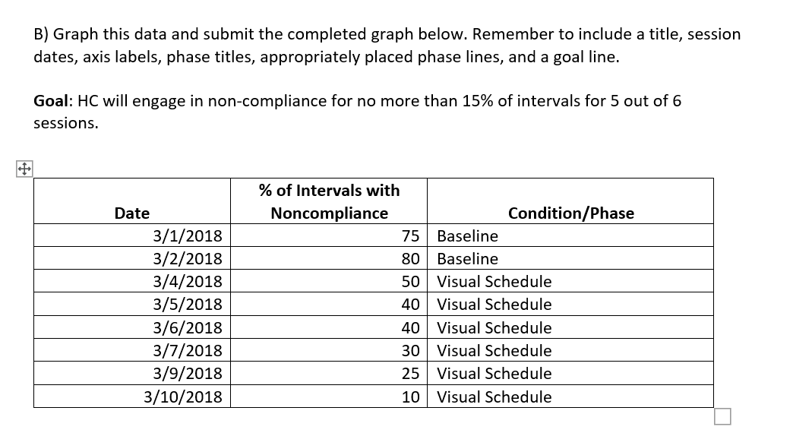
Let’s Practice – You Do

Slide 38
Visual Analysis - Trends
Pattern in the data which indicates a distinct direction in the performance of the behavior
3 data points in the same direction (Barlow & Hersen, 1984)
Increasing trend
(ascending)
Decreasing trend
(descending)

Slide 39
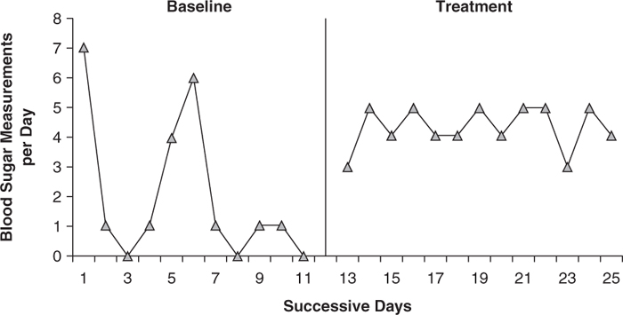
Visual Analysis – Variability versus Stability

Slide 40
Questions? kel48@txstate.edu

